Slide 1



Comparative Study of the Transient and Steady State Thermal Hydraulic Analysis of the Low Enriched Uranium (LEU) Core of Ghana Research Reactor -1 (GHARR-1).
Prince Amoah, Edward Shitsi, Emmanuel Ampomah-Amoako
P2.4-090

Slide 2
Comparative Study of the Transient and Steady State Thermal Hydraulics Analysis of the Low Enriched Uranium (LEU) Core of Ghana Research Reactor -1 (GHARR-1).
size approx. 9]
P2.4-090
Prince Amoah^{1,3*}, Edward Shitsi^{1, 2}, Emmanuel Ampomah-Amoako^{1, 3}
¹Graduate School of Nuclear and Allied Sciences, University of Ghana, P.O. Box AE1, Atomic Energy, Ghana.
²Nuclear Reactors Research Centre, National Nuclear Research Institute, Ghana Atomic Energy Commission,
P.O. Box LG 80, Legon-Accra, Ghana.
³Nuclear Regulatory Authority, P.O. Box AE 50, Kwabenya, Accra, Ghana.
*Corresponding Author: amprince77@gmail.com size

Slide 3
Comparative Study of the Transient and Steady State Thermal Hydraulics Analysis of the Low Enriched Uranium (LEU) Core of Ghana Research Reactor -1 (GHARR-1).
P2.4-090
Abstract
Countries seeking a quick bomb or would-be nuclear terrorists have eyes on poorly secured sites that contain significant quantities of high enriched uranium, (HEU). HEU is the material of choice for states or terrorists that seek to proliferate stealthily without testing their weapons. It is therefore critical to make current stocks of HEU as inaccessible as possible. One of the most effective long term approach is to eliminate it from as many locations as possible and convert the HEU cores to low-enriched uranium (LEU) core. The high enriched uranium core of the Ghana Research Reactor-1 has been converted to a low enriched uranium core. The transient and steady state thermal hydraulic analysis of the LEU core of Ghana Research Reactor -1 is presented in this work. The Monte Carlo N Particle code (MCNP-5) was used in obtaining neutronic parameters for the transient and steady state simulations. PARET/ANL was used in simulating transient responses of the GHARR-1 LEU core and PLTEMP/ANL was also used for the steady state simulations. Results obtained in both transient and steady state compared well with the experimental data.
Keywords: Ghana, Reactors, High Enriched Uranium (HEU) core, Low Enriched Uranium (LEU) core.
[click to edit Poster Title here using “Arial Bold” font size 12 or smaller if the title is too long]
[click to edit Author(s) name(s) with division, email (and/or) Affiliation here using “Arial” font size approx. 9]
ABSTRACT

Slide 4
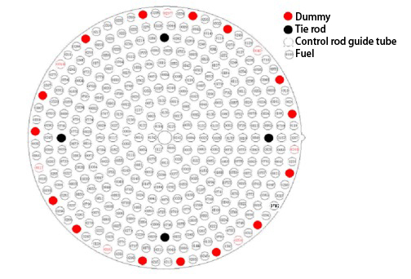
P2.4-090
Introduction
The U.S. Atomic Energy Commission defines a low enriched uranium (LEU) core as a core containing enriched uranium containing less than 20% of the isotope U-235.The same convention has been adopted by the International Atomic Energy Agency (IAEA), which defines low enriched uranium as a nuclear material that cannot be used for the manufacture of nuclear explosive devices without transmutation or further enrichment.
High enriched uranium (HEU) on the other hand is uranium enriched to more than 20% of the U-235 isotope. This type of nuclear fuel is described as weapon grade. Using HEU to fuel research reactors directly leads to a set of inevitable and obvious proliferation risks that are associated with diversion or theft of the material. Hence a massive campaign championed by the IAEA towards the conversion of all HEU cores to LEU.
INTRODUCTION
Fig.1: Fuel lattice arrangement of GHARR-1 core
The Ghana Research Reactor-1, GHARR-1, is a low power research rector, a Miniature Neutron Source Reactor (MNSR) with a tank-in-pool design. Following a core conversion exercise from HEU to LEU, a maximum thermal power level of 34kW can be generated with an equivalent thermal neutron flux of 1.0×10¹² n/cm²s. The reactor uses rod-type fuel (335 fuel pins, 15 dummies and 4 tie rods) containing approximately 12.5% enriched uranium-235 as UO₂ pellets in zircalo-4 cladding. The fuel lattice arrangement is shown in figure 1.

Slide 5
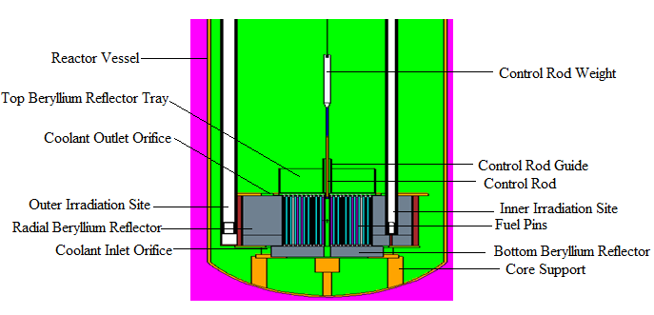
Core Components of GHARR-1
P2.4-090
Table 1: Comparison of core components of GHARR-1 HEU and LEU cores.
or smaller if the title is too long]
[click to edit Author(s) name(s) with division, email (and/or) Affiliation here using “Arial” font size approx. 9]
INTRODUCTION
Fig.2: Longitudinal section of GHARR-1 core.

Slide 6
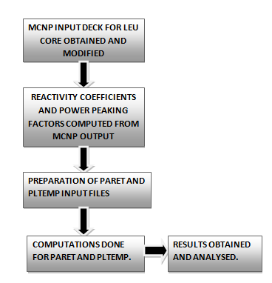
Methodology
P2.4-090
Transient and steady state thermal hydraulic analysis were conducted by obtaining kinetic parameters using the Monte Carlo N Particle Code (MCNP5). Kinetic parameters such as the temperature reactivity coefficients for moderator, void and fuel as well as the power peaking factors were computed from the MCNP5 simulations.
The transient studies of GHARR-1 with LEU core was studied using the PARET/ANL code (Version 7.3 of 2007). The total active region of GHARR-1 core was divided into two channels, one channel representing the hottest pin and the other representing the rest of the reactor core that is the average channel. The axial dimensions of these channels were divided into 21 equally spaced regions called the nodes. Reactivity insertions of 1.94 mk, 2.1 mk, 2.99 mk, 3.87 mk, 4.0 mk and 6.71 mk transients were simulated for the core. These insertions were selected to relate with those used in literature and the SAR of GHARR-1..
METHODS
Fig 3: Flow chart for the Methodology
The PLTEMP/ANL code version 4.0 was used to simulate and study the steady state thermal hydraulics of GHARR-1 with LEU core. The core of GHARR-1 was modelled for all the 335 fuel pins. The fuel pins were arranged in 12 fuel bundles, with the first 11 bundles containing 30 fuel pins, accounting for 330 fuel pins and the remaining 5 fuel pins were put in the last 12th bundle.

Slide 7
Results
P2.4-090
From experiments conducted for clean core reactivity insertions of 3.87 mk and 2.99 mk for GHARR-1 with LEU core, the data obtained was compared with the results from the PARET run. The peak power and outlet coolant temperatures for 2.99 mk and 3.87 mk reactivity insertions are compared in Figures 4 and 5.
RESULTS
Fig. 4: Comparison of power profile for PARET and Experimental data of GHARR-1 LEU core.
Fig. 5: Comparison of Coolant temperature for PARET and Experimental data of GHARR-1 LEU core.

Slide 8
Results
P2.4-090
The power profile for GHARR-1 with LEU core under various reactivity insertions was compared with that of the HEU core as shown in Figure 6. For reactivity insertion of 6.71 mk, peak powers of 154.60 kW and 198.85 kW were observed for LEU and HEU cores respectively. Figure 7 also shows the comparison of coolant temperatures for LEU and HEU cores of GHARR-1.
RESULTS
Fig. 7: Comparison of Coolant temperature for GHARR-1 HEU and LEU cores.
Fig. 6 Comparison of Power profile for GHARR-1 HEU and LEU cores.
The coolant temperatures for the LEU core was less than that of the HEU core for the various reactivity insertions. For an accident scenario, of a large reactivity insertion of 6.71 mk, the coolant temperature rose to a maximum of 90.15 °C and 114.34 °C for LEU and HEU cores respectively. These temperatures are far below the zircaloy clad melting point of about 1850 °C.

Slide 9
P2.4-090
Results
Simulations were run for the nominal LEU core power of 34 kW and other operable powers: 30 kW, 17 kW and 15 kW. Computed Values for the FIR, DNBR and ONBR are shown in Table 2.
The computed values of the ONBR and the DNBR indicate no possibility of boiling crisis in the core at the nominal power. The criteria of thermal-hydraulic design for GHARR-1 MNSR require that the DNBR should be greater than 2.55.
The values obtained for the computations of the coolant, clad and fuel temperatures using 40 °C as the inlet temperature and 1 bar as coolant pressure are also represented in Table 2. These results also indicates good safety margins for the operation of GHARR-1 with LEU core.
Table 2: Steady state thermal hydraulic parameters of GHARR-1 with LEU core.
Parameter/Power | 15KW | 17KW | 30KW | 34KW
Core flow rate (Kg/s) | 0.317 | 0.332 | 0.407 | 0.425
Coolant Temperature (°C) | 51.41 | 52.26 | 59.33 | 61.01
Maximum Clad Temperature (°C) | 83.00 | 86.60 | 117.91 | 126.30
Peak Fuel Temperature(◦C) | 83.33 | 86.93 | 118.24 | 126.63
ONBR | 1.56 | 1.44 | 1.27 | 1.15
FIR | 5.53 | 5.15 | 3.27 | 3.00
DNBR | 7.65 | 7.46 | 5.54 | 5.34
CONCLUSIONS

Slide 10
P2.4-090
Conclusion
Transient and steady state thermal hydraulic analysis of the LEU core of GHARR-1 has been studied and presented in this work using the PARET/ANL and PLTEMP/ANL codes. The reactor was found to be inherently safe even at accident conditions. The results of the LEU core was compared to the previous HEU core and the results showed that the LEU core is safe to operate just like the previous HEU core. Also, Good safety margins exist for the operation of the LEU core at nominal power of 34 kW. Results obtained compared well with experimental data.Hence the Reactor will continue to serve its purpose after conversion of the core from HEU to LEU to prevent proliferation risks.
CONCLUSIONS

