Slide 1
Global radioxenon emission inventory for 2014 by normal operational releases
from nuclear power plants and medical isotope production facilities
Martin Kalinowski
P2.4-606

Slide 2
Global radioxenon emission inventory for 2014
by normal operational releases from nuclear power plants and medical isotope production facilities
Martin Kalinowski
P2.4-606
The goal of the third ATM challenge is to perform atmospheric transport modelling in order to estimate radioxenon observations at selected IMS stations in the northern hemisphere for an extended period in the year 2014 (June to November). This estimation is needed for calibration and performance assessment of the verification system as described in the Treaty. The best estimates for Xe-133 emissions from known sources is used as input data for this exercise. This presentation summarizes the global radioxenon emissions inventory for the whole year 2014. It comprises all relevant nuclear facilities. For the two strong sources IRE (Belgium) and CRL (Canada) stack release data with a high time resolution are available. For nuclear power plants (NPP) in Europe and the USA the reported release for the whole year are applied in combination with information about their operational schedule. For all other NPPs and for the strongest research reactors sources the best estimates are used. The estimated release of the strongest nuclear research reactors sources is included as well as the annual emissions from the Mallinckrodt facility (The Netherlands), the NIIAR facility (Russia) and the Karpov Institute (Russia).
ABSTRACT

Slide 3
Purpose of updating the emission inventory
P2.4-606
Xe-133
The goal of the third ATM challenge is to perform atmospheric transport modelling in order to estimate radioxenon observations at selected IMS stations in the northern hemisphere for an extended period in the year 2014 (June to November). This estimation is needed for calibration and performance assessment of the verification system as described in the Treaty. See Maurer et al., O2.4-056 at SnT2021
Xe-131m, Xe-133, Xe-133m, Xe-135
The emission inventory for the whole set of all four CTBT relevant radioxenon isotopes will be applied in an inter-comparison that takes place in the second half of 2021. The objective is to find the best possible method for detecting nuclear explosion signals against the background caused by nuclear facilities. Screening methods using all four isotopes will be applied to determine which output scores best in nuclear explosion detection.
INTRODUCTION

Slide 4
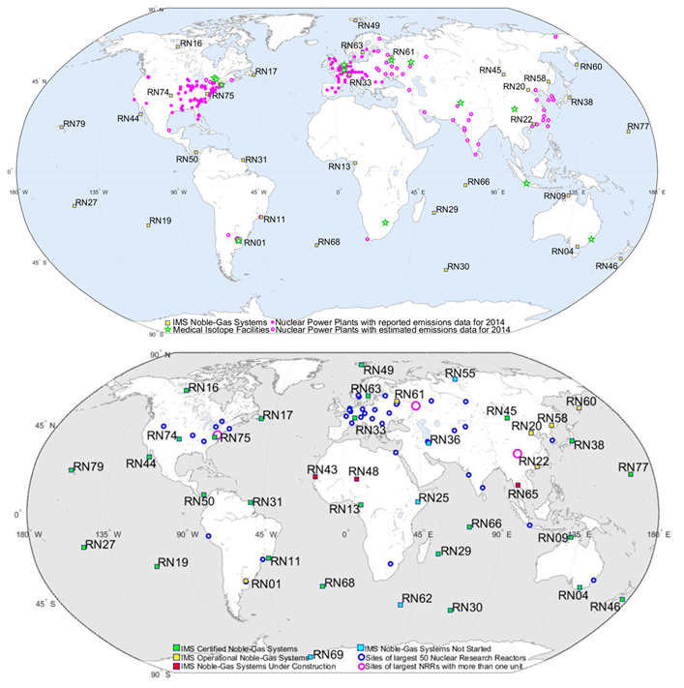
Summary of radioxenon emission inventory
P2.4-606
Sources of the data
Based on publicly available emission reports
Output of the project described here
Published as peer-reviewed papers
Data available as supplementary material
What sources are covered?
All nuclear power plants
All nuclear research reactors
All known medical isotope production facilities
Thoughts about spallation neutron sources
METHODS

Slide 5
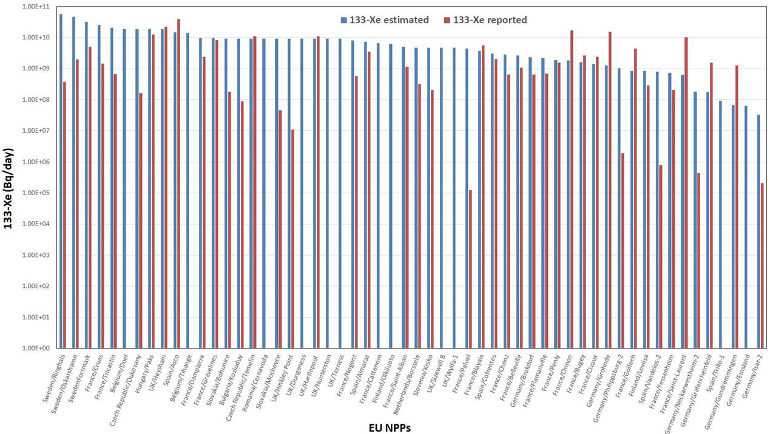
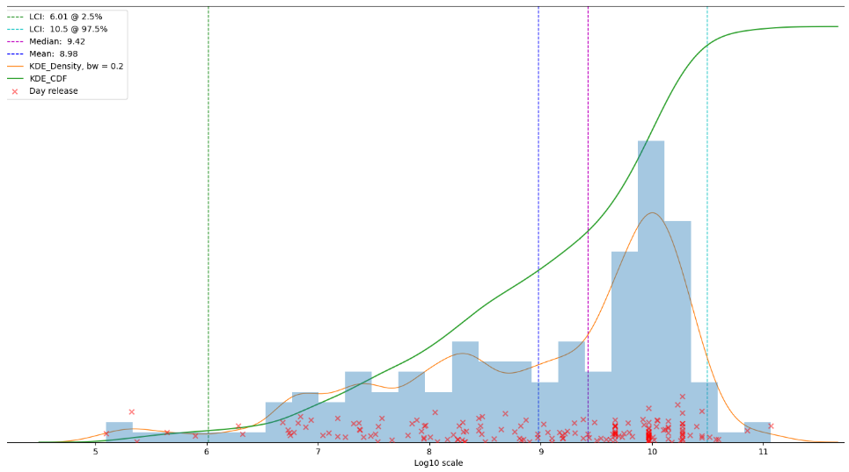
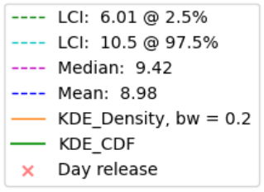
Highlights and new findings
P2.4-606
Lessons from NPP releases (Kalinowski/Tatlisu, 2020)
Highly variable from year to year
For several NPP sites the reported Xe-133 release in 2014 is up to 4 orders of magnitude different from the best estimate (Kalinowski/Tuma (2009)
Not correlated with any facility parameter
Mainly influenced by tiny leaks through the fuel cladding
Proposed solution
Don’t use standard emission value
If available, use real annual reports (here: 2014)
Otherwise use probability distribution, e.g. kernel density estimate see Kalinowski/Liu, P2.1-486 at SnT2021
RESULTS

Slide 6
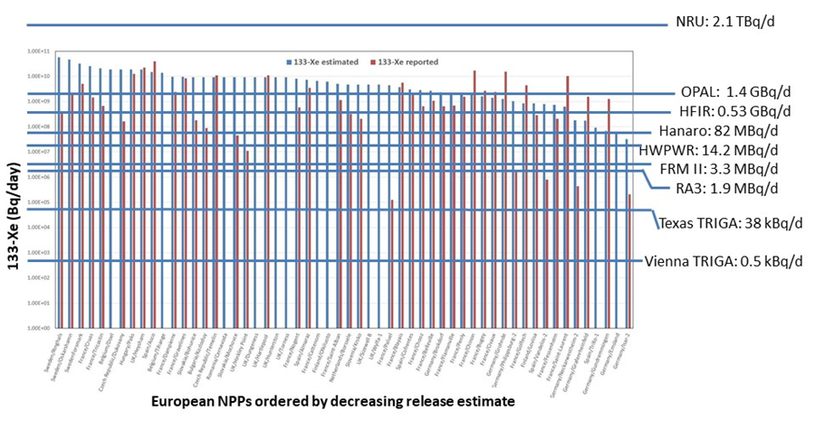
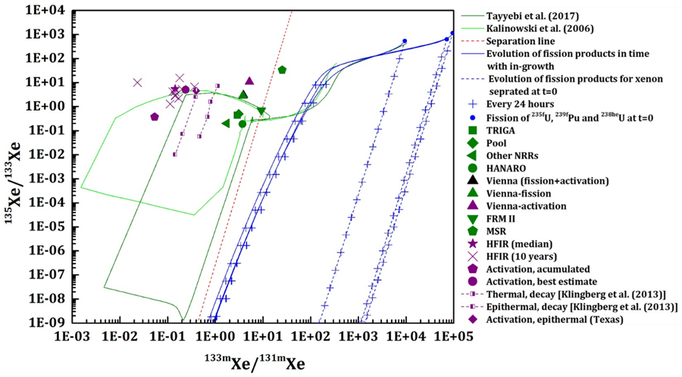
Highlights and new findings
P2.4-606
Lessons from NRR releases
(Kalinowski et al., 2021)
Highly variable from reactor to reactor
  Dependent on reactor type
  Correlated with reactor power
Findings
  Strong NRR emitters release more than many NPPs (here: 2014)
  Confirmed that activation may dominate (Klingberg et al., 2013)
RESULTS

Slide 7
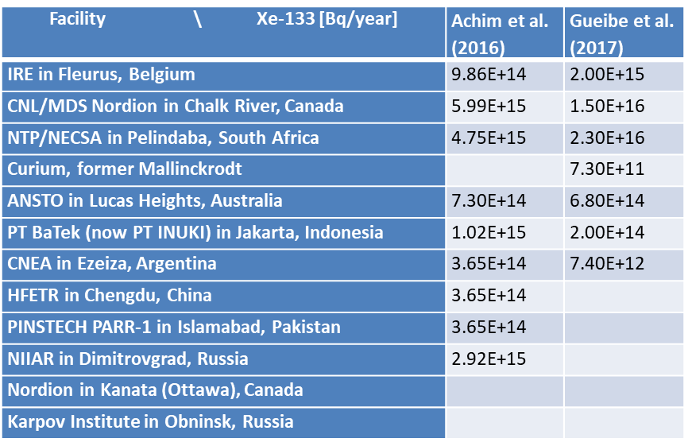
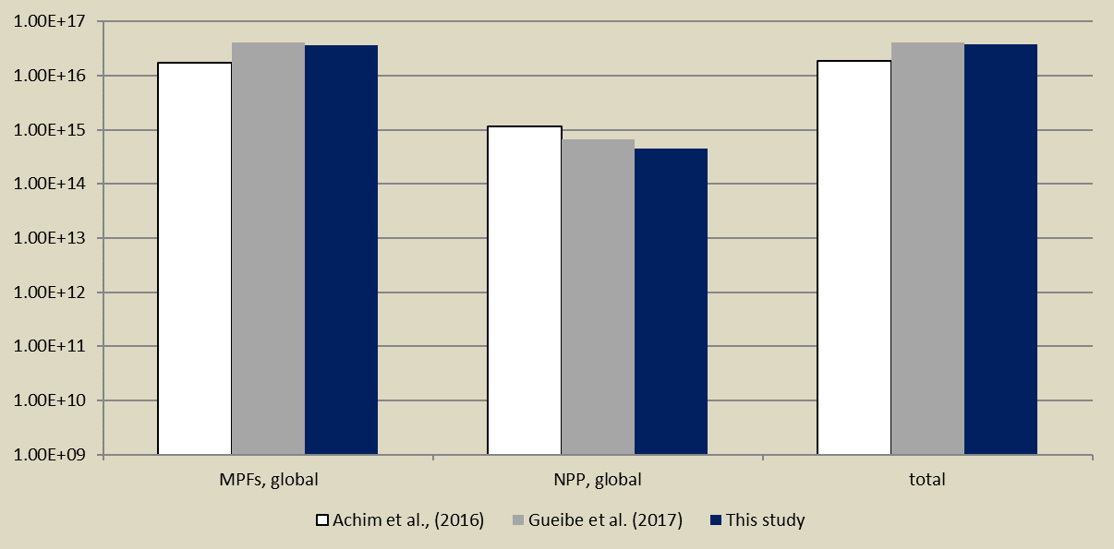
Highlights and new findings
P2.4-606
Lessons from MIPF releases (Kalinowski/Tatlisu, 2018)
Reports vs estimates
  The estimated globally aggregated emission inventory is very close to the update based on real reported emissions in 2014.
RESULTS

Slide 8
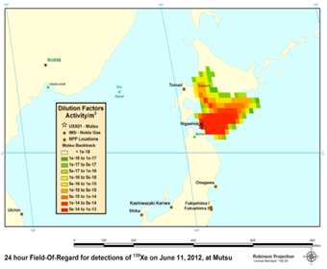
Highlights and new findings
P2.4-606
Other new thoughts
NPPs may also have a strong contribution from activation to their releases.
See Tayyebi/Kalinowski, O3.5-456 at SnT2021: “Radioxenon isotopic ratios from
activation of stable xenon in releases from nuclear facilities in relation to fission
sources visualized in multi-isotope-ratio plots”
Spallation neutron sources may cause remotely detectable releases.
See Kalinowski, et al. P2.4-607 at SnT2021 : “Investigation of Xe-135
observations at IMS noble gas systems generated by neutron activation and its
relevance for nuclear explosion monitoring”
Remember: Bowyer et al. (2013)
RESULTS

Slide 9
Global radioxenon emission inventory for 2014
by normal operational releases from nuclear power plants and medical isotope production facilities
Martin Kalinowski
P2.4-606
The global emission inventory summarizes the best estimates of radioxenon emissions from all nuclear facilities in the year 2014. It has been updated and extended to cover all four CTBT relevant isotopes.
The global radioxenon emission inventory is a unique data set to be used in studies to enhance data analysis from the noble gas component of the International Monitoring System.
Its first version with Xe-133 was used for the 3rd ATM Challenge and the update will be applied in the Radioxenon Nuclear Explosion Signal Screening Inter-Comparison to be conducted in the second half of 2021.
Several conclusions can be drawn from radioxenon emission data that are available that are important for effective nuclear explosion monitoring.
CONCLUSIONS

Slide 10
Global radioxenon emission inventory for 2014
by normal operational releases from nuclear power plants and medical isotope production facilities
Martin Kalinowski
P2.4-606
Bowyer, T.; et al. (2013) Detection of Elevated 135Xe in Northern Japan. Poster T1-P19 at SnT2013.
Kalinowski, M.; Tatlisu, H. (2018, April) Global radioxenon emission inventory for 2014 by normal operational releases from nuclear power plants and medical isotope production facilities. In EGU General Assembly Conference Abstracts (p. 9641).
Kalinowski, M.; Tatlisu, H. (2020) Global radioxenon emission inventory from nuclear power plants for the calendar year 2014. Pure and Applied Geophysics.
Kalinowski, M.; Tayyebi, P.; Lechermann, M.; Tatlisu, H. (2021): Global radioxenon emission inventory from nuclear research reactors. Accepted by Pure and Applied Geophysics.
Kalinowski, M.; Tuma, M.P. (2009) Global radioxenon emission inventory based on nuclear power reactor reports. Journal of Environmental Radioactivity 100, 58-70.
Klingberg, F. J., Biegalski, S. R., & Fay, A. G. (2013). Radioxenon signatures from activation of environmental xenon. Journal of Radioanalytical and Nuclear Chemistry, 296(1), 117-123.
References

