Slide 1
DATA FUSION BETWEEN INFRASOUND
AND ELECTROMAGNETIC PULSE (EMP)
Maayan Kahlon^{1,2}, Azi Lipshtat ¹, Colin Price ³, Anthony J. Weiss ²
Presentation number O2.1-061
¹ Israel NDC, Soreq Nuclear Research Center, Yavne, Israel
² Dept. of Electrical Engineering, Tel Aviv University, Israel
³ Dept. of Environment and Earth Sciences, Tel Aviv University, Israel

Slide 2
Data Fusion Between Infrasound
and Electromagnetic Pulse (EMP)
Maayan Kahlon, Azi Lipshtat, Colin Price, Anthony J. Weiss
Goal
To examine the possibility of improving the analysis process of atmospheric infrasound events under the
Comprehensive Nuclear-Test-Ban Treaty (CTBT)

Slide 3
Rational
Nuclear events emit both infrasound and EM signals
An infrasound signal which is not accompanied by an EM
signal is not a nuclear event
An Infrasound event which is accompanied by EMPs requires
further analysis (unless it can be shown that the EMPs are lightning)

Slide 4
The challenge
Most common EMPs are generated by lightning
There are 45 lightning per second occurring on earth
Lightning EMP may coincide with infrasound

Slide 5
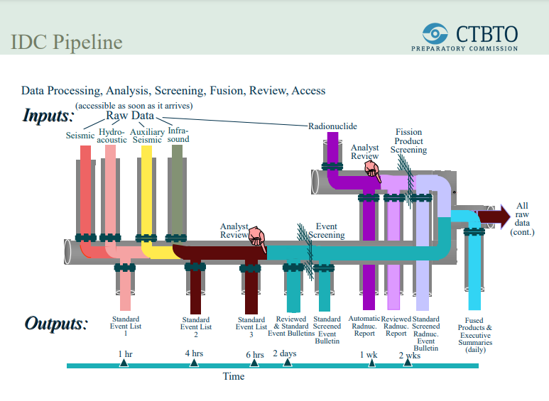

Slide 6
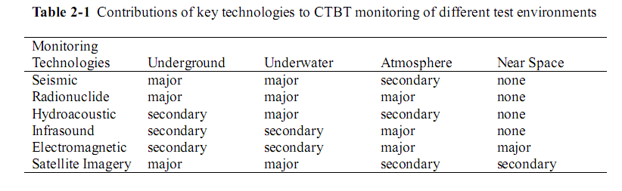
Monitoring systems

Slide 7
Methodology
Infrasound event
Detect EMP events
EM recording
Coincide in time and direction?
No
Not nuclear
Yes
All EMPs are lightning?
Yes
Not nuclear
No
Analysis required

Slide 8
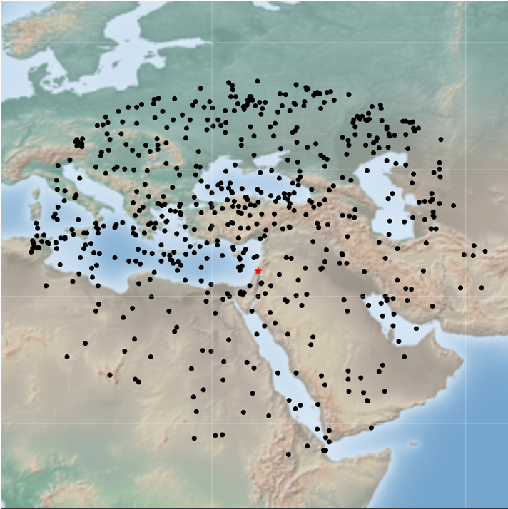
Infrasound Events
Infrasound SEL3 events from 36
non-consecutive days
580 events overall

Slide 9
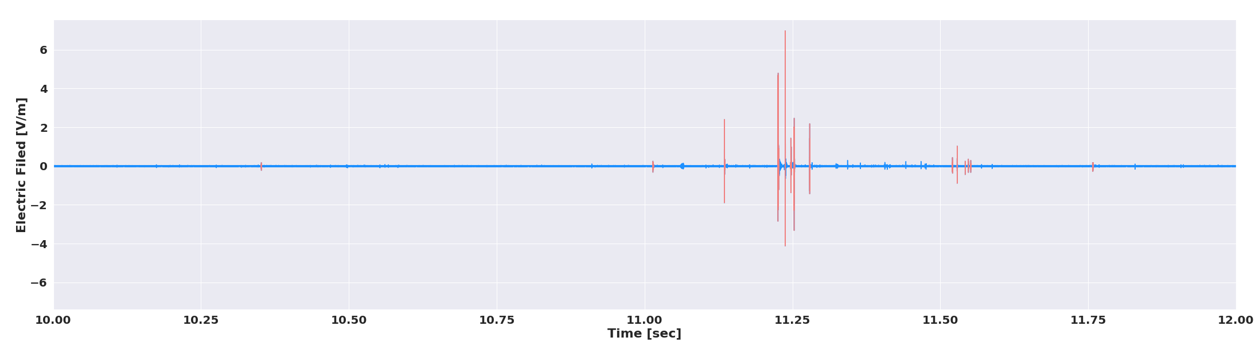
EM Measurements
Single station – one component of electric field and two perpendicular components of magnetic field
Measurements from the same 36 days as the infrasound data
About 5 million events detected (300 Tb of data)

Slide 10
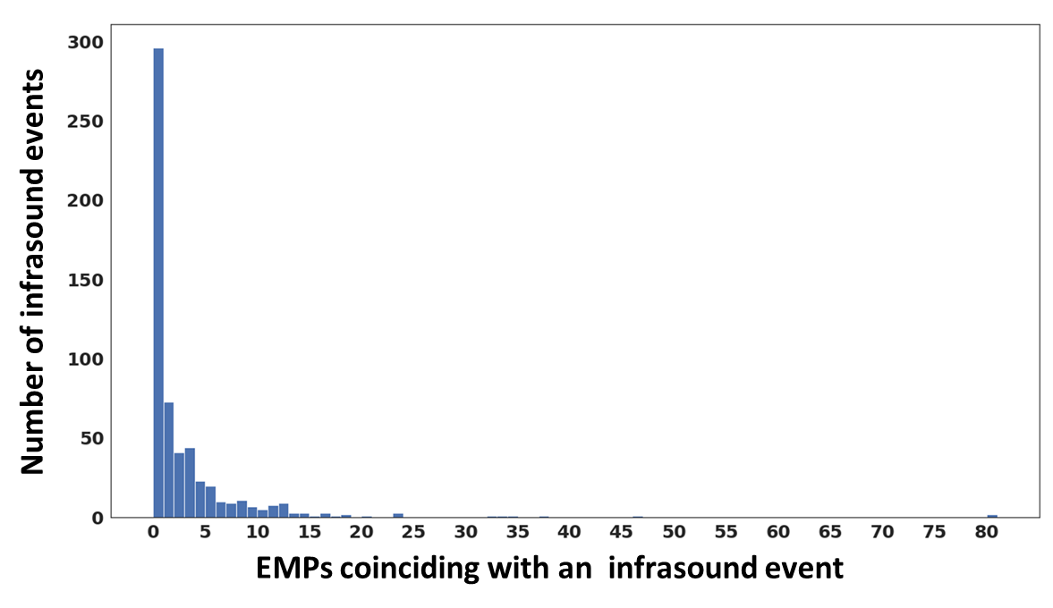
Infrasound – EMP Time and Azimuth Fusion
All infrasound events coincided with EMP events in time
49% that coincided in both time and azimuth
These events require further analysis

Slide 11
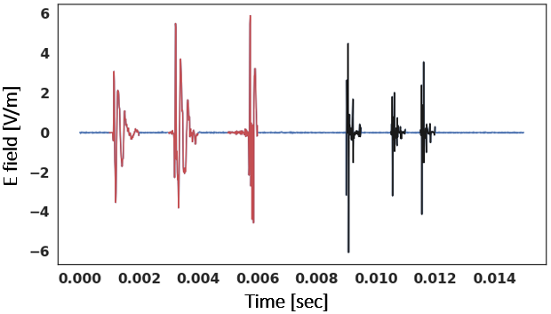

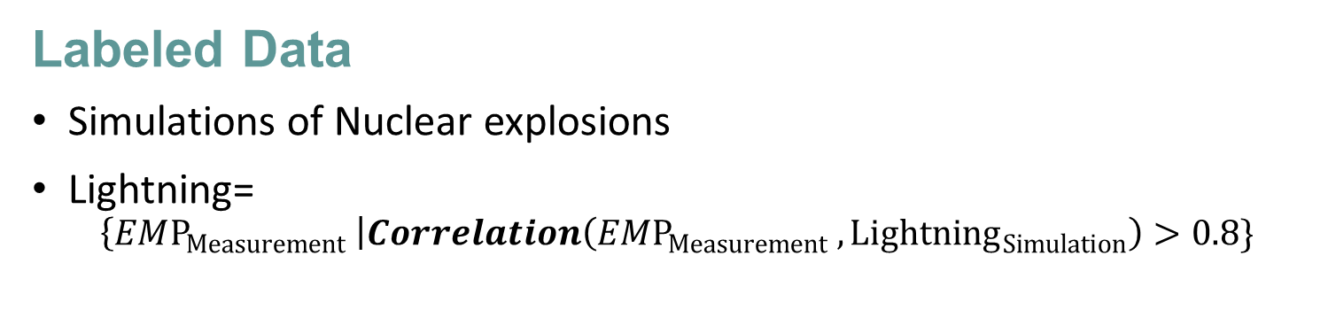
Labeled Data
Simulations of Nuclear explosions
Lightning=
$\left\{EMP_{Measurement} \right|Correlation\left(EMP_{Measurement}{ , Lightning}_{Simulation}\right)>0.8\}$

Slide 12
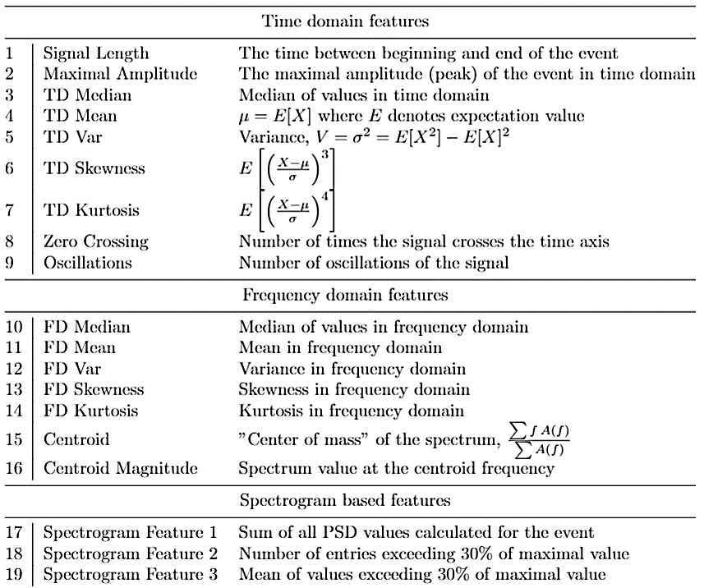
Features Extraction

Slide 13

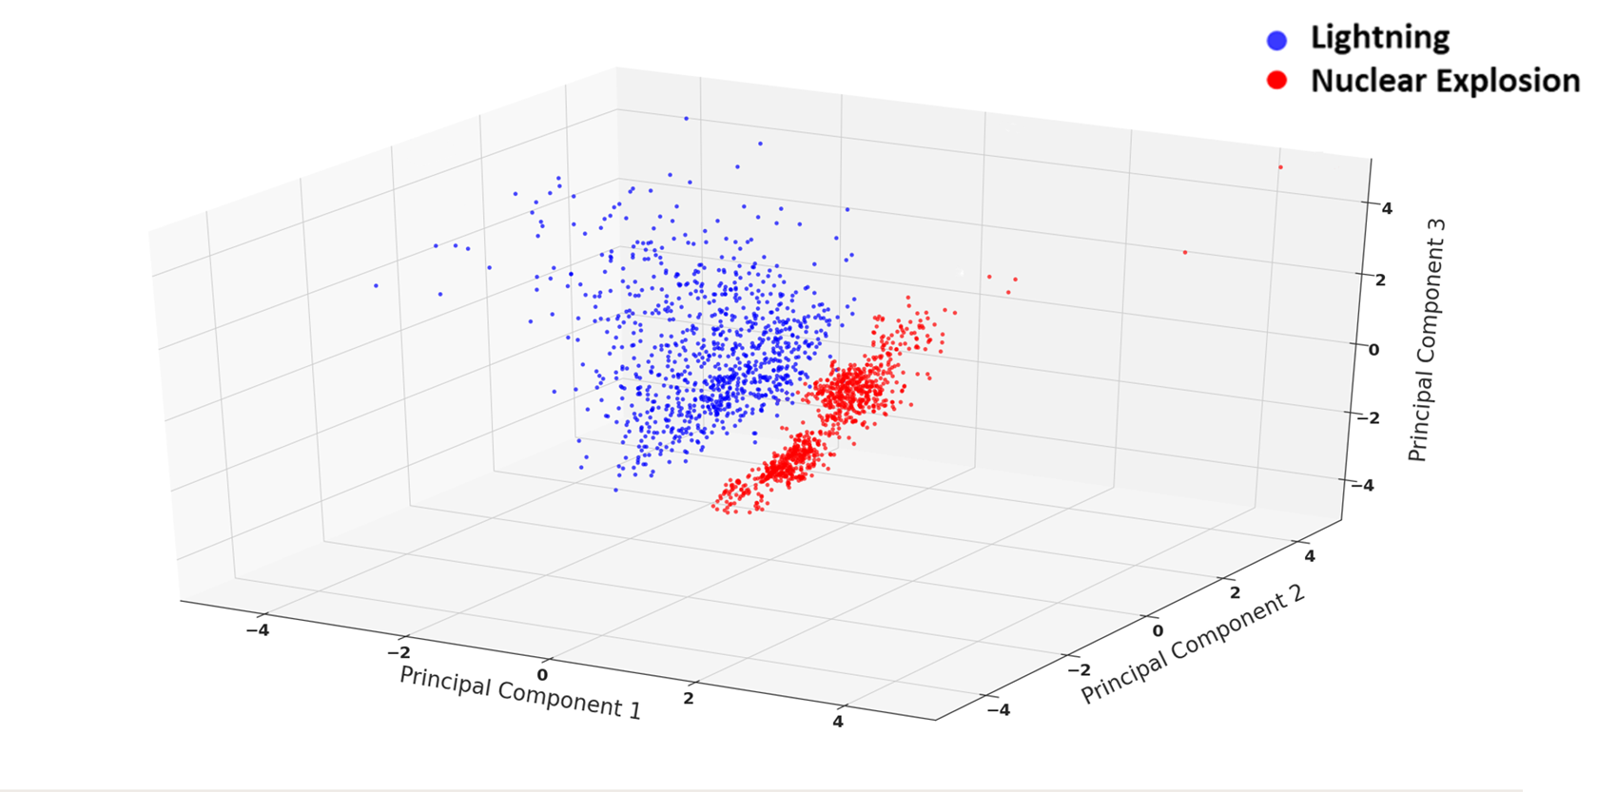
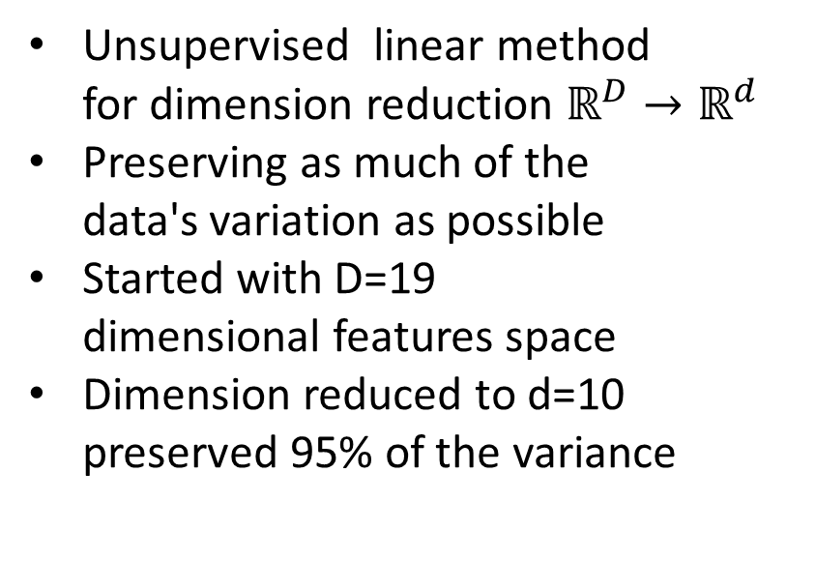
Principal Component Analysis (PCA)
Unsupervised linear method
for dimension reduction $ℝ^{D}→ℝ^{d}$
Preserving as much of the
data's variation as possible
Started with D=19
dimensional features space
Dimension reduced to d=10 preserved 95% of the variance

Slide 14
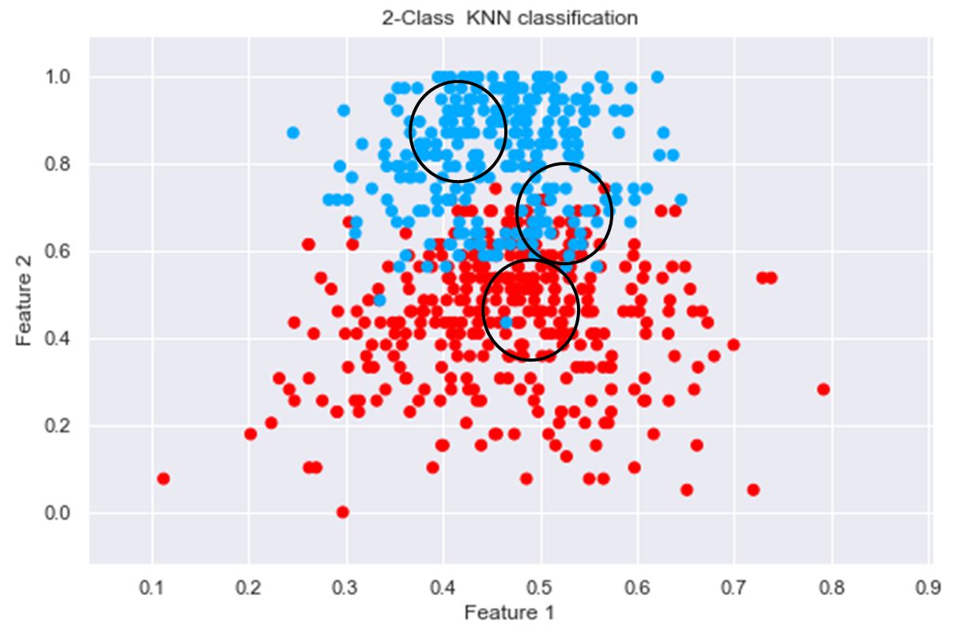
Classification
k Nearest Neighbors algorithm with k=5
10-Fold cross validation
for train – test split
Repeat 10 times with different groups of
lightning

Slide 15
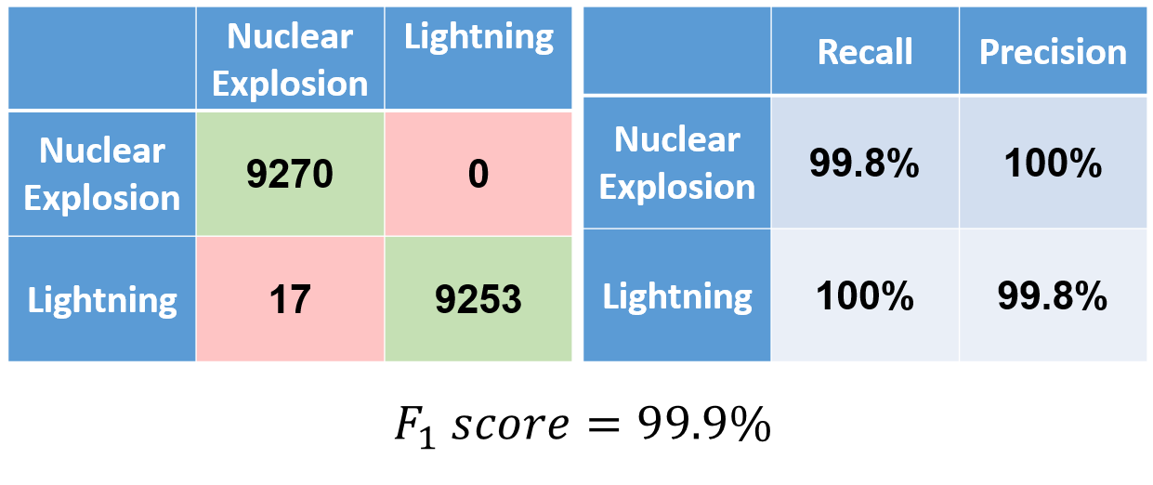
Machine Learning – Model Validation

Slide 16

Results
After all EM events which coincided with IS events were projected to the PCA space $ℝ^{d}$ and were classified, the results show:
All EMPs were classified as lightning
No infrasound event required further analysis

Slide 17
Results
STEP | INPUT | TIME MATCH | TIME & AZIMUZH MATCH | CLASSIFICATION
# Infrasound events | 580 | 580 | 284 | 0
# EMP events | 5000000 | 48318 | 1682 | All lightning

Slide 18
Conclusions
Time and azimuth fusion between infrasound and EMP is not sufficient to eliminate all non-nuclear infrasound events
Lightning EMP and Nuclear EMP can be discriminated using their properties
Infrasound analysis can be improved when fusing with EM data

Slide 19
Future Work
  Real time data fusion in the single station level
  A more accurate detection in time and location can be obtained by multi-station system
  Cooperation with existing lightning detection networks
  Train the ML model on a larger data set

