Slide 1

Seismic Hazard Estimates for State of Uttarakhand
Himalaya in terms of Peak Ground Acceleration
(PGA)]
Prof. SHANKER, Daya and Shubham
Indian Institute of Technology Roorkee
Department of Earthquake Engineering
Roorkee-247667, U K India
d.shanker@eq.iitr.ac.in
P1.2-060

Slide 2
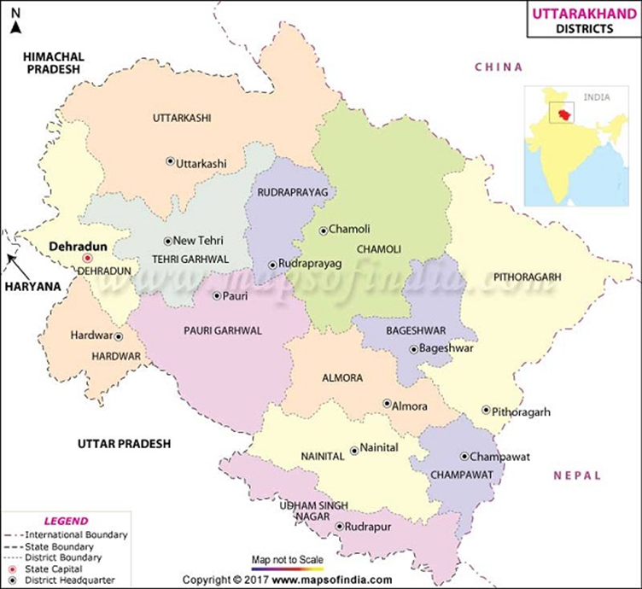
Seismic Hazard Estimates for State of Uttarakhand
Himalaya in terms of Peak Ground Acceleration (PGA)
Prof. SHANKER, Daya and SHUBHAM (Department of Earthquake Engineering, Indian Institute of Technology Roorkee-247667, U K India); d.shanker@eq.iitr.ac.
P1.2-060
ABSTRACT
Probabilistic Seismic Hazard Assessment (PSHA) for the state of Uttarakhand (280-320 N and 770-810 E) has been investigated considering two Next Generation Attenuation (NGA) models. Results are presented in terms of PGA for various return periods for each district. Initially, based on seismicity and seismtectonic characteristics the whole region has been defined into four seimogenic zones (UK-I, UK-II, UK-III and UK-IV. Seismic hazard computation is performed using CRISIS 2015. The study area has been divided into grid size of 0.2° x 0.2°. The input parameters are seismicity parameters and attenuation models. The estimated seismicity parameters and (NGA) models have been used to produced seismic hazard in terms of PGA for 20%, 10% and 2% probability of exceedance in 50 years which are equivalent to return periods of 225, 475 and 2475 years respectively. The hazard Contour maps have been produced for mean PGA for 2%, 10% and 20% probability of exceedance in 50 years as well as Uniform hazard spectra (UHS) at various sites for return periods of 225, 475 and 2475 years have been plotted and the rate of occurrence of earthquakes and PGA are compared in each source zone.
Roorkee
Fig 1. Map of Uttarakhand (2017)

Slide 3
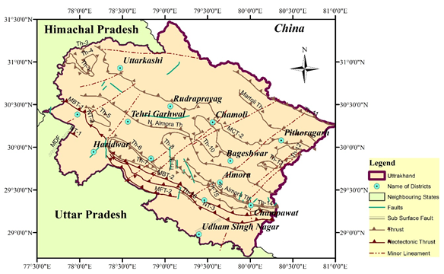
Seismic Hazard Estimates for State of Uttarakhand
Himalaya in terms of Peak Ground Acceleration (PGA)
Prof. SHANKER, Daya and SHUBHAM (Department of Earthquake Engineering, Indian Institute of Technology Roorkee-247667, U K India); d.shanker@eq.iitr.ac.
P1.2-060
1. INTRODUCTION
Uttarakhand is one of the northern state of India located in the foot hill of Himalayan region which is seismically most active because of the earthquake occurrence associated with major as well as minor faults. This state consisting of thirteen district, most of which occupies a part of Himalaya stretching about 320 km between Himachal Pradesh in the west and Kali River in the east, forming the Indo-Nepal border (Fig 2.)
UK Falls at foothills of Himalayan with 28.7°N - 31.1°N latitude and 77.6°E - 81°E longitude.
13 Districts divided into Two region, Garhwal and Kumaon with an area of 53,483 km²
Zone IV (severe) and Zone V (very severe) (IS: 1893-2016).
Seismically active due to thrusting of the Indian and Eurasian plate.
Fig 2. Tectonic map of Uttarakhand with major Thrust and Faults (Soni et. al., 2019).
Map of Uttarakhand (Map of U.K. (2017))

Slide 4
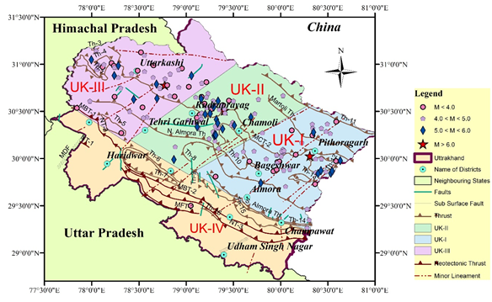
Seismic Hazard Estimates for State of Uttarakhand
Himalaya in terms of Peak Ground Acceleration (PGA)
Prof. SHANKER, Daya and SHUBHAM (Department of Earthquake Engineering, Indian Institute of Technology Roorkee-247667, U K India); d.shanker@eq.iitr.ac.
P1.2-060
INTRODUCTION
2. SEPARATION OF SEISMOGENIC SOURCE ZONES
For the purpose of PSHA, Uttrakhand, region has been divided into four Seismotectonic source zones as shown in Figure 3. The earthquakes data (1974 - 2018) taken from the catalogue of USGS and ISC and its epicentre distribution are also shown in this map. Seismotectonic sources zones are manifest on the basis of utilising information on tectonics and seismicity patters of the region, as well as geology of the area (Khattri et al., 1984).
To achieve this ARCGIS 10 software is used for source zone demarcation (UK-I, UK-II, UK-III and UK-IV).
3. ESTIMATION OF SEISMIC HAZARD
PARAMETERS
Figure 3: Seismicity map of the region. Demarcated source zone (UK-I, UK-II, UK-III and UK-IV) are also shown.
Shanker and Shubham, (2018), interpreted the parameter 'a' represents the seismicity of the region (productivity)
Map of Uttarakhand (Map of U.K. (2017))

Slide 5
Seismic Hazard Estimates for State of Uttarakhand
Himalaya in terms of Peak Ground Acceleration (PGA)
Prof. SHANKER, Daya and SHUBHAM (Department of Earthquake Engineering, Indian Institute of Technology Roorkee-247667, U K India); d.shanker@eq.iitr.ac.
P1.2-060
whereas 'b' gives the relative proportion of the large to small earthquakes and m_{c} is the magnitude of completeness or threshold magnitude. For present study, the Entire Magnitude Range Method (EMR) modified by Woessner and Wiemer (2005) and maximum curvature method is adopted to estimate the magnitude of completeness (m_{c}) as this method is stable under most conditions and provides a comprehensive seismicity model. In seimotectonic zone UK-II the EMR is not workable due to less earthquake events, that’s why Maximum Curvature method is used.
The instrumental and historical earthquake catalog is often short to reflect the full potential of long seismogenic fault. The maximum regional magnitude, M_{max} is the upper limit of magnitude for a given region or it is the magnitude of largest possible earthquake (Kijko, 2004). No earthquakes are to be expected with a magnitude exceeding M_{max.} For the present study, M_{max} has been computed by the equation given by Kijko and Sellevoll (1992) given as:
The results obtained is Shown in Table 1.
Table 1: Seismic hazard parameters considering entire earthquake
data-set from 1974-2018
Source zone | Area(sq. km) | mc | mmax | a | b | ±b | α | β | λm | Return period (1/λm) | Return period for m=6.0 (year)
UK-I | 13183.767 | 4.4 | 6.2 | 4.52 | 1.05 | 0.00 | 10.41 | 2.42 | 0.794 | 1.259 | 60.256
UK-II | 11682.674 | 4.6 | 6.7 | 4.64 | 1.08 | 0.19 | 10.68 | 2.49 | 0.470 | 2.128 | 69.183
UK-III | 13262.387 | 4.2 | 6.9 | 3.30 | 0.84 | 0.00 | 7.60 | 1.93 | 0.592 | 1.689 | 59.954
Map of Uttarakhand (Map of U.K. (2017))

Slide 6
Seismic Hazard Estimates for State of Uttarakhand
Himalaya in terms of Peak Ground Acceleration (PGA)
Prof. SHANKER, Daya and SHUBHAM (Department of Earthquake Engineering, Indian Institute of Technology Roorkee-247667, U K India); d.shanker@eq.iitr.ac.
P1.2-060
4. PROBABILISTIC SEISMIC HAZARD ANALYSIS
The ultimate goal of PSHA is to estimate ground motion at the particular site of interest. Seismic hazard results using the Ground Motion Prediction Equation (GMPE) can be analysed by developing seismic hazard curves, which means the annual probability of exceedance of different values of any selected ground motion parameter in a specified period of time. Such curves can be estimated for an individual zone and thereby aggregated for a particular site.The instrumental and historical earthquake catalog is often short to reflect the full potential of long seismogenic fault. The maximum regional magnitude, M_{max} is the upper limit of magnitude for a given region or it is the magnitude of largest possible earthquake (Kijko, 2004). No earthquakes are to be expected with a magnitude exceeding M_{max.} For the present study, M_{max} has been computed by the equation given by Kijko and Sellevoll (1992). Various attenuation models are proposed for the estimation of ground motion for specific regions and for the general area. These attenuation relationships have been developed considering a worldwide database for the shallow crustal earthquakes. The NGA (2014) models and their description which are used in this study are given in Table 2 (below).
NGA West2 model by Boore et al (2014)
Original units | g
Dimension | acceleration
Spectral Period range | 0-10 Sec
Valid Distance range | 0-300 km
Valid Magnitude range | 3-8.5
Type of distance metric | JyB
Residuals Distribution | LogNormal
Tectonic region | Active_Shallow_Crustal
NGA West2 model by Abrahamson, Silva and Kamai (2014)
Original units | g
Dimension | acceleration
Spectral Period range | 0-10 Sec
Valid Distance range | 0-300 Km
Valid Magnitude range | 3-8.5
Type of distance metric | Rrup
Residuals Distribution | LogNormal
Tectonic region | Active_Shallow_Crustal
Map of Uttarakhand (Map of U.K. (2017))

Slide 7
Seismic Hazard Estimates for State of Uttarakhand
Himalaya in terms of Peak Ground Acceleration (PGA)
Prof. SHANKER, Daya and SHUBHAM (Department of Earthquake Engineering, Indian Institute of Technology Roorkee-247667, U K India); d.shanker@eq.iitr.ac.
P1.2-060
5. RESULTS AND DISCUSSION
Table 3. Computed PGA value for 225,475 and 2475 years return periods for each district of Uttarakhand
Probabilistic Seismic Hazard Assessment (PSHA) for the state of Uttarakhand has been carried out using CRISIS 2015 Software, for which the study area has been divided into grid size of 0.2° x 0.2°. The input parameters are seismicity parameters (Table 1) and attenuation models (Table 2). Seismic hazard is computed in terms of PGA for 20%, 10% and 2% probability of exceedance in 50 years which are equivalent to return periods of 225, 475 and 2475 years respectively. Contour maps have been produced for mean PGA for 2%, 10% and 20% probability of exceedance in 50 years. Uniform hazard spectra (UHS) at various sites for return periods of 225, 475 and 2475 years have been plotted. Probabilistic Seismic Hazard results is presented in terms of PGA for various return periods for each district of Uttarakhand considering two 2014 NGA attenuation models given in Table 3 and mean PGA contour maps are shown in Figs 4 (a, b and c).
Cities | Abrahamson, Silva, and Kamai (2014) Attenuation Model (PGA) |  |  | Boore et al (2014) NGA West2 Attenuation Model (PGA)
 | 225 | 475 | 2475 | 225 | 475 | 2475
Almora | 0.13 | 0.16 | 0.27 | 0.13 | 0.20 | 0.41
Bageshwar | 0.15 | 0.19 | 0.31 | 0.16 | 0.23 | 0.45
Chamoli | 0.19 | 0.25 | 0.40 | 0.23 | 0.32 | 0.61
Champawat | 0.10 | 0.13 | 0.23 | 0.10 | 0.15 | 0.31
Dehradun | 0.14 | 0.19 | 0.34 | 0.11 | 0.17 | 0.35
Haridwar | 0.09 | 0.13 | 0.22 | 0.05 | 0.07 | 0.13
Nainital | 0.09 | 0.13 | 0.19 | 0.06 | 0.08 | 0.14
Pauri Garhwal | 0.14 | 0.19 | 0.32 | 0.13 | 0.20 | 0.42
Pithoragarh | 0.14 | 0.18 | 0.30 | 0.16 | 0.23 | 0.45
Rudraprayag | 0.21 | 0.27 | 0.43 | 0.23 | 0.33 | 0.61
Tehri Garhwal | 0.19 | 0.27 | 0.41 | 0.21 | 0.30 | 0.57
Udham Singh Nagar | 0.04 | 0.06 | 0.09 | 0.02 | 0.03 | 0.05
Uttarkashi | 0.19 | 0.25 | 0.43 | 0.19 | 0.28 | 0.56
Map of Uttarakhand (Map of U.K. (2017))

Slide 8
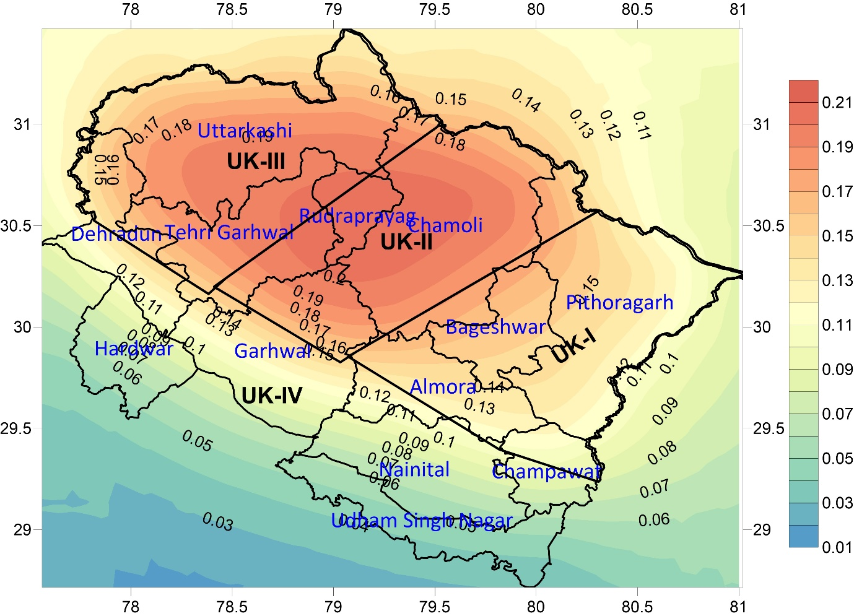
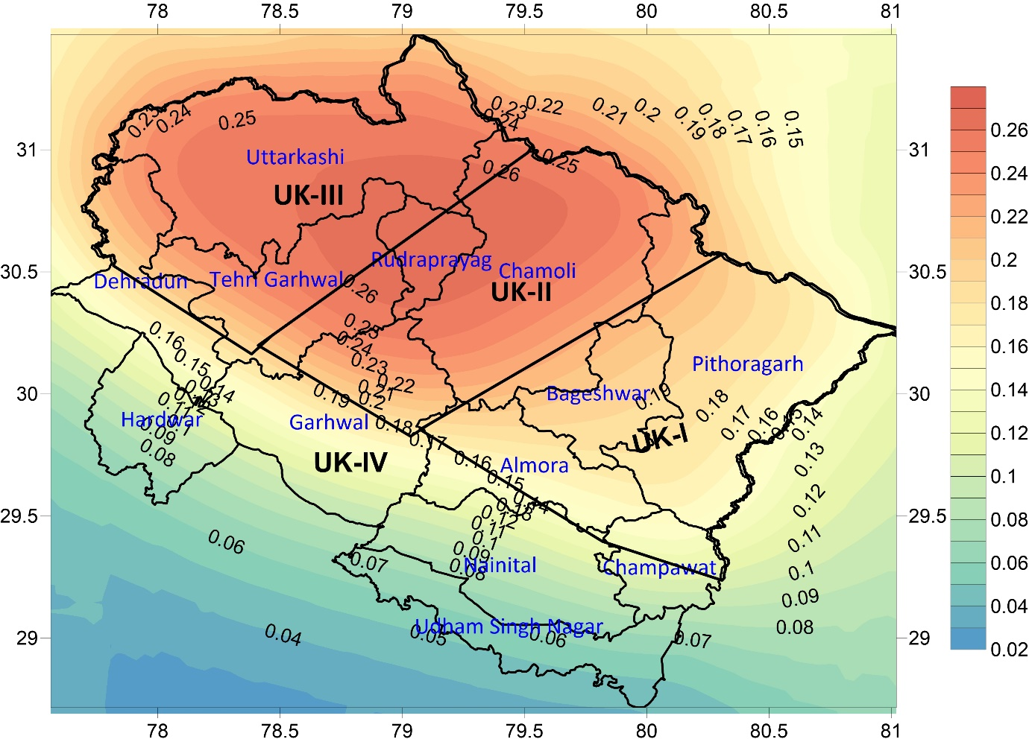
Seismic Hazard Estimates for State of Uttarakhand
Himalaya in terms of Peak Ground Acceleration (PGA)
Prof. SHANKER, Daya and SHUBHAM (Department of Earthquake Engineering, Indian Institute of Technology Roorkee-247667, U K India); d.shanker@eq.iitr.ac.
P1.2-060
(a)
(b)
Figure 4: (a) Mean PGA contour map for 225 and (b) 475 years return periods using Abrahamson, Silva and Kamai (2014) Attenuation Model
Map of Uttarakhand (Map of U.K. (2017))

Slide 9
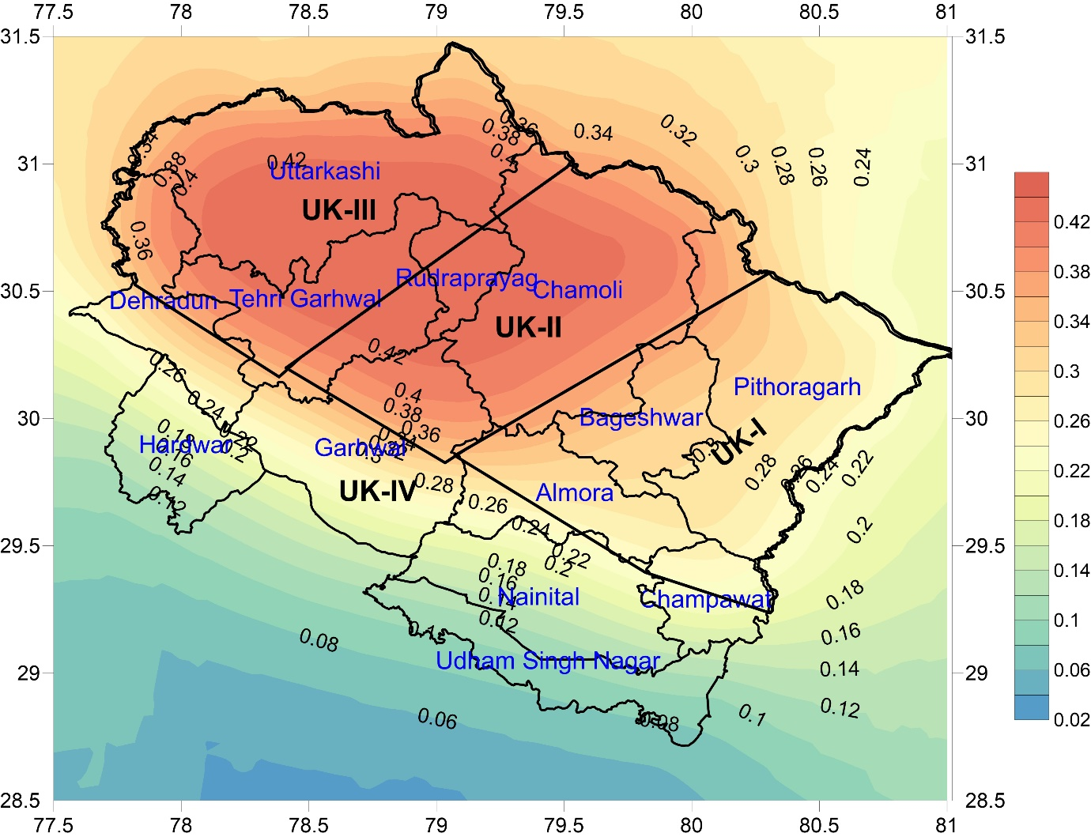
Seismic Hazard Estimates for State of Uttarakhand
Himalaya in terms of Peak Ground Acceleration (PGA)
Prof. SHANKER, Daya and SHUBHAM (Department of Earthquake Engineering, Indian Institute of Technology Roorkee-247667, U K India); d.shanker@eq.iitr.ac.
P1.2-060
Mean PGA contour maps for 225, 475 and 2475 years return periods have been generated using Surfer software (Figure 4- a, b, c) for Abrahamson, Silva and Kamai (2014). However, contour maps for Boore et al (2014) NGA West2 have not been shown here.
(c)
6. CONCLUDING REMARKS
The probabilistic seismic hazard assessment (PSHA) is investigated because it involves the production of contour maps that represent the levels of ground and structural shaking expected to be experienced over a particular return period (in years). PSHA incorporates all types of uncertainties associated with the earthquake location, occurrence, magnitude etc. and is considered economical and less conservative model. PSHA results are widely used for designing any type of structures to reduce the probability of hazard level. Generally, the shaking is represented in terms of peak ground acceleration (PGA) that is generated by the effects of the rupture of a geological fault and the propagation and attenuation of seismic waves reaching the bedrock. But, in actual research frontiers for state of the art in PSHA suggest to test the hazard curves against recorded strong motions and Mercalli intensity observations.
Figure 4: (c) Mean PGA contour map for 2475 years return periods using Abrahamson, Silva and Kamai (2014) Attenuation Model
Map of Uttarakhand (Map of U.K. (2017))

Slide 10
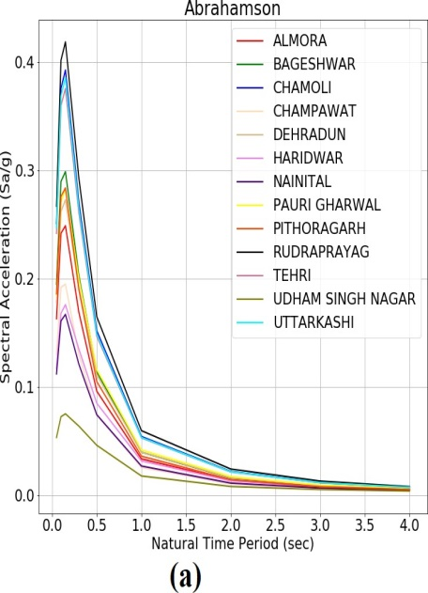
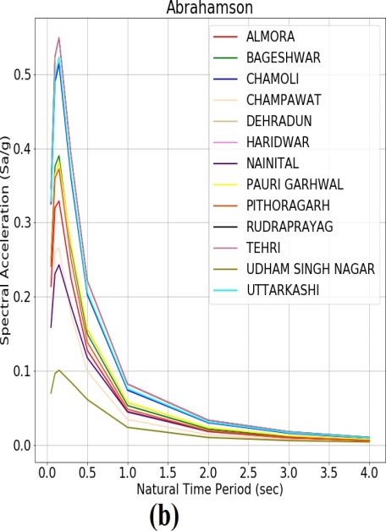
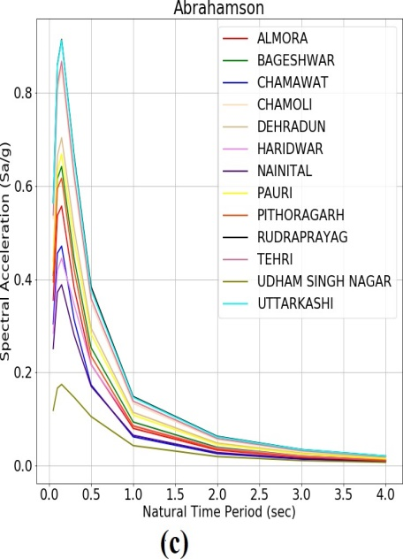
Seismic Hazard Estimates for State of Uttarakhand
Himalaya in terms of Peak Ground Acceleration (PGA)
Prof. SHANKER, Daya and SHUBHAM (Department of Earthquake Engineering, Indian Institute of Technology Roorkee-247667, U K India); d.shanker@eq.iitr.ac.
P1.2-060
On the basis of above study following conclusion may be drawn:
Seismicity parameters have been estimated for various source zones, the results show that rate of occurrence of earthquakes is high in source zone UK- I as compared to other zones and low in source zone UK-II.
Seismic hazard has been estimated in terms of PGA and UHS (Fig. 5) for various return periods for 225, 475 and 2475 years in different districts of Uttarakhand considering two NGA 2014 attenuation models. Results show that Rudraprayag district has maximum PGA value and Udham Singh Nagar has minimum value.
Figure 5: (a), (b) and (c) represent comparison of Uniform hazard spectra (UHS) at different districts of Uttarakhand for return periods of 225, 475 and 2475 years respectively, using Abrahamson, Silva and Kamai (2014) Attenuation Model.
Map of Uttarakhand (Map of U.K. (2017))

Slide 11
Seismic Hazard Estimates for State of Uttarakhand
Himalaya in terms of Peak Ground Acceleration (PGA)
Prof. SHANKER, Daya and SHUBHAM (Department of Earthquake Engineering, Indian Institute of Technology Roorkee-247667, U K India); d.shanker@eq.iitr.ac.
P1.2-060
Results presented in the study could be useful for earthquake community in a wide spectrum of applications, ranging from research, national seismic hazard maps, seismic design codes, earthquake financial loss modeling, and site-specific seismic hazard evaluations for important facilities (e.g., power plants, dams, tall buildings, etc.).
ACKNOWLEDGEMENTS
Authors are grateful to Department of Earthquake Engineering, Indian Institute of Technology Roorkee, Roorkee for excellent computational facilities. Views expressed in this paper are that of authors only, and may not necessarily be of the institute.
References
Abrahamson, N. A., Silva, W. J., and Kamai, R. (2014). Summary of the ASK14 ground motion relation for active crustal regions, Earthquake Spectra 30, 1025–1055.
Abramowitz, M., and Stegun, I.A. (eds.) (1970), Handbook of Mathematical Functions: with Formulas, Graphs and Mathematical Tables, 9th ed., Dover Publ., New York, 1046 pp
Boore, D. M., Stewart, J. P., Seyhan, E. , and Atkinson, G. A. (2014). NGA-West2 equations for predicting PGA, PGV, and 5% damped PSA for shallow crustal earthquakes, Earthquake Spectra 30, 1057–1085.
Khattri, K.,Rogers ,A., Perkins, D., and Algermissen, S. (1984). A seismic hazard map of India and adjacent areas. Tectonophysics 108 (1-2), 93-134.
Kijko, A. and Sellevoll, M., (1992). Estimation of earthquake hazard parameters from incomplete data files. Part II. Incorporation of magnitude heterogeneity. Bulletin of the Seismological Society of America 82 (1), 120-134.
Kijko, A. (2004). Estimation of the Maximum Earthquake Magnitude, Mmax, Pure and Appl.Geophys, 161,1655-1681.
Map of Uttarakhand (Map of U.K. (2017))

Slide 12
Seismic Hazard Estimates for State of Uttarakhand
Himalaya in terms of Peak Ground Acceleration (PGA)
Prof. SHANKER, Daya and SHUBHAM (Department of Earthquake Engineering, Indian Institute of Technology Roorkee-247667, U K India); d.shanker@eq.iitr.ac.
P1.2-060
Seismicity Data (1974-2018). The United States Geological Survey (USGS) & ISC, https://www.usgs.gov/., & www.isc.ac.uk
Seismic zoning map of India: (BIS-1893 (2016) Part 1.
Shanker, D. and Shubham (2018). On the seismic hazard in Himachal Pradesh and Uttarakhand States; Geosciences 2018, 8(2), 21-31.
Soni, Komal, Shanker, D., Shubham, Sabah, Nazeel (2019). Estimation of Seismic Hazard Parameters for Uttarakhand Region, Journal of Rock Mechanics & Tunnelling Technology (JRMTT), 25 (1) 21-32.
Woessner, J. and Wiemer, S. (2005). Assessing the quality of earthquake catalogues: Estimating the magnitude of completeness and its uncertainty. Bulletin of the Seismological Society of America 95 (2), 684-698.
Map of Uttarakhand (Map of U.K. (2017))

