Slide 1
Comparison of forward and backward source-receptor sensitivities for atmospheric inverse modeling using the HYSPLIT model with the Cross-Appalachian Tracer Experiment (CAPTEX) field experiment measurements
Tianfeng Chai^{1,2}, Mark Cohen¹, and Fong Ngan^{1,2}
1 Air Resources Laboratory, National Oceanic and Atmospheric Administration, College Park, MD, USA
2 Cooperative Institute for Satellite Earth System Studies (CISESS), University of Maryland, College Park, MD, USA

Slide 2
Comparison of forward and backward source-receptor sensitivities for atmospheric inverse modeling using the HYSPLIT model with the Cross-Appalachian Tracer Experiment (CAPTEX) field experiment
Tianfeng Chai^{1,2}, Tianfeng Chai^{1,2} , Mark Cohen¹, and Fong Ngan^{1,2}
1 Air Resources Laboratory, National Oceanic and Atmospheric Administration, College Park, MD, USA
2 Cooperative Institute for Satellite Earth System Studies (CISESS), University of Maryland, College Park, MD, USA
P1.1-650
Based on observations from monitoring stations or other platforms, unknown atmospheric pollutant emission sources, including source location, strength, and temporal variations, can be estimated using inverse modeling techniques. In such applications, 3D-particle Lagrangian dispersion models are usually employed, and the source-receptor sensitivities are calculated in either forward or backward modes for the source term estimation. While specifics of a given application may suggest a preference for one mode over the other, both forward and backward approaches can generally be applied for the inverse modeling. However, differences are often found in the inversion results between analyses based on forward and backward methodologies. In this study, we use the Cross-Appalachian Tracer Experiment (CAPTEX) field experiment as a test case to compute the source-receptor sensitivities between the known sources and air samples collected at 84 measurement sites. The differences between the forward and backward sensitivities calculated using the HYSPLIT model will be presented. The impact of the differences between the two approaches on the source term estimation results will be discussed. In addition, the underlying causes of the sensitivity discrepancies between the forward and backward approaches will be investigated and discussed.
ABSTRACT

Slide 3
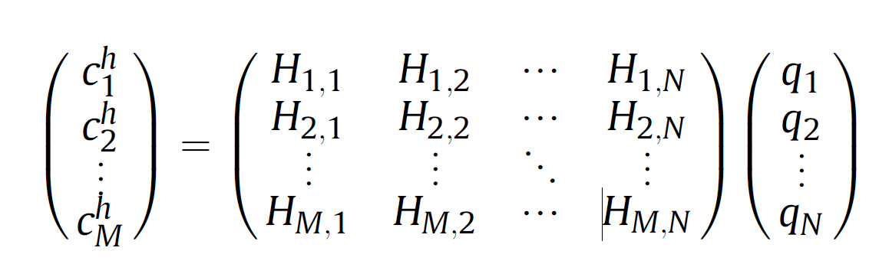
Comparison of forward and backward source-receptor sensitivities for atmospheric inverse modeling using the HYSPLIT model with the Cross-Appalachian Tracer Experiment (CAPTEX) field experiment
Tianfeng Chai^{1,2}, Tianfeng Chai^{1,2} , Mark Cohen¹, and Fong Ngan^{1,2}
1 Air Resources Laboratory, National Oceanic and Atmospheric Administration, College Park, MD, USA
2 Cooperative Institute for Satellite Earth System Studies (CISESS), University of Maryland, College Park, MD, USA
P1.1-650
Source term estimation using HYSPLIT Lagrangian Particle Dispersion Model
With Lagarangian particle dispersion models (LPDMs), source-receptor sensitivities (sometimes also called source to receptor dilution factors, or transfer coefficients ) can be calculated to construct a Transfer Coefficient Matrix (TCM). A HYSPLIT TCM is visualized in the right figure. Inverse modeling can be carried out to estimate emission source terms using the TCMs.
HYSPLIT inverse modeling has been applied to estimate different source terms using various measurements or receptors, such as air concentrations of radionuclides from a global monitoring network, satellite observations of volcanic ash mass loadings and ash cloud top heights, satellite aerosol optical depth observations of wildfire smoke, and measurements taken by aircrafts.
INTRODUCTION
Average source-receptor sensitivities H_{im} at 117 monitoring stations and 99 release segments. See doi.org/10.1016/j.atmosenv.2015.01.070 for details.

Slide 4
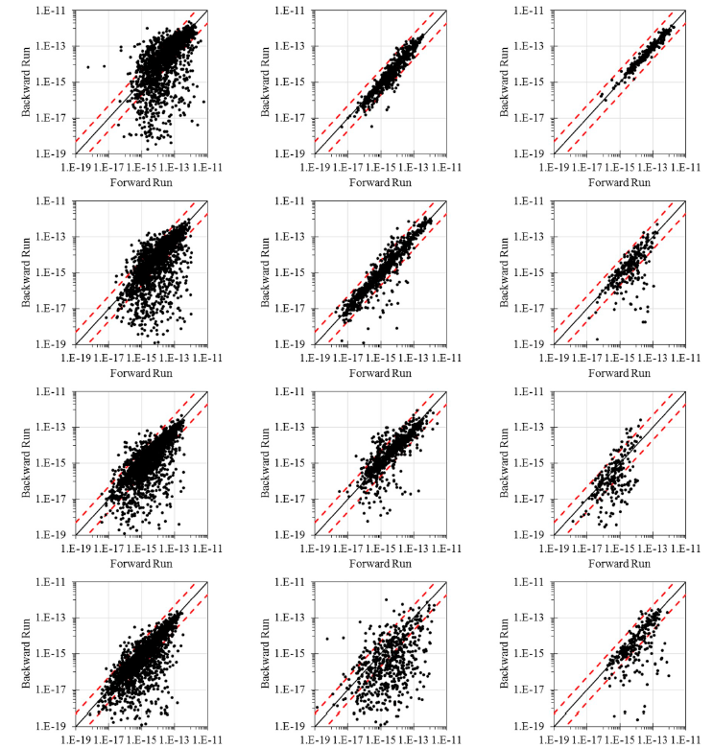
Comparison of forward and backward source-receptor sensitivities for atmospheric inverse modeling using the HYSPLIT model with the Cross-Appalachian Tracer Experiment (CAPTEX) field experiment
Tianfeng Chai^{1,2}, Tianfeng Chai^{1,2} , Mark Cohen¹, and Fong Ngan^{1,2}
1 Air Resources Laboratory, National Oceanic and Atmospheric Administration, College Park, MD, USA
2 Cooperative Institute for Satellite Earth System Studies (CISESS), University of Maryland, College Park, MD, USA
P1.1-650
Forward and backward source-receptor sensitivities
Source-receptor sensitivities can be calculated by running the HYSPLIT simulations in either a forward or a backward mode.
While the forward sensitivities are easy to calculate for known source locations and release time periods, the backward run can be a very efficient tool for some applications where the sources are mostly unknown.
The source-receptor sensitivities calculated using backward and forward modes may not have a good agreement. For instance, the scatter plots here (taken from Eslinger and Schrom, 2019) compare the dilution factors calculated using forward and backward HYSPLIT runs
INTRODUCTION
Copied fom Figure 4 of Eslinger and Schrom (2019) DOI:10.1016/j.jenvrad.2019.03.006

Slide 5
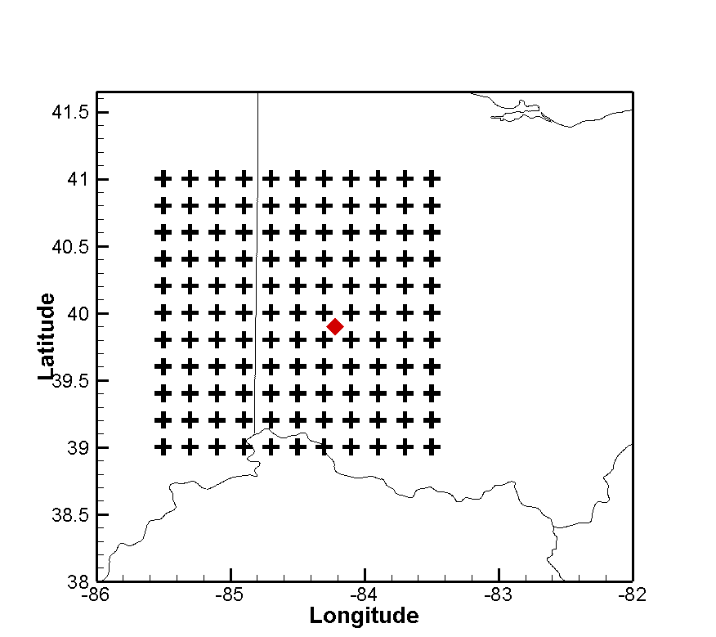
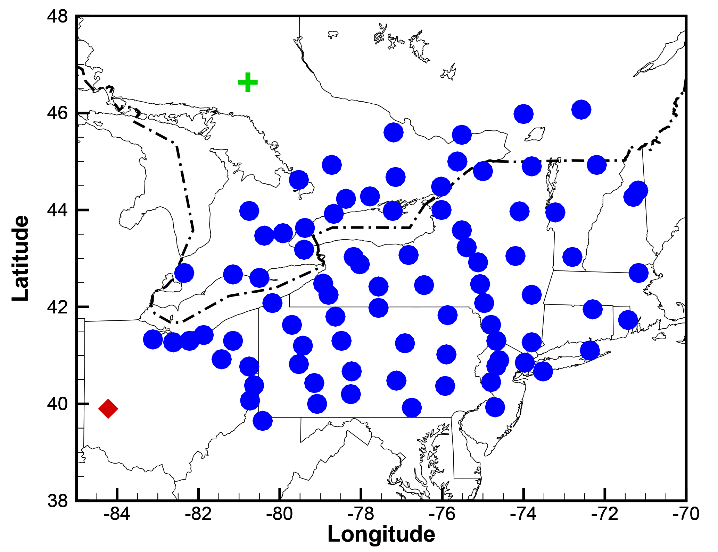
Comparison of forward and backward source-receptor sensitivities for atmospheric inverse modeling using the HYSPLIT model with the Cross-Appalachian Tracer Experiment (CAPTEX) field experiment
Tianfeng Chai^{1,2}, Tianfeng Chai^{1,2} , Mark Cohen¹, and Fong Ngan^{1,2}
1 Air Resources Laboratory, National Oceanic and Atmospheric Administration, College Park, MD, USA
2 Cooperative Institute for Satellite Earth System Studies (CISESS), University of Maryland, College Park, MD, USA
P1.1-650
Setup of Forward and backward sensitivity runs
Sensitivity runs are based on CAPTEX release 2 (3-hour release from Dayton, 17-20Z, Sep 25, 1983).
121 forward HYSPLIT dispersion runs are carried out from different candidate locations (“+” in left figure). The forward sensitivities to 400 measurements from 84 monitoring sites (circles in figure) are calculated.
400 backward runs starts from each measurement site and measurement ending time. The backward sensitivities at each of the 121 candidate locations at the release time are calculated.
Dayton, Ohio, U.S. shown as a red diamond, and Sudbury, Ontario, Canada shown as a green cross
METHODS
121 forward runs
48400 source-receptor sensitivities are calculated from both forward and backward runs.
400 backward runs

Slide 6
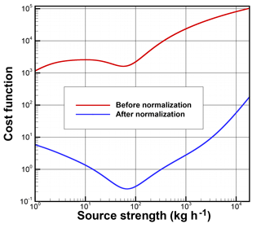
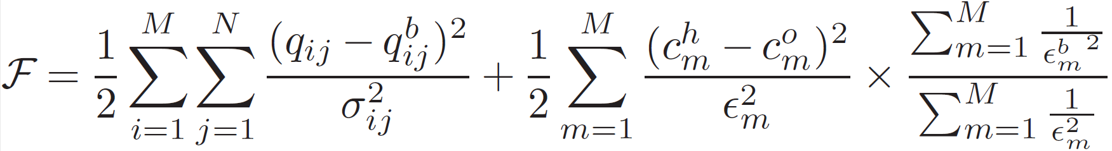
Comparison of forward and backward source-receptor sensitivities for atmospheric inverse modeling using the HYSPLIT model with the Cross-Appalachian Tracer Experiment (CAPTEX) field experiment
Tianfeng Chai^{1,2}, Tianfeng Chai^{1,2} , Mark Cohen¹, and Fong Ngan^{1,2}
1 Air Resources Laboratory, National Oceanic and Atmospheric Administration, College Park, MD, USA
2 Cooperative Institute for Satellite Earth System Studies (CISESS), University of Maryland, College Park, MD, USA
P1.1-650
Source term estimation
The unknown release location, time, and strength can be estimated by minimizing a cost function that calculates the differences between model predictions and observations, as well as the deviations of the final solution from the first guess.
A cost function normalization scheme is also introduced to avoid spurious minimal source term solutions (see figure below) when using logarithm concentration differences.
Finding a single source location as well as its source strength in this application is achieved by searching the location and strength that yield the best match between the predicted and the observed concentrations.
METHODS
Release rate q is generalized to be at multiple locations (ij). Superscript “b” denotes first guess and σ is the corresponding error variance. c^{h} and cº are HYSPLIT-predicted and measured concentrations, respectively. The observational errors ϵ_{m} are assumed to be uncorrelated. See Chai et al. (2018) for details.
Chai, T., Stein, A., and Ngan, F.: Weak-constraint inverse modeling using HYSPLIT-4 Lagrangian dispersion model and Cross-Appalachian Tracer Experiment (CAPTEX) observations – effect of including model uncertainties on source term estimation, Geosci. Model Dev., 11, 5135–5148, https://doi.org/10.5194/gmd-11-5135-2018
Cost function as a function of source strength before and after normalization.

Slide 7
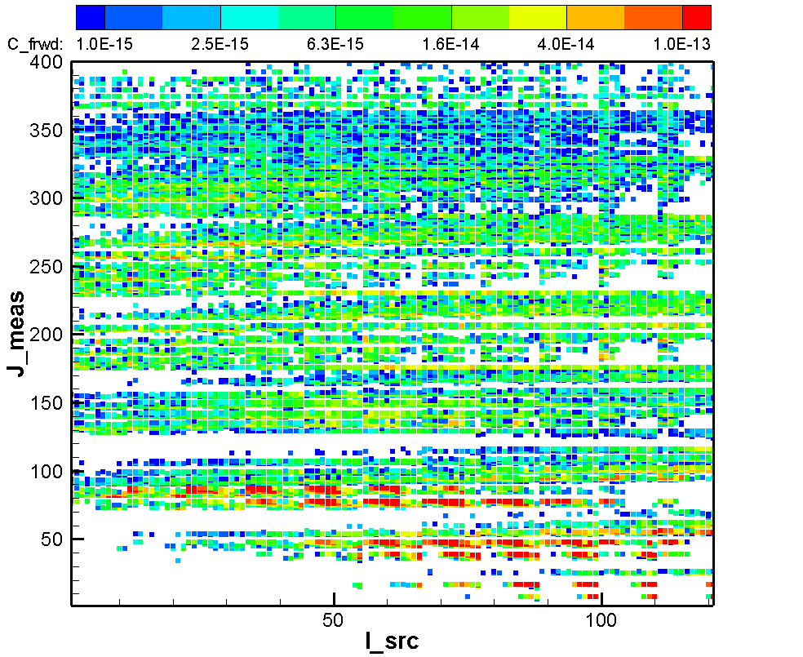
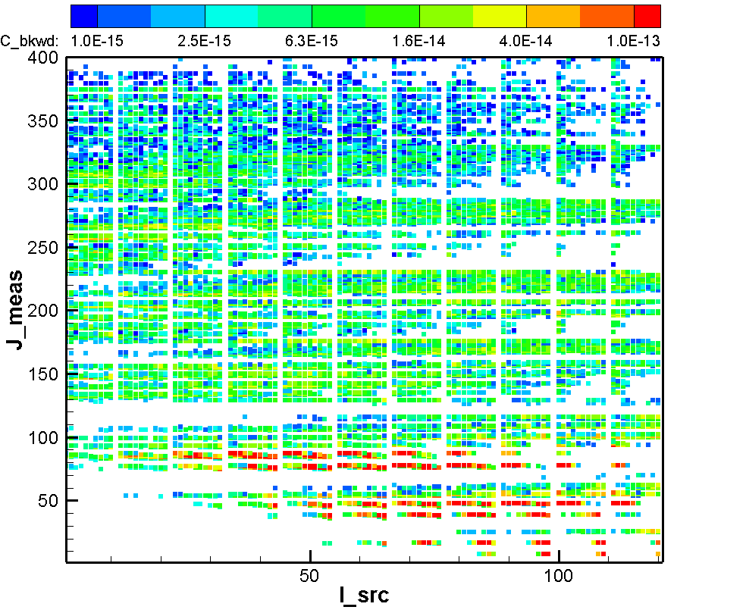
Comparison of forward and backward source-receptor sensitivities for atmospheric inverse modeling using the HYSPLIT model with the Cross-Appalachian Tracer Experiment (CAPTEX) field experiment
Tianfeng Chai^{1,2}, Tianfeng Chai^{1,2} , Mark Cohen¹, and Fong Ngan^{1,2}
1 Air Resources Laboratory, National Oceanic and Atmospheric Administration, College Park, MD, USA
2 Cooperative Institute for Satellite Earth System Studies (CISESS), University of Maryland, College Park, MD, USA
click to edit Poster Title here using “Arial Bold” font size 12 or smaller if the title is too long]
[click to edit Author(s) name(s) with division, email (and/or) Affiliation here using “Arial” font size approx. 9]
P1.1-650
Forward (left) and backward (right) source-receptor sensitivities results
The calculated source-receptor sensitivities between 121 sources (I_src: 1-121) and 400 receptors (J_meas: 1-400) are color-coded by the calculated sensitivity values. 2500 3D particles are used for each individual HYSPLIT run. For comparison, the backward TCM is rotated to be in the same shape as the forward TCM.
RESULTS

Slide 8
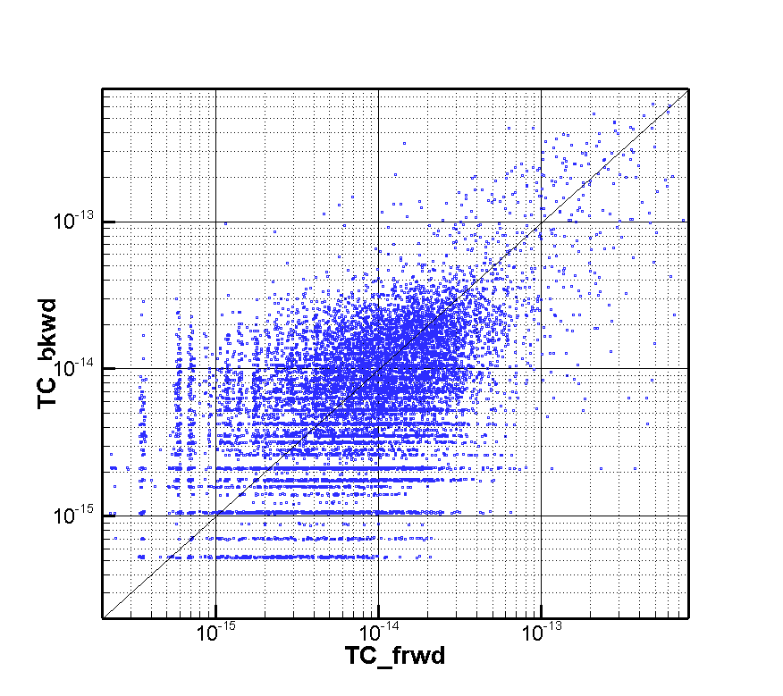
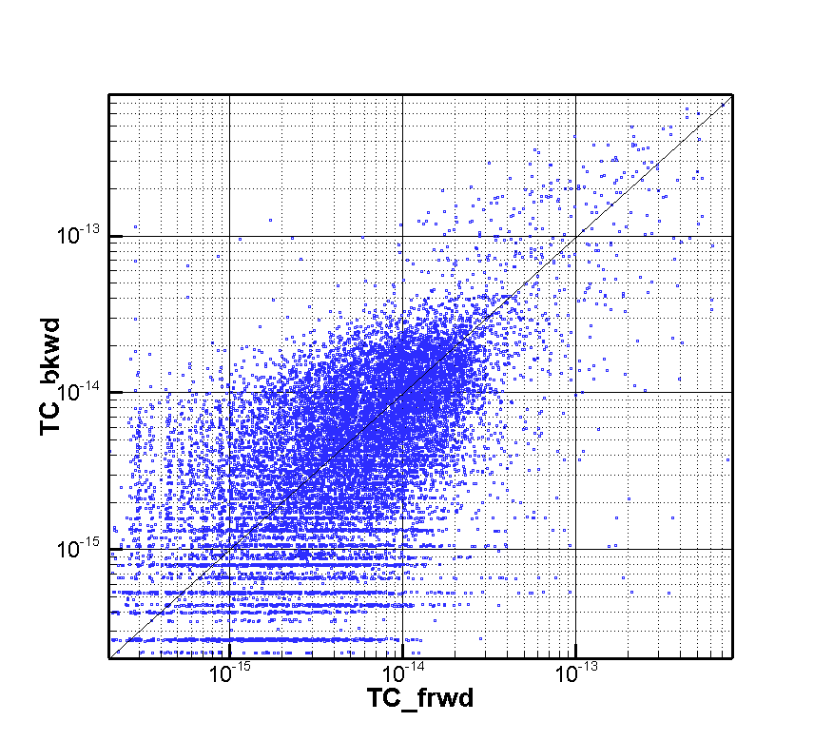
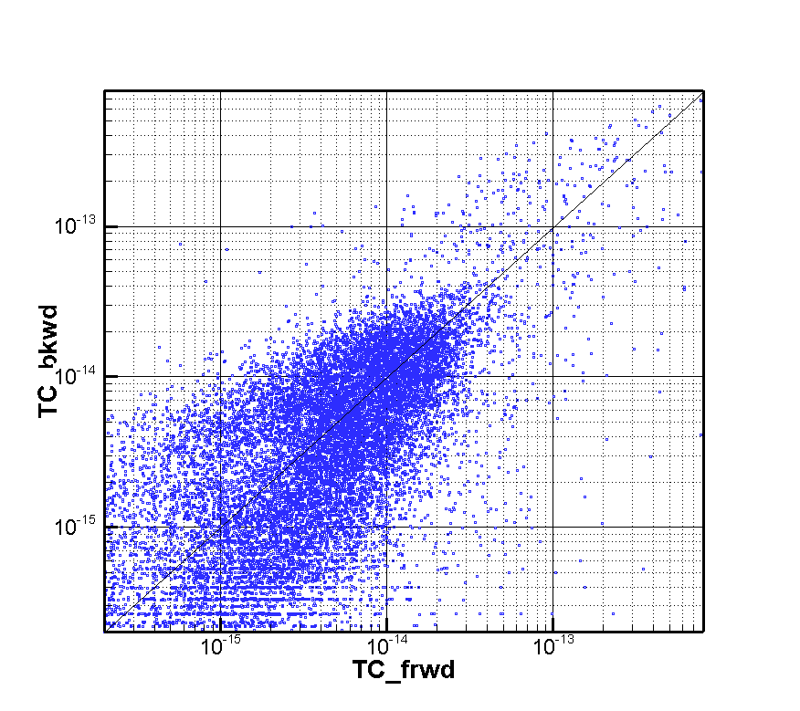
Comparison of forward and backward source-receptor sensitivities for atmospheric inverse modeling using the HYSPLIT model with the Cross-Appalachian Tracer Experiment (CAPTEX) field experiment
Tianfeng Chai^{1,2}, Tianfeng Chai^{1,2} , Mark Cohen¹, and Fong Ngan^{1,2}
1 Air Resources Laboratory, National Oceanic and Atmospheric Administration, College Park, MD, USA
2 Cooperative Institute for Satellite Earth System Studies (CISESS), University of Maryland, College Park, MD, USA
click to edit Poster Title here using “Arial Bold” font size 12 or smaller if the title is too long]
[click to edit Author(s) name(s) with division, email (and/or) Affiliation here using “Arial” font size approx. 9]
P1.1-650
Forward and backward sensitivities with different number of 3D particles (Np)
Np= 2,500, R_{ln}= 0.52
Np= 10,000, R_{ln}= 0.60
Np= 40,000, R_{ln}= 0.68
RESULTS
Increasing number of 3D particles used in the HYSPLIT model improves the agreement between forward and backward source-receptor sensitivities. Np=40,000 will be used in the later tests. Note that Correlation coefficient R_{ln} is calculated after taking logarithm operation of the sensitivities.

Slide 9
Comparison of forward and backward source-receptor sensitivities for atmospheric inverse modeling using the HYSPLIT model with the Cross-Appalachian Tracer Experiment (CAPTEX) field experiment
Tianfeng Chai^{1,2}, Tianfeng Chai^{1,2} , Mark Cohen¹, and Fong Ngan^{1,2}
1 Air Resources Laboratory, National Oceanic and Atmospheric Administration, College Park, MD, USA
2 Cooperative Institute for Satellite Earth System Studies (CISESS), University of Maryland, College Park, MD, USA
click to edit Poster Title here using “Arial Bold” font size 12 or smaller ifthe title is too long]
[click to edit Author(s) name(s) with division, email (and/or) Affiliation here using “Arial” font size approx. 9]
P1.1-650
Investigation of the causes of forward/backward sensitivity disagreement
In both forward and backward runs, particles are released at 10 m AGL (above ground level) and the (receptor) concentration grid is calculated in a 100m AGL layer. The 10m release height is chosen to reflect the actual release and measurement heights which are close to the ground. The 100m receptor layer is defined to allow more particles in each concentration grid cell. Defining 50m release height (as the midpoint of 100m layer) makes the source/receptor heights more consistent in the TCM calculations, but results did not yield better forward/backward sensitivity agreement.
Meteorological fields at the start and the end of each time step may affect the results differently because the time integration is not perfectly symmetric. Forcing the time step to be 1 min did not improve forward/backward sensitivity agreement over the original setting (time step automatically calculated using CFL condition with a factor of 0.75) .
RESULTS

Slide 10
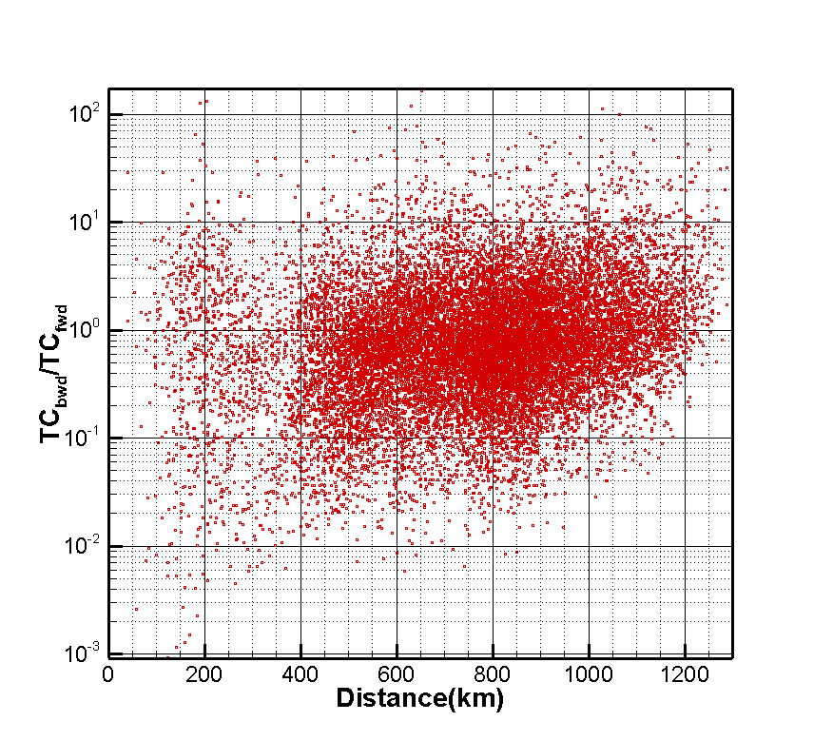
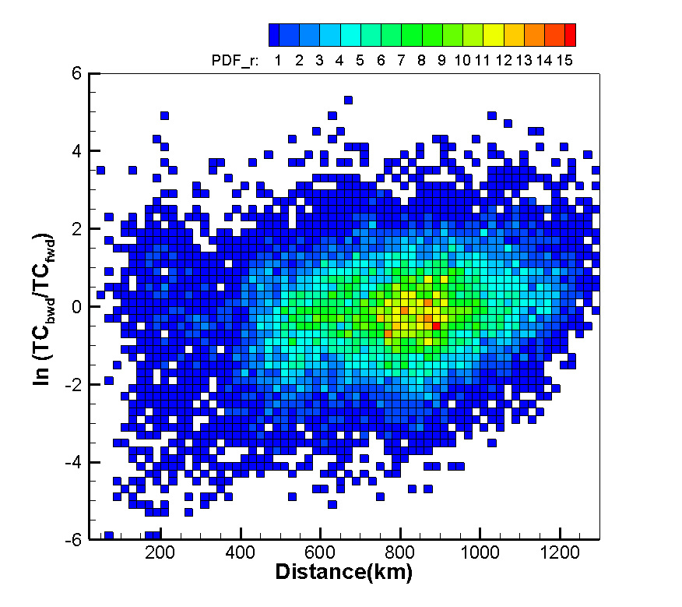
Comparison of forward and backward source-receptor sensitivities for atmospheric inverse modeling using the HYSPLIT model with the Cross-Appalachian Tracer Experiment (CAPTEX) field experiment
Tianfeng Chai^{1,2}, Tianfeng Chai^{1,2} , Mark Cohen¹, and Fong Ngan^{1,2}
1 Air Resources Laboratory, National Oceanic and Atmospheric Administration, College Park, MD, USA
2 Cooperative Institute for Satellite Earth System Studies (CISESS), University of Maryland, College Park, MD, USA
click to edit Poster Title here using “Arial Bold” font size 12 or smaller if the title is too long]
[click to edit Author(s) name(s) with division, email (and/or) Affiliation here using “Arial” font size approx. 9]
P1.1-650
How does the agreement between forward and backward source-receptor changes with the distance between source and receptor?
Scatter plot
Probability Density Function (1/km)
RESULTS
At shorter distances (~<500km), forward sensitivities tends to be larger than the backward ones.
At longer distances (~>1100km) , forward sensitivities are mostly smaller than the backward ones.

Slide 11
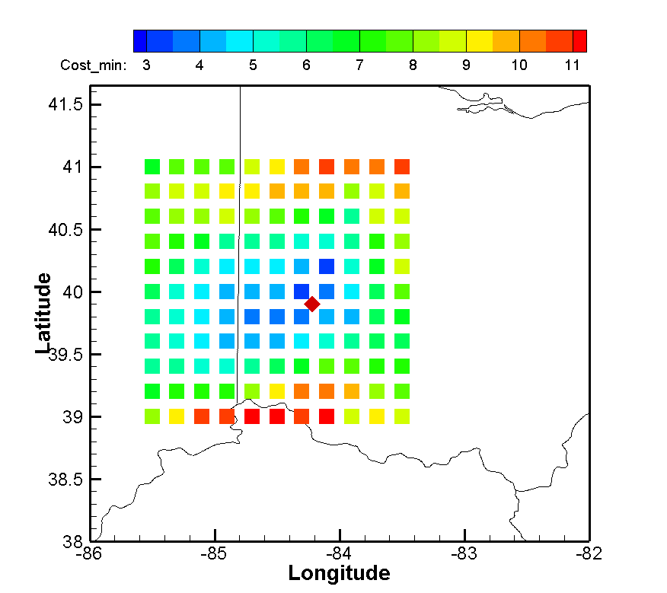
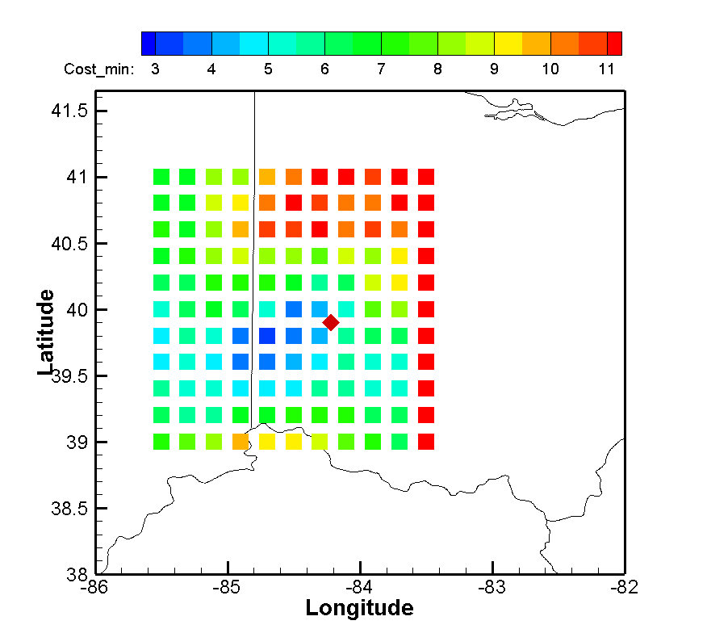
Comparison of forward and backward source-receptor sensitivities for atmospheric inverse modeling using the HYSPLIT model with the Cross-Appalachian Tracer Experiment (CAPTEX) field experiment
Tianfeng Chai^{1,2}, Tianfeng Chai^{1,2} , Mark Cohen¹, and Fong Ngan^{1,2}
1 Air Resources Laboratory, National Oceanic and Atmospheric Administration, College Park, MD, USA
2 Cooperative Institute for Satellite Earth System Studies (CISESS), University of Maryland, College Park, MD, USA
click to edit Poster Title here using “Arial Bold” font size 12 or smaller if the title is too long]
[click to edit Author(s) name(s) with division, email (and/or) Affiliation here using “Arial” font size approx. 9]
P1.1-650
Estimated release site and rate using forward and backward TCMs
Results using Forward TCM
Results using Backward TCM
The minimal cost function at each candidate source location associated with an optimal
release strength is indicated by color. The cost function is calculated with fractional and additive errors assumed as 20% and 20 pg/m3 for both measured and predicted concentrations.
Actual release site:39.90ºN, 84.22ºW, marked as a red diamond); “Δ” is the distance between the estimated and the actual release sites.
Actual release rate: 67 kg/hour.
RESULTS
Estimated release site 40.0ºN, 84.3ºW, Δ= 13.0km
Estimated release rate: 65.3 Kg/hour
Estimated release site 39.8ºN, 84.7ºW, Δ= 42.5km
Estimated release rate: 80.5 Kg/hour

Slide 12
Comparison of forward and backward source-receptor sensitivities for atmospheric inverse modeling using the HYSPLIT model with the Cross-Appalachian Tracer Experiment (CAPTEX) field experiment
Tianfeng Chai^{1,2}, Tianfeng Chai^{1,2} , Mark Cohen¹, and Fong Ngan^{1,2}
1 Air Resources Laboratory, National Oceanic and Atmospheric Administration, College Park, MD, USA
2 Cooperative Institute for Satellite Earth System Studies (CISESS), University of Maryland, College Park, MD, USA
click to edit Poster Title here using “Arial Bold” font size 12 or smaller if the title is too long]
[click to edit Author(s) name(s) with division, email (and/or) Affiliation here using “Arial” font size approx. 9]
P1.1-650
48400 pairs of source-receptor sensitivities calculated from 121 forward and 400 backward HYSPLIT simulations for CAPTEX release 2 are presented.
Forward and backward sensitivities show better agreement when more particles are used in the HYSPLIT simulations.
Forced 1-min integration time step or defining more consistent source/receptor vertical height did not improve the forward/backward sensitivity agreement.
The agreement between forward/backward source-receptor sensitivities appear to be worse when source and receptor are very close or too far away.
Source term estimation using both forward and backward TCMs yield reasonable results of release site and strength estimation. The estimates using the forward TCM is slightly better than those using the backward TCM.
Summary

