Slide 1
Climate Change Mitigation and Nuclear Weapon Testing/Explosion Reduction: Steps Towards Achieving Sustainable Development Goals
Ms.Zile Huma ,Pakistan

Slide 2
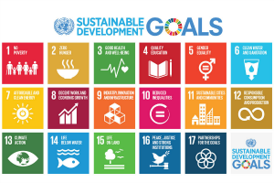
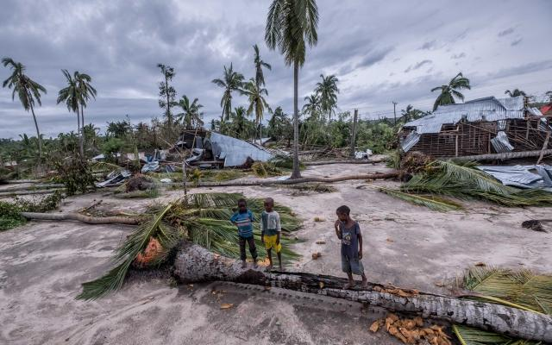
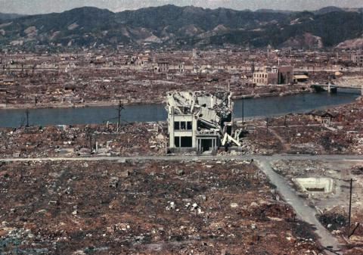
Climate Change mitigation and nuclear weapon Testing/Explosion Reduction: Steps towards Achieving Sustainable Development Goals
Zile huma ,zilehuma_1@Hotmail.com
PT5.2-e
Can we achieve SDGs?
Climate Change Disaster
Source: Oxfam.org
Nuclear Explosion disaster
Source:Atomic heritage foundation
Source:Un.org

Slide 3
Climate Change mitigation and nuclear weapon Testing/Explosion Reduction: Steps towards Achieving Sustainable Development Goals
Zile Huma, zilehuma_1@Hotmail.com]
PT5.2-e
ABSTRACT
Nuclear Testing/Explosion and climate Change are both traditional security and non- traditional security threats.They are directly linked to many Sustainable Development Goals. The achievement of sustainable development goals is not possible without taking concrete steps to mitigate climate change and putting an end to global nuclear explosion/testing.
ABSTRACT

Slide 4
Climate Change mitigation and nuclear weapon Testing/Explosion Reduction: Steps towards Achieving Sustainable Development Goals
Zile Huma, zilehuma_1@Hotmail.com
PT5.2-e
Qualitative Research methodology
Primary sources
      Interviews of Experts
      Speeches
      Research articles
Secondary Sources
Articles
      Books
METHODS

Slide 5
Climate Change mitigation and nuclear weapon Testing/Explosion Reduction: Steps towards Achieving Sustainable Development Goals
Zile Huma, zilehuma_1@Hotmail.com
PT5.2-e
Link of climate change and nuclear explosion with Sustainablae Development Goals
Almost all SDGs have direct link to climate change and nuclear testing
Goal 1(No Poverty) and Goal two (Zero Hunger). Climate Change disasters negatively impacts economy and food security of states which is a hurdle in achieving Goal 1(No Poverty) and Goal two (Zero Hunger).
Similarly millions are spent on nuclear testing and explosions which can be spent on initiatives to eliminate poverty and hunger across the globe.
2. Goal 3( Good Health and Well Being) and Goal 6 ( Clean Water and Sanitation)
Climate Change is also cause of many health issues like respiratory, eye infections and water borne diseases. Many reaons of climate change like carbon emission pollute water bodies.
Similarly Nuclear Testing and explosions relaese radiations which is dangerous for health of all living beings and source of polluting water bodies
CONCLUSIONS

Slide 6
Climate Change mitigation and nuclear weapon Testing/Explosion Reduction: Steps towards Achieving Sustainable Development Goals
Zile Huma, zilehuma_1@Hotmail.com
PT5.2-e
3. Goal 5 (Gender Equality) and Goal 10 (Reduced Equality)
Climate Change has increased the existing inequality gap between rich and poor nations and within the states. Climate Disasters also negatively affects women in different areas like increasing house chores burden, crimes against women during displacement, health problems, domestic violence.
Similarly nuclear weapon testing /explosion increases the chances of crimes against women, and health problems.
Goal 11 (Sustainable Cities and Communities) Goal 12 (Responsible Consumption and Production)
Population explosion, removal of green areas, increasing transport in cities and communities leads to lack of sustainable and quality life and also becomes cause of climate change.
Similarly, nuclear weapon testing and explosion also damages sustainable livings in cities and communties and divert resouces which could be spent healthy and sustainable livings.
CONCLUSIONS

Slide 7
Climate Change mitigation and nuclear weapon Testing/Explosion Reduction: Steps towards Achieving Sustainable Development Goals
Zile Huma, zilehuma_1@Hotmail.com
PT5.2-e
Goal 5 (Quality Education) and Goal 13( Climate Action)
The lack of formal syllabus on climate change and Nuclear testing and explosion at all educational level is cause of lack public awareness on their negative impacts.
Climate change and nuclear test/explosions are also interlinked. The nuclear testing and explosions damages ecosystem-relaeses radiations, carbon emissions, destroys forests which leads to climate change.
Goal 14 (life below Water) Goal 15 (Life on Land)
Climate Change impacts are dangerous for life below water and Life on Land. The increasing temperature of the earth evapoartes water bodies impacting water lives. Simialrly , climate catastrophes threatens not only human being but other species on land in different way.
Simialrly nuclear testing and explosion on land and below water have similar dangers.
Goal 16 ( Peace and Justice strong institution ) and Goal 17 (Partnership to achieve goals)
The dangers of climate change and nuclear explosion/ testing are accelerating due to weak institutions and lack of strong partnership at local, national and internationla level.
CONCLUSIONS

Slide 8
Climate Change mitigation and nuclear weapon Testing/Explosion Reduction: Steps towards Achieving Sustainable Development Goals
Zile Huma, zilehuma_1@Hotmail.com
PT5.2-e
Recommendations
1: Development of concensus for complete nuclear disaramanent across the globe
    Platform of UN
    Regional Organizations
    NGO’s, Civil Society.
2. Awareness campaigns at local, national and international level on climate change and nuclear explosion/testing negative impacts.
          Media Engagement
          Students involvement
3. Educational initiatives
          Topics on climate change and Nucleat programmes in educational syllabus.
          Scholarship in these areas of studies
4. More budget allocations at government level for researches on negative impacts of climate change and nuclear explosion/testing
RESULTS

Slide 9
Climate Change mitigation and nuclear weapon Testing/Explosion Reduction: Steps towards Achieving Sustainable Development Goals
Zile Huma, zilehuma_1@Hotmail.com
PT5.2-e
Recommendations
5: Strenghtening of global institutions to develop concrete policies and implentation mechnisms.
6: Use of public diplomacy
RESULTS

Slide 10
Climate Change mitigation and nuclear weapon Testing/Explosion Reduction: Steps towards Achieving Sustainable Development Goals
Zile Huma, zilehuma_1@Hotmail.com
PT5.2-e
“ Climate Change and nuclear testing/explosions have direct link to several SDGs.In order to achieve SDGs goals, we need to take concrete steps at local ,national and international level for climate change mitigation and putting an end to nuclear explosion”
CONCLUSIONS

