Slide 1

Operation of Kazakhstan National Data Center (KNDC) under COVID-19 pandemic
Igor Komarov , Dmitriy Gordiyenko,
Natalia Mikhailova, Pavel Ryabenko
#202
Kazakhstan National Data Center, Almaty, Kazakhstan

Slide 2
Operation of Kazakhstan National Data Center (KNDC)
under COVID-19 pandemic
Igor Komarov, Dmitriy Gordiyenko, Natalia Mikhailova, Pavel Ryabenko.
]
P4.5-202
In Kazakhstan, during two months of 2020 there was emergency rule for whole country. For Almaty, where KNDC is located, the urban office for coronavirus prohibited completely the operation of all offices including KNDC, movement of people and transport inside the city was limited. During 1-2 days it was necessary to re-arrange the operation of the Center, avoid the suspension of data acquisition and transmission processes, and continue data processing and seismic bulletins compilation. This became possible owing to gradual transfer of KNDC to the technology of virtual operation of servers and work machines started in 2018. By 2020, almost all servers and work machines operated through the Proxmox Virtual Environment with web-interface. This helped to arrange quickly distant operation of analysts, and control data arrival and operation of equipment and software. During two months, only one person had access to the office, not a specialist, responsible for heating and communications. He communicated with KNDC staff through WhatsApp application, received instructions and eliminated problems if it was necessary. During 2 months of the Center operation, with no people, owing to the well-arranged computer-communication infrastructure there were no failures in work, and all obligations were implemented properly and in time.
ABSTRACT

Slide 3
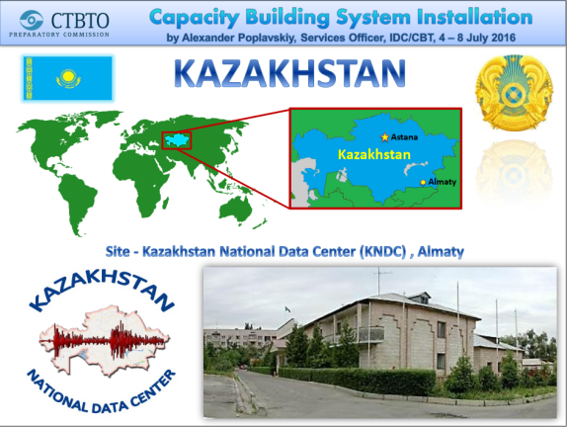
Operation of Kazakhstan National Data Center (KNDC)
under COVID-19 pandemic
Igor Komarov, Dmitriy Gordiyenko, Natalia Mikhailova, Pavel Ryabenko.
P4.5-202
The development and creation of a system owing to which it was managed to transfer quickly the KNDC staff to the online work and ensure the continuous operation of the most information resources of KNDC started in 2016 when the CTBTO, within its support of the National Data Centers, supplied the server equipment consisted of computational server (IBM System x3650MY), data storage system, power supply system and some peripheral equipment. By that time the topical task of KNDC was software and technical upgrade of the whole informational infrastructure operated since 2000.
INTRODUCTION

Slide 4
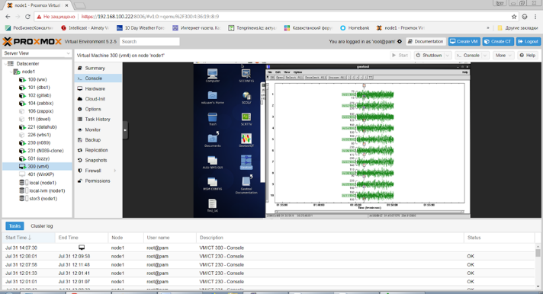
Operation of Kazakhstan National Data Center (KNDC)
under COVID-19 pandemic
Igor Komarov, Dmitriy Gordiyenko, Natalia Mikhailova, Pavel Ryabenko.
P4.5-202
It was necessary to provide and opportunity to apply and use new versions of the software, contemporary methods of storage and data access, and ensure high requirements on information systems safety. Basing on the contemporary tendencies of different virtualization systems application, it was decided to apply the systems and technologies on data virtualization to solve different tasks of seismic monitoring.
INTRODUCTION
The base of the future system became the one built on the base of the opensource software – Proxmox VE, and the first virtual machines were those having the CTBTO software - NDC-in-a-box. The virtual machines images were imported into formats supported by Proxmox virtualization system and run into testing exploitation. The following utilities were launched: cdrecv, cd2wng, cdsend and other ensuring the acquisition, storage and transmission of data.

Slide 5

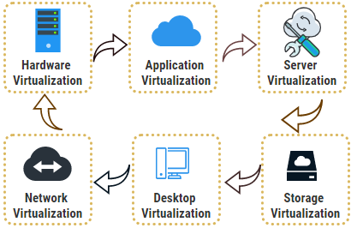
Operation of Kazakhstan National Data Center (KNDC)
under COVID-19 pandemic
Igor Komarov, Dmitriy Gordiyenko, Natalia Mikhailova, Pavel Ryabenko.
P4.5-202
The Proxmox VE virtualization system was chosen due to its wide opportunities on using different types of virtualization. It allows using the virtualization on the level of the operation systems and on the level of containers. Another advantage of the Proxmox virtualization system that allowed providing the online work is the opportunity of the remote control and administration of the system. The Proxmox has a functional web-interface that allows implementing the main functions of the server administration and have an access to virtual resources and servers, databases and other.
METHODS

Slide 6
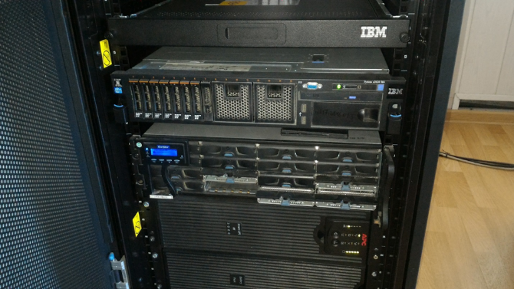
Operation of Kazakhstan National Data Center (KNDC)
under COVID-19 pandemic
Igor Komarov, Dmitriy Gordiyenko, Natalia Mikhailova, Pavel Ryabenko.
P4.5-202
First, the Proxmox virtualization system was built on the equipment provided by the CTBTO, so there was an opportunity to test all abilities of the system and the opportunity to use this system for the Data Center needs was confirmed. Later the system was renewed and upgraded, and launched into operation. It became the base for operation of some resources and software, such as database and web-site servers, mail server of the Data Centre. This transition was implemented by the end of 2019 – beginning of 2020. By that time the system represented a cluster of three Proxmox servers combined by a common distributed CEPH storage. Owing to such operation scheme it was managed to ensure a high level of system fault tolerance. At the time of a new system application and moving of active informational resource to it there was simultaneous development and testing of new software for data acquisition from different types of seismic and infrasound stations (Guralp, Nanometrics, Kinemetrics and other). The created software was installed inside the virtual container that was called datahub. The new software allowed for data acquisition, formatting and storage in the form of files located in the file storage, and data recorded into different databases.
METHODS

Slide 7
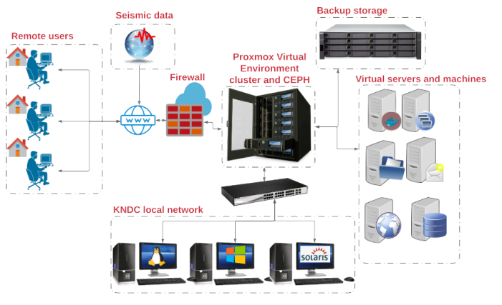
Operation of Kazakhstan National Data Center (KNDC)
under COVID-19 pandemic
Igor Komarov, Dmitriy Gordiyenko, Natalia Mikhailova, Pavel Ryabenko.
P4.5-202
By the lockdown beginning the Data Centre had a new, operable system that allowed the operation of the information systems providing the remote access and system control. For the Data Centre staff who needed to have access to the arriving data and those stored at their local computers, we have created virtual machines with different operation systems Linux and Windows. The access to such machines was provided using Proxmox interface and SPICE protocol (Simple Protocol for Independent Computing Environments), supported by Proxmox. The access to the remote resources was implemented using SSH protocol and its X11-forwarding method that allows users to launch the graphical applications installed in the remote Linux system.
RESULTS

Slide 8
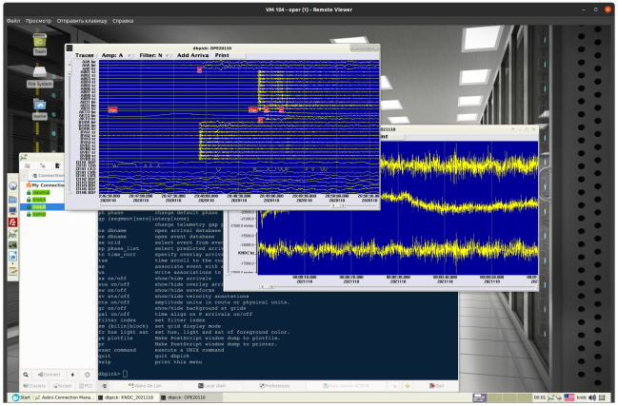
Operation of Kazakhstan National Data Center (KNDC)
under COVID-19 pandemic
Igor Komarov, Dmitriy Gordiyenko, Natalia Mikhailova, Pavel Ryabenko.
P4.5-202
The seismic data were also processed using virtual machines some of which also allowed launching the graphical applications installed at SUN workstations which software is used for seismic records processing and bulletins compilation.
The speed of response of such approach was quite good and this allowed the Data Centre analysts to implement their work in full manner. Owing to the SPICE protocol application there was an opportunity to transmit also a sound from the remote operation system. This was topical as the Data Centre uses sound alert for some processes.
RESULTS

Slide 9
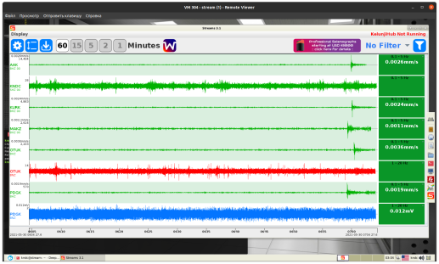
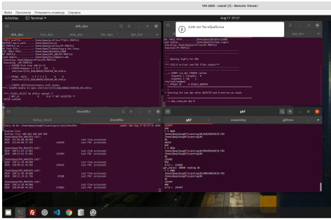
Operation of Kazakhstan National Data Center (KNDC)
under COVID-19 pandemic
Igor Komarov, Dmitriy Gordiyenko, Natalia Mikhailova, Pavel Ryabenko.
P4.5-202
RESULTS
To provide safety of the remote access session, we have set firewall having necessary routing rules.
For seismic data visualization arriving in miniseed format we have created another virtual machine with installed Ringserver and Streams software.
For the automated processing of seismic data arriving to the Data Centre in real time we use the software provided by the Norwegian Centre NORSAR. It was also moved to Linux virtual machine and we had an opportunity to control all processes of processing in real time. Figure 4 shows a window of Linux (Ubuntu) virtual machine with launched software for the automated processing — DP/EP and GBF.

Slide 10
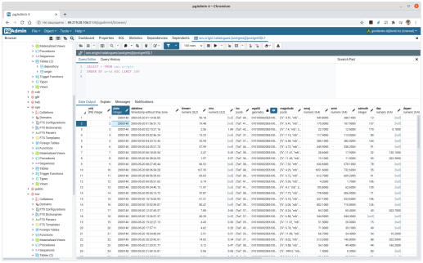
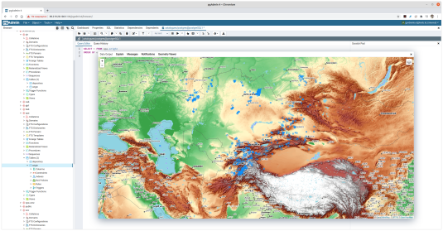
Operation of Kazakhstan National Data Center (KNDC)
under COVID-19 pandemic
Igor Komarov, Dmitriy Gordiyenko, Natalia Mikhailova, Pavel Ryabenko.
P4.5-202
RESULTS
A lot of data arriving and processing at the Data Centre are stored at the databases. The main of them are databases of the coming information, databases of statistic information and databases of seismic data processing results of different level of urgency. The database filling is automated, but for the further work and analysis of such data it was necessary to have the access to them. For this purpose, we have installed and set a client web-application to have access to the databases PostgreSQL — pgAdmin4, having embedded GIS, and this allowed implementing all necessary work remotely.

Slide 11
Operation of Kazakhstan National Data Center (KNDC)
under COVID-19 pandemic
Igor Komarov, Dmitriy Gordiyenko, Natalia Mikhailova, Pavel Ryabenko.
P4.5-202
Conclusion
Kazakhstan Data Centre has managed to support the operation of Data Centre systems during the period of full lockdown in Almaty, arrange the remote operation of staff including the service of urgent messages and compilation of operational bulletins.
We have provided an opportunity to control the operation of the whole network for acquisition, transmission and processing of different data. The support of different servers operation – mail, web-server, antivirus server and other was provided.
We have gained large experience in visualization software and support of its reliable operation even if some system components fails. If the pandemic continues we will be able to continue implementing the functions of the National Data Centre within our obligations under the CTBT.
CONCLUSIONS

