Slide 1

EXPERIENCES FROM THE CTBTO ONLINE CAPACITY BUILDING
ACTIVITIES DURING COVID-19 LOCKDOWN
Uchenna Onwuhaka Madu¹ & Awwal Bisallah¹
¹Nigeria Atomic Energy Commission, Abuja, Nigeria
uchechi231@gmail.com
P4.5-537

Slide 2
EXPERIENCES FROM THE CTBTO ONLINE CAPACITY BUILDING ACTIVITIES DURING COVID-19 LOCKDOWN
Uchenna Onwuhaka Madu¹ & Awwal Bisallah¹
¹Nigeria Atomic Energy Commission, Abuja, Nigeria
uchechi231@gmail.com
P4.5-537
The CTBT mandated the PTS to equip State Parties with the prerequisite capacity to monitor compliance to the Treaty. The advent of Covid-19 and its associated lockdown disrupted the capacity building activities of the PTS. To minimize the perceived disruption of training activities, the capacity building team of the CTBTO adopted an online training method. Two online NDC Waveform Training Courses on using SeisComP3 were conducted by the capacity building team on 2-6 November and 23-27 November via the WebEx platform. The two courses had about 27 participants. A SWOT test of the two online training courses was done using a structure questionnaire that was administered randomly to selected participants. An analysis of the results from the study identified timeliness, excellent knowledge and topic delivery as some of the identified strengths while internet interruptions, lack of physical presence and time zone differences were perceived weakness of the online training courses. The experiences gained by the State Parties that participated in the online training further strengthened the deployment of the CTBT verification technologies for civil and scientific purposes. Further funding of the capacity building activities will enhance the ability of State Parties in the monitoring compliance with the Treaty.
ABSTRACT

Slide 3
EXPERIENCES FROM THE CTBTO ONLINE CAPACITY BUILDING ACTIVITIES DURING COVID-19 LOCKDOWN
Uchenna Onwuhaka Madu¹ & Awwal Bisallah¹
¹Nigeria Atomic Energy Commission, Abuja, Nigeria
uchechi231@gmail.com
P4.5-537
The World Health Organization (WHO) on March 11, 2020 declared Covid 19 a pandemic as a result of the deaths recorded by more than 188 counties from the disease. The resultant effect of the WHO declaration was a total lockdown by different countries to curtail the spread of the disease. In the face of a crippling pandemic, technology has emerged as a major lifesaver. Face to face teaching method was replaced by online method. Online teaching especially during lock down period had both pros and cons. This study was conducted to deduce the perception of trainees about strengths, weaknesses, opportunities and threats of online training courses conducted by the CTBTO during the lockdown.
INTRODUCTION

Slide 4
EXPERIENCES FROM THE CTBTO ONLINE CAPACITY BUILDING ACTIVITIES DURING COVID-19 LOCKDOWN
Uchenna Onwuhaka Madu¹ & Awwal Bisallah¹
¹Nigeria Atomic Energy Commission, Abuja, Nigeria
uchechi231@gmail.com
P4.5-537
A survey using structured questionnaire was conducted to understand the perception of trainees about the strengths, weaknesses, opportunities and threats with respect to online training conducted by the CTBTO during the Covid 19 lockdown. The questionnaire was randomly distributed to the participants. The responses were sought on three-point – agree, undecided and disagree. It was sent to 20 trainees using emails and all the trainees responded back. The data was analysed using statistical tool of percentage
METHODS

Slide 5
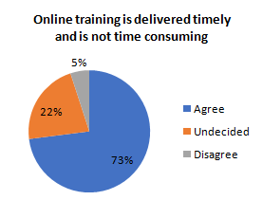
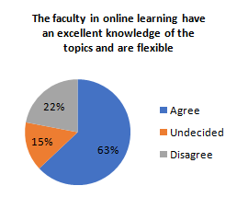
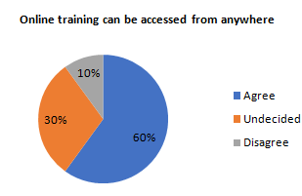
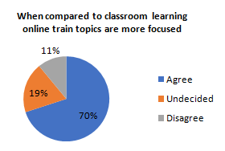
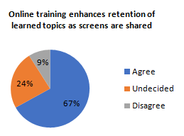
EXPERIENCES FROM THE CTBTO ONLINE CAPACITY BUILDING ACTIVITIES DURING COVID-19 LOCKDOWN
Uchenna Onwuhaka Madu¹ & Awwal Bisallah¹
¹Nigeria Atomic Energy Commission, Abuja, Nigeria
uchechi231@gmail.com
P4.5-537
Strength
Online training with its perceived strength cannot substitute classroom learning
RESULTS
A blend of online training with face to face teaching will make for a more meaningful and practical learning

Slide 6
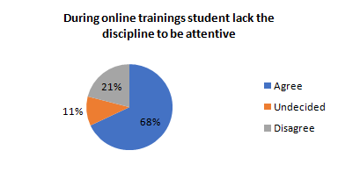
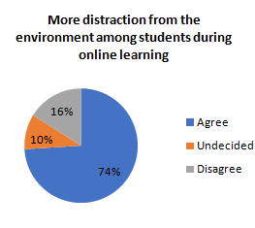
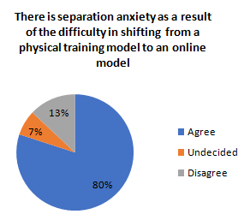
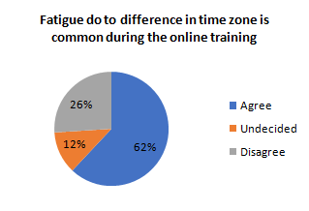
EXPERIENCES FROM THE CTBTO ONLINE CAPACITY BUILDING ACTIVITIES DURING COVID-19 LOCKDOWN
Uchenna Onwuhaka Madu¹ & Awwal Bisallah¹
¹Nigeria Atomic Energy Commission, Abuja, Nigeria
uchechi231@gmail.com
P4.5-537
Weakness
RESULTS
The trainees were not were prepared for the change in training model forced on them by the lockdown as they struggled to remain focused during the training

Slide 7
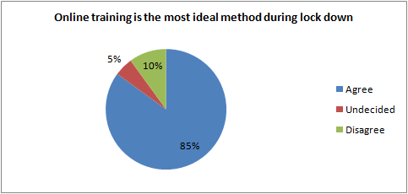
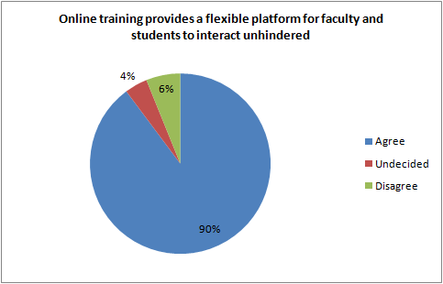
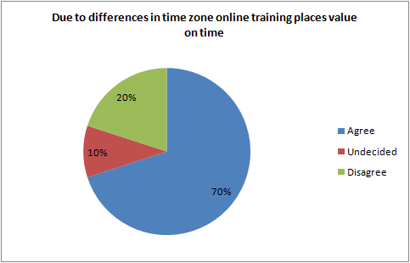
EXPERIENCES FROM THE CTBTO ONLINE CAPACITY BUILDING ACTIVITIES DURING COVID-19 LOCKDOWN
Uchenna Onwuhaka Madu¹ & Awwal Bisallah¹
¹Nigeria Atomic Energy Commission, Abuja, Nigeria
uchechi231@gmail.com
P4.5-537
Opportunities
RESULTS

Slide 8
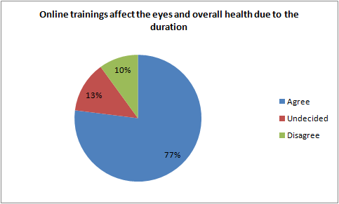
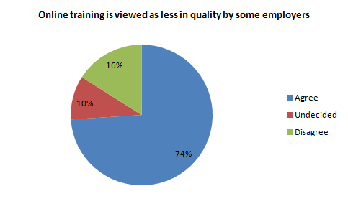
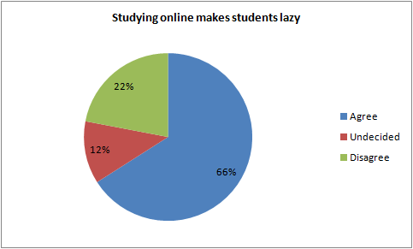
EXPERIENCES FROM THE CTBTO ONLINE CAPACITY BUILDING ACTIVITIES DURING COVID-19 LOCKDOWN
Uchenna Onwuhaka Madu¹ & Awwal Bisallah¹
¹Nigeria Atomic Energy Commission, Abuja, Nigeria
uchechi231@gmail.com
P4.5-537
Threats
RESULTS

Slide 9
EXPERIENCES FROM THE CTBTO ONLINE CAPACITY BUILDING ACTIVITIES DURING COVID-19 LOCKDOWN
Uchenna Onwuhaka Madu¹ & Awwal Bisallah¹
¹Nigeria Atomic Energy Commission, Abuja, Nigeria
uchechi231@gmail.com
P4.5-537
One of the major benefits of the Covid 19 lockdown is the introduction of online training method by the CTBTO. Online training method with the advent of Covid 19 has come to stay. It will continue to be a part of routine teaching and learning method to be adopted by the organisations to impart knowledge, if the perceived weaknesses and threats are dealt with. Constant appraisal of methods deployed by organizations in achieving set goals is necessary. Use of SWOT analysis in appraising the conduct of online trainings by the CTBTO thus, encourages the organizations of ideas that will lead to improved service delivery.
CONCLUSIONS

