Slide 1
Scheduled Calibration of IMS Seismic and T-phase Stations:
challenges and solutions within the COVID-19 pandemic scenario
Campus P.⁽¹⁾, Otsuka R.⁽¹⁾, Assef Parithusta R.⁽¹⁾, Guenther M.⁽¹⁾, Malephane H.⁽¹⁾, Malakhova M.⁽¹⁾,
Sid Ahmed Y.⁽¹⁾, Moumouni Kountche M. ⁽¹⁾, Bazarragchaa S.⁽¹⁾, Han D.⁽¹⁾, Marty J.⁽¹⁾
⁽¹⁾ CTBTO Preparatory Commission
P4.5-609

Slide 2
Scheduled Calibration of IMS Seismic and T-phase Stations: challenges and solutions within the COVID-19 pandemic scenario
Campus P.*, Otsuka R., Assef Parithusta R., Guenther M., Malephane H., Malakhova M., Sid Ahmed Y.,
Moumouni Kountche M., Bazarragchaa S., Han D., Marty J.
* Paola.Campus@ctbto.org
P4.5-609
One of the biggest challenges in operating and maintaining the CTBT International Monitoring System (IMS) Network is to assure compliance with specific requirements, as defined in the Operational Manuals.
Station Operators (SOs) ensure that Stations under their responsibility are meeting requirements on Data Availability, Data Surety and Data Quality
Data Quality requirements include the performance of
regular (or Scheduled) Station calibration activities
Standardized Calibration processes have been developed for Primary Seismic (PS) Auxiliary Seismic (AS) and Hydroacoustic T-phase (HAT-ph) Stations since 2011.
This poster focuses on the challenges encountered in performing 2020 Scheduled Calibration Activities for PS, AS and HAT-ph Stations, merged in the unprecedented scenario of the COVID-19 pandemic, on the achievements and on the learned lessons.
ABSTRACT

Slide 3
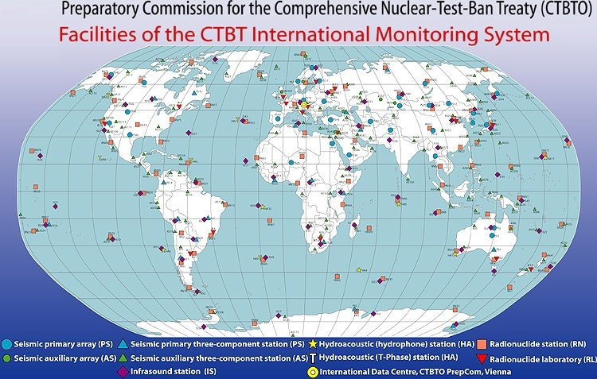
Scheduled Calibration of IMS Seismic and T-phase Stations: challenges and solutions within the COVID-19 pandemic scenario
Campus P.*, Otsuka R., Assef Parithusta R., Guenther M., Malephane H., Malakhova M., Sid Ahmed Y.,
Moumouni Kountche M., Bazarragchaa S., Han D., Marty J.
* Paola.Campus@ctbto.org
P4.5-609
In this context Station Operators faced the new challenge of operating Stations during lockdown or in periods of severe travel limitations, which deeply impacted maintenance activities.
The COVID-19 pandemic has deeply impacted populations around the World with dramatic consequences.
COVID-19: the new scenario
INTRODUCTION
Several IMS Stations experienced long-term outages due to the lack of travel opportunities to troubleshoot and fix existing issues on-site.

Slide 4
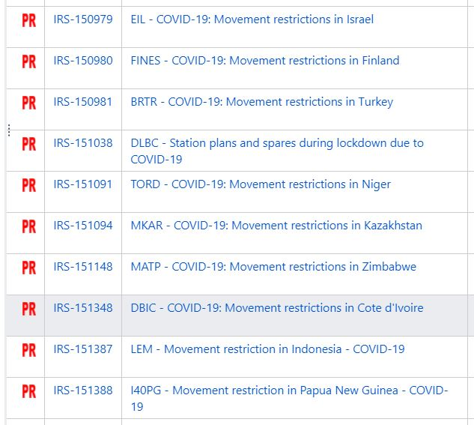
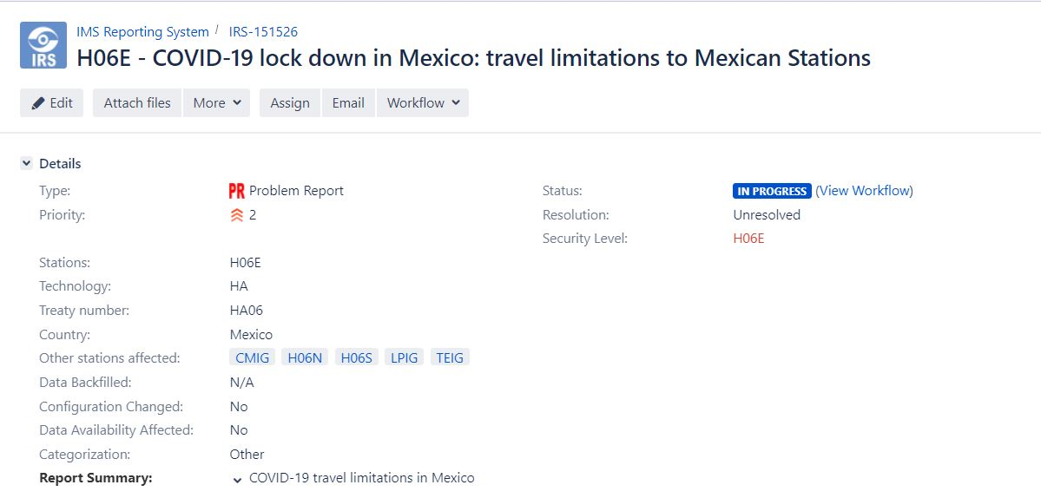



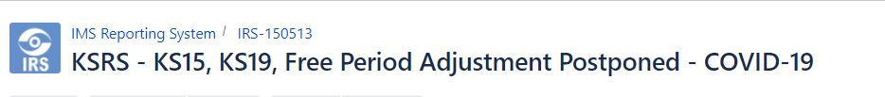
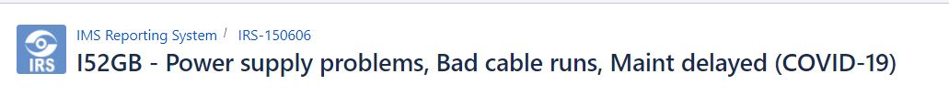
Scheduled Calibration of IMS Seismic and T-phase Stations: challenges and solutions within the COVID-19 pandemic scenario
Campus P.*, Otsuka R., Assef Parithusta R., Guenther M., Malephane H., Malakhova M., Sid Ahmed Y.,
Moumouni Kountche M., Bazarragchaa S., Han D., Marty J.
* Paola.Campus@ctbto.org
P4.5-609
Multiple issues affected the IMS Network during the COVID-19 pandemic
INTRODUCTION
Scheduled Calibration 2020 activities took place in this context

Slide 5
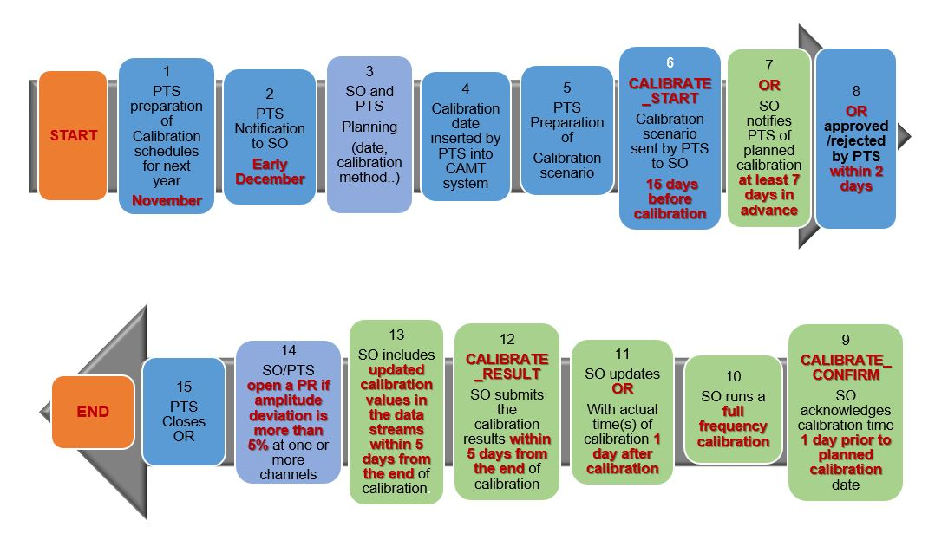
Scheduled Calibration of IMS Seismic and T-phase Stations: challenges and solutions within the COVID-19 pandemic scenario
Campus P.*, Otsuka R., Assef Parithusta R., Guenther M., Malephane H., Malakhova M., Sid Ahmed Y.,
Moumouni Kountche M., Bazarragchaa S., Han D., Marty J.
* Paola.Campus@ctbto.org
P4.5-609
The Scheduled Calibration process for Seismic and Hydroacoustic T-phase Stations
METHODS

Slide 6
Scheduled Calibration of IMS Seismic and T-phase Stations: challenges and solutions within the COVID-19 pandemic scenario
Campus P.*, Otsuka R., Assef Parithusta R., Guenther M., Malephane H., Malakhova M., Sid Ahmed Y.,
Moumouni Kountche M., Bazarragchaa S., Han D., Marty J.
* Paola.Campus@ctbto.org
P4.5-609
The Official Notification of Calibration Activities
at IMS Seismic and Hydroacoustic T-phase Stations in year YYYY
is sent to the relevant SOs
in early December of year YYYY-1 and proposes a Calibration Schedule with two potential calibration times during year YYYY: Main (first semester) and Backup (second semester) Time Window
    The SO provides the PTS with the following information:
    Selected calibration date (Main or Backup Time Window)
    Calibration performed through visit or remote access
    Ability to calibrate all sites/sensors
    Type of calibration hardware/software installed at the Station
    Calibration method and calibration signal characteristics (calibration scenario)
    E-mail address to be used for the planned calibration activities
    Indication of need for PTS technical assistance
METHODS

Slide 7
Scheduled Calibration of IMS Seismic and T-phase Stations: challenges and solutions within the COVID-19 pandemic scenario
Campus P.*, Otsuka R., Assef Parithusta R., Guenther M., Malephane H., Malakhova M., Sid Ahmed Y.,
Moumouni Kountche M., Bazarragchaa S., Han D., Marty J.
* Paola.Campus@ctbto.org
P4.5-609
Scheduled Calibration 2020 was significantly affected in the first semester by the effects deriving from the COVID-19 pandemic, such as:
Technical issues at Stations, which couldn’t be fixed due to travel limitations and/or technical limitation related to teleworking.
Strong delays in shipment of equipment, necessary to replace faulty Station components.
METHODS
In this complex scenario, the strategy adopted by PTS consisted in assuring:
Synergy with SOs to assess issues and provide support
Adaptation to rapidly evolving scenarios
Flexibility in modifying the original calibration time slots to maximize number of Scheduled Calibrations in 2020

Slide 8
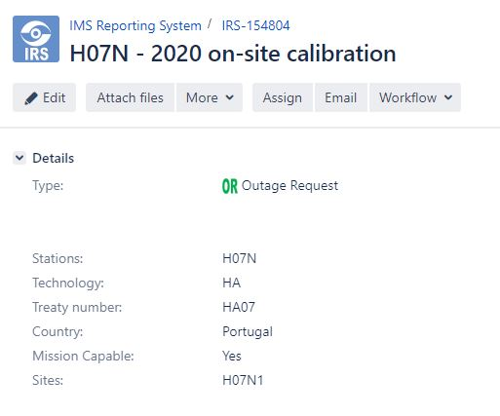
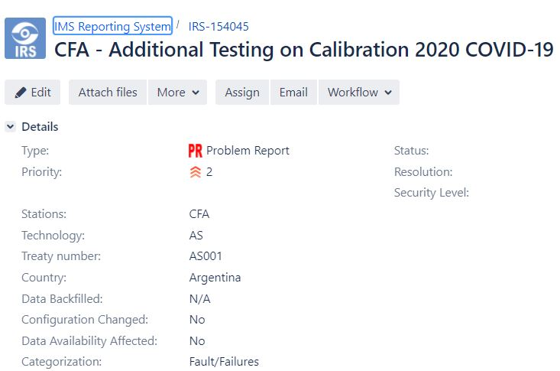
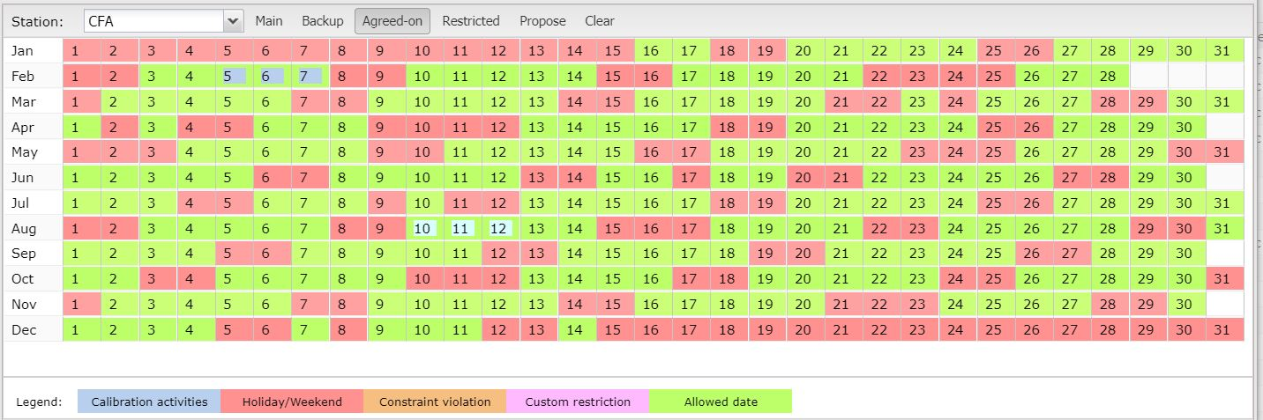
Scheduled Calibration of IMS Seismic and T-phase Stations: challenges and solutions within the COVID-19 pandemic scenario
Campus P.*, Otsuka R., Assef Parithusta R., Guenther M., Malephane H., Malakhova M., Sid Ahmed Y.,
Moumouni Kountche M., Bazarragchaa S., Han D., Marty J.
* Paola.Campus@ctbto.org
P4.5-609
Synergy with SOs:
Scheduled Calibration delegated to PTS in case of
lack of SO training or of existing technical difficulties
Adaptation to rapidly evolving scenarios:
Readiness to timely address
unexpected calibration issues
METHODS
Flexibility in modifying the original calibration time slots to maximize number of Scheduled Calibrations in 2020

Slide 9
Scheduled Calibration of IMS Seismic and T-phase Stations: challenges and solutions within the COVID-19 pandemic scenario
Campus P.*, Otsuka R., Assef Parithusta R., Guenther M., Malephane H., Malakhova M., Sid Ahmed Y.,
Moumouni Kountche M., Bazarragchaa S., Han D., Marty J.
* Paola.Campus@ctbto.org
P4.5-609
COVID-19 scenario
Synergy
Flexibility
Adaptation
Scheduled Calibration 2020
RESULTS
Increased number of Scheduled Calibrations in comparison with previous years
Increased number of Scheduled Calibrations in second semester 2020

Slide 10
Scheduled Calibration of IMS Seismic and T-phase Stations: challenges and solutions within the COVID-19 pandemic scenario
Campus P.*, Otsuka R., Assef Parithusta R., Guenther M., Malephane H., Malakhova M., Sid Ahmed Y.,
Moumouni Kountche M., Bazarragchaa S., Han D., Marty J.
* Paola.Campus@ctbto.org
P4.5-609
Lessons learned
Since it is impossible to predict the unpredictable, efforts should be made from both Station Operators and PTS to concentrate the performance of Scheduled Calibrations in the first semester of each calendar year, whenever possible.
This will allow sufficient time to address problematic cases and plan appropriate actions for the next Scheduled Calibration calendar;
Apply the Synergy-Adaptation-Flexibility approach to facilitate progress in the performance of Scheduled Calibrations activities for PS, AS and HAT-ph Stations;
Transform challenging situations in areas of opportunity;
Reinforce the Station Operators-PTS cooperation also through the use of the SSI Calibration Module (SCM, Poster P4.1-159);
Develop strategies to mitigate the negative effects of unpredictable events, like the COVID-19 pandemic.
CONCLUSIONS

Slide 11
Scheduled Calibration of IMS Seismic and T-phase Stations: challenges and solutions within the COVID-19 pandemic scenario
Campus P.*, Otsuka R., Assef Parithusta R., Guenther M., Malephane H., Malakhova M., Sid Ahmed Y.,
Moumouni Kountche M., Bazarragchaa S., Han D., Marty J.
* Paola.Campus@ctbto.org
P4.5-609
Thank you

