Slide 1


Changes in seismic levels in Thailand COVID-19 Epidemic Period:
Case Study of BKSI Earthquake Monitoring Station.
[CHARTCHAI KAMANAMOON]
[THAILAND]
Earthquake Observations Division
Thai Meteorological Department

Slide 2
Changes in seismic levels in Thailand COVID-19 Epidemic Period:
Case Study of BKSI Earthquake Monitoring Station.
Chartchai Kamanamoon Earthquake Observations Division Thai Meteorological Department, email nuengseismtmd@gmail.com
P4.5-204
The COVID-19 outbreak began to emerge in late 2019 at the Wuhan mine in China, with a dramatic increase in the number of people diagnosed with the novel coronavirus. This was until March 2020, when a few other countries started to report massive cases. In a world where people interact with each other at work and elsewhere, this resulted in a marked increase in the number of cases due to human-to-human transmission of this virus. Reducing the transmission of the virus is done by maintaining social distance.
As the number of people infected with the virus increased, the Thai government had to declare an emergency situation, causing department stores, schools, et cetera to close. Buses and even planes were disrupted to reduce mass gatherings. Except for pharmacies and other basic needs, workshops and heavy equipment usage were also reduced. There was more working from home. The effect of this lockdown has greatly reduced human-induced ground vibration. After the Thai government announced the removal of the lockdown, the ground shake from June 2020 returned to normal. The man-made seismic signals are clear in approximately 0.1 second intervals and can be observed from characteristics of the seismic signal surrounding the seismic monitoring station with PSDPDF.
ABSTRACT

Slide 3
Changes in seismic levels in Thailand COVID-19 Epidemic Period:
Case Study of BKSI Earthquake Monitoring Station.
Chartchai Kamanamoon Earthquake Observations Division Thai Meteorological Department, email nuengseismtmd@gmail.com
P4.5-204
The COVID-19 outbreak began to emerge in late 2019. At China's Wuhan mine, the number of confirmed cases of the novel coronavirus has increased dramatically. The rest of the world is unaware of that. This until March 2020. when a few other countries reported a large number of cases In a world where people interact with others at work and elsewhere This has led to a marked increase in the number of cases due to human-to-human transmission of this virus. Reducing the spread of the virus is keeping social distance. When the number of people infected with the virus increases.
There is more work at home. The effect of this lockdown is that the ground vibrations caused by humans are greatly reduced. And after the Thai government announced the cancellation of this lockdown, the ground vibrations since June 2020 increased back to normal. A man-made seismic signal is apparent in approximately 0.1 seconds.
INTRODUCTION

Slide 4
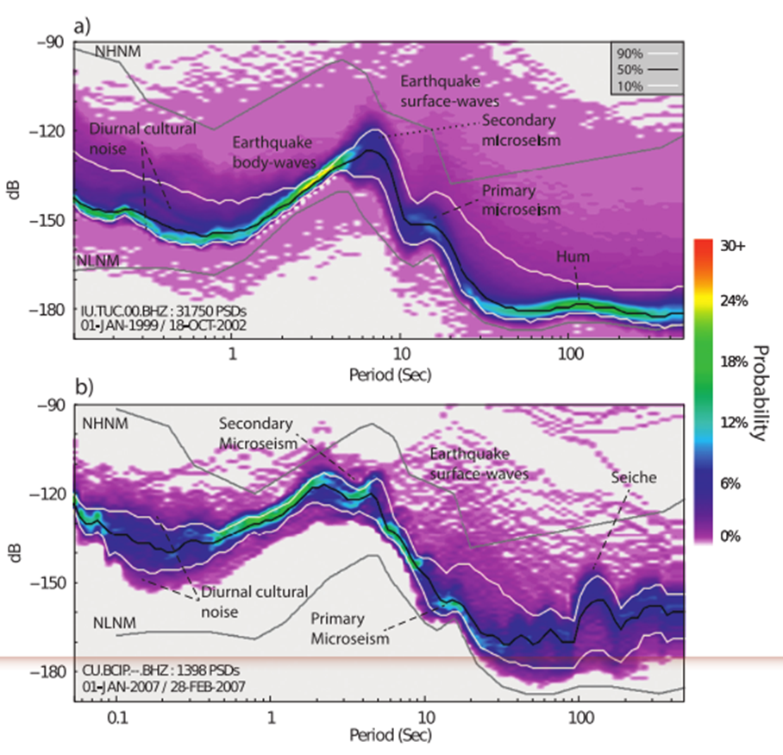
Changes in seismic levels in Thailand COVID-19 Epidemic Period:
Case Study of BKSI Earthquake Monitoring Station.
Chartchai Kamanamoon Earthquake Observations Division Thai Meteorological Department, email nuengseismtmd@gmail.com
P4.5-204
The PSDPDF method will be able to describe incoming noise signals from different sources. Most will come from Machines, water waves, and atmospheric changes
Ambient Seismic Noise can be divided into three phases:
Short periods (0.1–1 s) are caused by man-made activities such as cultivation, radiation emissions from generators, communications, traffic of cars, trains and machinery. Within the area around the measurement station, only a few kilometers away.
Intermediate periods (1–30 s) are caused by the vibration of the Earth as a natural phenomenon. Microseisms can be categorized as seismic magnitudes based on the nature of the tremors that are greater than the portions of the oscillating spectrum.
Long-period (30–500 seconds) These signals are normally generated from strong winds in the ocean and from the force of rainstorms, waves wash against the shore, commonly referred to as the hum.
METHODS
McNamara, D.E. & Buland, R.P., 2018. Visualization of the Ambient Seismic Noise
Spectrum.Pages – of: Nakata, N., Gualtieri, L., and Fichtner, A. (eds.), Seismic Ambient
Noise.Cambridge University Press, Cambridge, UK.

Slide 5
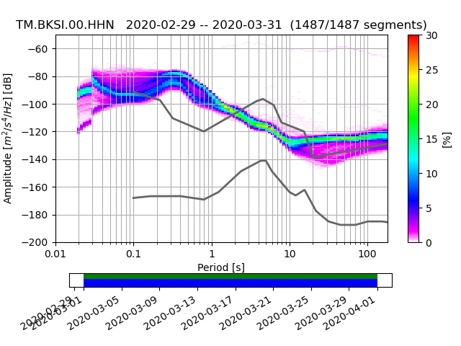
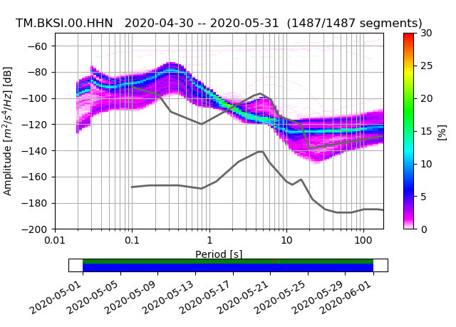
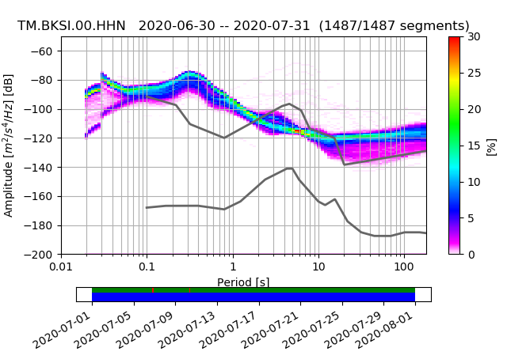
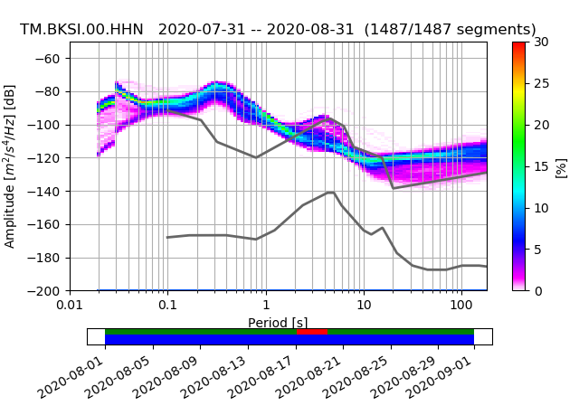
Changes in seismic levels in Thailand COVID-19 Epidemic Period:
Case Study of BKSI Earthquake Monitoring Station.
Chartchai Kamanamoon Earthquake Observations Division Thai Meteorological Department, email nuengseismtmd@gmail.com
P4.5-204
RESULTS
Prepare
LOCKDOWN
After

Slide 6
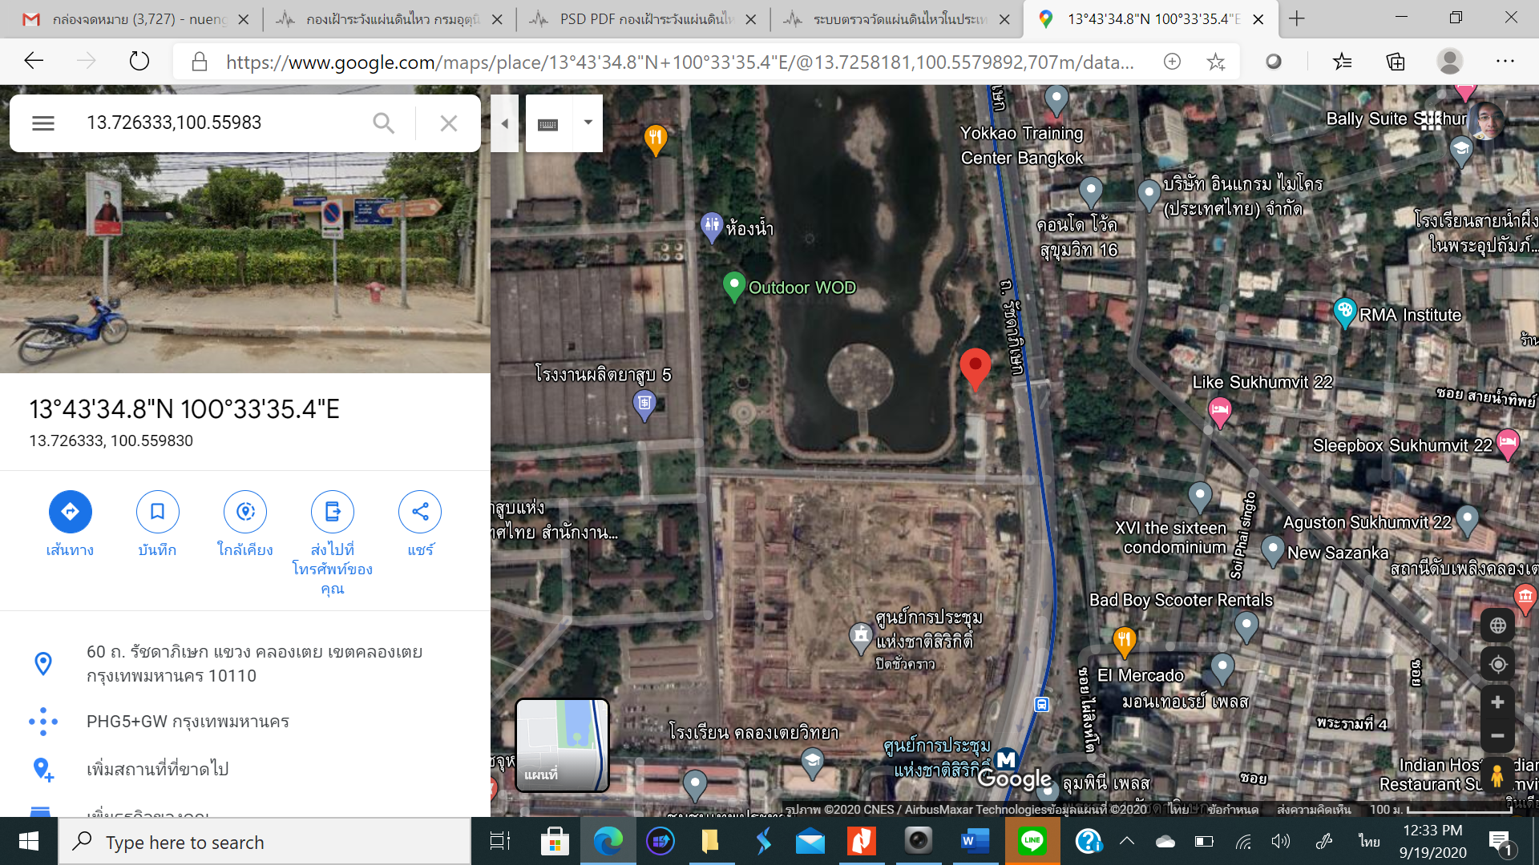
Changes in seismic levels in Thailand COVID-19 Epidemic Period:
Case Study of BKSI Earthquake Monitoring Station.
Chartchai Kamanamoon Earthquake Observations Division Thai Meteorological Department, email nuengseismtmd@gmail.com
P4.5-204
This caused a significant reduction in ground seismic noise across different frequencies. especially high frequency which is related to the seismic interference of man-made activities. in Bangkok After the announcement of a state of emergency, lockdown (26 March-30 April 2020) and an extension of time in May 2020.
This is in line with the unlocking of normal human-made activities and consistent with the results of studies in countries such as Belgium, New Zealand, India, etc.
CONCLUSIONS
which can be observed that The power will drop approximately ~10 dB at 0.1s or 10 Hz, which in June 2020 can be observed. Power will start to increase ~5 dB at 0.1s and in July and the following month. The level of man-made seismic noise has started to rise again.
Picture shows a satellite image of the position at the red pin of BKSI Bangkok Station.

