Slide 1
Structure of Technology Testing Program
for On-Site Inspections Equipment
Rémi Colbalchini
Poster No. P4.4-257
Vienna Institute for CTBT Science and Technology

Slide 2
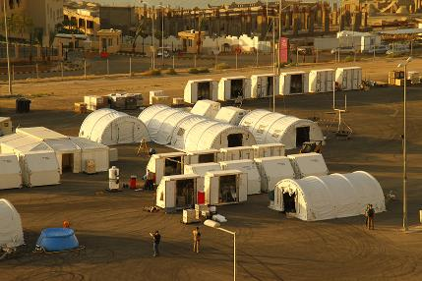
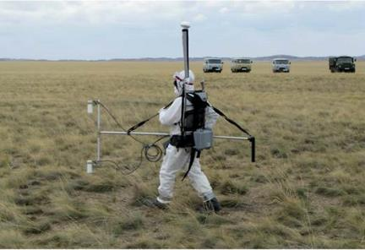
Structure of Technology Testing Program
for On-Site Inspections Equipment
Rémi Colbalchini, Equipment & Implementation Section, OSI, CTBTO
P4.4-257
OSI:
The sole purpose of an on-site inspection (OSI) shall be to clarify whether a nuclear weapon test explosion or any other nuclear explosion has been carried out in violation of Article I and, to the extent possible, to gather any facts which might assist in identifying any possible violator.
OSI/EP:
The objective of the OSI Equipment and Implementation Section (OSI/EP) is to provide the organization with the capability to undertake and apply on-site inspection activities and techniques as per para 69, Part II of the Protocol to the CTBT.

Slide 3
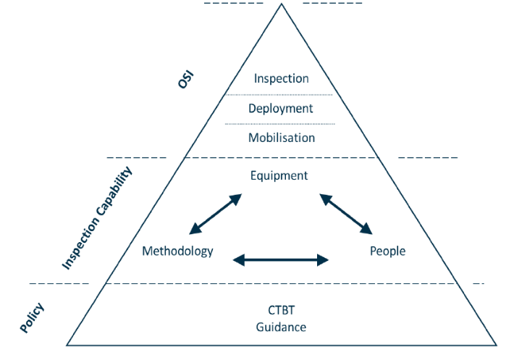
Structure of Technology Testing Program
for On-Site Inspections Equipment
Rémi Colbalchini, Equipment & Implementation Section, OSI, CTBTO
P4.4-257
OSI Division = the guardian of the OSI verification pillar
Technology Testing Program TTP: Why and How?
to bring transparency and confidence
to foster acceptance of recommendations
to meet a constant need of QM improvement
by defining a framework
by following a conceptual approach
by formalizing different interrelated technology development processes

Slide 4
Structure of Technology Testing Program
for On-Site Inspections Equipment
Rémi Colbalchini, Equipment & Implementation Section, OSI, CTBTO
P4.4-257
Requirements
Definition of requirements for the detection of observables by use of permitted inspection techniques
Survey / Analysis
Study of existing techniques/ methods and development needs
Observables
Identification of observables associated with preparing and conducting an underground nuclear test
Development
Planning, preparing and implementing a program for developing capabilities to apply inspection techniques in an OSI context (TTP)
Review
Assessment and evaluation of capabilities in light of lessons learned and technological advances
Establishing Technical and Operational Inspection Capabilities
Acquisition for Testing and Training
Capacity Building
Establishing baseline capabilities for ongoing testing, training and exercising
Technique Application
Testing of equipment and drafting of guidance for the integrated application of inspection techniques
(incl procedures and training materials)
Draft OSI Equipment List
Validation and proposal of specifications for inclusion in the draft OSI Equipment List to be considered by policy making organs

Slide 5
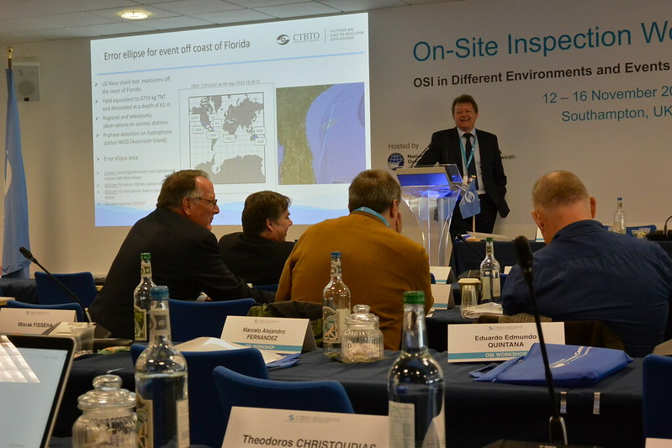
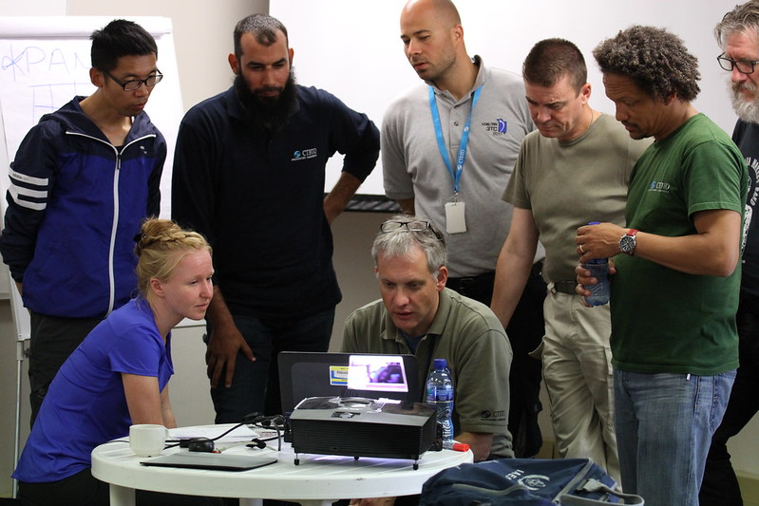
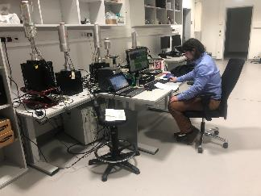
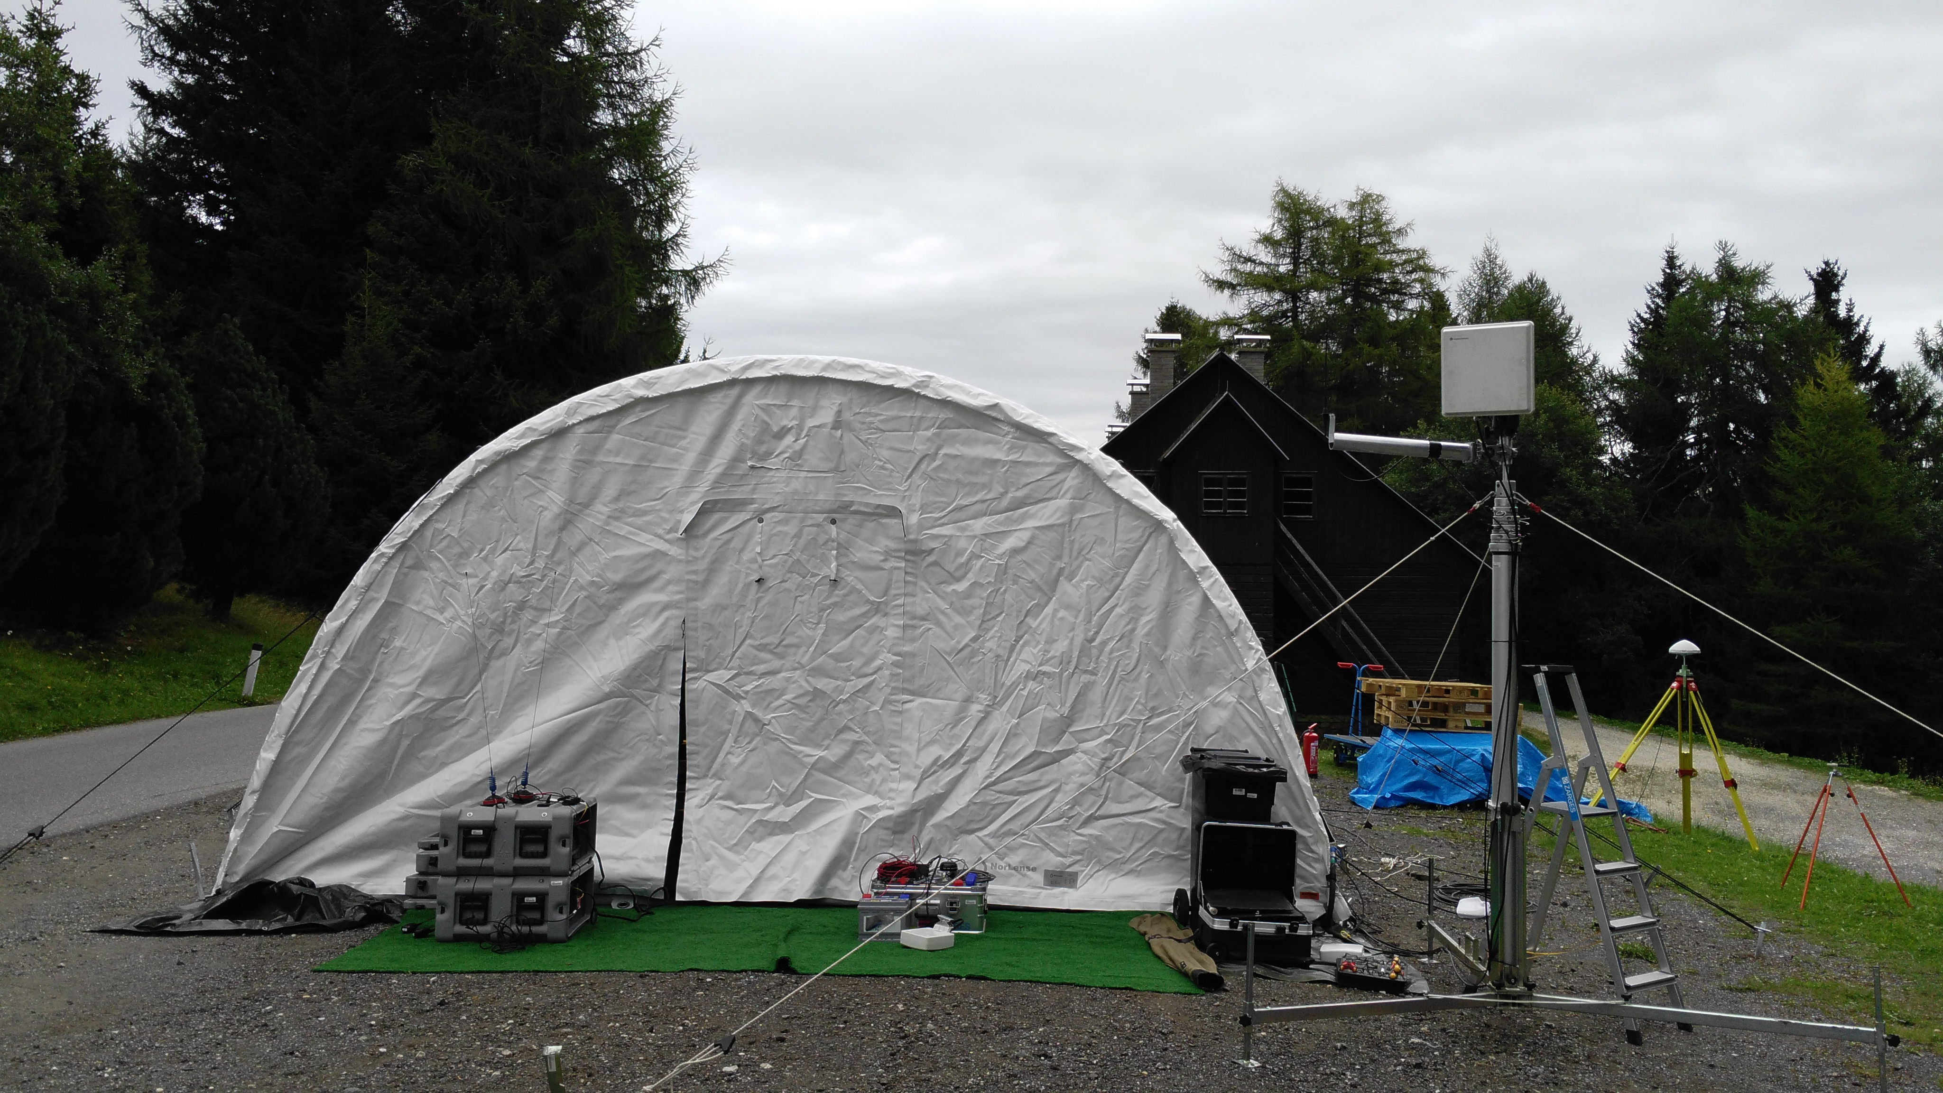
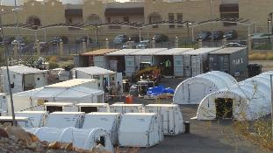
Structure of Technology Testing Program
for On-Site Inspections Equipment
Rémi Colbalchini, Equipment & Implementation Section, OSI, CTBTO
P4.4-257
Purpose of the TTP
to describe processes and provide protocols
to formalize and improve existing mechanisms in line with QM system
Possible Mechanisms
Expert Meetings / Workshops
Consultations / Consultancies
Laboratory / Field Tests
Development Projects
Exercises / Training Activities
Systematic development in iterative cycle approach

Slide 6

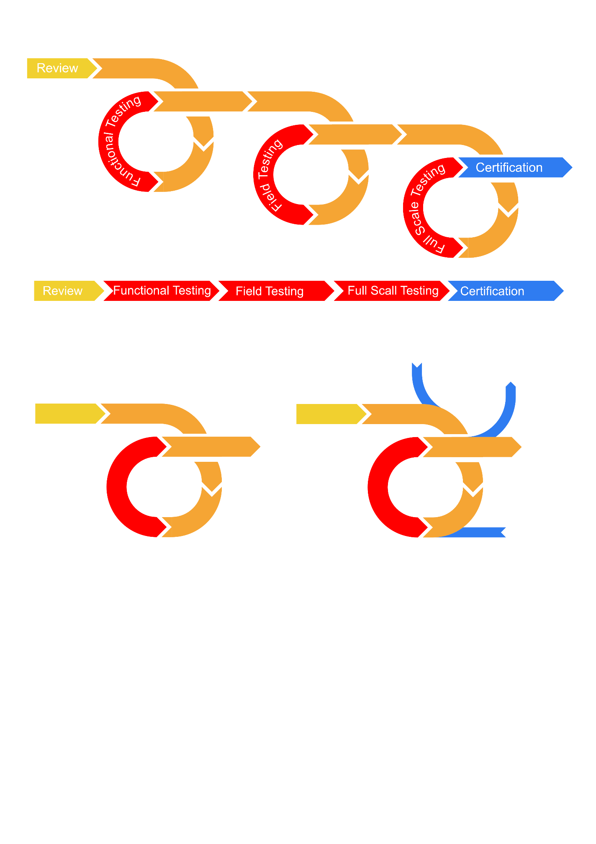
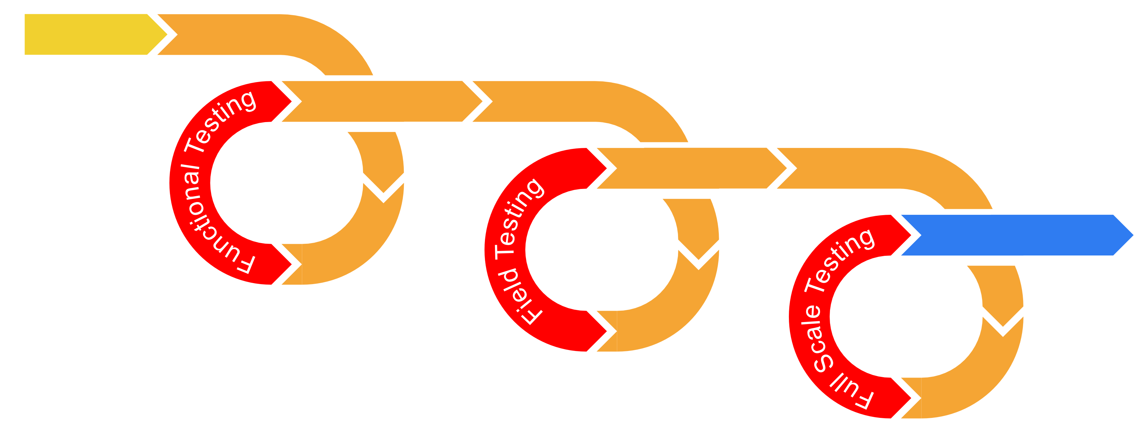
Structure of Technology Testing Program
for On-Site Inspections Equipment
Rémi Colbalchini, Equipment & Implementation Section, OSI, CTBTO
P4.4-257
Succession of incremental and iterative cycles
Observables
Inputs | Outputs
PMO discussions and papers Draft OSI Operational Manual Expert meeting and test reports Identified lessons (e.g. DILI) Proposed/revised equipment specs Equipment+Software+Manuals | Identified lessons (e.g. DILI) Technical reports Proposed/revised equipment specs QMS documents (e.g. SOPs/WINs) Training material
Development
1 Cycle
Testing
Planning
Multiple Cycles
Inputs/Outputs

Slide 7
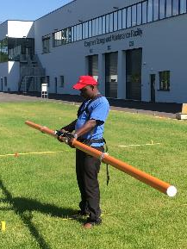
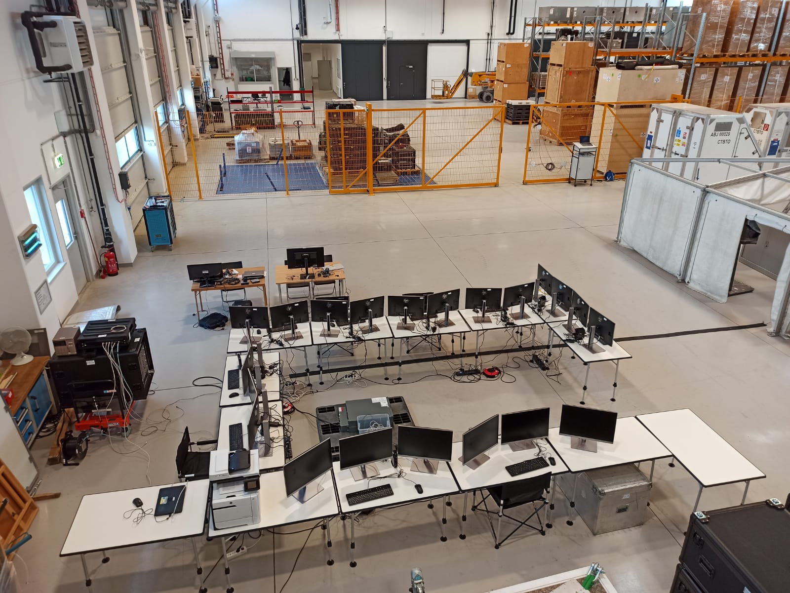
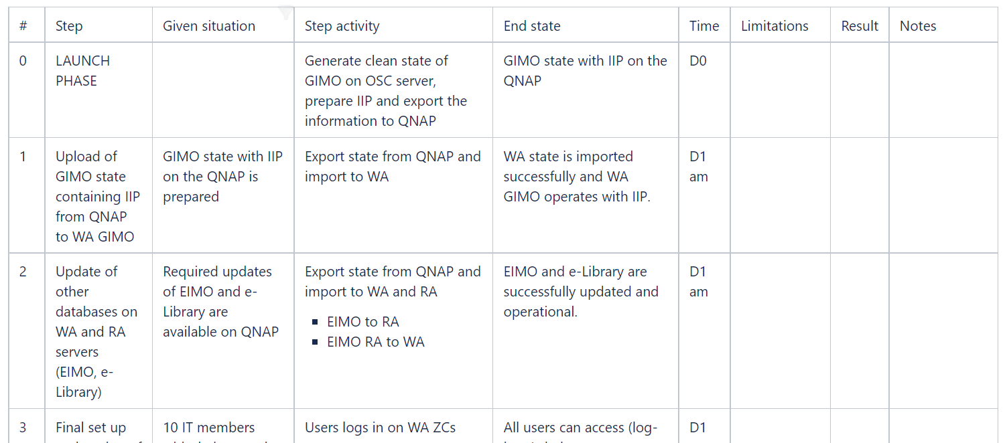
Structure of Technology Testing Program
for On-Site Inspections equipment
Rémi Colbalchini, Equipment & Implementation Section, OSI, CTBTO
P4.4-257
Acceptance/ Laboratory Test
Field Test
Technique-specific testing of equipment and methods for the application of inspection techniques
Regular Operational/Functional Testing
Assessment of performance and usability of equipment. No need of integration into OSI workflow.
TESTING
14-18 June 2021
Functional Test of new GIMO setup
Testing protocol drawn up with collaborative approach

Slide 8
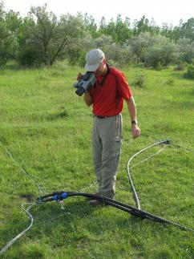
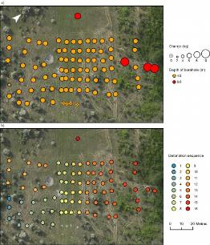

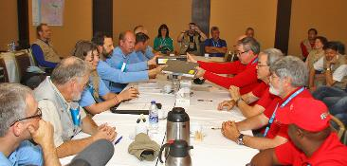
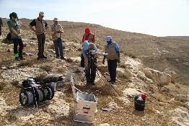
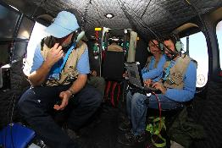
Structure of Technology Testing Program
for On-Site Inspections equipment
Rémi Colbalchini, Equipment & Implementation Section, OSI, CTBTO
P4.4-257
Field Exercise
Operational small- to large scale exercises based on tactical exercise scenarios to test one or more inspection activity or the operational readiness of the OSI verification element => e.g.
Integrated Field Exercise IFE14 –
HIGH LEVEL OF EVALUATION
TESTING

Slide 9
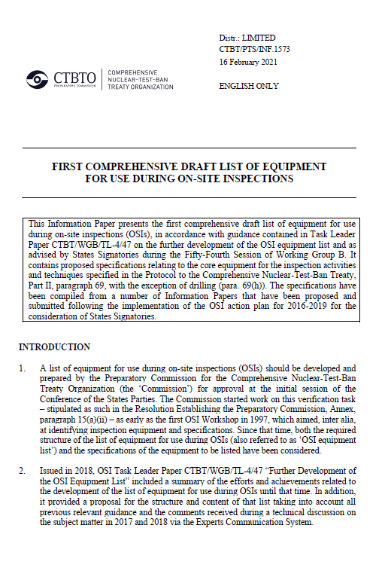
Structure of Technology Testing Program
for On-Site Inspections equipment
Rémi Colbalchini, Equipment & Implementation Section, OSI, CTBTO
P4.4-257
Draft OSI Equipment List
Validation and proposal of specifications for inclusion in the draft OSI Equipment List to be considered by policy making organs
(oral presentation Is5-239 1 Jul 2021)
Capacity Building
Establishing baseline capacity for ongoing testing, training and exercising =>
OSI Equipment Pool
QMS Documentation and Training Material
Outcome

Slide 10
Structure of Technology Testing Program
for On-Site Inspections equipment
Rémi Colbalchini, Equipment & Implementation Section, OSI, CTBTO
P4.4-257
Thank you!

