Slide 1



Using data science for predictive maintenance of noble gas systems within the International Monitoring System (IMS)
Rey Suarez, Malachi Schram, Subhrajit Sinha, Jan Strube, Mathew Thomas​
Pacific Northwest National Laboratory
P4.4-139
The views expressed here do not necessarily reflect the opinion of the United States Government, the United States Department of Energy, the United States Department of Defense, or the Pacific Northwest National Laboratory
PNNL-SA-162462

Slide 2
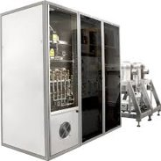
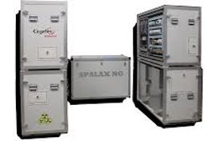
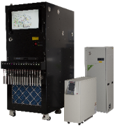
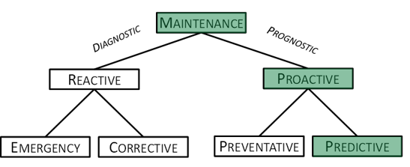
Introduction
P4.4-139
Background​
Noble gas systems are typically complex and consist of hundreds
of sensors​
Extensive diagnostic research together with on-going preventive maintenance helps provide more consistent network health​
The next phase in the maintenance design is developing predictive maintenance techniques to predict failures before they occur​
This will reduce the potential for catastrophic failures that bring systems down​
This will also provide the ability to be more strategic about scheduling maintenance trips and possibly extend the life of certain components​
Goals and Objectives​
Leverage advancements in data science to investigate algorithms capable of detecting failures in systems early​
Explore techniques to predict failures​
Implement and test algorithms against real-world data​
SAUNA-III
SPALAX-NG​
Xenon International
*Taxonomy of maintenance philosophies. (Kothamasu, Huang, & VerDuin, 2006)

Slide 3
Proactive Maintenance
P4.4-139
Preventive Maintenance​
Routine inspection of equipment regardless of condition​
Planned servicing of equipment regardless of condition​
This includes: testing parts, measurements, parts replacement, and cleaning, among other services, in an effort to prevent major problems with equipment​
On Xenon International, this might include, compressor tubing inspection, turbo pump oil change, computer cleaning, cryo-cooler cleaning/inspection/ nitrogen generator filter replacement and fan cleaning, etc…​
Predictive Maintenance​
Monitor key sensors / sub-systems of the system using the data to identify as early as possible sensor degradation​
Use trends identification to provide time-to-failure estimations and Remaining Useful Life (RUL) of a sensor, component, or subsystem​
Maximize equipment lifespan​
Minimize planned downtime​
Predict actionable maintenance​
Takes into account degradation characteristics (stress, weather, etc…)​

Slide 4
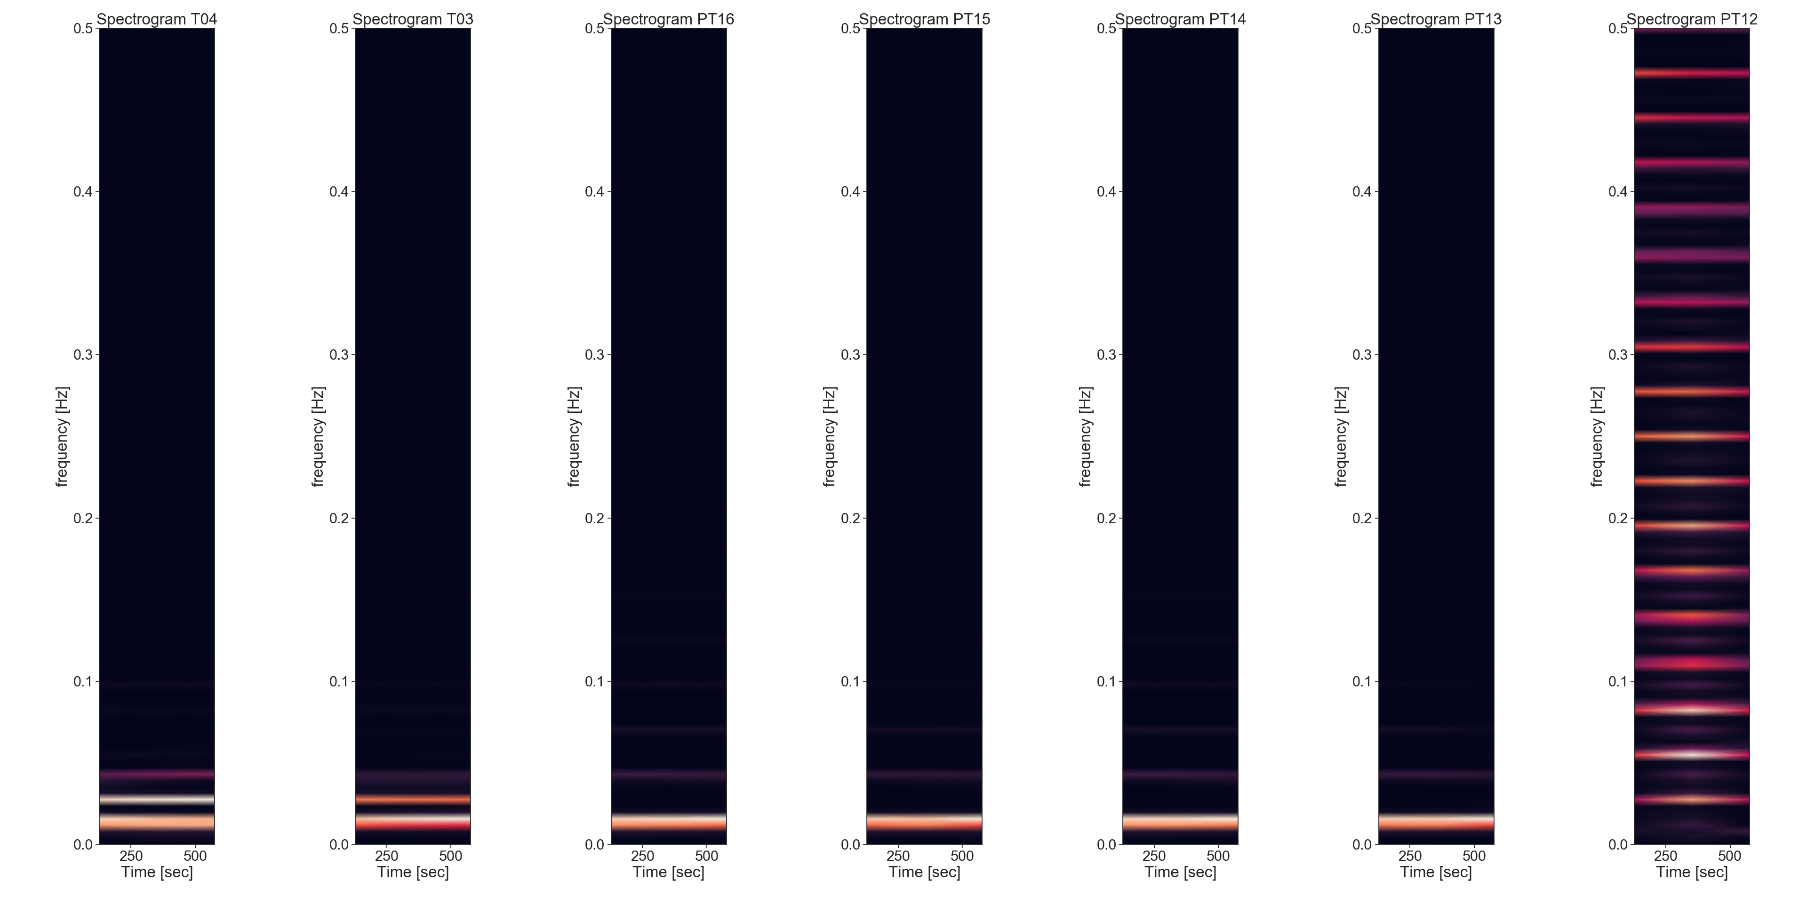

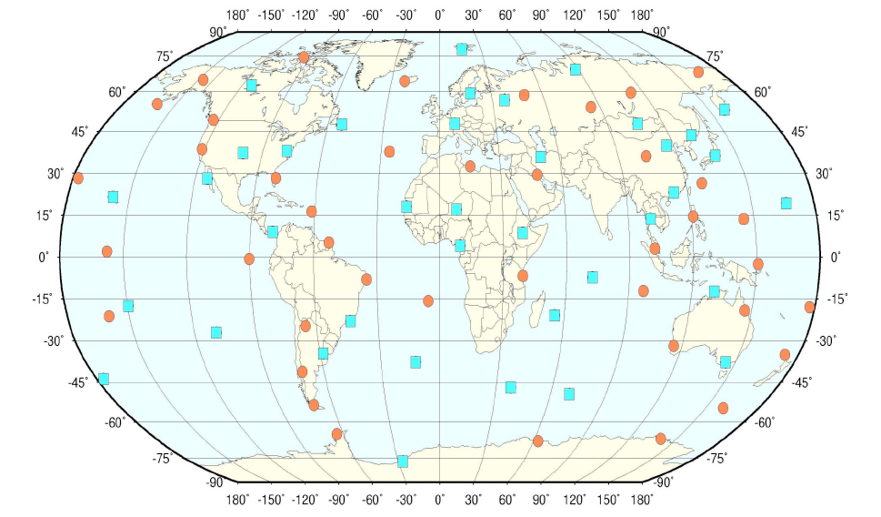

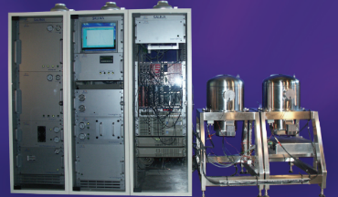
State of Health (SOH) Data
P4.4-139
State of Health (SOH) Data​
IMS SOH data is sent in 10-minute averages in files with 2-hour blocks​
Some previous work with high resolution data highlighted that 10-minute sampling was adequate for some of the analysis as many processes change on a lower time-scale
International Monitoring System (IMS)
SOH Data transmitted back to base station
International Data Center (IDC)
SAUNA
Spectrogram of some SAUNA sensors highlighting operation at low frequencies

Slide 5
Prognostics Approaches
P4.4-139
Reliability-based approach​
Depends heavily on component vendor historical data and average rate of failure (e.g., Mean Time Between Failure)​
Mainly used for uncritical, unmonitored components that do not have a physical model​
Usually not monitored in real-time ​
​
Data-driven approach​
Used with multiple sensors that monitor measurable parameters (e.g., temperature, pressure, flowrate, etc.)​
Categorized into conventional numerical methods and machine learning methods​
Elucidates gradual degradation of performance​
​
Physics-based approach​
Requires development of a physical model for components​
Requires mathematical representation of degradation​
​
Hybrid approach​
Combines physics-based and data-driven approaches​

Slide 6
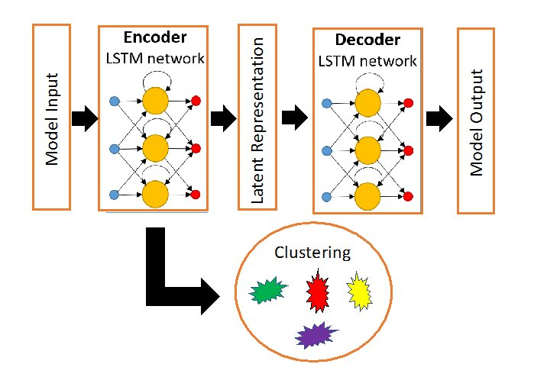
Data-driven Analysis Methods Investigated
P4.4-139
Long short-term memory (LSTM)​
An artificial neural network (RNN)​
Includes gates that optionally allow information to pass through​
Optimal for classification, processing, and making predictions with time series data​
Cluster Analysis​
Classify anomaly types​
Principle Component Analysis​
Structural Time Series modeling​
Expresses an observed time series as the sum of simpler components such as autoregressive processes, moving averages, etc…​
Can build in seasonal effects​
Gaussian Process Regressor (GPR)​
Non-parametric Bayesian approach toward regression problems​
Uncertainty quantification
Stacked LSTM model with layers to
model the temporal data​

Slide 7
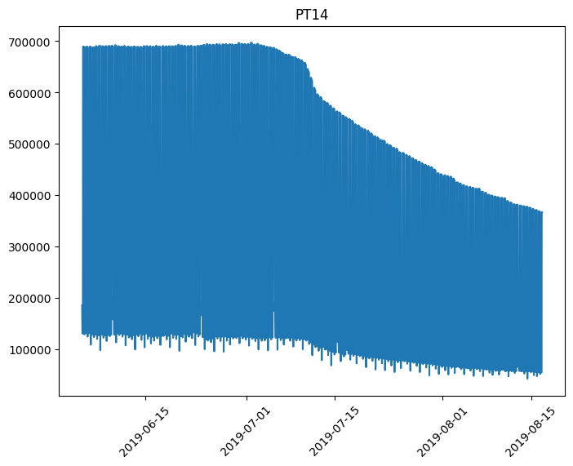
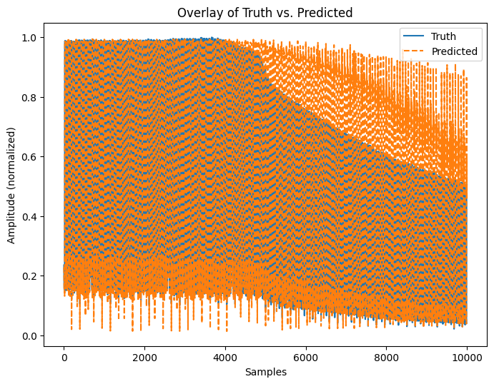
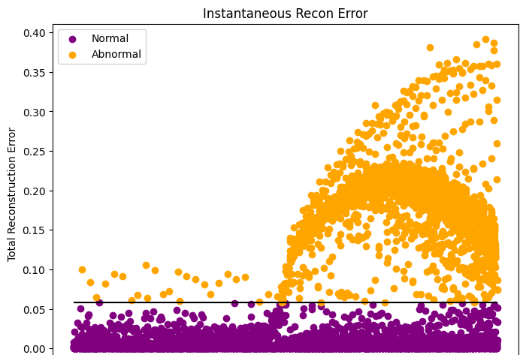

Current Results
P4.4-139
Analyzed a pump failure from the SAUNA at RN77
Trained univariate Conv1d-LSTM models for 5 different sensors to pre-filter the data​
The figures on the right show the performance of the trained model on data with failure over a 2-month window (for sensor PT14)​
Top plot shows the ground truth data with visible fault (decay)​
Middle plot shows the predictions from the trained model (look back – 60, look forward – 1)​
Bottom plot shows the reconstruction error, which would start alerting based on threshold selection​
Looked at multivariate models encompassing the different sensors, yet to find a correlation​
Features currently being investigated

Slide 8
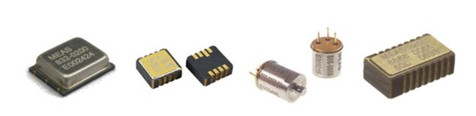
Moving Forward
P4.4-139
Develop a figure-of-merit for predictive maintenance algorithms​
Increase the LSTM model future prediction window​
Incorporate Keras Tuner to help identify optimal hyperparameters that are used to control the learning process in machine learning​
Implement algorithms into current SOH monitoring tools​
Perform failure classification analysis​
Identify data gaps ​
Strategically choose sensors to monitor components specifically for predictive maintenance​
New strategically chosen sensors may be a key
to help with predictive analytics algorithms​
Acknowledgements: This work was supported by the NNSA Office of Nuclear Verification

