Slide 1

The Expert Communications System
Roberta Nettuno, Lucas Ferreira
P4.3-414

Slide 2
The Expert Communications System
Roberta Nettuno, Lucas Ferreira
P4.3-414
The Expert Communications System (ECS) is a secure internet-accessible application, sharing and strengthening the intersessional work of the Commission and its subsidiary bodies, that enables registered users from States Signatories, the Provisional Technical Secretariat (PTS) and a restricted observers’ number to the Preparatory Commission (PC) to access to official documents.
Users can launch or participate in discussions related to the ongoing and forthcoming meetings of the Commission and its subsidiary bodies or access documents’ drafts. Live streaming and on-demand videos of meetings and as well as related information are also available on ECS.
Recently work has begun to redesign ECS by adding a new user interface and to adhere to the corporate identity standards, referenced in the CTBTO Style Manual, and to re-organize all available information in a more user-friendly way to support needs, comments and feedback collected from registered members and observers.
Moreover, ECS is undergoing a process to refactor its source code in a more robust way, removing old legacy dependencies, and introducing the principles of CD/CI as well as moving deployment to a Docker environment.
ABSTRACT

Slide 3
The Expert Communications System
Roberta Nettuno, Lucas Ferreira
P4.3-414
The approach followed was to divide the releases in phases, starting with the layout adjustments and bugs fixing.
Some functionalities have been adapted and/or simplified to offer a better user experience as well.
Recently ECS has been updated in terms of style and usability to adhere to the corporate identity standards referenced in the CTBTO Style Manual.
The landing page has been completely redesigned to show at a glance all the main information:
4 boxes displaying the most recent items of: documents, meetings, presentations and discussions
An announcement banner at the top, displaying the latest announcements
Live stream box appearing whenever there’s a ongoing streaming
A left menu to navigate quickly to the most visited Policy Making Organ Sessions of the CTBTO
A category select box to speed up the research through different working areas of the PTS
Moreover the ECS is now fully responsive, available to many different devices.
INTRODUCTION

Slide 4
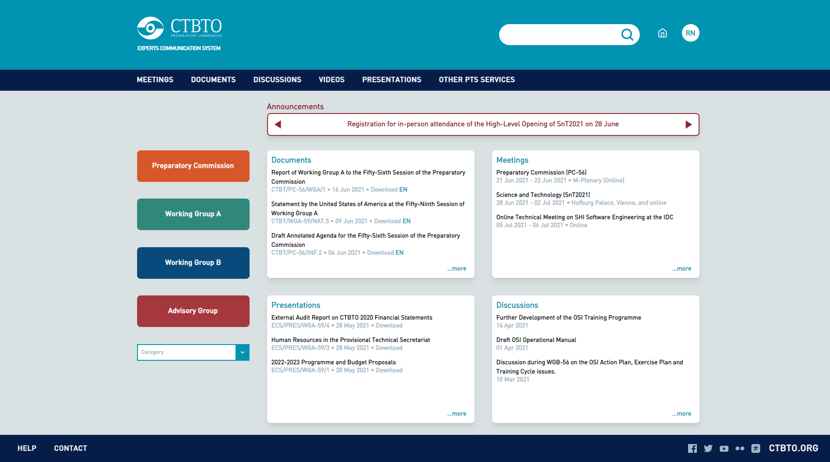
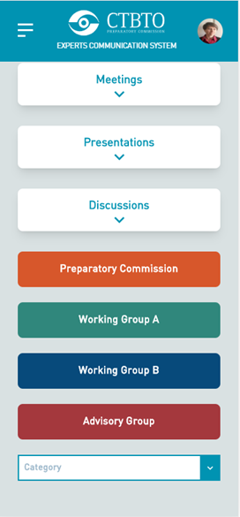
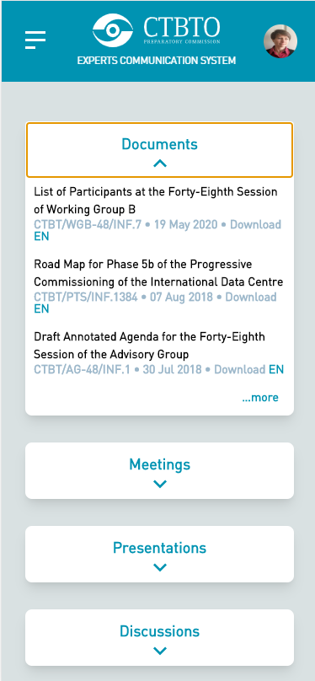
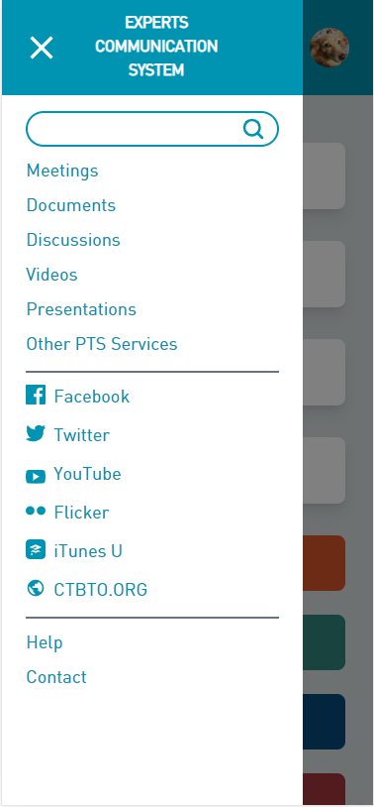
The Expert Communications System
Roberta Nettuno, Lucas Ferreira
P4.3-414

Slide 5
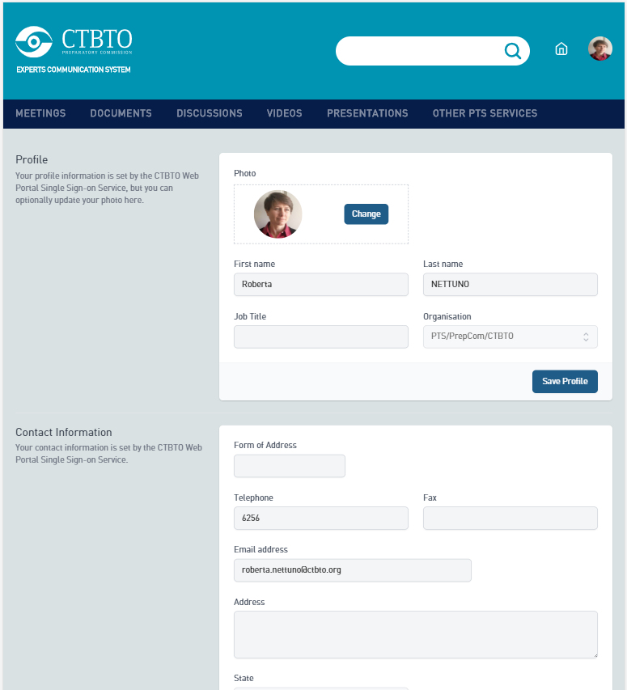
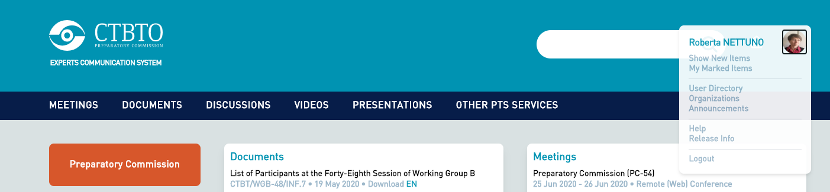
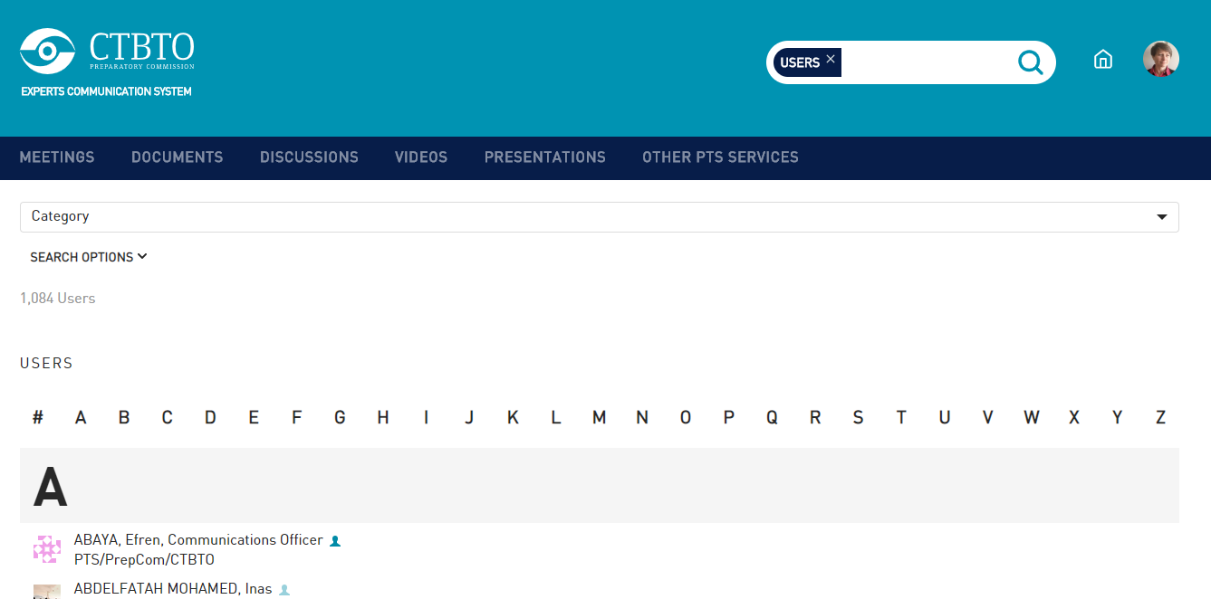
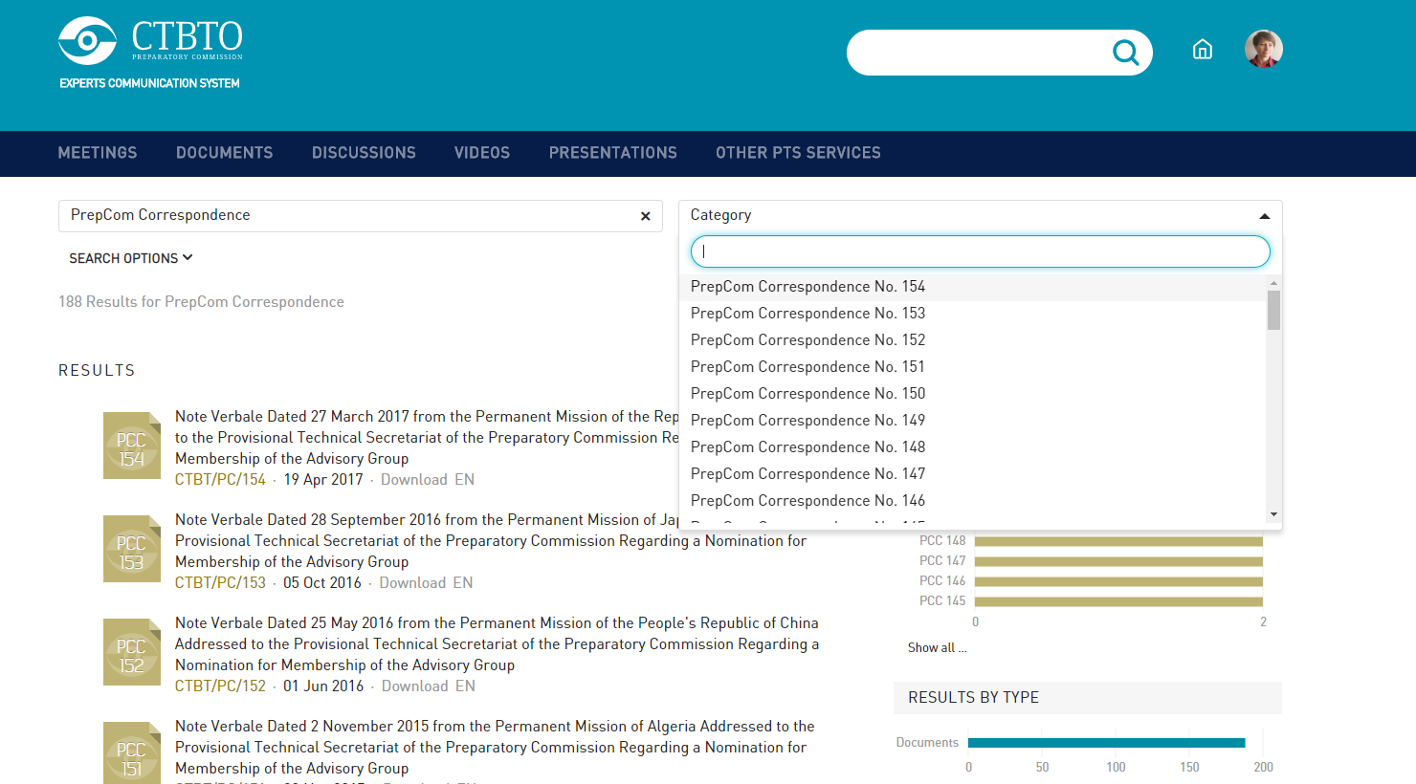
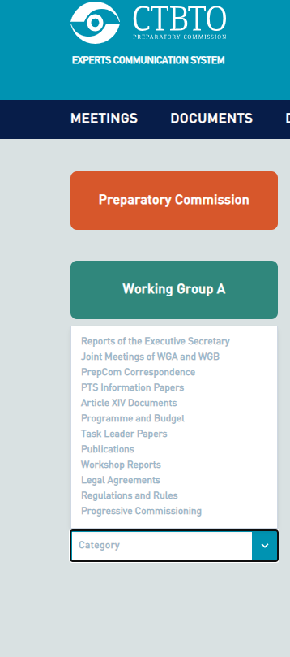
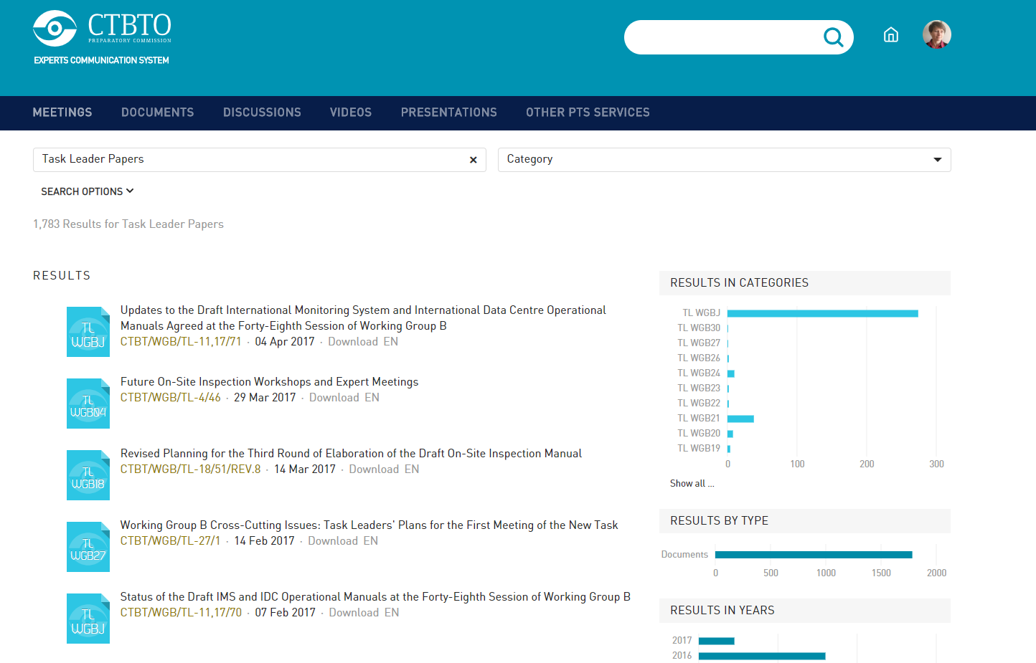
The Expert Communications System
Roberta Nettuno, Lucas Ferreira
P4.3-414
RESULTS

Slide 6
The Expert Communications System
Roberta Nettuno, Lucas Ferreira
P4.3-414
In the current second phase, the application has gone through several technical improvements like:
Removing partially the outdated AngularJS, replaced by the React framework
Using of the GraphQL, a descriptive query language, for more robust APIs
Implementation of the Continuous Development and Integration (CI/CD) best practices, moving the environment to docker containers, deploying them using GitLab CI pipelines, including unit, regression and code coverage testing.
Security fixes as suggested by the UNICC Security Scorecard Report
Removing outdated and useless dependencies, using the Dependency track tool.
Additionally the video player (one coming from a yearly subscription) was replaced by a native HTML5 player
METHODS

Slide 7
The Expert Communications System
Roberta Nettuno, Lucas Ferreira
P4.3-414
Future Plans
The second phase will be completed by integrating ECS with the new Video Platform, fully migrating all the internal pages to the React framework, adding some more small enhancements and functionalities.
A possible third phase will see a re-designing of the search functionality and some additional new features that will personalize the experience of the users navigating through ECS pages.
CONCLUSIONS

