Slide 1

Development of Alert Monitoring System for the Malaysian Radionuclide Monitoring Station (RN42)
Mohd Fauzi Haris, Saaidi Ismail, Mohd Dzul Aiman Aslan, Muhammad Rawi Mohamed Zin, Faisal Izwan Abdul Rashid, Muhammed Zulfakar Zolkaffly, Norita Md. Norwawi
P4.3-418

Slide 2
Development of Alert Monitoring System for the Malaysian Radionuclide Monitoring Station (RN42)
Mohd Fauzi Haris¹, Saaidi Ismail¹, Mohd Dzul Aiman Aslan¹, Muhammad Rawi Md Zin¹, Mohd Faisal Izwan Abd Rashid¹, Muhammed Zulfakar Zolkaffly¹, Norita Md. Norwawi²
P4.3-418

Slide 3
Development of Alert Monitoring System for the Malaysian Radionuclide Monitoring Station (RN42)
Mohd Fauzi Haris¹, Saaidi Ismail¹, Mohd Dzul Aiman Aslan¹, Muhammad Rawi Md Zin¹, Faisal Izwan Abdul Rashid¹, Muhammed Zulfakar Zolkaffly¹, Norita Md. Norwawi²
P4.3-418
* Managing the National Data Centre (NDC) including the task of monitoring the result is part of the routine task. Consequently, chance to miss the important events that happened at the stations that require immediate response is high. As a result, immediate action could not be taken efficiently.
* This paper aims at discussing the development of a simple alert system for monitoring the health of RN42 station. The selection of the parameters and their threshold is based on our observation and can be customized in the programming script including the existence of natural radionuclides such as Beryllium-7 (Be-7) and Sodium-24 (Na-24) as indicator.
* The alert system developed using Python and integrated with existing client email software. Simple tweaks and configurations to integrate with an application such as Microsoft Outlook and Mozilla Thunderbird will also be discussed. Alert will be sent to the authorized recipient to their smartphone using Telegram Bot.
ABSTRACT

Slide 4
Development of Alert Monitoring System for the Malaysian Radionuclide Monitoring Station (RN42)
Mohd Fauzi Haris¹, Saaidi Ismail¹, Mohd Dzul Aiman Aslan¹, Muhammad Rawi Md Zin¹, Faisal Izwan Abdul Rashid¹, Muhammed Zulfakar Zolkaffly¹, Norita Md. Norwawi²
P4.3-418
Situation
Malaysia through the Malaysian Nuclear Agency (Nuklear Malaysia) as the CTBT National Authority operates:
        a radionuclide monitoring station (RN42); and,
        a CTBT National Data Centre (MY-NDC)
Although MY-NDC operates 24/7, its personnel are currently tasked to be physically present at the data centre during normal working hours (9am to 6pm) throughout the year
Furthermore, they are also engaged with responsibilities other than MY-NDC activities
As such, they could overlook important events at RN42 that may require immediate response
Objective
To develop an alert monitoring system that could assist MY-NDC personnel in monitoring important events at RN42
Expected Outcome
Increased MY-NDC’s efficiency as technical advisor in supporting the CTBT National Authority
INTRODUCTION
Notes:
Definition of important = category 3 and above

Slide 5
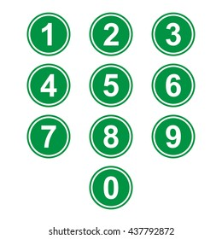
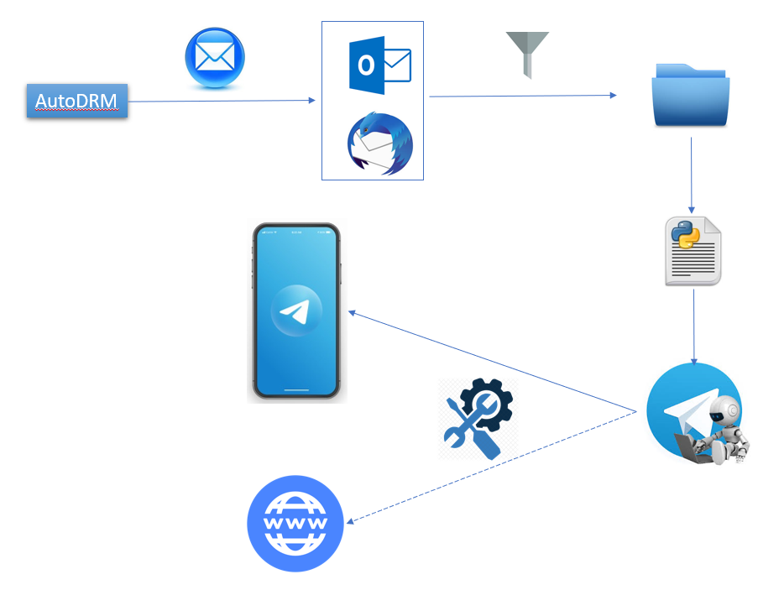

Development of Alert Monitoring System for the Malaysian Radionuclide Monitoring Station (RN42)
Mohd Fauzi Haris¹, Saaidi Ismail¹, Mohd Dzul Aiman Aslan¹, Muhammad Rawi Mohamed Zin¹, Mohd Faisal Izwan Abd Rashid¹, Muhammed Zulfakar Zolkaffly¹, Norita Md. Norwawi²
P4.3-418
Make subscription to ARR via AutoDRM
Setup email client, either using Linux or Windows Operating System.
Filter email and move/copy to specified folder.
Run customized Python script to read and parse email message in the folder, based on interested parameters or keywords
Same Python script will send the alert to Telegram using Bot.
Alert received through Telegram Apps
Authorized user’s email
METHODS
Future works

Slide 6

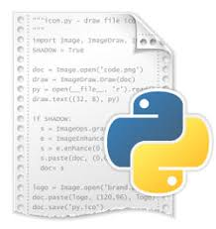



Development of Alert Monitoring System for the Malaysian Radionuclide Monitoring Station (RN42)
Mohd Fauzi Haris¹, Saaidi Ismail¹, Mohd Dzul Aiman Aslan¹, Muhammad Rawi Md Zin¹, Faisal Izwan Abdul Rashid¹, Muhammed Zulfakar Zolkaffly¹, Norita Md. Norwawi²
P4.3-418
Scripting in Operating System Environment
Shell script runs in Linux environment only.
Python script is more robust and can be deployed in both environments (Linux and Windows)
Optimizing Microsoft Outlook is still in progress. Power Shell ISE will be used for that purpose
Make sure the machines that run the scripts is connected to the Internet
Email Client Software
Thunderbird need to be installed with FiltaQuilla Add-on for smoother process, both for Linux and Windows
Telegram
Telegram messages can be viewed either on smartphone or web browser
Pin your Alert group chat to avoid missing or unnoticed the important alert.
METHODS

Slide 7
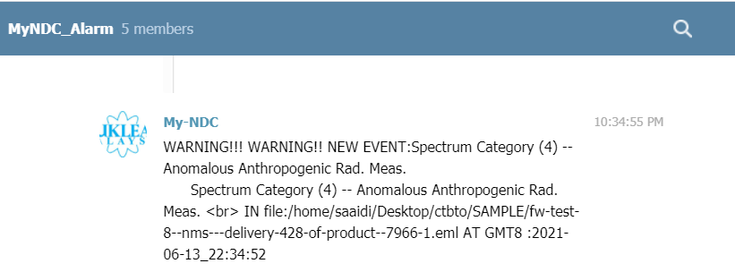
Development of Alert Monitoring System for the Malaysian Radionuclide Monitoring Station (RN42)
Mohd Fauzi Haris¹, Saaidi Ismail¹, Mohd Dzul Aiman Aslan¹, Muhammad Rawi Md Zin¹, Faisal Izwan Abdul Rashid¹, Muhammed Zulfakar Zolkaffly¹, Norita Md. Norwawi²
P4.3-418
Chat Name with #of members
RESULTS
Spectrum Category
Timestamp of email arrival
Arrived subscribed email subject

Slide 8
Development of Alert Monitoring System for the Malaysian Radionuclide Monitoring Station (RN42)
Mohd Fauzi Haris¹, Saaidi Ismail¹, Mohd Dzul Aiman Aslan¹, Muhammad Rawi Md Zin¹, Faisal Izwan Abdul Rashid¹, Muhammed Zulfakar Zolkaffly¹, Norita Md. Norwawi²
P4.3-418
1- Monitoring and alert system has successfully developed to assist MY-NDC personnel in delivering important event at RN42 instantaneously.
2- The system developed will help to increase efficiency of MY-NDC as a technical advisor in delivering information to the CTBT National Authority.
3- All authorized users in national authority could obtain alert information simultaneously.
CONCLUSIONS

Slide 9
Development of Alert Monitoring System for the Malaysian Radionuclide Monitoring Station (RN42)
Mohd Fauzi Haris¹, Saaidi Ismail¹, Mohd Dzul Aiman Aslan¹, Muhammad Rawi Md Zin¹, Faisal Izwan Abdul Rashid¹, Muhammed Zulfakar Zolkaffly¹, Norita Md. Norwawi²
P4.3-418
1- Using PREL data to determine level of alert event based on National
Authority requirements
2- Next level of information such as type of detected radionuclide could also be accessed
through Telegram chat
3- Integration with Machine Learning algorithm for forecasting of certain interested
radionuclide or event
4- Category of detections published in web accessible for authorized user
FUTURE WORK

