Slide 1

The Italian CTBTO CNF: readiness status
D. Pesaresi, M. Bertoni, E. Del Negro, P. Comelli, S. Parolai and N. Casagli
P4.1-248

Slide 2
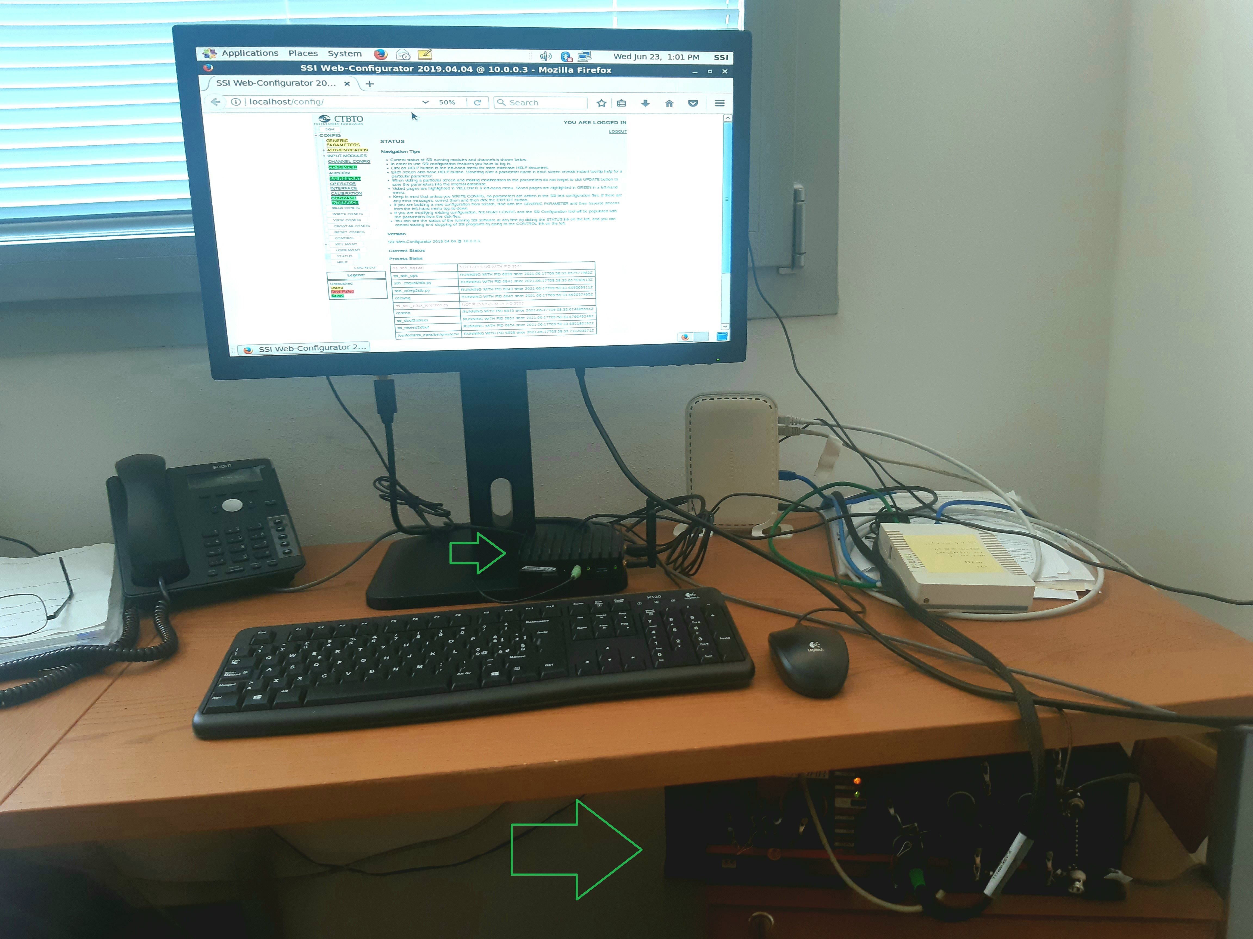
The Italian CTBTO CNF: readiness status
D. Pesaresi, M. Bertoni, E. Del Negro, P. Comelli, S. Parolai and N. Casagli, CRS, dpesaresi@inogs.it, OGS
P4.1-248
The Italian CNF under test in the OGS LAB.
The big green arrow indicates the digitizer, a Quanterra Q330HR.
The small green arrow indicates the Standard Station Interface (SSI), running on a Fitlet2 downgraded with CentOS6, with the authentication token (USB pen).
Routers are added to fully simulate the station LAN in the field.
The Italian CNF is currently sending authenticated CD1 data in real time to the PTS.

Slide 3
The Italian CTBTO CNF: readiness status
D. Pesaresi, M. Bertoni, E. Del Negro, P. Comelli, S. Parolai and N. Casagli, CRS, dpesaresi@inogs.it, OGS
P4.1-248
The CTBTO PrepCom and the Government of Italy agreed that the seismic station located in Cludinico (CLUD) may participate as a prototype Cooperating National Facility (CNF) in experiment conducted by the Commission. The Government of Italy designed the National Institute of Oceanography and Applied Geophysics – OGS (Italy) as responsible for the management of the station. This station can contribute to further refine the CTBTO location capabilities in the Europe/Middle East area of about 21% as shown in Pesaresi and Horn (2015).
In this presentation, we will illustrate the technical details of the solutions adopted to incorporate the Italian CNF into the CTBTO International Monitoring System (IMS). We considered a CTBTO specific seismic data acquisition system, but we then opted to keep the available standard one with the addition of the CTBTO Standard Station Interface (SSI). For the SSI we had to go through hardware and software procurement: we then experienced some difficulties in installing the SSI software and its required Operating System, solved with the help of the PTS. We will also illustrate the other required technicalities like the upgrade of the UPS, the anti-tamper device operations, the establishment of data communication link and the security measures adopted.
ABSTRACT

Slide 4
The Italian CTBTO CNF: readiness status
D. Pesaresi, M. Bertoni, E. Del Negro, P. Comelli, S. Parolai and N. Casagli, CRS, dpesaresi@inogs.it, OGS
P4.1-248
The CTBT verification system includes the possible use of other data for expert technical analysis. PrepCom and Italy agreed to designate OGS seismic station CLUD as a CNF. This can contribute to refine CTBTO locations in the Europe/Middle East of about 21%.
Beyond the lMS, IDC and OSl, the full Treaty verification system also includes NDCs and the possible use of other data to supplement IMS data for expert technical analysis.
States Parties may establish cooperative arrangements with the CTBTO, in order to make available to the IDC supplementary data from national monitoring stations that are not formally part of the IMS. Upon request by a State Party the PTS shall take the steps required to certify that a given monitoring facility meets the technical and operational requirements specified in the relevant operational manuals for an IMS facility and plan for the authentication of its data.
The Preparatory Commission for the Comprehensive Nuclear Test Ban Treaty Organization and the Government of the Italian Republic agreed that the seismic station located in Cludinico (CLUD) may participate as a prototype Cooperating National Facility (CNF) in experiment conducted by the Commission. The Government of Italy designed the National Institute of Oceanography and Applied Geophysics – OGS (Italy) as responsible for the management of the station. This station can contribute to further refine the CTBTO location capabilities in the Europe/Middle East area of about 21% as shown in Pesaresi and Horn (2015).
INTRODUCTION

Slide 5
The Italian CTBTO CNF: readiness status
D. Pesaresi, M. Bertoni, E. Del Negro, P. Comelli, S. Parolai and N. Casagli, CRS, dpesaresi@inogs.it, OGS
P4.1-248
Power Supply. We estimated the power consumption of the instrumentation (digitizer, router, SSI, satellite terminal) and purchased and installed enough batteries at the station in the field to support operations without main for 14 days.
Security. Even though the station tunnel is not open to the public, we installed a fence to secure the seismic station pit. The fence has a door that will be equipped with an anti tamper device connected to the SSI of the CTBTO.
Digitizer. We considered the purchase of the special digitizer from Kinemetrics, the M+, fully compliant with CTBTO specifications (CD1 protocol and built-in authentication). However, in order to rationalize the maintenance of the full seismic network we adopted the solution of the Standard Station Interface (SSI).
SSI. Under the guidance of the PTS, we purchased a Fitlet2 (https://fit-iot.com/web/products/fitlet2/) from the Israeli Compulab. It is a low power, rugged PC well suited for field operations. It comes with an excellent MINT operative system, quite fast. Unfortunately, the SSI software package must run on the obsolete CentOS6. Downgrading our Fitlet2 from MINT to CentOS6 has been quite a challenge, most probably due to the unreliable handle of USB by CentOS6. The PTS staff then promptly provided us with an ISO image of one of their test SSI. After the purchase of a larger internal hard disk to accommodate such an image, we were finally able to get our SSI up and running. Configuration though was also quite tricky for us: as an example, to get our SSI to communicate with our Quanterra Q330 digitizer we needed to know the specific port used by the obsolete “comserv” communication software used in old times to communicate with old Quanterra digitizers. But again, PTS staff promptly helped us in solving every issue step by step. It must be noted that by now PTS shall use SSI software package running on the more modern CentOS7.
Authentication. Under the guidance of the PTS, we purchased the USB-Token SmartCard-HSM from the German CardContact. PTS staff helped us to generate and handle our authentication keys.
METHODS

Slide 6
The Italian CTBTO CNF: readiness status
D. Pesaresi, M. Bertoni, E. Del Negro, P. Comelli, S. Parolai and N. Casagli, CRS, dpesaresi@inogs.it, OGS
P4.1-248
Power Supply. Enough batteries are installed at the station in the field to support operations without main for 14 days.
Security. A fence is installed to secure the seismic station pit: it will be equipped with an anti tamper device connected to the SSI of the CTBTO.
SSI. System is configured, up and running, sending real time authenticated CD1 data to the CTBTO.
Authentication. An USB-Token SmartCard-HSM from the German CardContact is in place with authentication system with the proper keys up and running.
RESULTS

Slide 7
The Italian CTBTO CNF: readiness status
D. Pesaresi, M. Bertoni, E. Del Negro, P. Comelli, S. Parolai and N. Casagli, CRS, dpesaresi@inogs.it, OGS
P4.1-248
The following items of the Italian CNF are at present (June 2021) compliant with CTBTO specifications:
  power supply UPS
  security
  data format
  authentication
The following items of the Italian CNF are at present (June 2021) NOT compliant with CTBTO specifications:
  calibration
  anti tamper device
We are currently in contact with PTS to solve the two remaining issues
After that we could proceed with the formal step of station certification, reasonably within a few months from now (by the end of 2021)
CONCLUSIONS

