Slide 1



Combined quality control check source for improved gain tracking
and calibration
Johnathan Slack, Michael Mayer, Matthew Cooper, James Ely, Michael Foxe
Pacific Northwest National Laboratory
P4.1-196
PNNL-SA-162594

Slide 2
Combined quality control check source for improved gain tracking and calibration
Johnathan Slack, Michael Mayer, Matthew Cooper, James Ely, Michael Foxe
Pacific Northwest National Laboratory
P4.1-196
Quality control (QC) in beta-gamma coincidence systems that are used for radioxenon measurement is currently performed using a Cs-137 check source. Compton scattering in the scintillating plastic (polyvinyl-toluene) of the beta detector creates a line of activity from the 667 keV gamma captured by the sodium iodide (NaI) across the beta dynamic range. Fitting the Compton scatter line provides a beta endpoint energy. The beta endpoint is used in combination with the 662 keV gamma peak to track the gain drift in the system before and after a sample measurement to ensure system stability during the count. Periodic QC checks are performed as well to monitor the long-term health of the system. By introducing another isotope to the check source, Ba-133, a second Compton scatter line can be generated in the coincidence counts that is well separated from the first. This would provide improved gain tracking, efficiency monitoring, and potential data on detector degradation. The multiple low-energy gamma lines of Ba-133, as compared to the 662 keV of Cs-137, would provide additional peaks for the energy and efficiency calibrations.
ABSTRACT

Slide 3
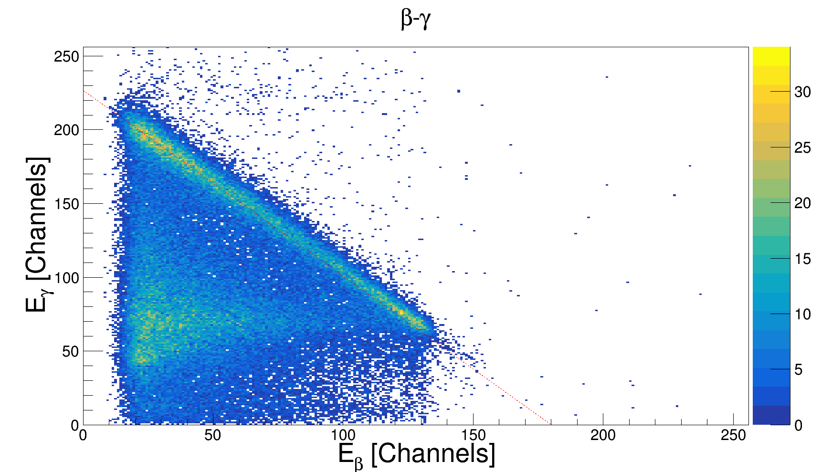
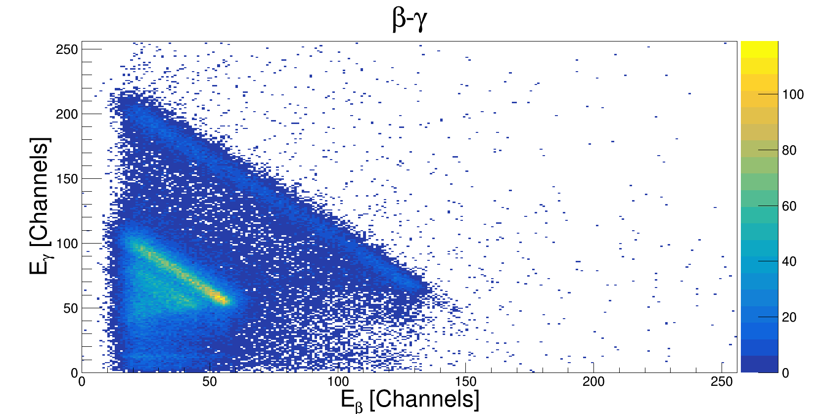
Combined quality control check source for improved gain tracking and calibration
Johnathan Slack, Michael Mayer, Matthew Cooper, James Ely, Michael Foxe
Pacific Northwest National Laboratory
P4.1-196
Beta-Gamma radioxenon systems perform regular source checks with Cs-137 for quality control of the detection system (left). Gain tracking is performed through fitting of the Compton scatter line but only provides a single point of reference in the beta dynamic range. By adding a second QC check source a secondary Compton scatter line can be generated (right), providing another reference point.
With two beta reference points both the gains and linearity of the detector can be tracked over time.
Objectives
Beta-gamma QC with Cs-137 and a fit line showing the endpoint positions
Beta-gamma QC with Cs-137 and Ba-133. The Ba-133 is roughly twice the activity of the Cs-137 to overcome noise contributions.

Slide 4
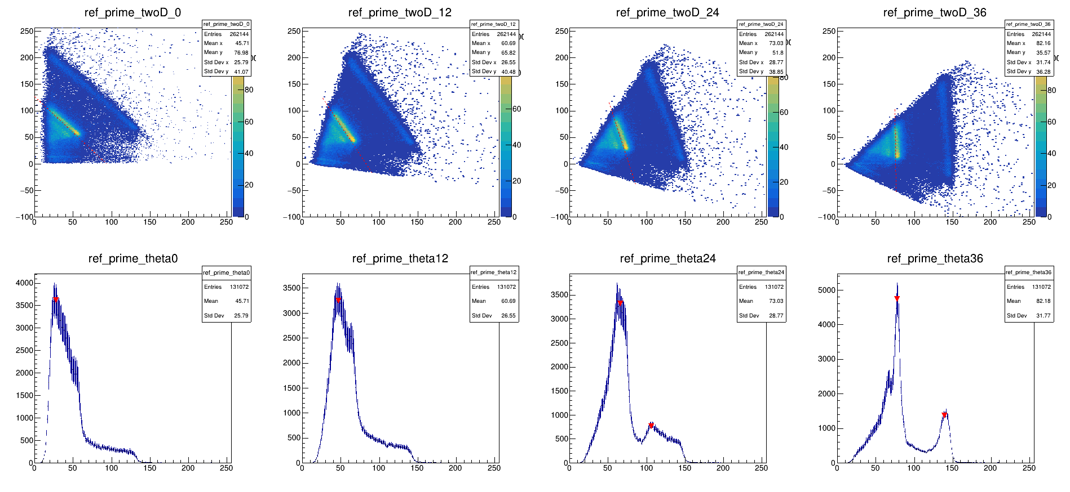
Combined quality control check source for improved gain tracking and calibration
Johnathan Slack, Michael Mayer, Matthew Cooper, James Ely, Michael Foxe
Pacific Northwest National Laboratory
P4.1-196
Rotation and Fitting
Low end noise that varies from system to system can complicate fitting of the Compton scatter line.
Rotation of the beta-gamma histogram about the origin will orient the Compton scatter lines vertically, drastically reducing noise contributions to the fit.
Projecting each rotation onto the x-axis creates evolving peaks whose apex will reach a minimum in the full width at half maximum (FWHM) when fully vertical.
METHODS
Top: Rotations of the beta-gamma histogram at 0, 12, 24, and 36 degrees
Bottom: Projections onto the x-axis of the beta-gamma histogram demonstrating the separation of the peaks as the lines become vertically oriented . Fitting is performed with standard gaussians.

Slide 5
Combined quality control check source for improved gain tracking and calibration
Johnathan Slack, Michael Mayer, Matthew Cooper, James Ely, Michael Foxe
Pacific Northwest National Laboratory
P4.1-196
Tracking Rotation Data
Projections and fits are performed for every 1-degree of rotation.
Tracking the FWHM data of the fitted peaks during rotation creates a parabolic well (left). Fitting the wells yields the ideal rotation angle for that QC measurement.
Tracking the peak heights during rotation creates two maxima in the Cs-137 data. One in the early stages of rotation before the two Compton scatter lines have sufficiently separated, and another that very closely matches to the same rotation angle in the minimum of the FWHM data. However, the Ba-133 height data does not have a maximum in the same range.
METHODS
Peak FWHM values as a function of rotation angle. Low values of the rotation angle can have erratic behavior due to noise contributions. As the rotation approaches higher angles a consistent parabolic well forms.
Peak heights as a function of the rotation angle. Noise contributions cause a maximum in the Ba-133 peak height about 10 degrees before vertical alignment is achieved.

Slide 6
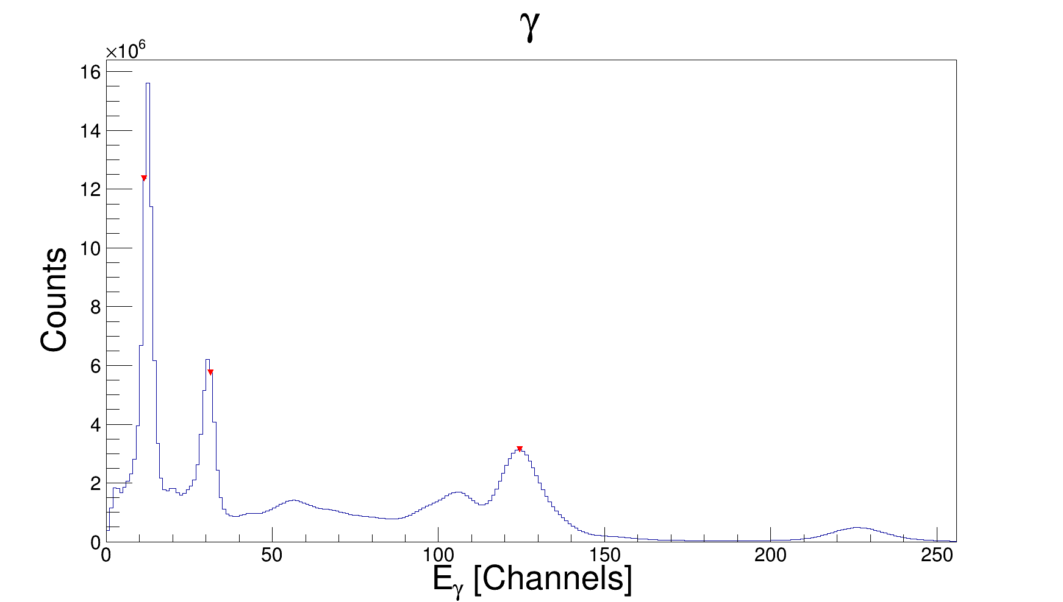
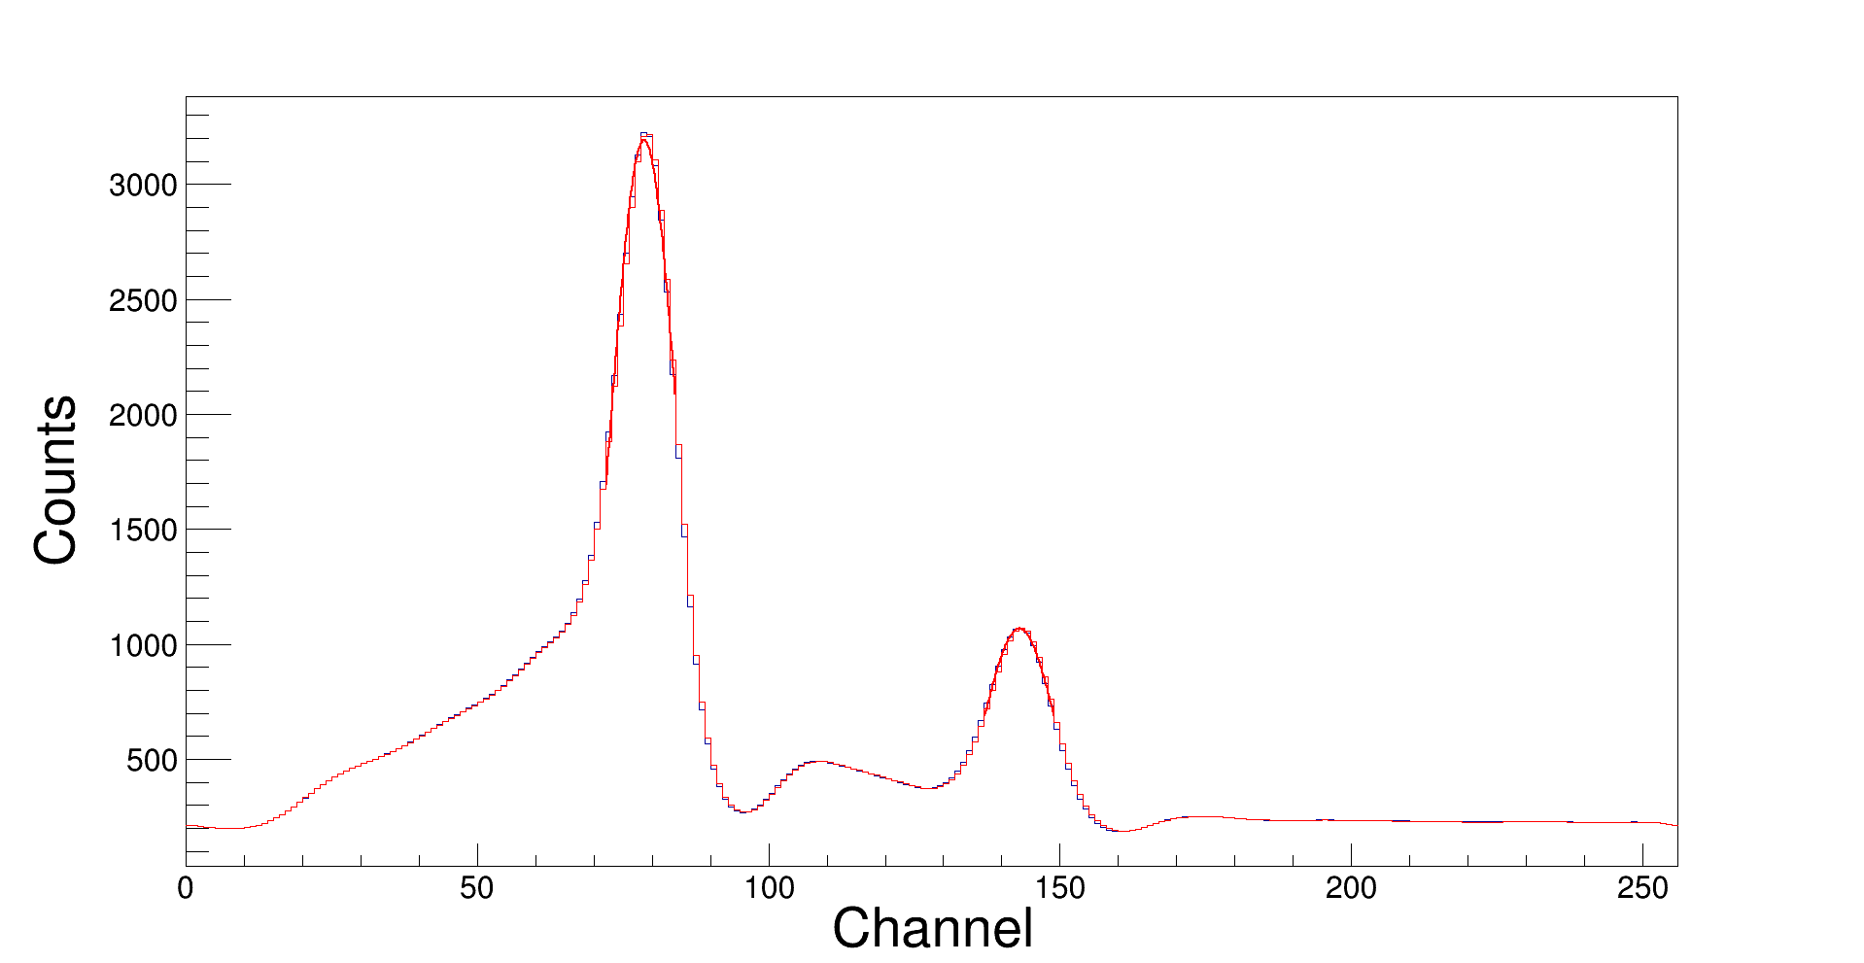
Combined quality control check source for improved gain tracking and calibration
Johnathan Slack, Michael Mayer, Matthew Cooper, James Ely, Michael Foxe
Pacific Northwest National Laboratory
P4.1-196
Rotated Data to Endpoint Positions
Gamma spectral data is peak fit and recorded directly, no rotation is necessary (left plot).
For the beta-gamma data a final projection is created at the ideal rotation angle to obtain the ideal peak (right plot).
Fit data including position, height, and FWHM are recorded for the ideal rotation projection.
Peak fit positions in the rotated frame of reference are tracked backwards to the original beta-gamma frame, generating a beta endpoint position.
β
Ba-133
31 keV
Ba-133
Rotated
Compton
Ba-133
81 keV
Cs-137
Rotated
Compton
METHODS
Ba-133
356 keV
Cs-137
662keV
Left: Gamma spectral data with peak identification. The low energy 32 keV of Cs-137 is not present due to the source being encased in a small stainless-steel tube. The Ba-133 is a standalone, plastic-encased, check source.
Right: A projection at the ideal rotation angle with gaussian fits of the two distinct peaks.

Slide 7
Combined quality control check source for improved gain tracking and calibration
Johnathan Slack, Michael Mayer, Matthew Cooper, James Ely, Michael Foxe
Pacific Northwest National Laboratory
P4.1-196
Endpoint Tracking
Dual source data was collected over a roughly two-month period spanning late 2020 and early 2021.
The beta zero endpoints for both sources (right) remain stable, with few exceptions, during the test indicating a lack of gain/linearity shift in the beta spectrum.
Deviations in the Ba-133 endpoints are attributed to shorter QC measurements when the Cs-137 was disturbed.
Three gamma singles peaks (below) appear to vary with physical displacement of the Cs-137.
RESULTS

Slide 8
Combined quality control check source for improved gain tracking and calibration
Johnathan Slack, Michael Mayer, Matthew Cooper, James Ely, Michael Foxe
Pacific Northwest National Laboratory
P4.1-196
Ideal Rotation Data Tracking
FWHM data for the Cs-137 peaks (left), and modestly so for the Ba-133, indicate a step like behavior.
Peak areas for both peaks shows the step behavior in higher contrast (right).
Operational notes indicate the Cs-137 source was removed and replaced on the days when a step occurs in the data (11/23, 12/1, 12/11, 12/15, 12/18, and 01/12). The Cs-137 source was frequently not placed back in precisely the same location. The possibility also exists that the Ba-133 could have been inadvertently repositioned during these movements. Vertical dashed lines indicate source movement dates.
RESULTS

Slide 9
Combined quality control check source for improved gain tracking and calibration
Johnathan Slack, Michael Mayer, Matthew Cooper, James Ely, Michael Foxe
Pacific Northwest National Laboratory
P4.1-196
Gain tracking by QC endpoint determination is a valuable tool for ensuring beta-gamma ROI alignment between calibrations.
Area and/or peak count rate data can be used as an indication of inconsistent placement of the QC source.
Additional gamma spectrum peaks from Ba-133 could be utilized in system calibrations along with the four radioxenon isotopes.
Further performance testing on multiple beta-gamma systems is planned that will investigate fit parameters as they relate to ROI efficiencies.
Next steps include:
  Converting count rates in ROIs/peaks to a correlation with detector efficiency.
  Examining the relationship between Ba-133 peaks to Cs-137 noise contributions.
  Investigating possible correlations between the slopes of the Compton scatter lines (e.g., left) and the endpoints energies, ROI efficiencies, etc.
  Make improvements to the fitting algorithm during rotation to improve reliability with lower count statistics.
  Determine the relationship between source irregularities and the distance between endpoint positions (right).
CONCLUSIONS

