Slide 1

Research on Local Seismic Events Detection Method Based on
Deep Neural Network
Li Jian,Wang Xiaoming, Liu Zhehan,Wang Juan, Shang Jie,Gai Lei,
Qiu Hongmao,Nan De,Wang Xuliang
P3.6-541

Slide 2
Research on Local Seismic Event Detection Method Based on Deep Neural Network
Li Jian,Wang Xiaoming, Liu Zhehan,Wang Juan, Shang Jie,Gai Lei, Qiu Hongmao,Nan De,Wang Xuliang
P3.6-541
Introduction
Method
Local Phase Picking based on Multi-task CNN
Seismic Noise Signal Recognition using GAN+LSTM
Phases association based on P/S wave velocity ratio.
Results
Conclusion
OUT LINE

Slide 3
Research on Local Seismic Event Detection Method Based on Deep Neural Network
Li Jian,Wang Xiaoming, Liu Zhehan,Wang Juan, Shang Jie,Gai Lei, Qiu Hongmao,Nan De,Wang Xuliang
P3.6-541
An event detection method based on deep neural network combined with the average wave speed ratio of multiple stations is proposed for detecting local events under the global sparse seismic network. Firstly, the method uses multi-task convolution neural network to detect and identify the direct P and S phases, as well as estimate their arrival time. Then a joint network of GAN and LSTM is used to identify and eliminate the noise signals in detections. Finally，according to the principle that the P and S wave velocity ratios of local earthquakes in the regional network are consistent, the association of seismic phases from multiple stations are realized. The P and S phases arrival time and wave velocity ratio are used to estimate the preliminary origin time. The hyperbolic method based on station pairs is used to estimate the preliminary event location. Using the preliminary origin time and location of the event as the initial value of the conventional iterative inversion location method, and finally the exact event location and time are obtained.
ABSTRACT

Slide 4
Research on Local Seismic Event Detection Method Based on Deep Neural Network
Li Jian,Wang Xiaoming, Liu Zhehan,Wang Juan, Shang Jie,Gai Lei, Qiu Hongmao,Nan De,Wang Xuliang
P3.6-541
With the dramatic increase in the number of seismic stations and the volume of historical data in the global earthquake monitoring network, the performance of traditional seismic data processing methods is not satisfactory. New problems and challenges are emerging in the quality of automatic processing of the event bulletin and the application of historical data mining.
The seismic data processing method based on machine learning and deep learning, directly based on waveform data, constructs the historical data probability model, realizes the signal and event detection based on the model, and forms a new type of seismic event detection method.
In this paper, we proposed an event detection method based on deep neural network combined with the P/S average wave speed ratio of multiple stations to detect local events.
INTRODUCTION

Slide 5
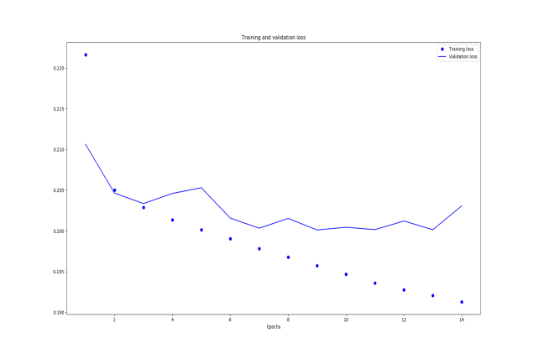
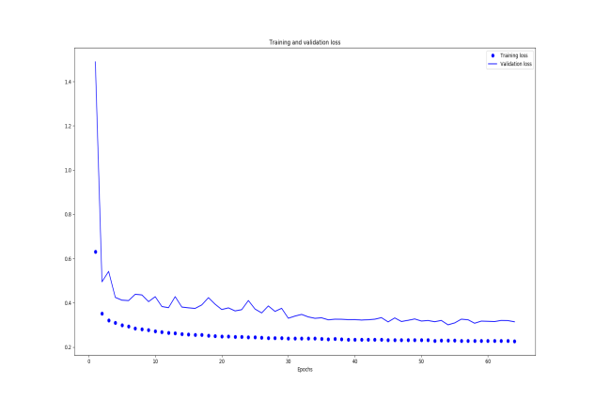
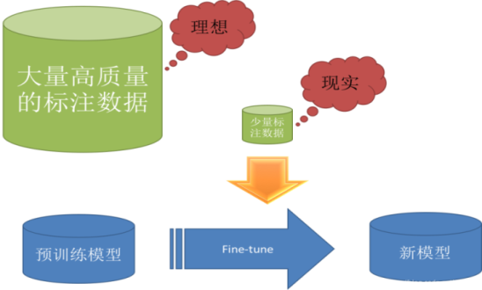
Research on Local Seismic Event Detection Method Based on Deep Neural Network
Li Jian,Wang Xiaoming, Liu Zhehan,Wang Juan, Shang Jie,Gai Lei, Qiu Hongmao,Nan De,Wang Xuliang
P3.6-541
Local Phase Picking Based On Multi-task CNN
multi-task convolution neural network ：
A joint loss function
Realizing seismic phase detection and arrival time estimation simultaneously.
METHODS
Model Training
Transfer Learning:
Transferring the model to a small-scale data set of stations in target area.

Slide 6
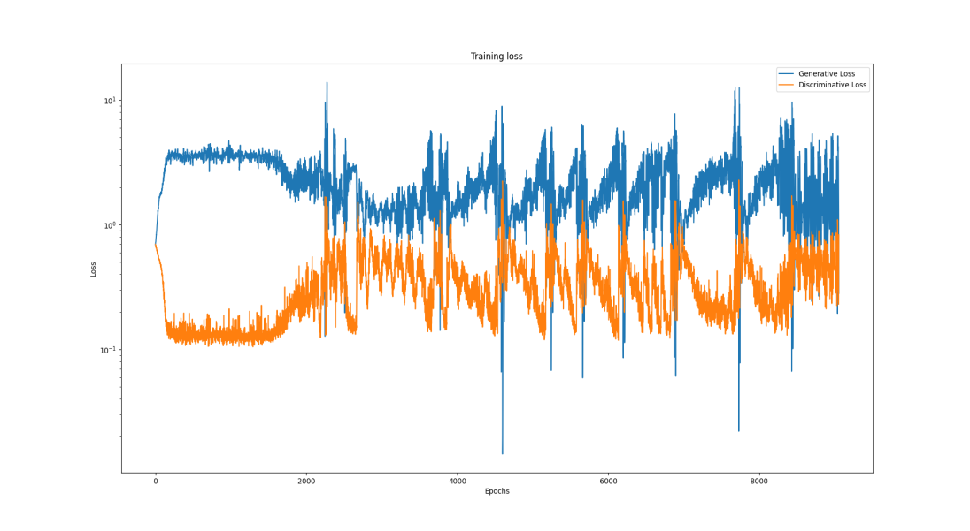
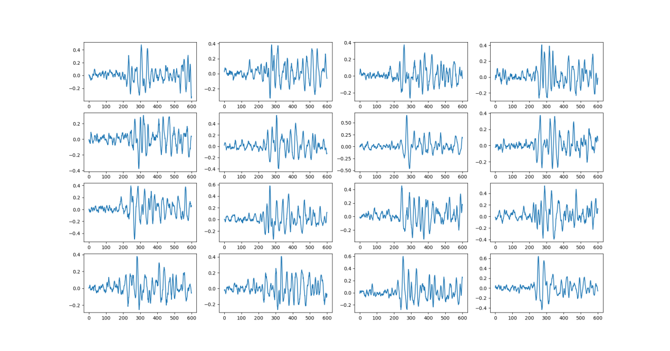
Research on Local Seismic Event Detection Method Based on Deep Neural Network
Li Jian,Wang Xiaoming, Liu Zhehan,Wang Juan, Shang Jie,Gai Lei, Qiu Hongmao,Nan De,Wang Xuliang
P3.6-541
Seismic Noise Signal Recognition using GAN+LSTM
Model building
METHODS
Model Training
Generated waveforms
Training GAN using seismic phase data, the discriminator
of GAN can obtain the signal features of seismic phases.
Training the GAN(discriminator)+LSTM on mixed
seismic phases and noise signals to classify 2 type signals.

Slide 7
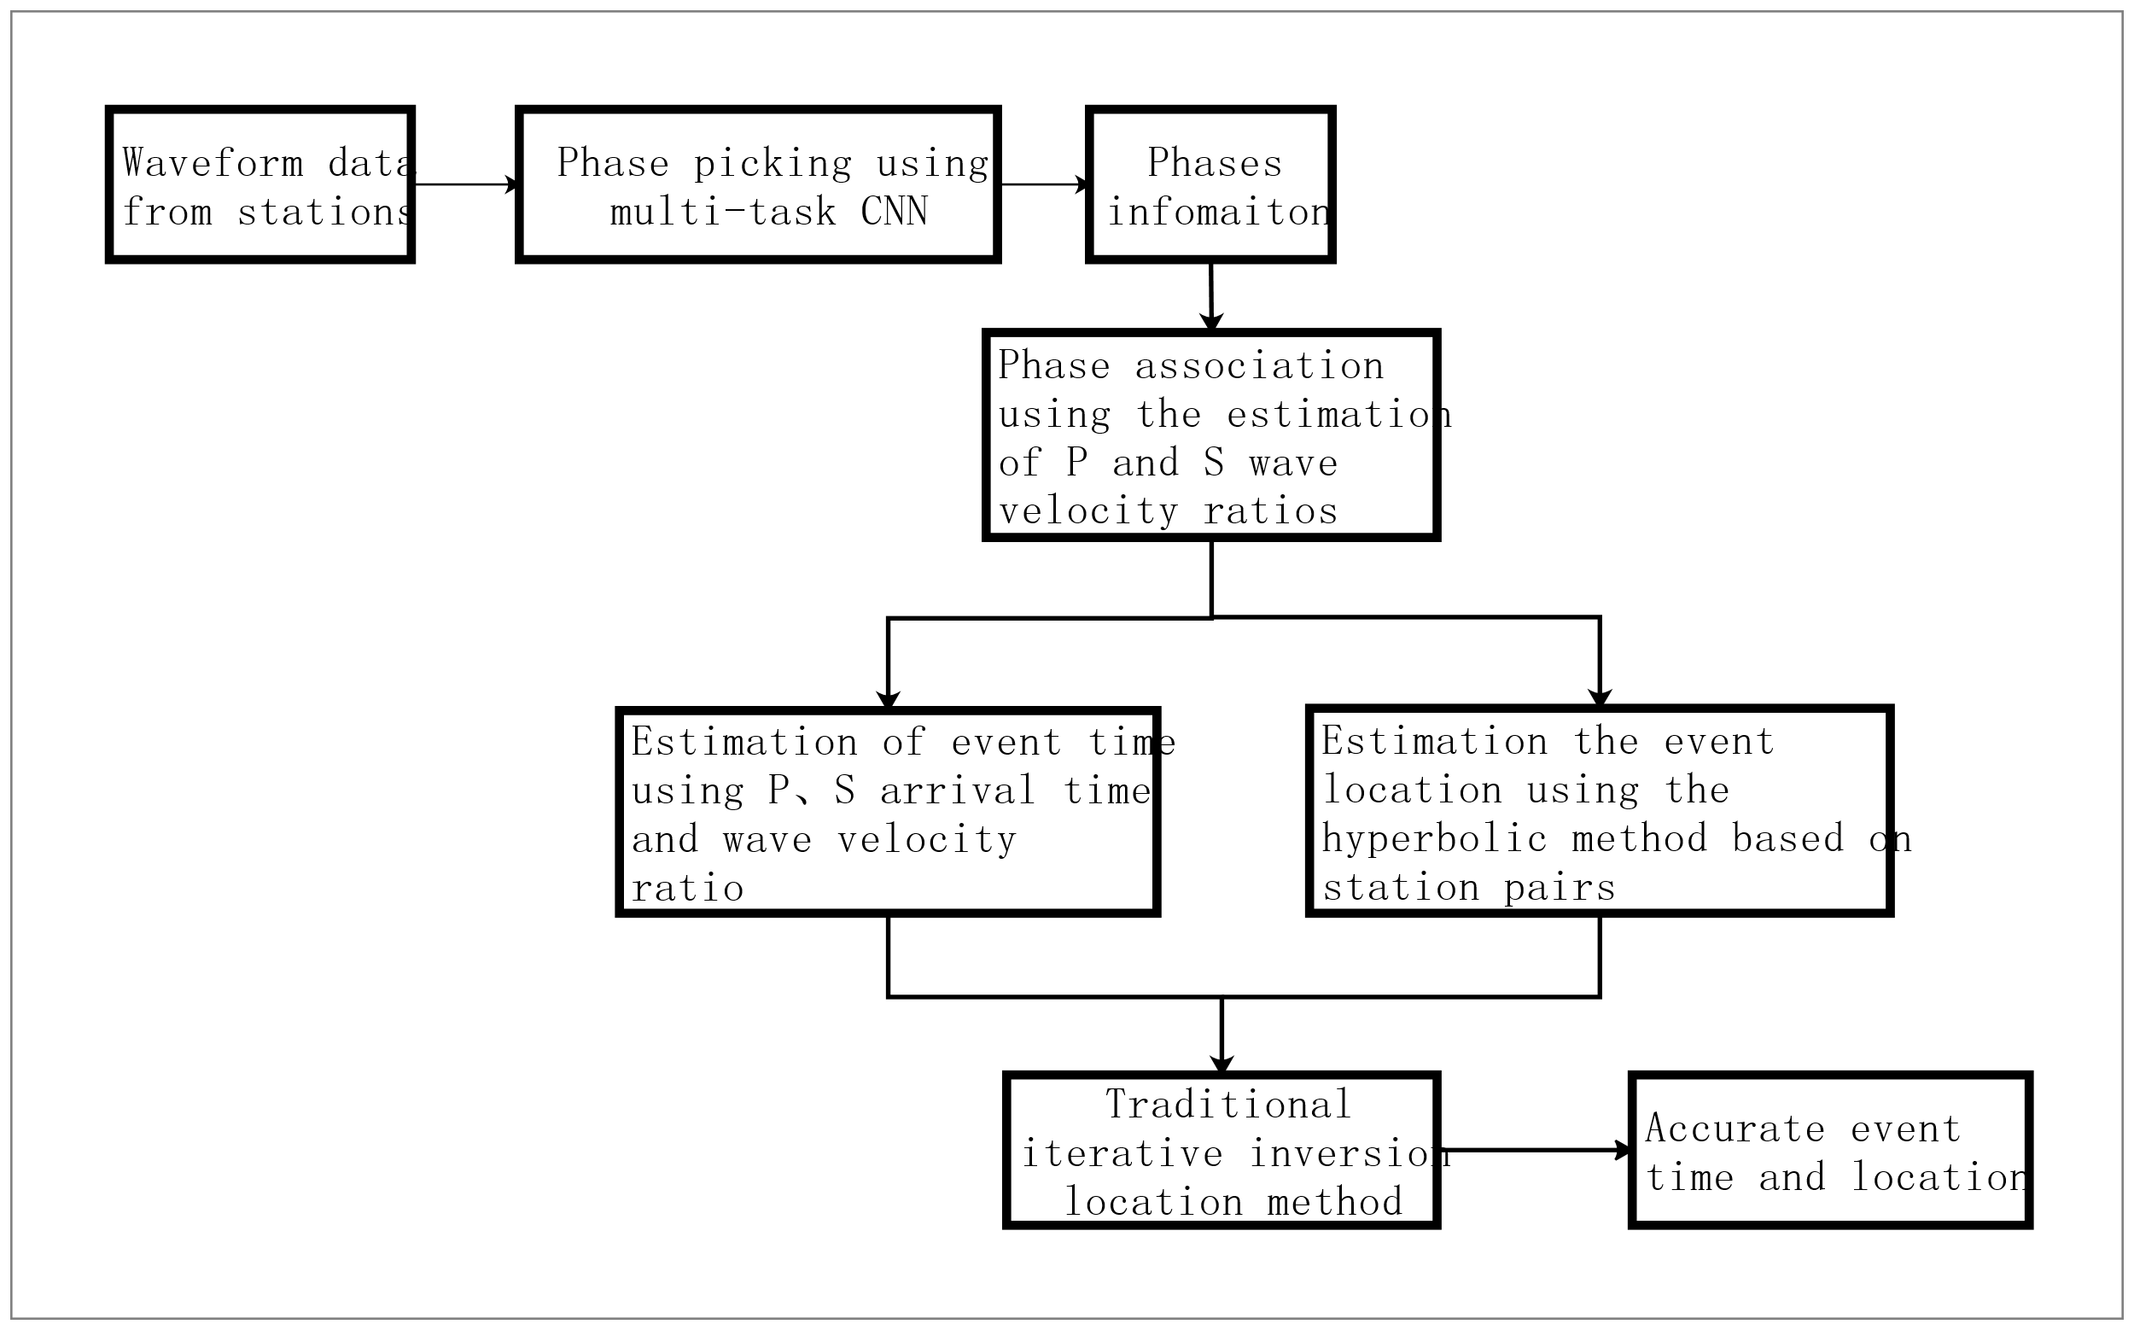
Research on Local Seismic Event Detection Method Based on Deep Neural Network
Li Jian,Wang Xiaoming, Liu Zhehan,Wang Juan, Shang Jie,Gai Lei, Qiu Hongmao,Nan De,Wang Xuliang
P3.6-541
Phases Association based on P/S Wave Velocity Ratio
Local phases association
METHODS

Slide 8
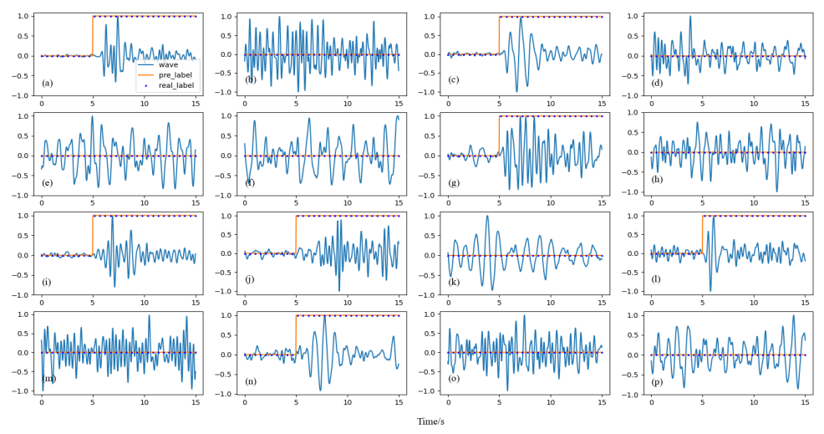
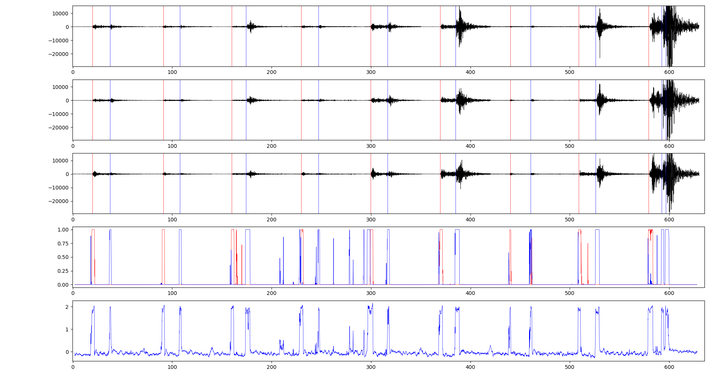
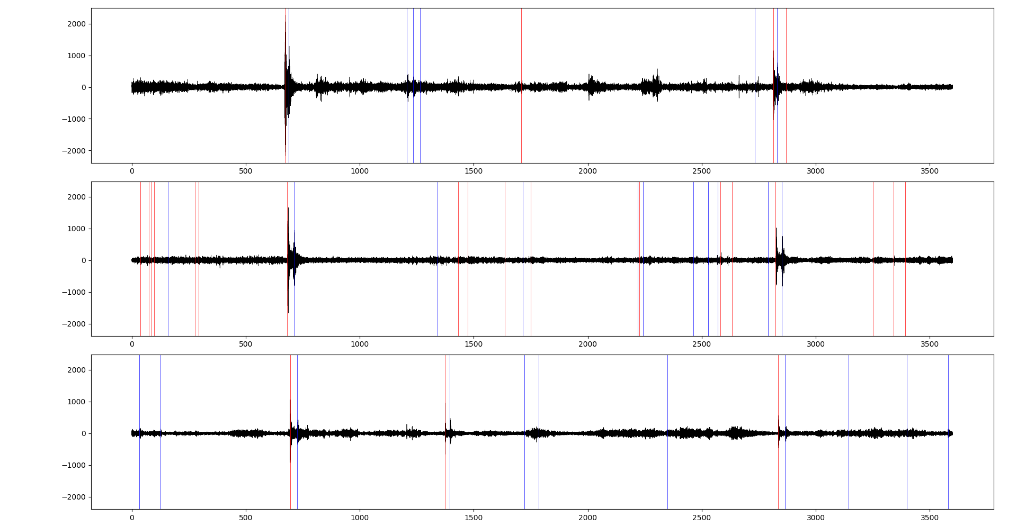
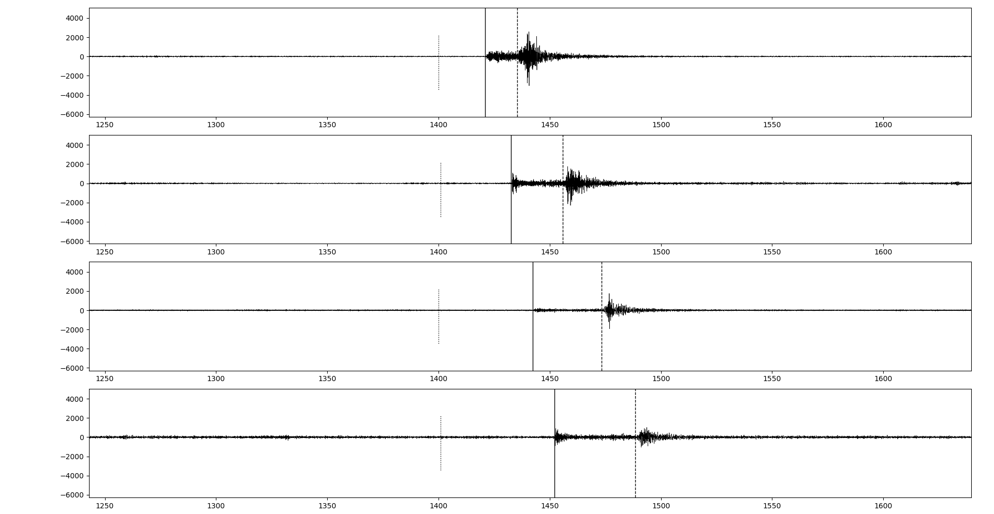
Research on Local Seismic Event Detection Method Based on Deep Neural Network
Li Jian,Wang Xiaoming, Liu Zhehan,Wang Juan, Shang Jie,Gai Lei, Qiu Hongmao,Nan De,Wang Xuliang
P3.6-541
Phase picking
Phase picking
RESULTS
CBT BHZ
KDN BHZ
YNB BHZ
Phase association

Slide 9
Research on Local Seismic Event Detection Method Based on Deep Neural Network
Li Jian,Wang Xiaoming, Liu Zhehan,Wang Juan, Shang Jie,Gai Lei, Qiu Hongmao,Nan De,Wang Xuliang
P3.6-541
A local event detection method was proposed, it picked the P/S phases using multi-task CNN, and identified the noise signals using GAN+LSTM, and realized the phases association using a method based on estimation of P/S wave velocity ratio.
The actual data test shows that the method can accurately pick up the P and S phase of the local earthquake events in the continuous waveform data, realizing reliable detection of local events.
The application research of machine learning in seismic data processing is still a hot spot. The research trends range from seismic phase picking and arrival time estimation to phases association and event location. In the future, it may also be extended to applied research on focal mechanism and source characteristics. The research goals will also develop from single station data to multiple stations data, from regional network to global network, and from research system to real-time application system.
CONCLUSIONS

