Slide 1

Discrimination between Earthquakes and Quarries Blasts Using Committee Machine
Ahmed Lethy, Adel S. Othman, Mohamed N. ElGabry, Hesham Hussein
Poster No. P3.6-197
National Research Institute of Astronomy and Geophysics NRIAG, 11421 Helwan Egypt

Slide 2
Discrimination between Earthquakes and Quarries Blasts Using Committee Machine
Ahmed Lethy, Adel S. Othman, Mohamed N. ElGabry, Hesham Hussein
P3.6-197
A committee machine was used to combine supervised and unsupervised artificial neural networks to discriminate between earthquakes and quarry blasts using data from the Egyptian National Seismological Network (ENSN).
The unsupervised network is used as a measure of accuracy for the results of the supervised neural network.
The unsupervised Self-Organized Map (SOM) and the k-means clustering algorithms are used to estimate support and confidence measures for the results. Meanwhile, the supervised neural network is used to discriminate between earthquakes and explosions.
The artificial neural networks are trained using different input parameters which are the P wave spectrum corner frequency (P_{cF}), S wave corner frequency (S_{cF}), and the ratio (R_{cf}) of P_{cF} to S_{cf}. The combined approach succeeds to discriminate between earthquakes and quarry blasts in Northern Egypt. The method provides the results with a measure of confidence which eliminates false discrimination.
The current paper represents an idea to implement artificial intelligence to assist experts in decision-making situations. The committee machine could identify the nature of a particular event, using the aid of several discrimination methods. The proposed committee machine could combine the results of several algorithms and expert opinions to form one single output with a confidence measure.
ABSTRACT

Slide 3
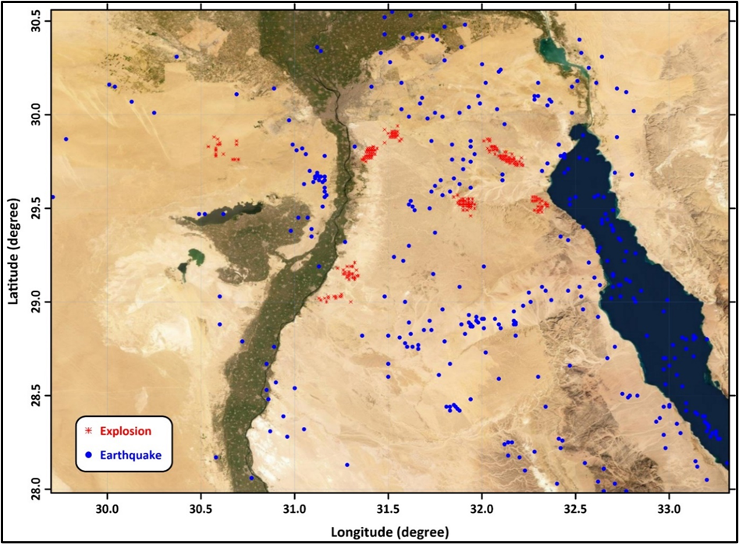
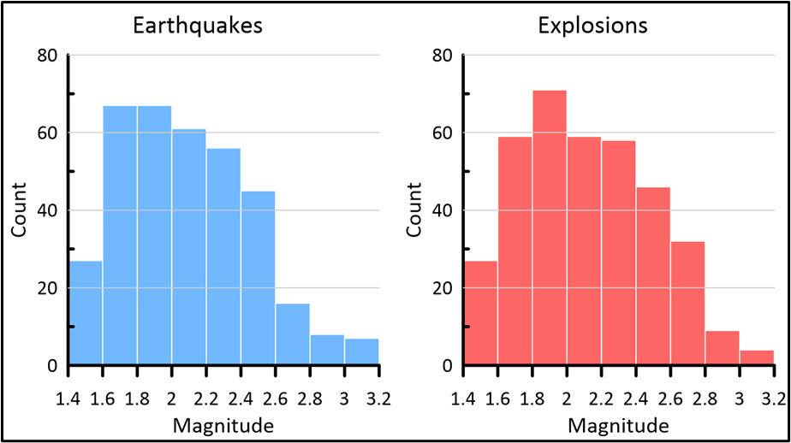
Discrimination between Earthquakes and Quarries Blasts Using Committee Machine
Ahmed Lethy, Adel S. Othman, Mohamed N. ElGabry, Hesham Hussein
P3.6-197
The data set used in this study are 720 seismic events (354 natural earthquakes and 366 explosions) recorded by the Egyptian National Seismological Network (ENSN) within the Northern part of Egypt.
The source parameters the duration magnitude (Md), P-wave spectrum corner frequency (P_{cf}), S-wave corner frequency (S_{cf}), and the ratio (R_{cf}) of P_{cf} to S_{cf} were used for discrimination.
INTRODUCTION

Slide 4
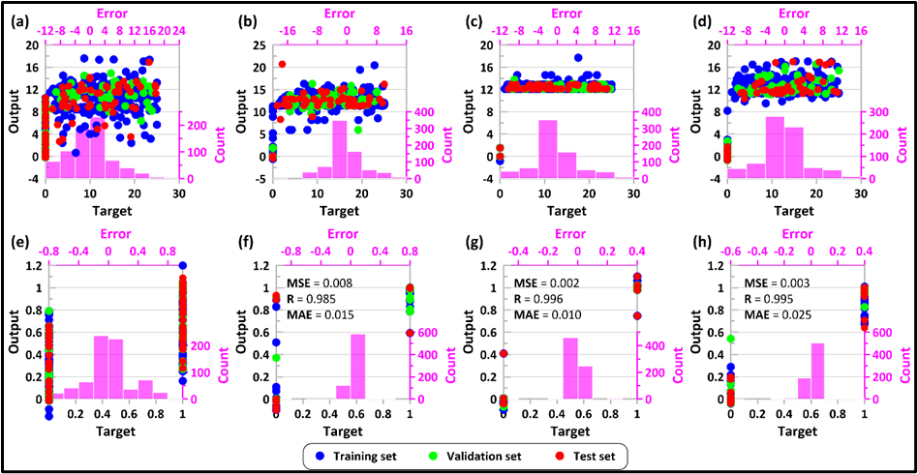
Discrimination between Earthquakes and Quarries Blasts Using Committee Machine
Ahmed Lethy, Adel S. Othman, Mohamed N. ElGabry, Hesham Hussein
P3.6-197
Artificial Neural Network
Input parameters
Four pairs of ANNs were trained with two distinct target sets.
The first target set is the source depth, where the explosions have zero depth and the earthquakes have deeper depths.
The second target set was a binary set formed of ones for earthquakes and zeros for explosions.
P_{cf}
S_{cf}
R_{cf}
P_{cf}, S_{cf}, R_{cf}
METHODS
Event Type Event Depth

Slide 5
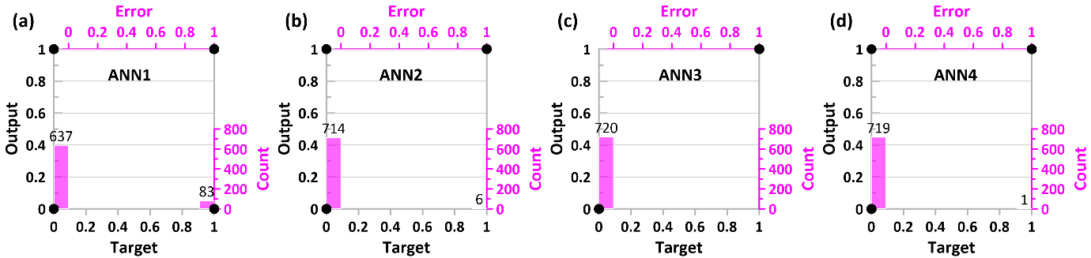
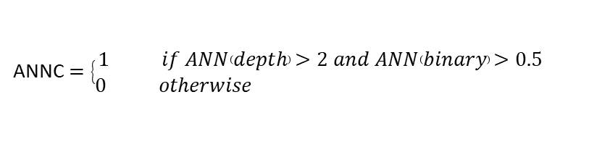
Discrimination between Earthquakes and Quarries Blasts Using Committee Machine
Ahmed Lethy, Adel S. Othman, Mohamed N. ElGabry, Hesham Hussein
P3.6-197
To enhance the results, the output of each pair of the ANNs that has the same input parameter are combined.
ANNC $=\left\{\begin{matrix}1 if ANN\left(depth\right)>2 and ANN\left(binary\right)>0.5 \\ 0 otherwise \end{matrix}\right.$
METHODS

Slide 6
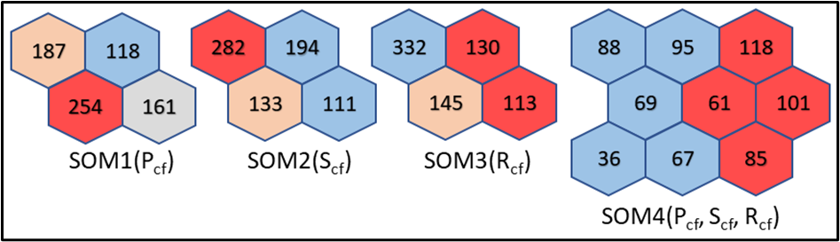
Discrimination between Earthquakes and Quarries Blasts Using Committee Machine
Ahmed Lethy, Adel S. Othman, Mohamed N. ElGabry, Hesham Hussein
P3.6-197
Self-organizing map (SOM)
The Self-organizing map (SOM) is a type of neural network that can perform clustering
The neurons in the SOM are arranged in a two-dimensional array
The SOM is used to classify the dataset into 9 clusters based on the three parameters (P_{cf}, S_{cf}, R_{cf}) and into 4 clusters based on every single parameter. The events were grouped in one of the groups by similarity according to the Euclidean distance between parameters.
The results of SOM are usually represented by hits and weights positions plots
METHODS

Slide 7
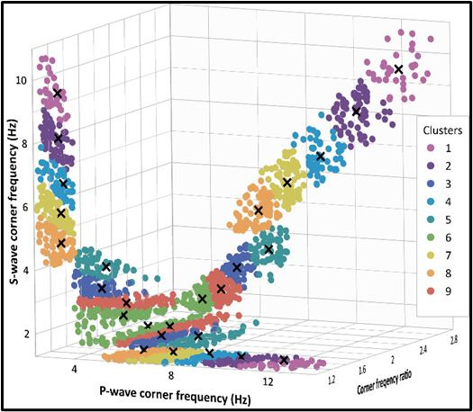
Discrimination between Earthquakes and Quarries Blasts Using Committee Machine
Ahmed Lethy, Adel S. Othman, Mohamed N. ElGabry, Hesham Hussein
P3.6-197
K-means
The main idea in k-means clustering is to find the center of each subset/cluster.
Using the clusters obtained by the SOMs, the number of clusters is predetermined and the centers could easily be obtained by finding the mean of the members of each cluster using Euclidean distance.
METHODS

Slide 8
Discrimination between Earthquakes and Quarries Blasts Using Committee Machine
Ahmed Lethy, Adel S. Othman, Mohamed N. ElGabry, Hesham Hussein
P3.6-197
Support and Confidence Measures
Each cluster C contains a number of events “hits” (nE). Some of them represent Earthquakes (nEq) and the others represent explosions (nEx).
The support and confidence measures for these clusters could be defined as follows:
The cluster support value (SC)is the ratio of the number of events in that cluster to the total number of events (TE).
SC=nE/TE, (5)
The confidence of a certain type of event in a given cluster is the ratio of the number of events of that type in the given cluster to the number of events in that cluster.
The confidence of earthquakes of a given cluster is CfEq=nEq/nE, (6)
The confidence of explosions of a given cluster is CfEx=nEx/nE, (7)
METHODS

Slide 9
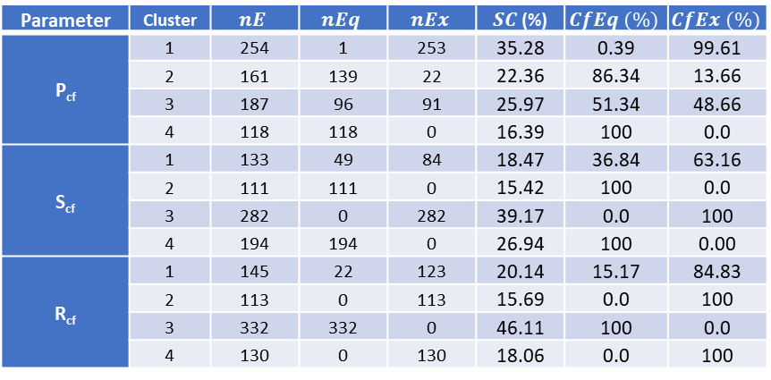
Discrimination between Earthquakes and Quarries Blasts Using Committee Machine
Ahmed Lethy, Adel S. Othman, Mohamed N. ElGabry, Hesham Hussein
P3.6-197
Support and Confidence Measures
Parameter | Cluster | $$nE$$ | $$nEq$$ | $$nEx$$ | $SC$ (%) | $$CfEq (\%)$$ | $$CfEx (\%)$$
P_{cf} | 1 | 254 | 1 | 253 | 35.28 | 0.39 | 99.61
 | 2 | 161 | 139 | 22 | 22.36 | 86.34 | 13.66
 | 3 | 187 | 96 | 91 | 25.97 | 51.34 | 48.66
 | 4 | 118 | 118 | 0 | 16.39 | 100 | 0.0
S_{cf} | 1 | 133 | 49 | 84 | 18.47 | 36.84 | 63.16
 | 2 | 111 | 111 | 0 | 15.42 | 100 | 0.0
 | 3 | 282 | 0 | 282 | 39.17 | 0.0 | 100
 | 4 | 194 | 194 | 0 | 26.94 | 100 | 0.00
R_{cf} | 1 | 145 | 22 | 123 | 20.14 | 15.17 | 84.83
 | 2 | 113 | 0 | 113 | 15.69 | 0.0 | 100
 | 3 | 332 | 332 | 0 | 46.11 | 100 | 0.0
 | 4 | 130 | 0 | 130 | 18.06 | 0.0 | 100
METHODS

Slide 10
Discrimination between Earthquakes and Quarries Blasts Using Committee Machine
Ahmed Lethy, Adel S. Othman, Mohamed N. ElGabry, Hesham Hussein
P3.6-197
Discrimination procedure
METHODS

Slide 11
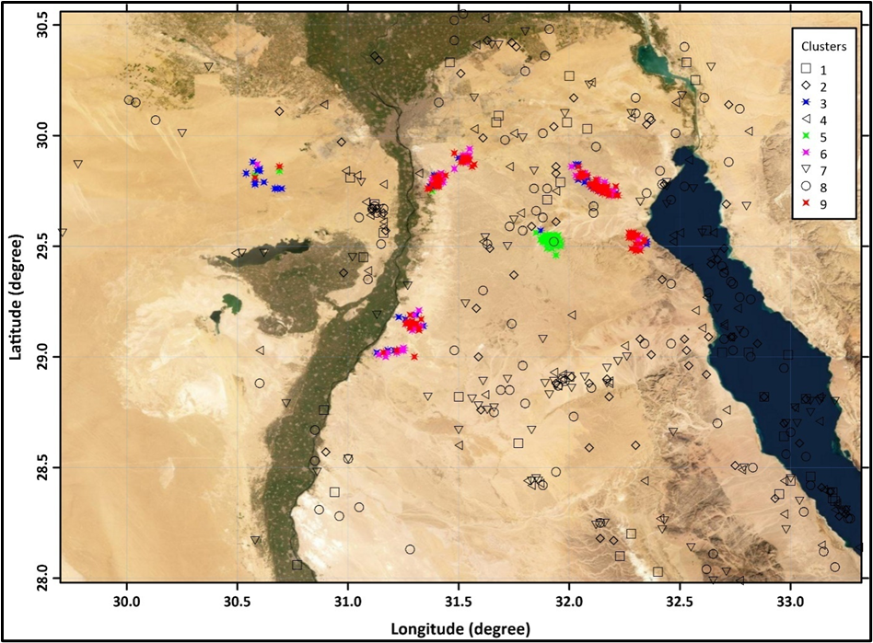
Discrimination between Earthquakes and Quarries Blasts Using Committee Machine
Ahmed Lethy, Adel S. Othman, Mohamed N. ElGabry, Hesham Hussein
P3.6-197
Discrimination Results
The nine cluster SOM almost separates the earthquakes and explosions in different clusters. All the clusters contain a single event-type except cluster 8 which contains 94 earthquakes and only one explosion. To visualize the result of these SOM clusters the events were posted on a satellite map with the holding cluster number indicated with different shapes
The green-colored asterisks (cluster 5) are almost concentrated in a single location. Indicating different detonation techniques
RESULTS

Slide 12
[click to edit Poster Title here using “Arial Bold” font size 12 or smaller if the title is too long]
[click to edit Author(s) name(s) with division, email (and/or) Affiliation here using “Arial” font size approx. 9]
P3.6-197
The simple combination applied to the ANN outputs enhances the result significantly. The combined results of the ANN trained with the corner frequency ratio Rcf and the ANN trained with the three parameters almost have 100 percentage correct discrimination. These results indicate that the Rcf parameter is significantly characterizing the earthquakes from the explosions.
The nine cluster SOM almost separates the earthquakes and explosions in different clusters. All the clusters contain a single event-type except cluster 8 which contains 94 earthquakes and only one explosion. To visualize the result of these SOM clusters the events were posted on a satellite map with the holding cluster number indicated with different shapes.
The green-colored asterisks (cluster 5) are almost concentrated in a single location. Indicating different detonation techniques.
The committee machine produces 100% correct results with confidence measures that represent the probability of event-type occurrence within the holding cluster.
The current work represents an idea to implement artificial intelligence to assist experts in decision-making situations. The committee machine could Identify the nature of a particular event using the aid of several discrimination methods. The proposed committee machine could combine the results of several algorithms and expert opinions to form one single output with a confidence measure.
CONCLUSIONS

