Slide 1
Automatic Classification of Particulate Radionuclide Spectra
Tryggvi Edwald
P3.5-026

Slide 2
Automatic Classification of Particulate Radionuclide Spectra
Tryggvi Edwald, tryggvi.edwald@gmail.com
P3.5-026
This poster* describes progress in 2020 on using Machine Learning, or “Deep Learning”, to
classify IMS particulate radionuclide spectra into two classes:
“Likely Normal” (Categories 1,2) and
“Requires Scrutiny by Analyst” (Categories 3,4,5).
The aim is to assist IDC radionuclide analysts by reducing their workload of “normal” spectra, which are the majority of IMS spectra, reserving their expertise to where it is needed.
The method described here entirely ignores radionuclide science. This is on purpose (for this initial study).
The whole point of this first effort was to find how close to a correct classification one could get using only
Machine Learning methods, and treating the spectra as any series of data. Accuracy of over 94%
has been achieved. It is considered likely that by injecting RN science into the calculations, the
results could be improved.
(*) The work described here was made while the author was a staff member of the CTBTO. However, the work was done entirely on his own time,
without using resources of the PTS other than idle computer time, and access to the IMS data. No PTS project suffered because of this study.
ABSTRACT

Slide 3
Automatic Classification of Particulate Radionuclide Spectra
Tryggvi Edwald, tryggvi.edwald@gmail.com
P3.5-026
The Machine Learning algorithm behind this method was trained on a large number of radionuclide
spectra already classified by human analysts, and therefore the input samples were of high quality. (The current algorithm cannot reliably process spectra of lesser quality or faulty spectra.)
Several Artificial Neural Networks (ANNs) were tested, but of those tested, the most successful was of the
shape shown on the next slide. The network was implemented in Tensorflow (2.x) Keras.
The ANN includes specific mechanisms to guard against numerical instability and overfitting.
As is normal practice, a significant, randomly selected, fraction of the whole dataset was set aside for testing the accuracy of the network, after training is completed (data not ‘seen’ by the network during training).
During training, the algorithms set a fraction of the input data aside for ‘validation’, after every ‘epoch’.
An epoch is one full run of the dataset through the network, in which the network parameters are updated.
After each epoch, the accuracy of the network on the training data is compared with its accuracy on the
validation data. How these values develop shows the training progress, and may be used to determine
when it should end - for instance, if ther is apparently no further improvement.
Relative sizes of the training, validation, and final testing datasets were varied in this study, and often
depend on the full dataset size, but commonly the division is around 80%/10%/10% respectively.
INTRODUCTION

Slide 4
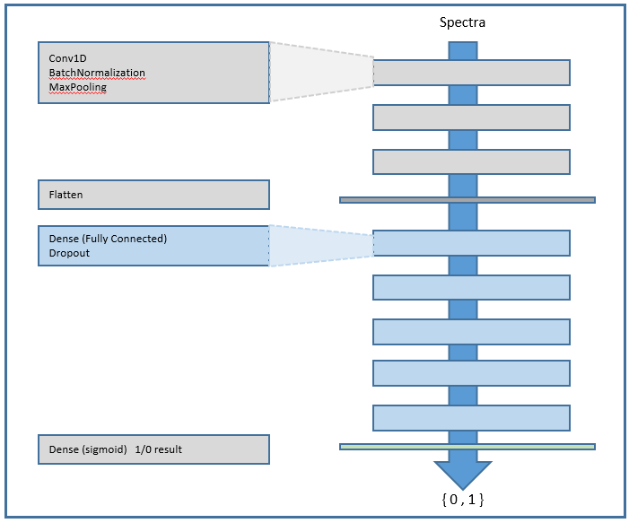
Automatic Classification of Particulate Radionuclide Spectra
Tryggvi Edwald, tryggvi.edwald@gmail.com
P3.5-026
ANN Network Structure
The spectra are fed in at the top
The network consists of three similar
‘Convolution’ blocks, (three layers
in each block, as shown here on the
left) …
… a single ‘flatten’ layer …
… five ‘Dense’ blocks, each
with two layers, …
… and finally a single classification layer
yields the binary output.

Slide 5
Automatic Classification of Particulate Radionuclide Spectra
Tryggvi Edwald, tryggvi.edwald@gmail.com
P3.5-026
Around 150K high-quality radionuclide spectra from June 2011 to late 2019, were fed through the network.
In 2011, changes were made to the processing pipeline that mean incorporating earlier spectra would
require extra work. (The current author has lost access to the data, so no updates with data from 2020-2021 can be made.)
The effect of pseudo-Calibration
Each spectra comes with one or more polynomials for Energy Calibration, to translate between the spectra energies and the channel-number in the Multi-Channel Analyzers. These polynomials can be problematic for
a learning algorithm to make use of, as the energy translation may map onto a variable number of channels, and regularizing these to a fixed number of channels –a necessity for neural network learning- would involve
re-sampling and/or padding the incoming data.
An approach selected was to use the Detector-ID as a proxy for calibration, assuming that each detector would
probably have similar energy calibrations through a few years of data. (This assumption may not hold, as the PTS
will use the Detector-ID throughout the lifetime of the detector, through repairs, rebuilds and relocations.)
It was found that adding the detector ID as a single column (one extra input node) on the spectra increases the
accuracy of the model in excess of 2 percentage points. (Precise value depends on Model design.)
METHODS-I

Slide 6
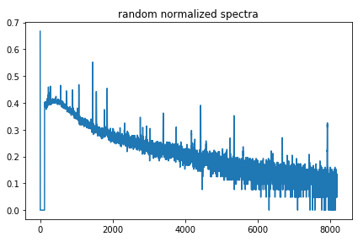
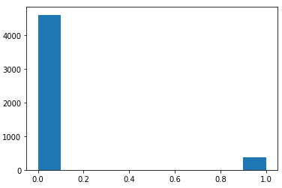
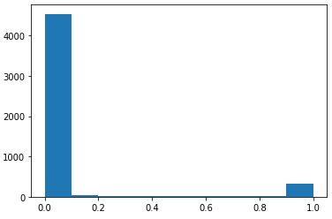
Automatic Classification of Particulate Radionuclide Spectra
Tryggvi Edwald, tryggvi.edwald@gmail.com
P3.5-026
Is the Full Spectra Needed?
While identifying which features of the spectra have the most impact on the outcome, it was found that under
these classes ( {1,2} and {3,4,5} ) the model does not lose any accuracy in its predictions by discarding
three-quarters of the spectra. Using the first 2048 channels only, the prediction accuracy does not drop.
The model still managed to reach some 94% accuracy on unseen data. The precise amount of reductions
possible without loss of accuracy has not been determined.
This is, of course, not news to the radionuclide science, as energies of the treaty-relevant nuclides are well
known, but this is important if calculation resources are limited. The reduced 1/4-spectra model can be run on
common small GPU-based processors, such as Nvidia’s Jetson computer, with relatively minuscule memory).
METHODS-II
Above, left: a typical, normalized full spectra; on the right, the first ¼ of the spectra.
Above left: actual distribution, on the right: predicted distribution of classes (note tiny
values around 0.2 on the right)

Slide 7
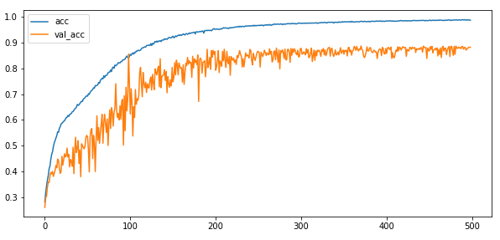
Automatic Classification of Particulate Radionuclide Spectra
Tryggvi Edwald, tryggvi.edwald@gmail.com
P3.5-026
Results of Learning
Around 150 thousand spectra were fed through the network. On an 8-GPU Nvidia DGX-1 Server, an epoch of 150K
spectra took around 6 seconds to process. Typically, there were 500 epochs in each training run (this number is an
experimentally determined function of when the networks stops improving.
A typical trace of accuracy improving with epochs (500 epochs in this case):
Legend:
acc: Accuracy on the dataset used for learning
val_acc: Accuracy on a separate set of data used repeatedly during the learning, for validation purposes.
The final accuracy is calculated on a third dataset, which the learning algorithm
doesn’t “see” until the learning phase is complete.
A gap between validation and training accuracy usually indicates that the network is ‘overfitting’ the model to the training data, and won’t necessarily do well on spectra
it hasn’t seen yet.
RESULTS
The Models described above reliably reached over 94%
accuracy on unseen spectra.
The proportion of false positives (blue, in table on right) is
reason for concern, and needs further work to reduce.
Actual \ Predictions : 0 (%) 1 (%)
----------------------------------------
0 : 4522 (90.44%) 144 ( 2.88%)
1 : 134 ( 2.68%) 200 ( 4.00%)
Correct predictions: 94.44% (4722 of 5000)

Slide 8
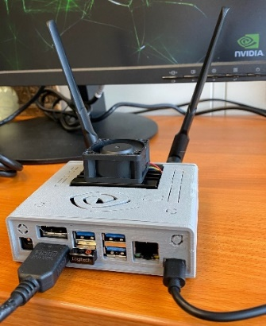
Automatic Classification of Particulate Radionuclide Spectra
Tryggvi Edwald, tryggvi.edwald@gmail.com
P3.5-026
Implementing an “inference Engine”
On the right, the “analyst”: an Nvidia Jetson Nano,
built and operated by the author.
The small computer fits into a box 10x10x3 cm, and can
be operated for hours on battery power.
It runs a full Linux OS, and has a full Python 3 environ-
ment, Jupyter server and TensorFlow 2.x,
among other software.
A fully-trained model from the above discussion (trained on the reduced-size spectra) was downloaded
into this smaller platform. A small REST server on the
device receives a full spectra, and returns the classifi-
cation as predicted by the model in a second or less.
RESULTS
GPU | 128-core Maxwell
CPU | Quad-core ARM A57 @ 1.43 GHz
Memory | 4 GB 64-bit LPDDR4 25.6 GB/s

Slide 9
Automatic Classification of Particulate Radionuclide Spectra
Tryggvi Edwald, tryggvi.edwald@gmail.com
P3.5-026
This work is an interesting start, but only a start. Further work is needed, if this approach is to be useful.
To be useful to IDC Analysts, the algorithm needs to handle incorrect spectra, and spectra of low quality.
It would be useful to incorporate a mechanism to consider prior spectra from the same detector, both as
a quality assurance mechanism, and to handle seasonal and cyclical changes in ‘normal’ values.
An obvious weakness of the current approach is the ignorance of energy calibrations. Further work is
needed to establish whether re-scaling or re-sampling the spectra of different lengths (after energy cali-
bration) introduce any processing artifacts.
The above proposed improvements of the current algorithm can be made purely based on statistical and
Machine Learning methods, (without application of radionuclide physics) and still be useful.
However, it is unlikely that a method of this sort will become reliable, and be accepted by the radionuclide community, without the application of radionuclide science - e.g. using high quality nuclide libraries to identify spectra peaks as nuclides, and other features of the existing data processing pipeline.
Finally, the extension of these methods to the Noble-Gas domain seems obvious, but this author had only begun to apply Machine Learning to $β-γ$ spectra when this study came to an end.
CONCLUSIONS
The

