Slide 1
Proficiency Test Exercises (PTE) : Bringing Certainty into Uncertainty
Nikolaus Hermanspahn, Herbert Gohla
P3.2-279

Slide 2
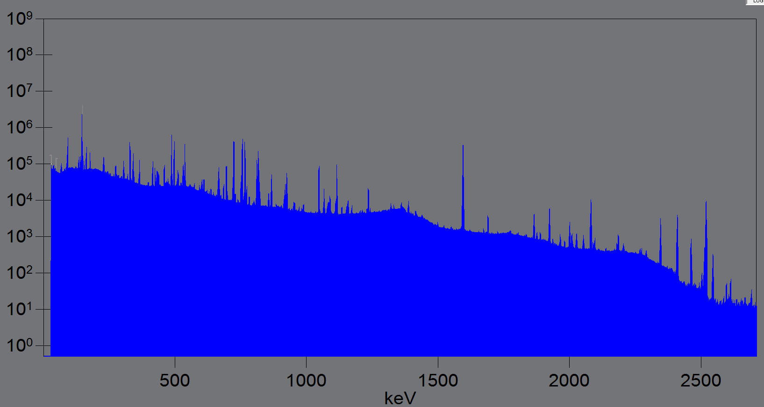
Proficiency Test Exercises (PTE) : Bringing Certainty into Uncertainty
Nikolaus Hermanspahn, Herbert Gohla
P3.2-279
Proficiency Test Exercises for IMS Laboratories
IMS laboratories are part of the International Monitoring system (IMS) and provide critical data and assessments on potential Treaty violations. The laboratories also fulfil an essential role in the Quality Assurance program for radionuclide IMS stations.
Proficiency Test Exercises (PTEs) are held annually to test the performance of IMS laboratories and to provide them with feedback for improvement.
Particulate PTEs have been held since 2000 and Noble Gas PTEs have started in 2021.
Background
Evaluation criteria have been established for individual results for a PTE and these results are used to grade the laboratories. In addition to these pass/fail criteria, data from PTEs contains additional information that could be used to further improve laboratory performance.
Goal
Establish additional tools to evaluate overall performance of individual laboratories and to provide information on performance of PTEs.
Quick Facts on CTBT Particulate PTEs
16 participating IMS laboratories
Per PTE one of six IMS standard geometries
Fresh fission and activation products
10-30 nuclides are evaluated in each exercise
Analysis by gamma spectrometry
Spectra typically contain 200-300 peaks

Slide 3
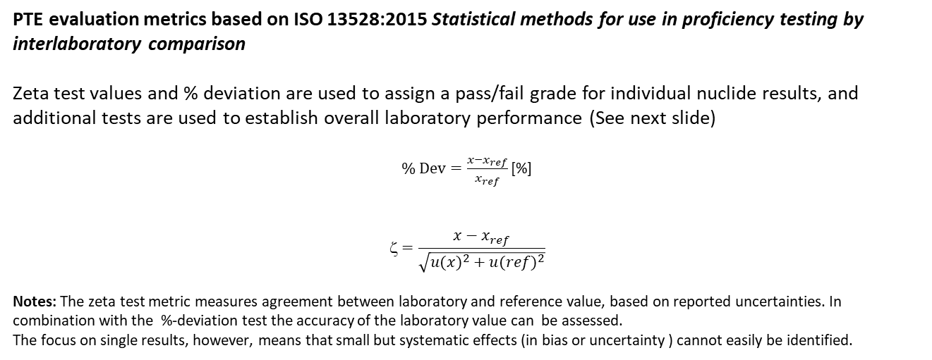
Proficiency Test Exercises (PTE) : Bringing Certainty into Uncertainty
Nikolaus Hermanspahn, Herbert Gohla
P3.2-279
PTE evaluation metrics based on ISO 13528:2015 Statistical methods for use in proficiency testing by interlaboratory comparison
Zeta test values and % deviation are used to assign a pass/fail grade for individual nuclide results, and additional tests are used to establish overall laboratory performance (See next slide)
$\text{\%} \text{Dev}=\frac{x−x_{ref}}{x_{ref}}$ [%]
$$\text{z}=\frac{x−x_{ref}}{\sqrt{{u(x)}^{2}+{u(ref)}^{2}}}$$
Notes: The zeta test metric measures agreement between laboratory and reference value, based on reported uncertainties. In combination with the %-deviation test the accuracy of the laboratory value can be assessed.
The focus on single results, however, means that small but systematic effects (in bias or uncertainty ) cannot easily be identified.

Slide 4
Proficiency Test Exercises (PTE) : Bringing Certainty into Uncertainty
Nikolaus Hermanspahn, Herbert Gohla
P3.2-279
CTBT PTE Evaluation metrics – particulate PTE
The five metrics listed below are used to assess the performance of each laboratory. They provide acceptance criteria for individual nuclide results and are the basis for grading of the laboratory.
 | Metric | Method | Acceptance Limit | Comments
1 | Accuracy (Estimate of bias) | %difference test (%Deviation) | <15% | Required
2 | Accuracy | zeta test (ζ) | <3 | Required
3 | Correct identification of nuclides | False negative test | All major nuclides identified | Required
4 | Correct identification of nuclides | False positive test | None | Indicator
5 | Precision (Uncertainties) | Inter-quartile range test for relative uncertainty (R_{L}) rations | Q1-3(Q3-Q1) to Q3+3 (Q3-Q1) | Indicator

Slide 5
Proficiency Test Exercises (PTE) : Bringing Certainty into Uncertainty
Nikolaus Hermanspahn, Herbert Gohla
P3.2-279
Evaluation of PTEs is based on ISO13528:2015
9.8 Evaluation of participant uncertainties in testing: “….. The ζ scores described in section 9.6 and E_{n} scores in section 9.7 are options for evaluation of results against the claimed uncertainty.”
Underestimation of uncertainties will result in higher ζ values, and can lead to an increased number of fail results for the laboratory. The statistical analysis may allow to distinguish between individual outliers and systematic underestimation of uncertainty.
Overestimation of uncertainties reduces ζ values and increases chances of meeting the acceptance criteria. If the % deviation criteria is still met pass criteria are still met. In this case it can only be picked up in statistical analysis of the laboratory’s results.
Distribution of ζ values can be used to identify bias in laboratory results.

Slide 6
Proficiency Test Exercises (PTE) : Bringing Certainty into Uncertainty
Nikolaus Hermanspahn, Herbert Gohla
P3.2-279
Use of zeta (ζ )distribution plots:
For an idealized measurement the zeta test distribution is identical to the standard normal distribution. Deviation from the standard normal distribution may therefore indicate systematic effects, such as a systematic bias or under- or overestimation of uncertainties.
Overestimation of uncertainties will give low zeta values and therefore is likely to result in a good grade for the laboratory but can show up as a distribution of zeta tests that is too sharp –as in the example below for a distribution with σ=0.5.

Slide 7
Proficiency Test Exercises (PTE) : Bringing Certainty into Uncertainty
Nikolaus Hermanspahn, Herbert Gohla
P3.2-279
Histograms can provide a picture of the PTE as a whole, or even show overall performance for multiple PTEs. 540 individual results are combined in the distribution of zeta test values pictured below. The distribution of laboratory test results closely matches a normal standard distribution. This is an indication that overall IMS laboratories are providing accurate results. It is also an indication that uncertainty of reference values and that of the IMS laboratories overall are well estimated.

Slide 8
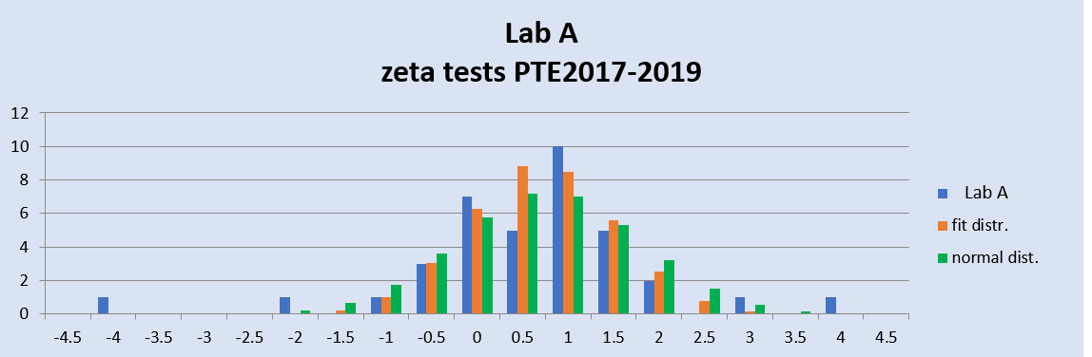
Proficiency Test Exercises (PTE) : Bringing Certainty into Uncertainty
Nikolaus Hermanspahn, Herbert Gohla
P3.2-279
Example 1: The plot below shows the distribution of zeta test values for one laboratory (Lab A – in blue) for a three year period. The distribution agrees well with the shifted standard normal distribution (in green). Some outliers are visible, caused by individual discrepant results. All discrepant results (zeta > 3) need to be investigated by the laboratory, but overall results are good and laboratory uncertainties seem to be well estimated.
Results show a small bias (μ= 0.7). The bias, could be investigated, but may be spurious, as the dataset is based on 3 samples only.

Slide 9
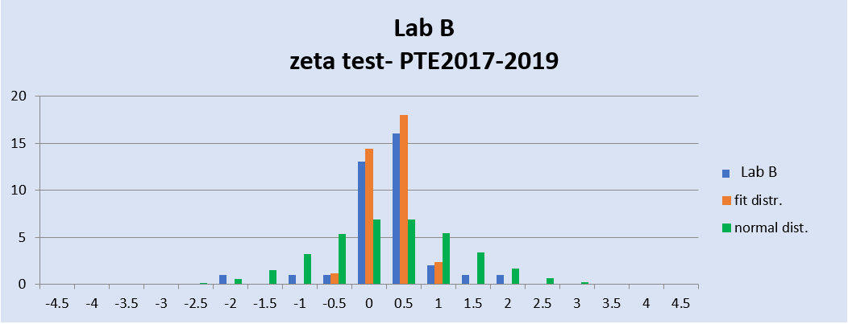
Proficiency Test Exercises (PTE) : Bringing Certainty into Uncertainty
Nikolaus Hermanspahn, Herbert Gohla
P3.2-279
Example 2: The plot below shows the distribution of zeta test values for one laboratory (Lab B – in blue) for a three year period. The distribution clearly differs from the standard normal distribution (in green). The orange distribution shown, is a normal distribution (μ 0.3, σ = 0.3) which approximates the laboratory data. While all laboratory results pass the ζ test, the distribution may be indicate an overestimation of laboratory uncertainties and the laboratory can be instructed to investigate.

Slide 10
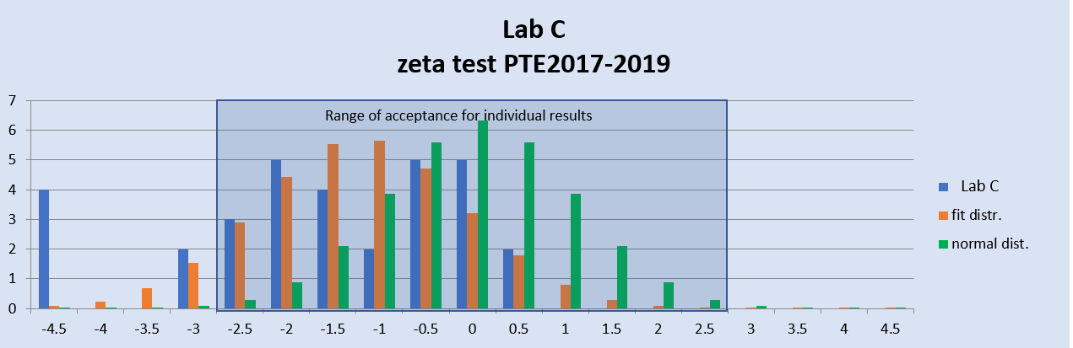
Proficiency Test Exercises (PTE) : Bringing Certainty into Uncertainty
Nikolaus Hermanspahn, Herbert Gohla
P3.2-279
Example 3: The plot below shows the distribution of zeta test values for one laboratory (Lab C – in blue) for a three year period. The distribution clearly differs from the standard normal distribution (in green) and also shows some outliers, but also shows that most individual results are acceptable. The orange distribution shown, is a normal distribution (μ -1.2, σ = 1.1) which approximates the laboratory data. The distribution may indicate that the laboratory has a bias and would warrant further investigation.

Slide 11
Proficiency Test Exercises (PTE) : Bringing Certainty into Uncertainty
Nikolaus Hermanspahn, Herbert Gohla
P3.2-279
Conclusion
The statistical evaluation and graphical presentation of ζ scores in histograms aides in assessing the complete set of results as opposed to focusing on singular fail results.
The relative large number of results per exercise makes it possible to provide feedback based on a single exercise.
The evaluation should not be used as additional pass/fail criteria, but can aid laboratories in identifying weaknesses.

