Slide 1



Development of an Ultra-Sensitive Gamma-Gamma Coincidence System for Radionuclide Measurements at International Monitoring System Stations
M. Sharma¹, J. Burnett¹, A. Myers¹, L. Lidey¹, H. Miley¹,
T. Anderson², H. Persson², K. Phillips²
¹Pacific Northwest National Laboratory ; ²Mirion Technologies
Poster No.: P3.1-312
Disclaimer: The views expressed here do not necessarily reflect the views of the United States Government, the United States Department of Energy, the National Nuclear Security Administration or the Pacific Northwest National Laboratory.
Cleared for Release. PNNL Release No.: PNNL-SA-162613

Slide 2
Development of an Ultra-Sensitive Gamma-Gamma Coincidence System for Radionuclide Measurements at International Monitoring System Stations
M. Sharma¹, J. Burnett¹, A. Myers¹, L. Lidey¹, H. Miley¹, T. Anderson², H. Persson², K. Phillips²
¹Pacific Northwest National Laboratory ; ²Mirion Technologies
P3.1-312
Next-generation gamma-gamma coincidence measurements have the potential to significantly improve the detection of particulate radionuclides relevant for Treaty monitoring purposes. Sophisticated laboratory systems have demonstrated order of magnitude improvements for radionuclides such as ¹⁰⁶Ru/¹⁰⁶Rh and ¹³⁴Cs. However, the implementation of these systems at IMS particulate stations has been limited by the complexity of acquisition hardware, data processing, and analysis techniques required. At Pacific Northwest National Laboratory (PNNL, USA), in collaboration with Mirion Technologies (USA), a prototype system suitable for station deployment is being developed. Designed for practical implementation and operation, the system consists of acquisition electronics that are compatible with the existing station hardware and streamlined software capable of calculating the activity of relevant radionuclides using coincidence algorithms. This presentation discusses the design, validation and performance of the system, and compares the detection sensitivity with standard IMS stations.
ABSTRACT

Slide 3
Development of an Ultra-Sensitive Gamma-Gamma Coincidence System for Radionuclide Measurements at International Monitoring System Stations
M. Sharma¹, J. Burnett¹, A. Myers¹, L. Lidey¹, H. Miley¹, T. Anderson², H. Persson², K. Phillips²
¹Pacific Northwest National Laboratory ; ²Mirion Technologies
P3.1-312
Radionuclide (RN) monitoring is one of the four verification technologies of the International Monitoring System (IMS)
  Specifications were derived from CD/NTB/WP.224, 1995
The IMS includes 80 stations to collect aerosols from the atmosphere and analyze for radionuclides using high-resolution gamma spectrometry
  Such as ¹⁴⁰La, ¹⁴⁰Ba, ¹³⁴Cs, ¹³⁷Cs, etc.
In 1998, the Radionuclide Aerosol Sampler/Analyzer (RASA) was introduced as an automated aerosol system for the IMS after six years of development at PNNL
After 20+ years of operational lessons learned, a new approach to RASA is under development. One aspect is reported here
BACKGROUND

Slide 4
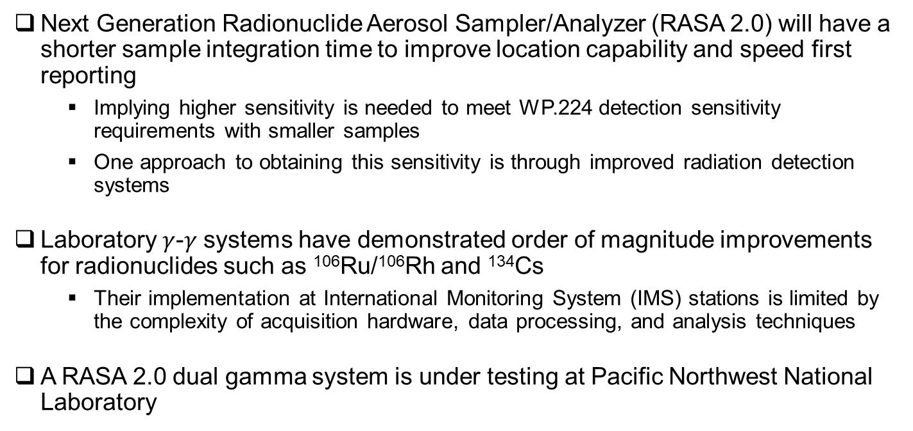
Development of an Ultra-Sensitive Gamma-Gamma Coincidence System for Radionuclide Measurements at International Monitoring System Stations
M. Sharma¹, J. Burnett¹, A. Myers¹, L. Lidey¹, H. Miley¹, T. Anderson², H. Persson², K. Phillips²
¹Pacific Northwest National Laboratory ; ²Mirion Technologies
P3.1-312
Next Generation Radionuclide Aerosol Sampler/Analyzer (RASA 2.0) will have a shorter sample integration time to improve location capability and speed first reporting
  Implying higher sensitivity is needed to meet WP.224 detection sensitivity requirements with smaller samples
  One approach to obtaining this sensitivity is through improved radiation detection systems
Laboratory $γ$-$γ$ systems have demonstrated order of magnitude improvements for radionuclides such as ¹⁰⁶Ru/¹⁰⁶Rh and ¹³⁴Cs
  Their implementation at International Monitoring System (IMS) stations is limited by the complexity of acquisition hardware, data processing, and analysis techniques
A RASA 2.0 dual gamma system is under testing at Pacific Northwest National Laboratory
INTRODUCTION

Slide 5
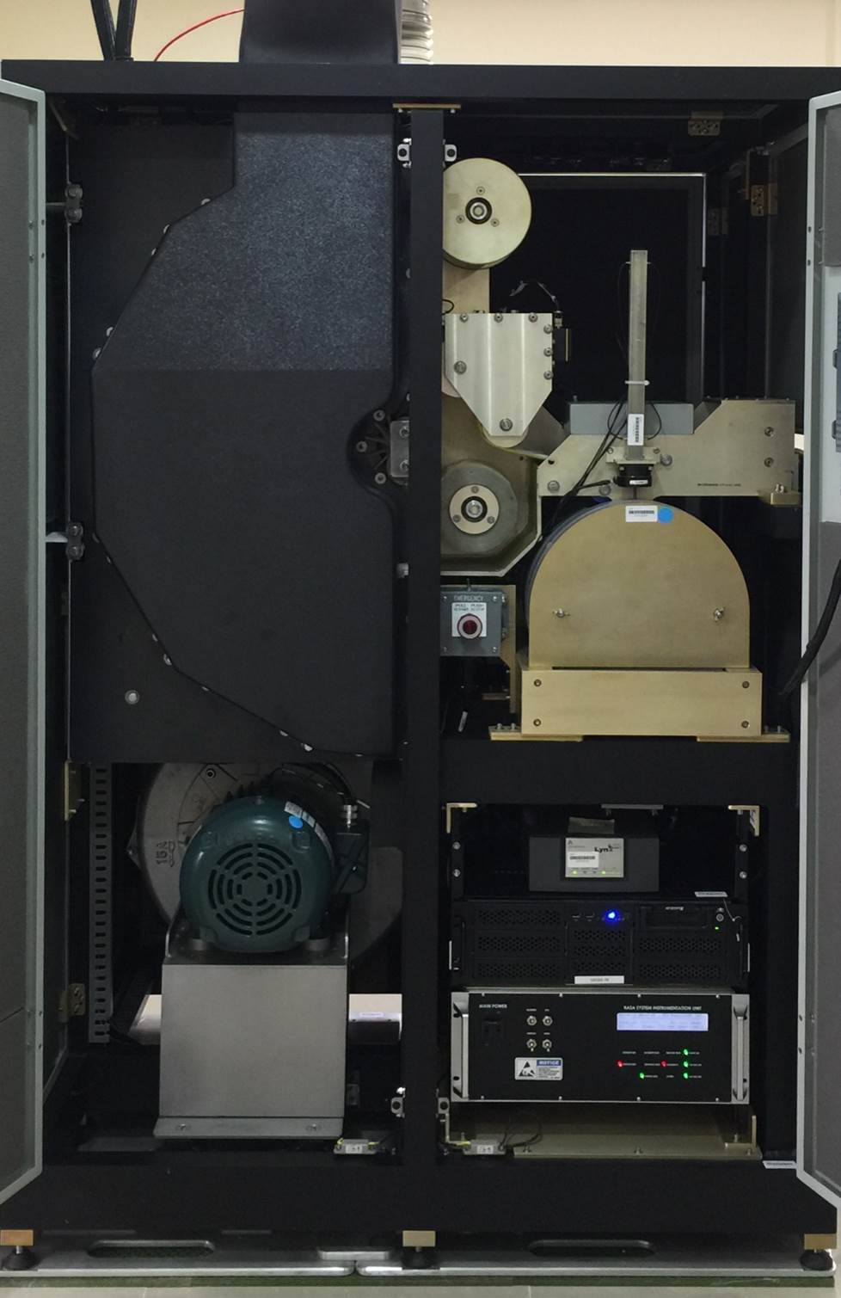
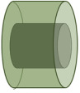
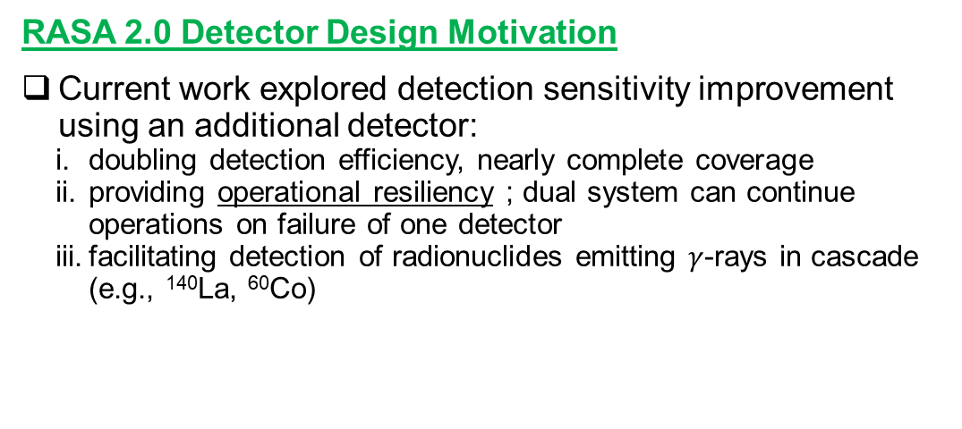
Development of an Ultra-Sensitive Gamma-Gamma Coincidence System for Radionuclide Measurements at International Monitoring System Stations
M. Sharma¹, J. Burnett¹, A. Myers¹, L. Lidey¹, H. Miley¹, T. Anderson², H. Persson², K. Phillips²
¹Pacific Northwest National Laboratory ; ²Mirion Technologies
P3.1-312
RASA 2.0 Detector Design Motivation
Current work explored detection sensitivity improvement using an additional detector:
doubling detection efficiency, nearly complete coverage
providing operational resiliency ; dual system can continue operations on failure of one detector
facilitating detection of radionuclides emitting $γ$-rays in cascade (e.g., ¹⁴⁰La, ⁶⁰Co)
Air flow
Mylar wrap roll
MOTIVATION
Particulate collection
RASA 2.0 Dual Gamma Geometry
Original RASA Wrap Around Geometry
HPGe
Sample
MCA
90% Relative Efficiency HPGe Detector
Original RASA-an automated collection and analysis aerosol radionuclide monitoring system

Slide 6
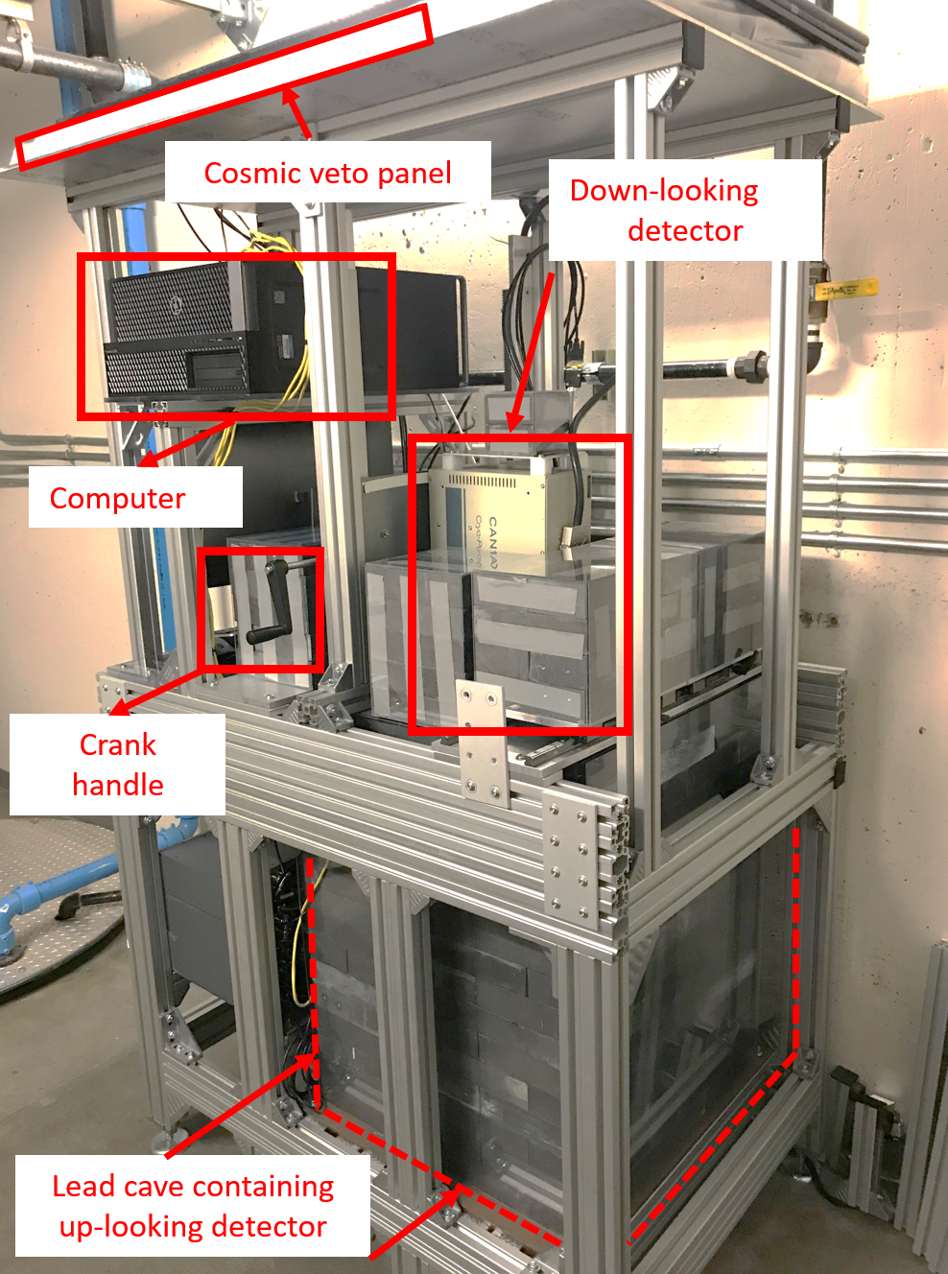
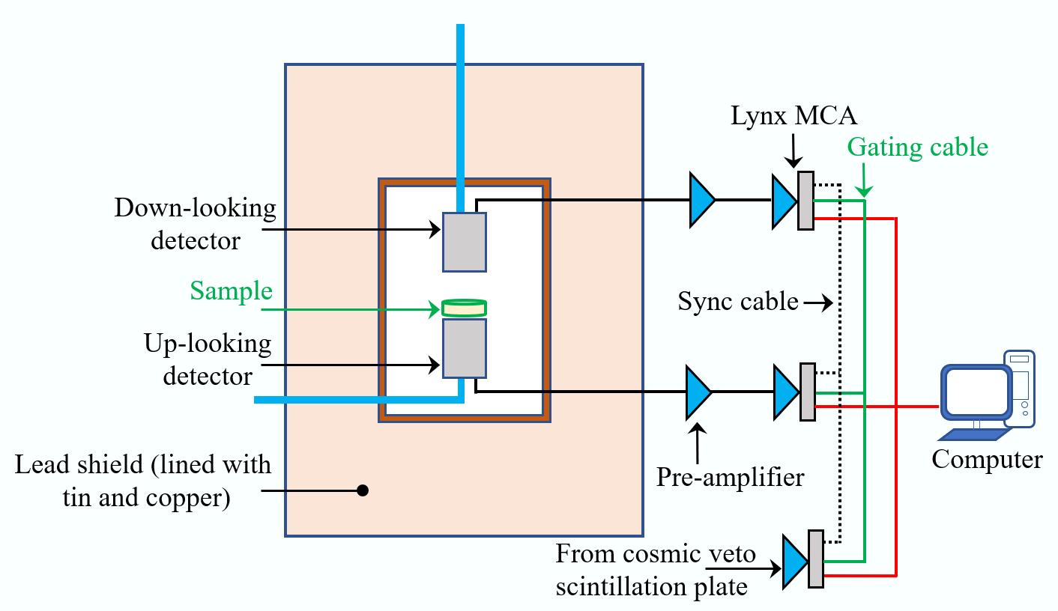
Development of an Ultra-Sensitive Gamma-Gamma Coincidence System for Radionuclide Measurements at International Monitoring System Stations
M. Sharma¹, J. Burnett¹, A. Myers¹, L. Lidey¹, H. Miley¹, T. Anderson², H. Persson², K. Phillips²
¹Pacific Northwest National Laboratory ; ²Mirion Technologies
P3.1-312
RASA 2.0 Dual Gamma Spectrometry
In March 2021, a dual gamma-spectrometer was constructed similar to what might be expected at IMS station
Two HPGe detectors in up-down configuration, each detector
has active area 6500 mm², cooled via electrically powered cryostat
meets CTBT requirements
characterized by Mirion technologies ⇒ source-less efficiency calibration
METHODS
Schematic of the novel dual gamma-spectrometer at PNNL
Dual Gamma-Spectrometer at PNNL

Slide 7
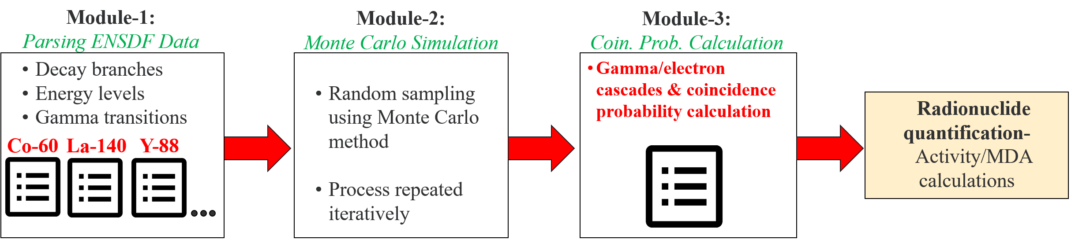
Development of an Ultra-Sensitive Gamma-Gamma Coincidence System for Radionuclide Measurements at International Monitoring System Stations
M. Sharma¹, J. Burnett¹, A. Myers¹, L. Lidey¹, H. Miley¹, T. Anderson², H. Persson², K. Phillips²
¹Pacific Northwest National Laboratory ; ²Mirion Technologies
P3.1-312
Novel Quantification Software Approach
Summed dual gamma data can be analyzed just as IMS data is analyzed today
Coincidence data might only need to be analyzed under certain, triggering conditions
Spectrometer collects list-mode data: each event’s time-stamp/energy is saved:
Coincident gamma-rays (e.g., from ¹⁴⁰La) can be identified
Significantly reducing background, potentially improving detection limits
Software developed to quantify 𝜸-𝜸 coincidences, operating in two segments:
Coincidence Identification: generate coincidence spectra
Radionuclide Quantification: (Monte-Carlo) simulated radionuclide-specific coincidence detection probability
METHODS
Modular structure improves computational efficiency
  As gamma/electron cascades need not be re-produced for various systems

Slide 8
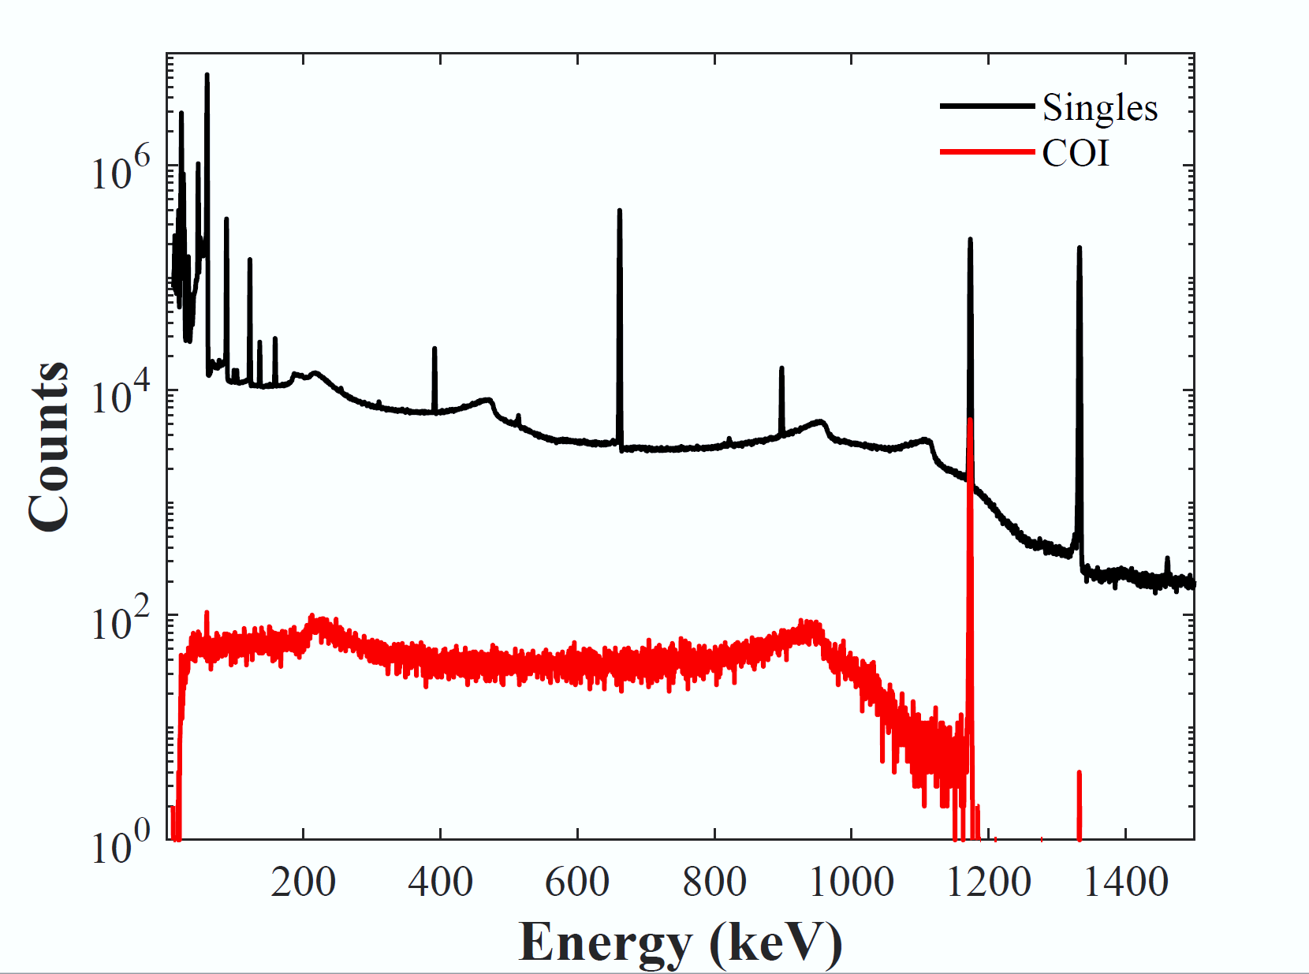
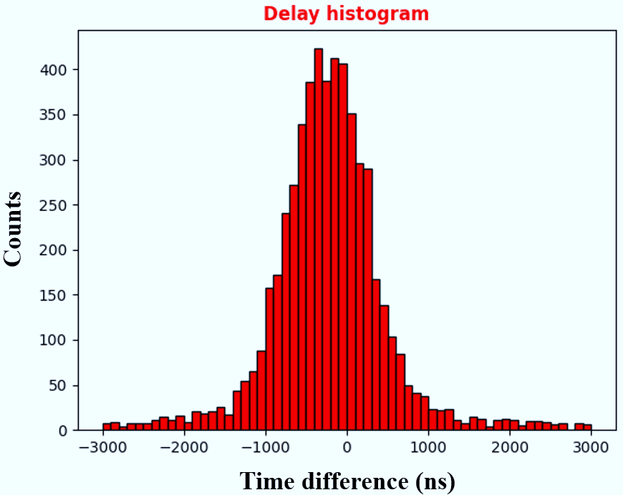


Development of an Ultra-Sensitive Gamma-Gamma Coincidence System for Radionuclide Measurements at International Monitoring System Stations
M. Sharma¹, J. Burnett¹, A. Myers¹, L. Lidey¹, H. Miley¹, T. Anderson², H. Persson², K. Phillips²
¹Pacific Northwest National Laboratory ; ²Mirion Technologies
P3.1-312
Quantification Software -Typical Input/Output
Coincidence Identification:
  Input: time-stamped data from each (LynxTM) Multichannel Analyzer
  Output:
    Delay histogram (right, below), Singles/Summed spectra
    Energy-gated coincidence spectra (see right figure, compatible with Canberra’s Genie 2000 software)
Radionuclide Quantification:
  Input: Radionuclide’s decay scheme (Evaluated Nuclear Structure Data File, ENSDF), X-ray info, Gating energies
  Output: Coin. detection probability specific to radionuclide/coin. pair (left, below)
Singles
Coincidence
Sample coincidence histogram obtained from software’s segment $I$
Singles and coincidence spectra shown for a ⁶⁰Co source
Reduced continuum in coincidence spectrum shows promising improvement than singles
METHODS
Simulated coincidence detection probabilities
        needed for radionuclide quantification
Figure shows probability convergence with number of software runs (iterations). Also shown is the respective computational time taken by the software
Delay histogram generated by software’s segment $I$
Timing distribution of coincident events predicted by the software

Slide 9

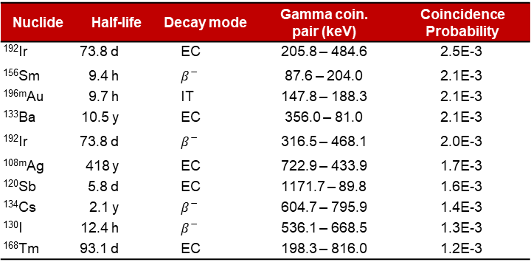
Development of an Ultra-Sensitive Gamma-Gamma Coincidence System for Radionuclide Measurements at International Monitoring System Stations
M. Sharma¹, J. Burnett¹, A. Myers¹, L. Lidey¹, H. Miley¹, T. Anderson², H. Persson², K. Phillips²
¹Pacific Northwest National Laboratory ; ²Mirion Technologies
P3.1-312
Software Validation
Nuclide | Half-life | Decay mode | Gamma coin. pair (keV) | Coincidence Probability
¹⁹²Ir | 73.8 d | EC | 205.8 – 484.6 | 2.5E-3
¹⁵⁶Sm | 9.4 h | $$β^{−}$$ | 87.6 – 204.0 | 2.1E-3
^{196m}Au | 9.7 h | IT | 147.8 – 188.3 | 2.1E-3
¹³³Ba | 10.5 y | EC | 356.0 – 81.0 | 2.1E-3
¹⁹²Ir | 73.8 d | $$β^{−}$$ | 316.5 – 468.1 | 2.0E-3
^{108m}Ag | 418 y | EC | 722.9 – 433.9 | 1.7E-3
¹²⁰Sb | 5.8 d | EC | 1171.7 – 89.8 | 1.6E-3
¹³⁴Cs | 2.1 y | $β^{−}$ | 604.7 – 795.9 | 1.4E-3
¹³⁰I | 12.4 h | $$β^{−}$$ | 536.1 – 668.5 | 1.3E-3
¹⁶⁸Tm | 93.1 d | EC | 198.3 – 816.0 | 1.2E-3
10 CTBT-relevant radionuclides with largest coincidence detection probabilities predicted by the software for 10⁶ iterations
EC: Electron capture, $β^{−}$: Beta decay, IT: Isomeric transition
RESULTS
Activities calculated using raw (summed) and coincidence spectra for the calibration standard ;
Summed/coincidence activities in excellent agreement with the decay-corrected certificate activities
Nuclide | Gated energy (keV) | Projected energy (keV) | Activity [Bq]
 |  |  | Dual detector (summed) | Dual detector (coincidence) | Certificate
⁶⁰Co | 1173.2 | 1332.5 | 282.1 ± 1.7 | 274.7 ± 2.2 | 280.5 ± 3.3
⁸⁸Y | 898.0 | 1836.1 | 4.0 ± 0.1 | 3.8 ± 0.3 | 4.0 ± 0.1

Slide 10
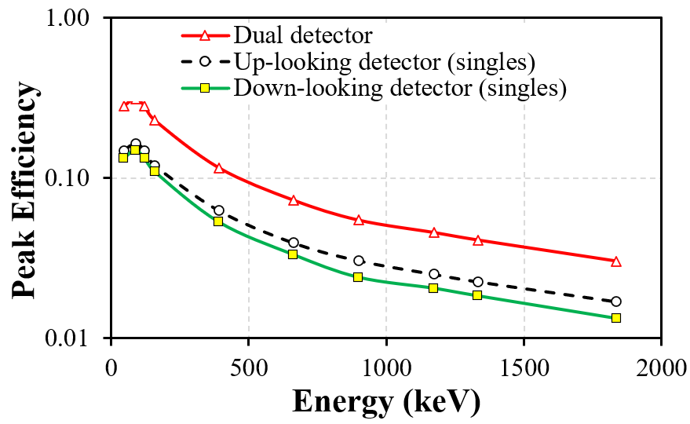
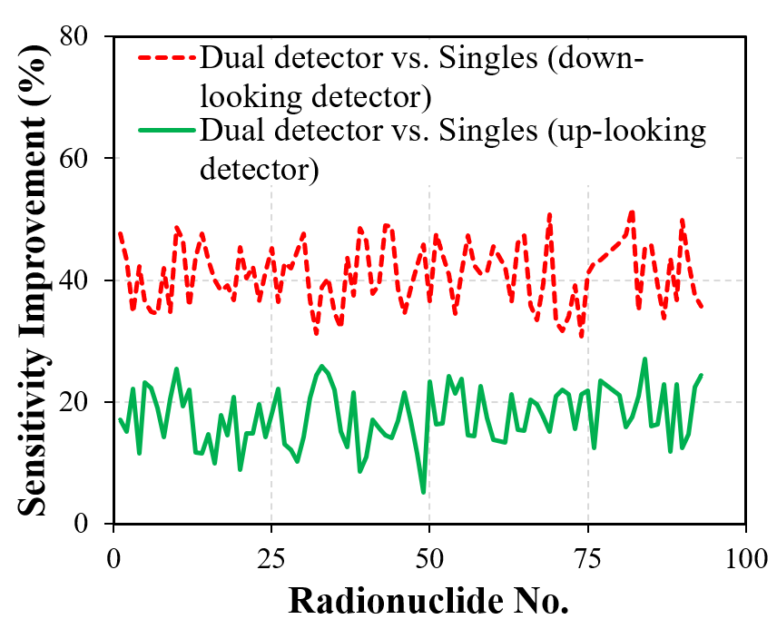
Development of an Ultra-Sensitive Gamma-Gamma Coincidence System for Radionuclide Measurements at International Monitoring System Stations
M. Sharma¹, J. Burnett¹, A. Myers¹, L. Lidey¹, H. Miley¹, T. Anderson², H. Persson², K. Phillips²
¹Pacific Northwest National Laboratory ; ²Mirion Technologies
P3.1-312
Dual Detector Improvements ; Comparison With IMS Station
Detection efficiency and sensitivity improvement with dual detector approach
Comparison of dual gamma-spectrometer’s sensitivity with RASA system at IMS Stations
Sensitivity comparison of dual detector approach vs. Singles
  Figures show improvement with dual detector for 84 CTBT-relevant radionuclides
For 24-h acquisition, sensitivity improved by 5-52% (avg. 29%)
Second detector improved peak efficiency by 1.9-2.0 (avg. 2.0)
RESULTS
Sensitivity comparison of Singles/Dual detector with current RASA system
Improvements consistently better than the ones for current RASA configuration
Improvement 73-96% (avg. 86%) and 84-97% (avg. 90%) for singles and summed case, respectively
13 radionuclides’ improvement: 59-94% (avg. 78%) and 75-95% (avg. 85%) for singles and summed case, respectively
With current RASA configuration (air collection volume ~23000 m³)
With next-generation RASA configuration (air collection volume 36000 m³)
*Sensitivity improvement: improved sensitivity with dual approach vs. sensitivity calculated using ~51000 RASA samples taken at 20 global IMS stations
Singles (Summed): when single (both) detectors are used to calculate sensitivity
Up-looker: up-looking (down-looking) detector

Slide 11
Development of an Ultra-Sensitive Gamma-Gamma Coincidence System for Radionuclide Measurements at International Monitoring System Stations
M. Sharma¹, J. Burnett¹, A. Myers¹, L. Lidey¹, H. Miley¹, T. Anderson², H. Persson², K. Phillips²
¹Pacific Northwest National Laboratory ; ²Mirion Technologies
P3.1-312
Results demonstrate potential improvement in detection sensitivity at radionuclide aerosol monitoring stations through the use of a dual detector approach
  Detection sensitivity improved up to 52% (avg. 29%) for 84 CTBT-relevant radionuclides
In-house software developed to analyze dual gamma-spectrometer’s output
  Summed/coincident activities validated with calibration source for ⁶⁰Co and ⁸⁸Y
Future work will explore:
  Sensitivity improvement using coincidence technique; coincidence timing window optimization
  Validating coincidence detection probabilities for radionuclides other than ⁶⁰Co and ⁸⁸Y
CONCLUSIONS

Slide 12
Development of an Ultra-Sensitive Gamma-Gamma Coincidence System for Radionuclide Measurements at International Monitoring System Stations
M. Sharma¹, J. Burnett¹, A. Myers¹, L. Lidey¹, H. Miley¹, T. Anderson², H. Persson², K. Phillips²
¹Pacific Northwest National Laboratory ; ²Mirion Technologies
P3.1-312
Thank You!

