Slide 1

Upgrading the Detection System of the MIKS Xenon Isotope Monitoring Complex
during Preparation for the International Certification
M.Yu. Chernov, D.E.Ergashev, O.A.Gerasimchuk, N.P.Goryacheva, D.A.Molodtsev,
M.S.Orlov, V.V.Probylov, N.A.Sidorov, D.V.Timofeev, and O.V. Tkachev
P3.1- 434

Slide 2
Upgrading the Detection System of the MIKS Xenon Isotope Monitoring Complex
during Preparation for the International Certification
Chernov M.Yu., Ergashev D.E., Gerasimchuk O.A., Goryacheva N.P., Molodtsev D.A.,
Orlov M.S., Probylov V.V., Sidorov N.A., Timofeev D.V., and Tkachev O.V.
ALL-RUSSIAN RESEARCH INSTITUTE OF AUTOMATICS (VNIIA)
P3.1-434
The MIKS system has been developed for establishing the Russian segment of IMS, which is being created pursuant to the provisions of the Comprehensive Nuclear-Test-Ban Treaty (CTBT).
The Provisional Technical Secretariat of the Preparation Commission for the Comprehensive Nuclear-Test-Ban Treaty Organization (PTS PC CTBTO) specifies the following requirements for spectrometry systems, which are part of alike equipment, in the Certification of Noble Gas Equipment at IMS Stations document (CTBT/PTS/INF.921/Rev.3):
- the detector shall be calibrated for gamma energy and resolution between 25 keV and 400 keV, with a calibration point at
80 keV;
- the detector shall be calibration for beta energy and peak resolution;
- the gamma resolution shall be better than 15% at 80 keV and the beta resolution shall be better than 40 keV at 129 keV;
- the equipment shall be able to perform quality control spectral acquisition;
- the upper limit for the memory effect of the measurement cell (counts due to xenon radionuclide from the previous sample) shall be 5%;
- systems that measure Compton scattering of gamma-rays for the quality control purpose shall demonstrate a broad calibration range of beta- and gamma-ray energies in order to perform measurements of beta-gamma pairs, which are resulted from the Compton scattering over the entire gamma-energy range.

Slide 3
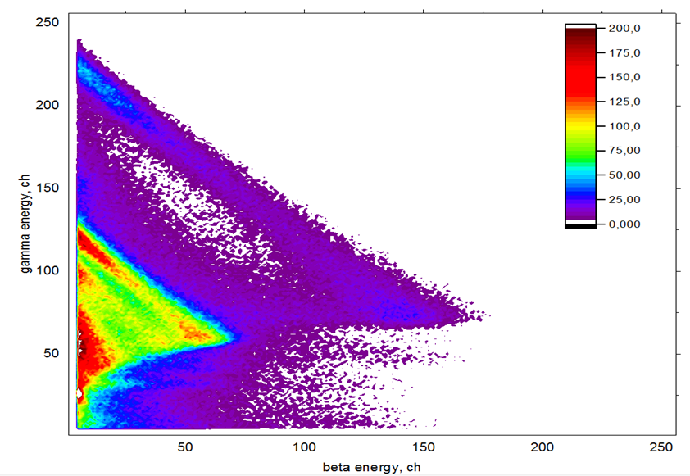
Upgrading the Detection System of the MIKS Xenon Isotope Monitoring Complex
during Preparation for the International Certification
Chernov M.Yu., Ergashev D.E., Gerasimchuk O.A., Goryacheva N.P., Molodtsev D.A.,
Orlov M.S., Probylov V.V., Sidorov N.A., Timofeev D.V., and Tkachev O.V.
ALL-RUSSIAN RESEARCH INSTITUTE OF AUTOMATICS (VNIIA)
P3.1-434
Here is an example of the histogram based on data obtained by the MIKS system during measurements of beta-gamma pairs resulted from the Compton scattering of photons from ¹³⁷Cs+¹³³Ba over the entire gamma range (Figure 1). There is a color scale of counts in a respective channel on the right in Figure 1.
Before the upgrading, the detector was calibrated for gamma- and X-ray energy using a quality control source (¹³³Ba + ¹³⁷Cs) included in the spectrometer design. The 81 keV and 356 keV lines of ¹³³Ba and 661.7 keV line of ¹³⁷Cs were used. The least squares method was applied to build up the straight line upon points obtained, which fit the dependence of the channel number of the pulse spectrum analyzer on the gamma energy.
The obtained accuracy is sufficient for solving the problem of selecting the width (in channels) of a region of interest along the gamma-energy axis in radionuclide detection and for measuring the spectrometer resolution for the gamma energy.
Figure 1

Slide 4
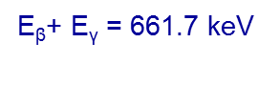
Upgrading the Detection System of the MIKS Xenon Isotope Monitoring Complex
during Preparation for the International Certification
Chernov M.Yu., Ergashev D.E., Gerasimchuk O.A., Goryacheva N.P., Molodtsev D.A.,
Orlov M.S., Probylov V.V., Sidorov N.A., Timofeev D.V., and Tkachev O.V.
ALL-RUSSIAN RESEARCH INSTITUTE OF AUTOMATICS (VNIIA)
P3.1-434
The energy calibration of the beta channel is mainly used to select the width (in channels) of regions of interest in detection of radionuclides and evaluate the energy resolution based on an energy of internal conversion electrons from ^{131m}Xe and ^{133m}Xe decays. The calibration is performed by means of ¹³⁷Cs. This decision is based on the following facts:
–¹³⁷Cs suffers beta-decay to an excited state of ^{137m}Ba. This isomer state has a lifetime of about 14 min and an excitation energy of 661.7 keV. As a result, beta radiation from ¹³⁷Cs and emission of 661.7 keV gamma-photon from the decay of barium isomer state do not coincide in time and are not detected in a coincidence spectrum;
– a small portion of 661.7 keV gamma-photons may undergo Compton scattering in the beta-detector material with a loss of energy E_{β}. The gamma-photon scattered by the beta-detector is highly probable to deposit the remaining energy Е_{γ} in the gamma-detector. These two events occur almost simultaneously and are detected in the coincidence spectrum, forming a line with an equation based on the energy conservation law:
Figure 1 shows similar straight lines produced by the scattering of ¹³³Ba (356 keV) photons.

Slide 5
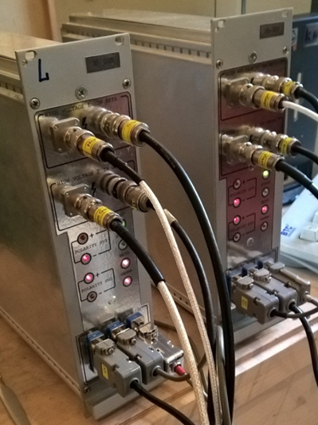
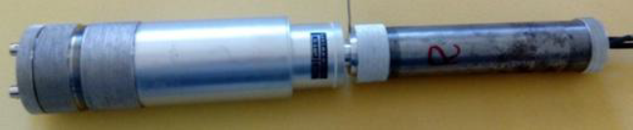
Upgrading the Detection System of the MIKS Xenon Isotope Monitoring Complex
during Preparation for the International Certification
Chernov M.Yu., Ergashev D.E., Gerasimchuk O.A., Goryacheva N.P., Molodtsev D.A.,
Orlov M.S., Probylov V.V., Sidorov N.A., Timofeev D.V., and Tkachev O.V.
ALL-RUSSIAN RESEARCH INSTITUTE OF AUTOMATICS (VNIIA)
P3.1-434
From the late 2016 and till now, the MIKS system has been operating at RN58 IMS station near Ussuriysk and always transmitting desired data to the National Data Center (NDC, Dubna, Moscow Region), which are then re-forwarded to the International Data Center (IDC, Vienna, Austria).
The MIKS system prototype was tested in December, 2016, with samples of radioactive xenon isotopes. The detectors in the MIKS prototype showed the energy resolution of
42−48 keV at 129 keV, which is inconsistent with the requirements of the PTS PC CTBTO (no greater than 40 keV at 129 keV).
Figure 2 – The beta-gamma coincidence detector (left) and two spectrometers for signals from the beta-gamma coincidence detector (right), which were delivered to VNIIA by the Khlopin Radium Institute under a contract

Slide 6
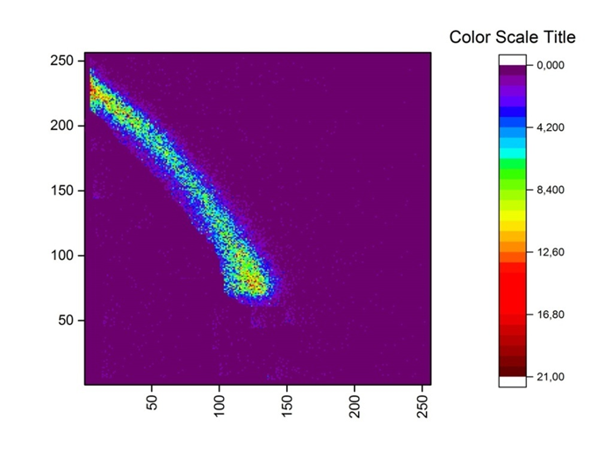
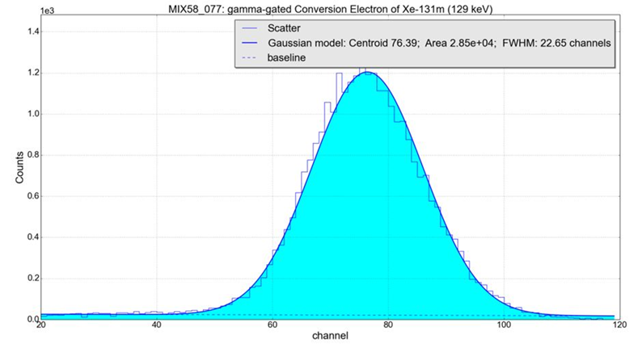
Upgrading the Detection System of the MIKS Xenon Isotope Monitoring Complex
during Preparation for the International Certification
Chernov M.Yu., Ergashev D.E., Gerasimchuk O.A., Goryacheva N.P., Molodtsev D.A.,
Orlov M.S., Probylov V.V., Sidorov N.A., Timofeev D.V., and Tkachev O.V.
ALL-RUSSIAN RESEARCH INSTITUTE OF AUTOMATICS (VNIIA)
P3.1-434
Figure 3 – Processing of peaks of conversion electrons coincident in time with gamma-rays from ^{131m}Xe for the detector No. MIX58_077
Figure 4 – Histogram of β-γ coincidences for MIX58_002 with a ¹³⁷Cs source. The acquisition time was 7200 s

Slide 7
Upgrading the Detection System of the MIKS Xenon Isotope Monitoring Complex
during Preparation for the International Certification
Chernov M.Yu., Ergashev D.E., Gerasimchuk O.A., Goryacheva N.P., Molodtsev D.A.,
Orlov M.S., Probylov V.V., Sidorov N.A., Timofeev D.V., and Tkachev O.V.
ALL-RUSSIAN RESEARCH INSTITUTE OF AUTOMATICS (VNIIA)
P3.1-434
The basic trends in enhancing the detector characteristics were to select the scintillator and optimize the optical scheme.
In order to upgrade the detector, the following aspects were considered:
- refinement of the measurement cell by polishing the surfaces and improving the light collection;
- upgrade of the light guide;
- replacement of a PMT in the beta-detector.
Figure 5 − Diagrams of the measurement cell and the light guide in the previous version (left)
and the version offered by VNIIA (right)

Slide 8
Upgrading the Detection System of the MIKS Xenon Isotope Monitoring Complex
during Preparation for the International Certification
Chernov M.Yu., Ergashev D.E., Gerasimchuk O.A., Goryacheva N.P., Molodtsev D.A.,
Orlov M.S., Probylov V.V., Sidorov N.A., Timofeev D.V., and Tkachev O.V.
ALL-RUSSIAN RESEARCH INSTITUTE OF AUTOMATICS (VNIIA)
P3.1-434
All measures taken allowed us to get a histogram of beta-gamma coincidences for ¹³⁷Cs, which was almost identical to the histogram of the SAUNA system.
In the final version, the beta scintillator has an outer diameter of 16.7 mm, an inner diameter of 15.0 mm, and a length of 36 mm. The dimensions of the light guide are as follows: the diameters of its bases are 27.0 and 17.0 mm, and its height is 12.5 mm.
Figure 6 – The histogram of beta-gamma coincidences from ¹³⁷Cs for the VNIIA version of the light guide and the measurement cell (left) and the histogram of beta-gamma coincidences from ¹³⁷Cs for the SAUNA detector (right)

Slide 9
Upgrading the Detection System of the MIKS Xenon Isotope Monitoring Complex
during Preparation for the International Certification
Chernov M.Yu., Ergashev D.E., Gerasimchuk O.A., Goryacheva N.P., Molodtsev D.A.,
Orlov M.S., Probylov V.V., Sidorov N.A., Timofeev D.V., and Tkachev O.V.
ALL-RUSSIAN RESEARCH INSTITUTE OF AUTOMATICS (VNIIA)
P3.1-434
Figure 7 – Two beta-gamma coincidence detectors (left) and two spectrometers for signals from the beta-gamma coincidence detector (right), which were produced by VNIIA and installed in the MIKS system

Slide 10
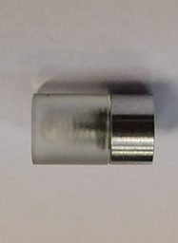
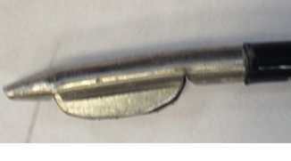
Upgrading the Detection System of the MIKS Xenon Isotope Monitoring Complex
during Preparation for the International Certification
Chernov M.Yu., Ergashev D.E., Gerasimchuk O.A., Goryacheva N.P., Molodtsev D.A.,
Orlov M.S., Probylov V.V., Sidorov N.A., Timofeev D.V., and Tkachev O.V.
ALL-RUSSIAN RESEARCH INSTITUTE OF AUTOMATICS (VNIIA)
P3.1-434
During the WGB PTS PC CTBTO session in August 2019, the PTS representatives recommended us to improve the statistics in the region of E_{γ} + E_{β} = 661.7 keV and provide a 31 keV calibration point in the calibration of the MIKS system.
Therefore, in December 2019, the quality control (QC) sources of the MIKS system were replaced by new sources with a modified design.
The basic change was the use of organic glass in the new design to form the active zone of the source instead of 0.5−1.0 mm thick steel used in the previous version. Photos of the previous and new sources are shown in Figure 8.
Figure 8 – Photos of the previous (left) and new Plexiglas (right) QC sources

Slide 11
Upgrading the Detection System of the MIKS Xenon Isotope Monitoring Complex
during Preparation for the International Certification
Chernov M.Yu., Ergashev D.E., Gerasimchuk O.A., Goryacheva N.P., Molodtsev D.A.,
Orlov M.S., Probylov V.V., Sidorov N.A., Timofeev D.V., and Tkachev O.V.
ALL-RUSSIAN RESEARCH INSTITUTE OF AUTOMATICS (VNIIA)
P3.1-434
Figure 9 depicts histograms of beta-gamma coincidence spectra from the MIKS detectors prior to and after the replacement of the QC sources (the acquisition time was T = 2 h).
Figure 9 − Histograms of spectra from the MIX58_193 detector with the previous QC source (left) and with the new one (right)

Slide 12
Upgrading the Detection System of the MIKS Xenon Isotope Monitoring Complex
during Preparation for the International Certification
Chernov M.Yu., Ergashev D.E., Gerasimchuk O.A., Goryacheva N.P., Molodtsev D.A.,
Orlov M.S., Probylov V.V., Sidorov N.A., Timofeev D.V., and Tkachev O.V.
ALL-RUSSIAN RESEARCH INSTITUTE OF AUTOMATICS (VNIIA)
P3.1-434
The main changes in the design of the measurement cell, the optical scheme, and the beta-detector as a unit, which affected its resolution, were as follows:
- the suitable scintillator (ВС404) was selected;
- fine polishing of the cell shell was performed;
- the measurement chamber was coated with an anti-adsorbing material;
- the optical scheme was modified, and the light guide was replaced;
- the PMT was replaced with a Hamamatsu R1924 PMT;
- the QC source design was modified.
The MIKS system, equipped with the upgraded detectors, has the following characteristics:
- the energy resolution of the beta-channel ranges from 37.6 to 38.2 keV at 129 keV;
- the detection efficiency of beta-gamma coincidences is 0.9 or higher at a beta-energy of 30 keV and 0.6 or higher at a beta-energy of 81 keV;
- the memory effect does not exceed 3%;
- the minimum detectable concentration of ¹³³Хе for an acquisition time of 14 h and a pumped air volume of no less than
10 м³ is 0.5 mBq/m³ or less;
the minimum detectable activity of ¹³³Хе for an acquisition time of 14 h is 5 mBq or less, which corresponds to a volume activity of 2.2×10⁻¹¹ Ci/L when a sample 6 ml in volume is directly injected into the detector;
the statistics of beta-gamma coincidences (the number of coincidences in the region of Е_{γ} + Е_{β} = 661.7 keV) from ¹³⁷Cs has been increased by 50%.

