Slide 1

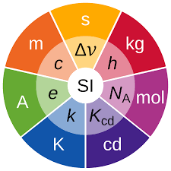

Side event
on metrology
SE01-O4
Applying ISO/IEC 17025 and PTS/IMS Requirements:
A Case Study on Primary Calibration of Infrasound Sensors
Dominique RODRIGUES
Laboratoire National de Métrologie et d’Essais (LNE)
10th September 2025
Notes:
Speaker presentation …
Case study on how ISO 17025, defining general requirements for accreditation of Calibration and Testing laboratories, was implemented on a new LNE’s calibration service, which is the primary calibration of infrasound sensors.
General overview of the standard, and focus on some specific requirements, specific to this new calibration sevice.

Slide 2





Applying ISO/IEC 17025 and CTBTO IMS Requirements:
A Case Study on Primary Calibration of Infrasound Sensors
Side event
on metrology
SE01-O4
Dominique RODRIGUES
Why ISO/IEC 17025 Accreditation?
Benefits of Accreditation
Formal recognition of technical competence by an independent third party.
Builds trust and credibility through impartial external assessment.
International recognition via ILAC Mutual Recognition Arrangement.
Alignment with PTS/IMS requirements.
Ensures consistent, reproducible, and traceable results.
Notes:
Why targeting an ISO 17025 accreditation ?
Such accreditation is more than just meeting a standard
Formal recognition of competence granted by an independent third-party accreditation body.
This independent supervision is essential to build trust & credibility.
Thanks to the ILAC MRA, the accreditation is recognized internationally, allowing the calibration certificates to be accepted in all the world without the need for re-testing.
It also means direct alignment with the PTS/IMS requirements for service providers.
Finally, this ensures that the results are consistent, reproducible, and fully traceable to the SI.

Slide 3
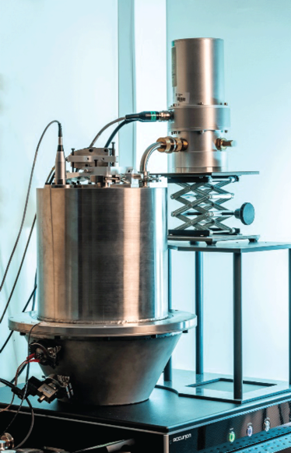
Applying ISO/IEC 17025 and CTBTO IMS Requirements:
A Case Study on Primary Calibration of Infrasound Sensors
Side event
on metrology
SE01-O4
Dominique RODRIGUES
Calibration Method Overview
Primary Calibration Using a Laser Pistonphone (IEC TR 61094-10)
The infrasound sensor to be calibrated is exposed to a calculable sound pressure produced in a coupler by a piston.
The sound pressure is calculated from the acoustic impedance of the coupler and the measurement of the volume velocity of the piston.
Calibration range: 10 mHz – 20 Hz
Method in accordance with IEC TR 61094-10.
Notes:
Few words about the calibration method
New calibration service at LNE : Primary calibration of infrasound sensors by using a laser pistonphone.
Core of the method is a rigid piston, generating a calculable sound pressure in a coupler, in the freq. 10 mHz up to 20 Hz.
This is achieved through the measurement of the volume velocity of the piston using a laser interferometer, combined with the accurate knowledge of the acoustic impedance of the coupler.
The procedure fully complies this IEC Technical Report, the international reference for low-frequency primary calibration of microphones.

Slide 4
Applying ISO/IEC 17025 and CTBTO IMS Requirements:
A Case Study on Primary Calibration of Infrasound Sensors
Side event
on metrology
SE01-O4
Dominique RODRIGUES
ISO/IEC 17025 Mapping to PTS/IMS Requirements for Service Providers
4. General requirements
4.1 Impartiality *
4.2 Confidentiality **
5. Structural Requirements ***
7. Process requirements
Requester
7.1 ***
Requests, tenders & contracts
7.2 ***
Selection, validation & verification of methods
7.3 ***
Sampling
7.4 *
Handling
7.5 *
Technical Records
7.6 ***
Measurement Uncertainty
7.7 *
Ensuring the validity of results
7.8 **
Reporting of results
Requester
feedback
6.1 Resource requirements
7.11 *
Control of Data
7.10 *
Nonconforming Work
7.9 **
Complaints
6.2 *
Personnel
6.3 *
Facilities & Environment
6.4 ***
Equipment
6.5 ***
Traceability
6.6 *
Purchasing & Subcontracting
8.1 Management System ***
8.8 ***
Internal Audit
8.7 Corrective Action ***
8.2 ***
Documentation
8.3 ***
Document Control
8.4 ***
Records
8.5 Risks and Opportunities ***
8.6 Improvement ***
8.9 Management Review ***
Legend - PTS/IMS Requirements mapping (in development):
* Whole clause is relevant
** Specific requirements apply
*** Some requirements may not apply
Notes:
Here a general overview of the ISO 17025 standard as well as the corresponding mapping with PTS/IMS requirements for service providers, still in development.
The standard is divided into 4 main blocks:
General & Structural requirements — Ensure laboratory operate impartially, maintain confidentiality, and has a clear organizational structure.
A block for Process requirements, clause 7: defines how the laboratory operates — from initial request up to reporting of results.
A block for Resource requirements, Clause 6 — ensuring that laboratory has appropriate resources.
Finally a block for the Management System, Clause 8 — to ensure that the laboratory operates a management system that drives quality, consistency, and continual improvement.
Let me show you how these requirements have been implemented in practice for this new calibration service.

Slide 5
Applying ISO/IEC 17025 and CTBTO IMS Requirements:
A Case Study on Primary Calibration of Infrasound Sensors
Side event
on metrology
SE01-O4
Dominique RODRIGUES
Implementation: General & Structural Requirements (Clauses 4 & 5)
Key aspects:
Impartiality (4.1)
  Clear policy & preventive measures.
  Formal staff commitment, reviewed annually.
  Escalation to Ethics Committee if needed.
Confidentiality (4.2)
  Professional secrecy for staff.
  Controlled access (premises & IT).
  Secure data transmission & limited third-party sharing.
Structural Framework (5)
  Legal entity: Public Industrial and Commercial Establishment (EPIC) Governance: board with industry, consumers, administrations, staff.
  Accredited scope clearly defined & limited.
  Unified QMS across all sites, supported by quality actors.
Notes:
First block.
Shortly as there is nothing specific here regarding the new calibration service, this is implemented at a high level in LNE’s organization.
Impartiality is enforced through clear policies, staff commitments, and when needed, escalation to an Ethics Committee.
Confidentiality is ensured by professional secrecy obligations, controlled access, and secure transmission of results.
Structurally, LNE is a legal entity. Its governance includes all stakeholders, and its accredited scope is clearly defined and limited. Finally, a unified QMS applies to all calibration sites, and all staff is responsible for keeping it strong.

Slide 6
Applying ISO/IEC 17025 and CTBTO IMS Requirements:
A Case Study on Primary Calibration of Infrasound Sensors
Side event
on metrology
SE01-O4
Dominique RODRIGUES
Implementation: Resource Requirements (Clause 6)
Key Aspects:
Personnel (6.2)
  Qualified staff with a specific training plan.
Facilities & environmental (6.3)
  Controlled laboratory environments (temperature).
Equipment (6.4)
  Regularly maintained & calibrated equipment, with documented records.
Metrological traceability to SI units (6.5)
  Full traceability chain to SI units
External services and supplies (6.6)
  Approved suppliers and external services under QMS control
Notes:
Block 2 : Resource Requirements. 5 items
Personnel: staff competence specific training for calibration services. Qualifications are formalized, based on objective criteria.
Facilities & Environment: Influence factors are identified, Some controlled (T, V), other monitored.
Equipment & Metrological traceability. Focus
Finally, external services and suppliers: They are carefully selected, approved, and monitored under our quality management system.
Focus on these 2 items: Equipment and Metrological Traceability.

Slide 7
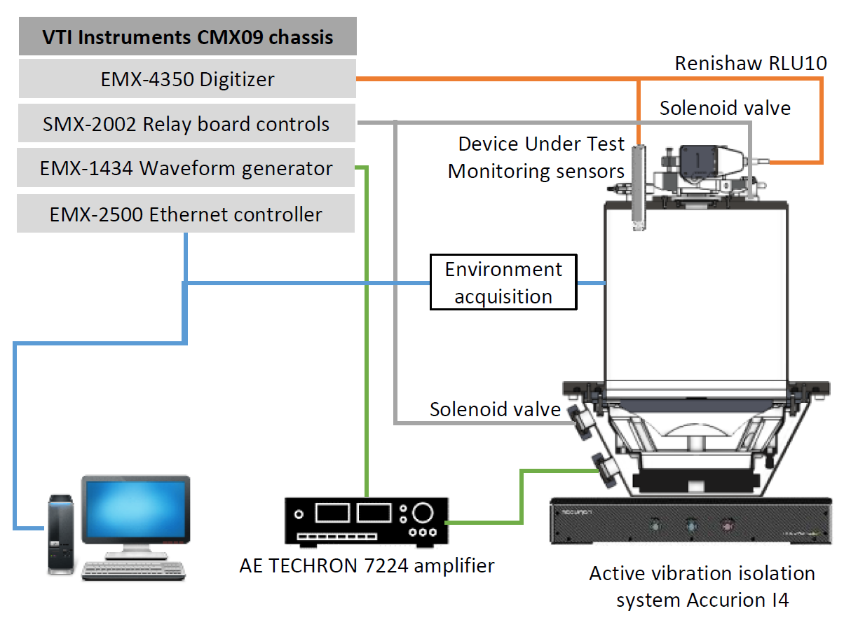
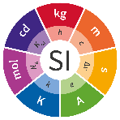
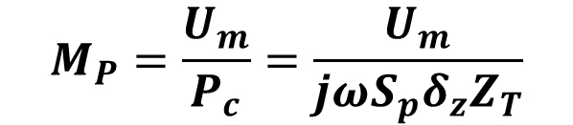
XX.X-XXX
Applying ISO/IEC 17025 and CTBTO IMS Requirements:
A Case Study on Primary Calibration of Infrasound Sensors
Dominique RODRIGUES
Implementation: Resource Requirements - Metrological Traceability (Clause 6.5)
Metrological Traceability
Metrological traceability shall be ensured for all equipment that contributes to the validity of the reported results.
Measurand: Sensor pressure sensitivity
Critical equipment calibrated by accredited labs.
  Unbroken chain of calibrations, each contributing to the measurement uncertainty.
$$M_{P}=\frac{U_{m}}{P_{c}}=\frac{U_{m}}{{jωS_{p}δ_{z}Z}_{T}}$$
Notes:
Metrological traceability is necessary for any equipment that contributes to the validity of the reported results.
Here, the measurand is the sensitivity, defined as the ratio of measured output sensor voltage to the applied sound pressure.
Critical equipment can be seen as those contributing to build the unit, here V/Pa :
For example, the digitizer linked to the volt unit,
the waveform generator to the second,
piston area to the meter,
….
Metrological traceability means that all these equipment have to be calibrated by accredited laboratories, either ILAC members or National Metrology Institutes under the CIPM MRA.
with the requirement that the build derived unit V/Pa must be linked to the base units through an unbroken chain of calibrations.

Slide 8


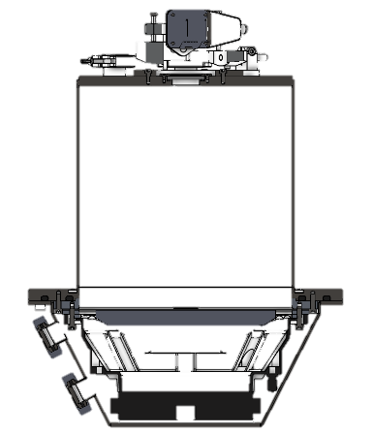


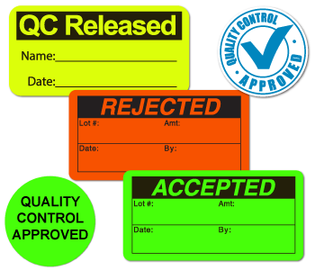
Applying ISO/IEC 17025 and CTBTO IMS Requirements:
A Case Study on Primary Calibration of Infrasound Sensors
Side event
on metrology
SE01-O4
Dominique RODRIGUES
Implementation: Resource Requirements - Equipment (Clause 6.4)
Example : Provisions for the cylindrical coupling cavity
    Documented procedure for handling, transport, storage, use and planned maintenance
Critical specifications identified: dimensions (radius & height)
    Calibration periodicity : every 5 years
    Conformance criteria: dimensional drift < 0,2 mm
Records maintained:
Manufacturing files, service history, calibration certificates, return-to-service report.
Safeguards: restricted access to trained staff.
Control: immediate tagging & withdrawal of non-compliant equipment.
Notes:
How manage Equipment regarding Clause 6.4.
Here is an example illustrating how this is implemented, I choose the cavity of the pistonphone.
A specific procedure covers the entire lifecycle of the equipment — from handling and transport to storage, use, and maintenance. This procedure is mandatory.
The critical specifications to be monitored are identified: here the radius and height of the cylindrical cavity — it affects directly the acoustic impedance of the cavity.
Then, a calibration periodicity and conformance criteria are defined.
Conformance criteria is the dimensional drift, reported in the uncertainty budget, here we choose 0.2 mm.
The periodicity is defined by the laboratory as a balance between cost and risk: the cost incurred by unnecessary repetition of the control, and the risk that the dimensional drift exceed effectively the conformance criteria. Here we choose 5 years for this control.
All records are maintained.
We have safeguards, with restricted access to trained staff only.
And clear tags to inform about the status of the equipment.
Other similarly

Slide 9
Applying ISO/IEC 17025 and CTBTO IMS Requirements:
A Case Study on Primary Calibration of Infrasound Sensors
Side event
on metrology
SE01-O4
Dominique RODRIGUES
Implementation: Process Requirements (Clause 7)
Key Aspects:
Review of requests and contracts (7.1) → Clarity on customer requirements.
Selection, verification & validation of methods (7.2) → Appropriate and proven methods.
Sampling (7.3) → Non applicable in this context
Handling of calibration items (7.4) → identification, protection, traceability.
Technical records (7.5) → Complete, accurate, retrievable.
Measurement uncertainty (7.6) → Evaluation of all significant contributors.
Ensuring validity of results (7.7) → QC, comparisons, repeat checks.
Reporting (7.8) → Clear, traceable, compliant with requirements.
Complaints (7.9) → Process to handle external feedback.
Nonconforming work (7.10) → Detection, control, corrective action.
Data control (7.11) → Integrity, backup, confidentiality.
Notes:
Clause 7 defines how the laboratory operates, covering the full process from the initial request through to the reporting of results.
It includes:
Reviewing requests and contracts — to make sure customer requirements are clear and feasible,
Selecting and validating methods — confirm they are appropriate and proven,
Sampling — non applicable in this context.
Handling of calibration items — proper identification, protection, and traceability
Technical Records — are complete, accurate and retrievable,
Measurement uncertainty
Ensuring validity of results — including quality control, comparisons,
Reporting — clear and traceable,
Complaints and nonconforming work with corrective actions — strong requirements to build trust
Data control — guarantee integrity, backup, and confidentiality.
In short, Clause 7 defines the laboratory’s core processes that directly determine the quality and credibility of its calibration results.
Now, let me focus on the following requirements.

Slide 10
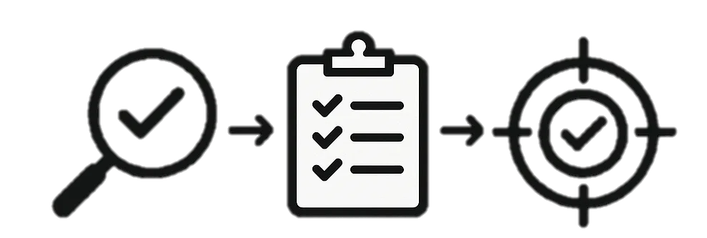
Applying ISO/IEC 17025 and CTBTO IMS Requirements:
A Case Study on Primary Calibration of Infrasound Sensors
Side event
on metrology
SE01-O4
Dominique RODRIGUES
Implementation: Process Requirements
Selection, verification & validation of methods (Clause 7.2)
Method Selection
Calibration based on IEC TR 61094-10
  Laser pistonphone → internationally recognized primary method
Verification
Confirm method performance to achieve required uncertainty:
  Equipment performance checks
  Interlaboratory comparisons (PTSAVH.A-C1, INFRA.AUV-C1, LNE internal comparison)
Validation
Non-standard methods shall be validated:
  Assessment of influencing factors
  Evaluation of measurement uncertainty
  Comparison with other validated methods (pressure reciprocity, static pressure sensors)
  Interlaboratory comparisons
Notes:
Clause 7.2 aims to guarantee that the calibration method is appropriate, verified and validated.
Selection : here the method is based on a IEC TR, so internationally recognized.
Verification aims to confirm that the method achieves the required performance and uncertainty. At LNE:
interlaboratory comparisons — such as PTSAVH.A-C1, INFRA.AUV-C1, and LNE internal comparisons
Validation: required for non-standard methods. Formally, a IEC Technical Report is not a standard. ISO 17025 provides a list of possible tools,
Best tool for validation new method : comparisons with independent recognized methods. Here, comparisons against calibration by pressure reciprocity using microphones & Static pressure calibration using barometers.
By verifying and validating the method, we ensure that the calibration results are reliable, traceable, and internationally accepted.

Slide 11
Applying ISO/IEC 17025 and CTBTO IMS Requirements:
A Case Study on Primary Calibration of Infrasound Sensors
Side event
on metrology
SE01-O4
Dominique RODRIGUES
Implementation: Process Requirements
Measurement uncertainty (7.6)
ISO/IEC 17025 requires laboratories to evaluate all significant sources of uncertainty.
Evaluation is performed according to the GUM methodology.
For the laser pistonphone method, main contributors include:
  Measurement of sensor output
  Piston properties
  Coupler properties
  Sensor parameters
  Imperfection of theory
  Processing of results
  Repeatability of measurements
Expanded uncertainties (k=2, 95% confidence): typically in the range
  0.04 dB – 0.08 dB (magnitude)
  0.22° – 0.90° (phase)
Analysis of the Measurement Process
Quantify Uncertainty Sources
Propagate Uncertainty
Report Result
Feedback
Notes:
Evaluation of measurement uncertainty is mandatory of course.
Evaluation was performed following the GUM – A Guide published by the BIPM, It structure the approach in a 4 steps methodology.
For the laser pistonphone method, several family contributors have been considered:
The measurement of sensor output,
piston and coupler properties,
…
Leading to the following best expanded uncertainties : between 0.04 and 0.08 dB for magnitude, and between 0.22° and 0.90° for phase.
Depends on the frequency and also on the sensor type.

Slide 12
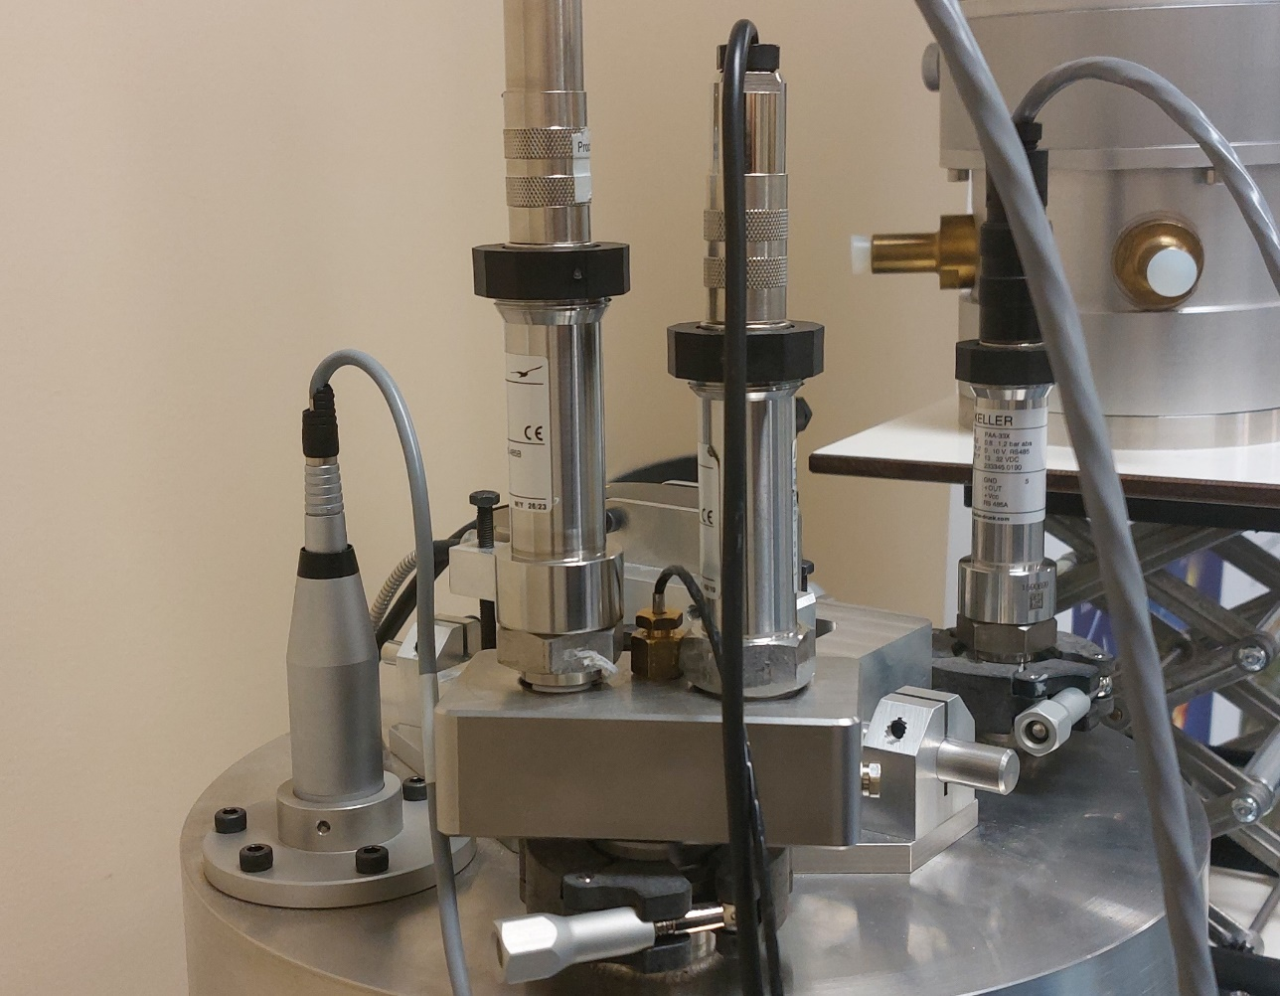
Applying ISO/IEC 17025 and CTBTO IMS Requirements:
A Case Study on Primary Calibration of Infrasound Sensors
Side event
on metrology
SE01-O4
Dominique RODRIGUES
Implementation: Process Requirements
Ensuring validity of results (7.7)
ISO/IEC 17025 requires labs to monitor validity of results continuously.
Aim: detect anomalies, ensure ongoing reliability and comparability.
Approaches include:
  Systematic evaluation of bias using reference standards
    Keller PAA-33X (freq. < 0.1 Hz)
    B&K 4160 (freq. > 0,1 Hz)
  Review of reported results
  Participation in interlaboratory comparisons
Notes:
Ensuring the validity of results is also a crucial requirement.
This is essential to detect anomalies early, avoid measurement drift, and maintain long-term reliability and comparability.
Here, we used the following approaches:
Again, systematic evaluation of bias against well-characterized reference standards.
For frequencies below 0.1 Hz, comparison against a previously calibrated Keller barometer.
For frequencies above, comparison against a previously calibrated microphone.
Regular review of reported results to check for consistency.
Participation to interlaboratory comparisons.

Slide 13
Applying ISO/IEC 17025 and CTBTO IMS Requirements:
A Case Study on Primary Calibration of Infrasound Sensors
Side event
on metrology
SE01-O4
Dominique RODRIGUES
Implementation: Process Requirements
Data control (7.11)
ISO/IEC 17025 requires controlled management of data & information.
Reliable data control ensures integrity, transparency and reproducibility of results.
Software managed like equipment
  Version & change history
  Secure storage
Validation of data collection, processing & reporting through:
  Cross-checks with independent systems
  Independent/manual calculations on the same dataset
  Reference datasets with known results
  Interlaboratory comparisons
Falcon
(python, compiled)
Data acquisition
CSV files
Raw data
Pistonphone Analysis
(Excel Worksheet)
Basic calculations,
data control, report
LaPCal
(COM Object, python)
Read raw data,
complex calculations
Software Workflow for Laser Pistonphone Calibration
Notes:
Clause 7.11 requires controlled management of data and information.
This means that collection, process and report of data must be reliable and verifiable.
We manage software like measurement equipment:
we keep detailed version and change histories,
and store software in secure environments with restricted access.
For data collection, processing, and reporting, each piece of software is validated.
Validation of this data workflow is done with different tools:
Cross-checks of data with independent systems, for example Falcon ….
Manual calculations on the same dataset, For example Excel Worksheets …
Use of reference datasets with known results, For example LapCal & Falcon
interlaboratory comparisons, provides global validation.
By this way, we ensure that every step of the data chain is reliable, controlled, and internationally defensible.

Slide 14
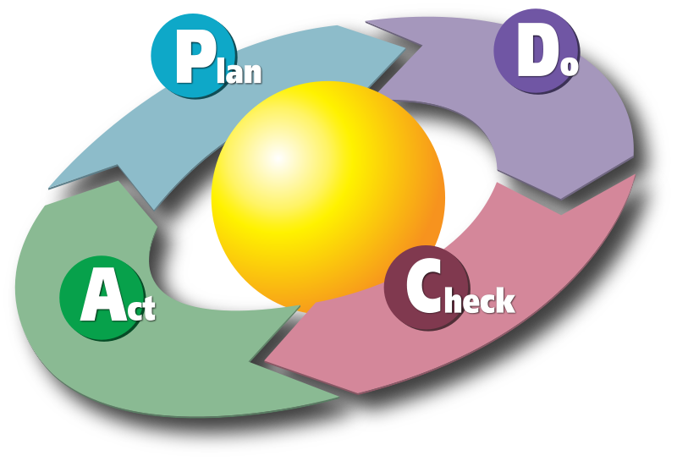
Applying ISO/IEC 17025 and CTBTO IMS Requirements:
A Case Study on Primary Calibration of Infrasound Sensors
Side event
on metrology
SE01-O4
Dominique RODRIGUES
Implementation: Management system requirements (Clause 8)
ISO/IEC 17025 requires a management system to support technical activities.
Two implementation options:
  Option A → follow Clauses 8.2–8.9 (quality system within the lab).
  Option B → operate under ISO 9001-certified management system.
Core elements (Clause 8.x):
  Document control & records management
  Management of risks & opportunities
  Corrective actions & continual improvement
  Internal audits & management reviews
Ensures consistency, impartiality, and confidence in calibration services.
Notes:
Last clause, for management system requirements.
Very shortly
There are two ways to meet these requirements:
Option A: laboratories establish a management system inside the lab covering Clauses 8.2 to 8.9.
Option B: laboratories can demonstrate compliance through an existing ISO 9001-certified management system.
LNE use the option A
The management system covers:
Document and record control,
Management of risks and opportunities ,
Corrective actions and continuous improvement,
Regular internal audits and management reviews.
Together, these measures ensure that the laboratory operates consistently, maintains impartiality, and builds confidence in the reliability of its calibration services.

Slide 15

Applying ISO/IEC 17025 and CTBTO IMS Requirements:
A Case Study on Primary Calibration of Infrasound Sensors
Side event
on metrology
SE01-O4
Dominique RODRIGUES
Conclusion
ISO/IEC 17025 accreditation ensures competence, reliability, and international recognition of calibration results.
LNE’s capability: pioneer in ISO/IEC 17025-accredited laboratory for primary infrasound calibration (COFRAC accreditation n°2-28, Scope available on www.cofrac.fr)
Contribution to PTS/IMS: supports sensor reliability,
global comparability, and confidence in monitoring results.
Opportunities for collaboration: interlaboratory comparisons,
method development, and knowledge sharing.
Notes:
In conclusion,
ISO 17025 accreditation provides guarantee of competence, impartiality, and international recognition of calibration results.
At LNE, our accreditation is delivered by COFRAC The French Accreditation Body, which is a signatory of the ILAC Mutual Recognition Arrangement.
By applying this standard, LNE is happy in participating to reinforce the credibility and comparability of IMS measurements.
I would like to conclude by encouraging collaboration, through interlaboratory comparisons, joint developments, and exchanges to continue improving calibration methods and supporting the IMS mission.

