Slide 1
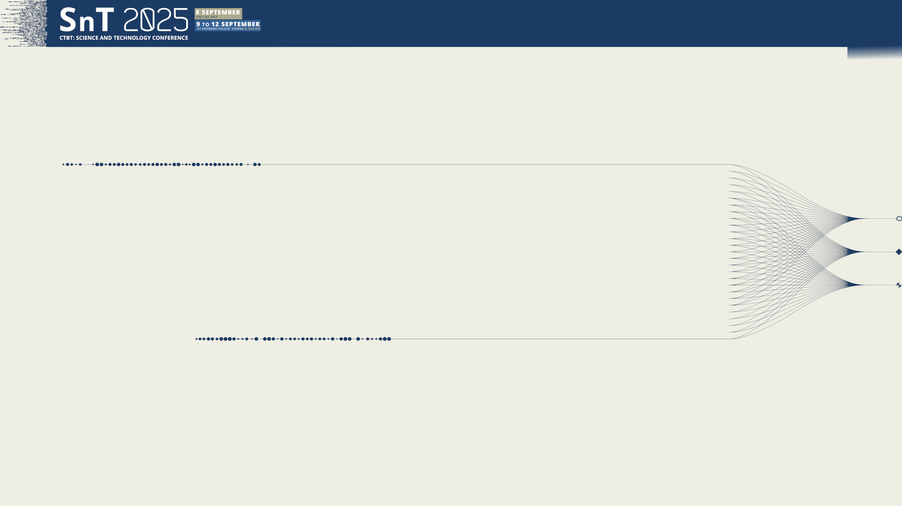
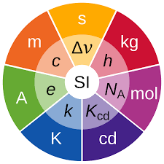

Side event
on metrology
SE01-O3
Underwater Acoustic - primary standards, traceability to the SI units, comparisons and validation
Stephen Robinson
National Physical Laboratory, UK
10 September 2025

Slide 2
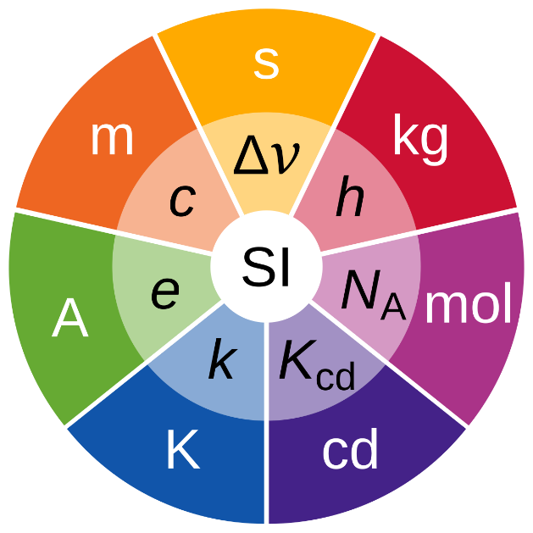
Underwater Acoustic - primary standards, traceability to the SI units, comparisons and validation Stephen Robinson
Side event
on metrology
SE01-O3
Overview
Primary standards for underwater acoustics
Realisation of acoustic standards
Traceability to the S.I.
Validation of standards
Dissemination of standards
Calibration at ocean conditions
Issues for in-situ calibrations

Slide 3
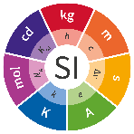

Underwater Acoustic - primary standards, traceability to the SI units, comparisons and validation Stephen Robinson
Side event
on metrology
SE01-O3
General overview
National Metrology Institutes
Primary reference standard
Accredited / Expert Laboratories
Working standard
One site calibration laboratories
Travelling standard
Final user
Measuring equipment
Established using a
primary method of measurement
Metrological traceability
Property of a measurement result whereby the result can be related to a reference through a documented unbroken chain of calibrations, each contributing to the measurement uncertainty.
The Primary method of measurement provides the essential first link in the chain of traceability from the definition of a unit of the International System of Units (SI)

Slide 4

Underwater Acoustic - primary standards, traceability to the SI units, comparisons and validation Stephen Robinson
Side event
on metrology
SE01-O3
Metrology for low-frequency hydroacoustics
Establish the necessary calibration procedures and methods, to provide traceability to the SI for UWA measurements at very low frequencies.
Disseminate traceable standards for hydrophone calibration
Primary calibration
Secondary calibration
On-Site calibration
Consequences & improve data quality
Impact
Primary methods for underwater calibration of hydrophones traceable to S.I. units

Slide 5
Underwater Acoustic - primary standards, traceability to the SI units, comparisons and validation Stephen Robinson
Side event
on metrology
SE01-O3
State of the art for low frequency hydroacoustic standards
For conventional free-field acoustic measurements, the primary standard is established over the range 250 Hz to 500 kHz by the free-field reciprocity method IEC 60565-1:2020.
For low frequency pressure calibrations, a number of primary standard methods are available in the range 0.1 Hz to 250 Hz – described in IEC 60565-2:2019.
However: the BIPM Key Comparison Data Base (KCDB) contains only one best Calibration and Measurement Capabilities (CMCs) for an NMIs in the low frequency (NPL: 25 Hz to 400 Hz)
Current CMCs in primary standards for sound pressure have a lower limiting frequency of 25 Hz
There are no Key Comparisons underpinning calibration standards below 250 Hz, or for any pressure calibrations
  To be addressed in 2026-2028 by CCAUV
CMCs
No CMCs No KCs
CMCs & KCs
10 s
1 s
0.1 s
0.01 s
period
Static pressure
IMS hydroacoustic monitoring range
Free-field stds
0.1 Hz
1 Hz
10 Hz
100 Hz
250 Hz
frequency
Need for a validated primary standards covering the 0.5 Hz – 250 Hz

Slide 6
Pressure versus free-field calibration
Underwater Acoustic - primary standards, traceability to the SI units, comparisons and validation Stephen Robinson
Side event
on metrology
SE01-O3
A hydrophone responds to the pressure averaged across the active element - average of the magnitude and phase of the pressure
Pressure calibration of a hydrophone
  Calibration method where the hydrophone element is exposed to an oscillating pressure, often in an enclosed chamber
Free-field calibration
  Calibration method where the response of the hydrophone is determined to a plane sound wave incident from a given direction
A difference between pressure and free-field sensitivity is the directional response
At low frequencies, pressure and free-field sensitivity are identical when:
  a) the diffraction factor of the hydrophone is unity (omnidirectional)
  b) the hydrophone has negligible response to particle velocity and pressure gradient,
  c) the frequency of calibration is sufficiently below the lowest resonance frequency of the hydrophone so that the sensitivity of the hydrophone is independent of acoustic impedance
At very low frequencies, sensitivities in air and water are identical
Notes:
Calibrations in the APV may be conducted using two different approaches. Using an absolute method of calibration, or by using a relative method. Each method has it’s merits depending on what is required.
The general requirement for testing in the APV is to characterise a transducer over a suite of environmental conditions. This requires many measurements to be repeated at different temperatures and depths, so speed of the measurement process is often an important consideration to ensure the best use of time. Therefore, this type of work benefits from the quicker relative measurement methods, but this does require a calibrated reference device to perform these measurements and some accuracy is lost when compared to absolute measurement calibration methods.

Slide 7
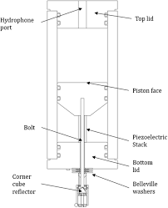
Primary calibrations methods - IEC 60565-2:2019
Underwater Acoustic - primary standards, traceability to the SI units, comparisons and validation Stephen Robinson
Side event
on metrology
SE01-O3
Hydrostatic excitation method
Travelling wave tube method
Vibrating column method
Calculable pistonphone
Coupler reciprocity method
Notes:
Calibrations in the APV may be conducted using two different approaches. Using an absolute method of calibration, or by using a relative method. Each method has it’s merits depending on what is required.
The general requirement for testing in the APV is to characterise a transducer over a suite of environmental conditions. This requires many measurements to be repeated at different temperatures and depths, so speed of the measurement process is often an important consideration to ensure the best use of time. Therefore, this type of work benefits from the quicker relative measurement methods, but this does require a calibrated reference device to perform these measurements and some accuracy is lost when compared to absolute measurement calibration methods.

Slide 8
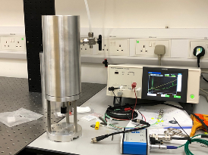
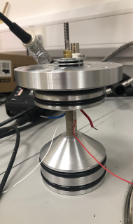
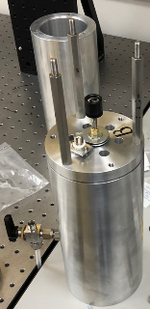
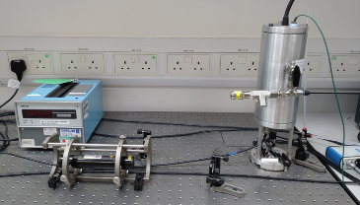
Primary Method 1: Hydrophone calibration by pistonphone
Underwater Acoustic - primary standards, traceability to the SI units, comparisons and validation Stephen Robinson
Side event
on metrology
SE01-O3
small chamber is driven by a piston
filled with air
pressure depends on compliance and volume change
  compliance may be calculated
  volume change measured (optical measurement of piston displacement using laser interferometer)
piston driven by piezo stack
can provide phase as well as magnitude
established in air acoustics for microphones
frequency range: 0.5 Hz - 250 Hz

Slide 9
Primary Method 1: Hydrophone calibration by pistonphone
Underwater Acoustic - primary standards, traceability to the SI units, comparisons and validation Stephen Robinson
Side event
on metrology
SE01-O3
corrections required for non-adiabatic conditions (heat correction)
electrical impedance of hydrophone
  causes difficulty at low frequencies
  “insert voltage” correction required to account for preamplifier loading
sensitivity of piezo hydrophone should be invariant with frequency to very low frequencies (<0.5 Hz)
results shown for B&K8104 hydrophone
Malcher et al, Metrologia, 61, 025011, (2024)
comparison with independent methods
  static pressure sensor – provides link with DC standards
  microphone calibration
microphone can also be calibrated
comparison undertaken with LNE and DFM for microphone calibration
good agreement within uncertainties

Slide 10
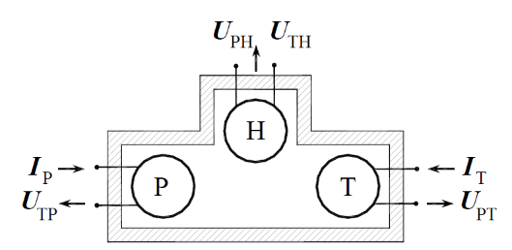
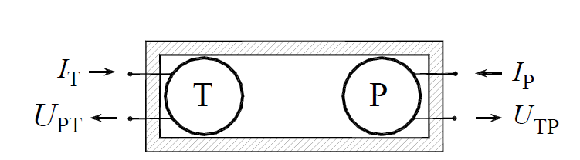
Primary Method 2: Coupler reciprocity (NPL)
Underwater Acoustic - primary standards, traceability to the SI units, comparisons and validation Stephen Robinson
Side event
on metrology
SE01-O3
Three hydrophones (one reciprocal)
Hydrophones inserted into small chamber
Compliance of the chamber is a crucial parameter to be determined
Fluid filled
May be pressurised to simulate depth
Frequency range typically ~1 Hz to 2 kHz
Can provide phase as well as magnitude
Reference-transfer method
  reference transducers used in two-port coupler
  no need to know hydrophone compliance

Slide 11
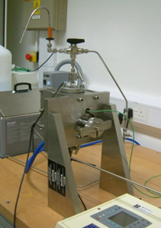
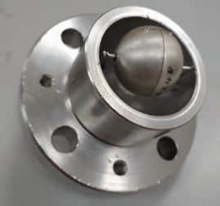
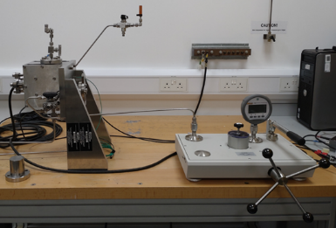
Primary Method 2: Coupler reciprocity (NPL)
Underwater Acoustic - primary standards, traceability to the SI units, comparisons and validation Stephen Robinson
Side event
on metrology
SE01-O3
Reference – Transfer method established by NPL
  fluid filled with deionised degassed water
Reference transducers are spherical transducers
  no compliant material
  compliance of reference chamber only required
Lock-in amplifiers used for signal detection
Problems with lowest frequencies
  repeatability must be improved
  very high electrical impedance of transducers
  must prevent any electrical conductance through water
Hydrostatic pressure: up to 7 MPa (~700 m depth)
  difficult to operate at ambient pressure(trapped air)
Temperature control (water jacket):

Slide 12
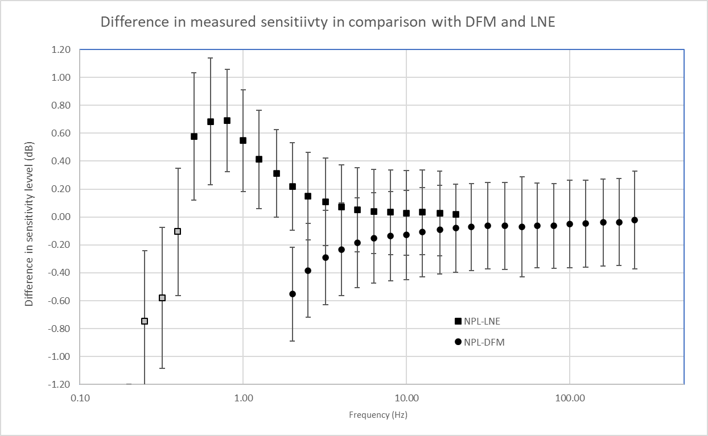
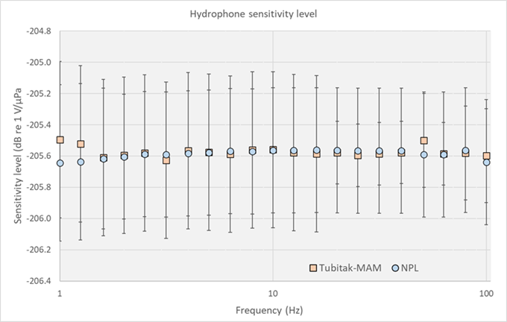
Validation
Underwater Acoustic - primary standards, traceability to the SI units, comparisons and validation Stephen Robinson
Side event
on metrology
SE01-O3
Comparison between independent methods
  based on different physical principles
  little or no common sources of uncertainty
  Comparison between laser pistonphone and coupler reciprocity
Comparison between laboratories
  No Key Comparison so far under CCAUV (scheduled for 2026-2028)
  Informal comparisons undertaken of secondary calibrations (eg NPL & Tubitak-MAM)

Slide 13
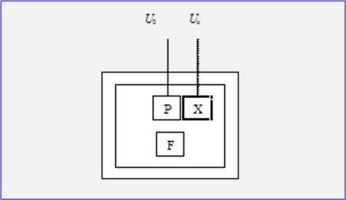
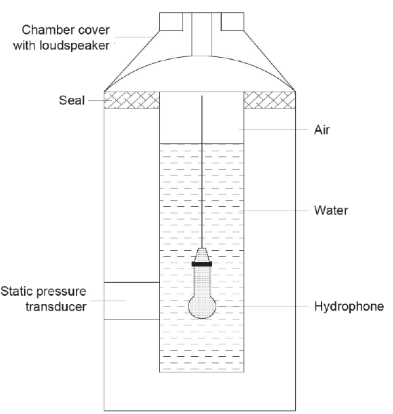
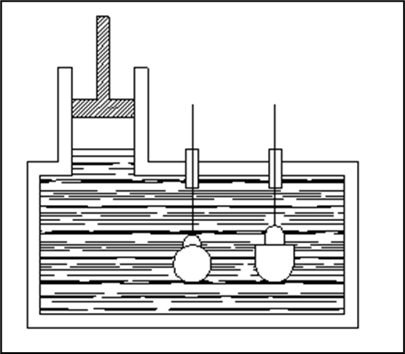
Underwater Acoustic - primary standards, traceability to the SI units, comparisons and validation Stephen Robinson
Side event
on metrology
SE01-O3
Secondary calibration methods in small chamber
Hydrophone under test and reference are exposed to same pressure field in small chamber
  Described in IEC 60565-2
Ideally, pressure is the same in all parts of the chamber (if not, corrections needed for wave modes)
Comparison calibration undertaken
Sound generation can be by pistonphone, loudspeaker (in air) or by auxiliary transducer
Hybrid air/water configurations may be applied

Slide 14
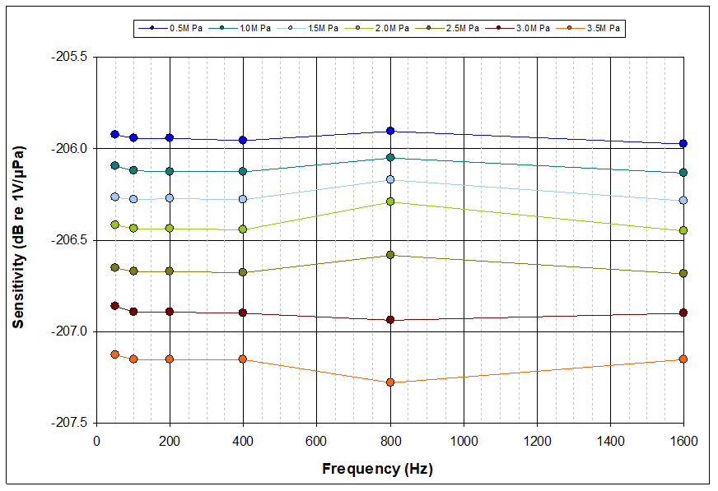
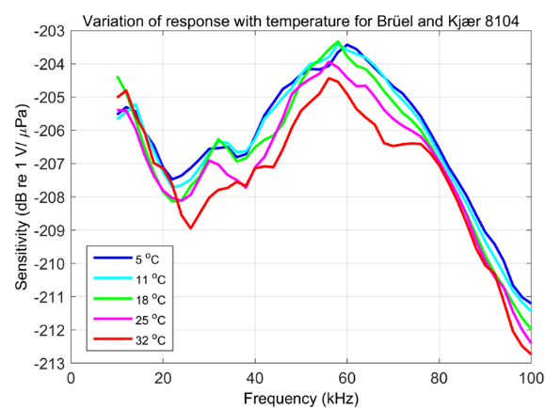
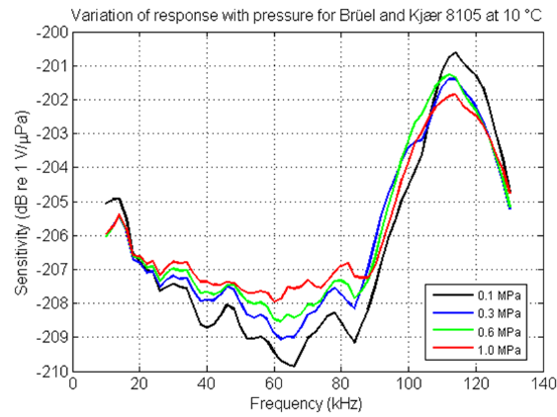
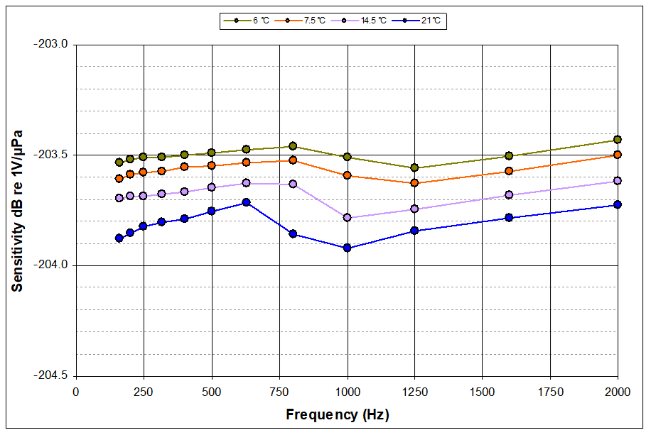
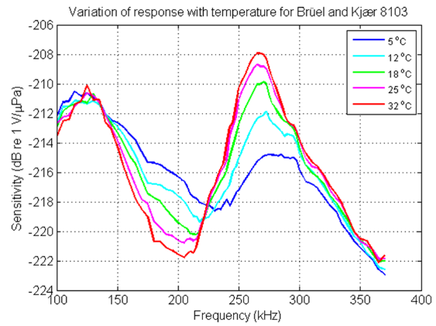
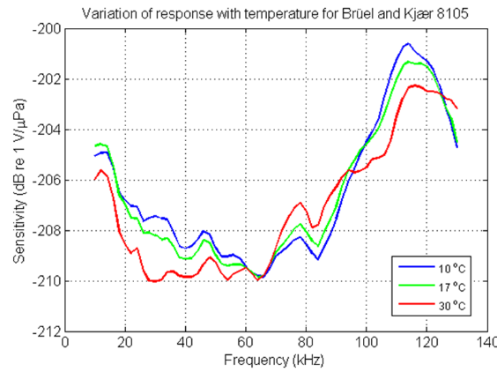
Underwater Acoustic - primary standards, traceability to the SI units, comparisons and validation Stephen Robinson
Side event
on metrology
SE01-O3
Hydrophone calibration in the laboratory and at simulated ocean conditions

Slide 15
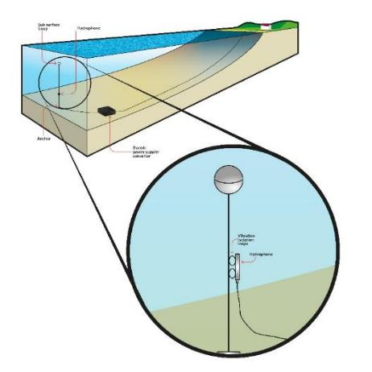
In-situ testing
Underwater Acoustic - primary standards, traceability to the SI units, comparisons and validation Stephen Robinson
Side event
on metrology
SE01-O3
Difficult to co-locate calibrated sensor and sensor under test
Difficult to work with known sound sources
Expensive to deploy hydrophones or sources locally
Use of calibrated source requires knowledge of propagation to hydrophone (or at least accurate distance)
  Unless source can be located at the hydrophone triplet
Use of natural source requires knowledge of source characteristics and complex propagation
Use of calibrated hydrophone requires co-location with monitoring station hydrophone – logistically difficult
  But plenty of natural sound sources to provide signals

Slide 16
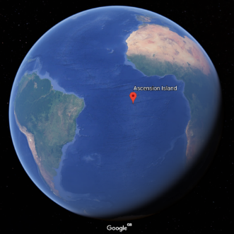
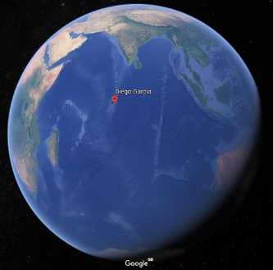
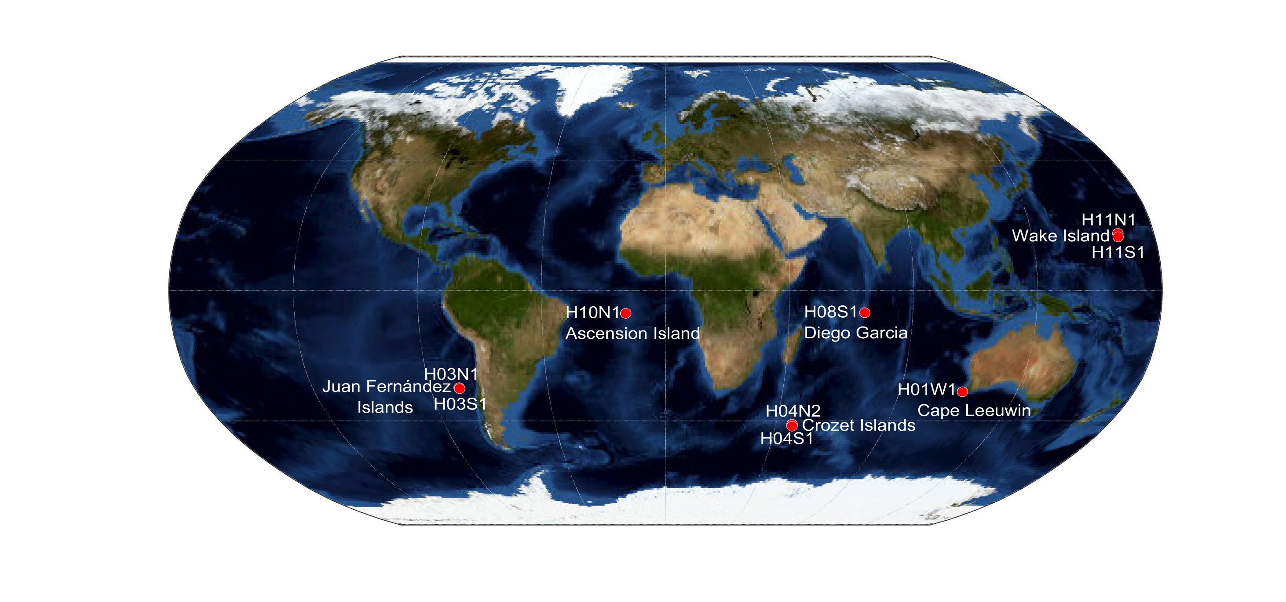
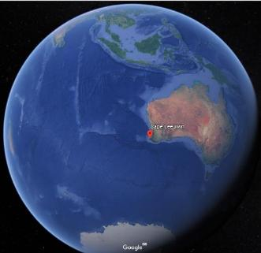
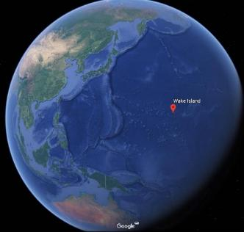
Underwater Acoustic - primary standards, traceability to the SI units, comparisons and validation Stephen Robinson
Side event
on metrology
SE01-O3
Ascension Is
Diego Garcia
Cape Leeuwin
Wake Island

Slide 17
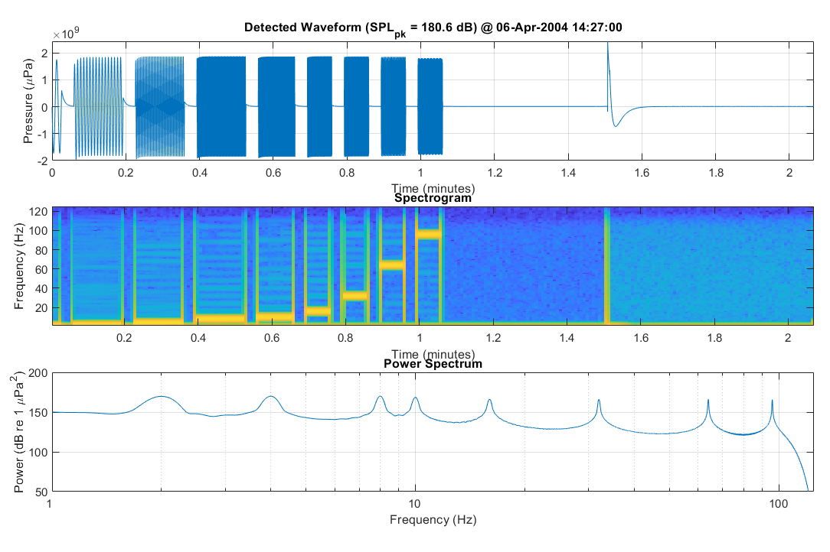
Underwater Acoustic - primary standards, traceability to the SI units, comparisons and validation Stephen Robinson
Side event
on metrology
SE01-O3
Existing calibration checks – electrical signal injection
Periodic injection of electrical signals to check signal acquisition chain
Checks only electrical system – not acoustic sensor element

Slide 18
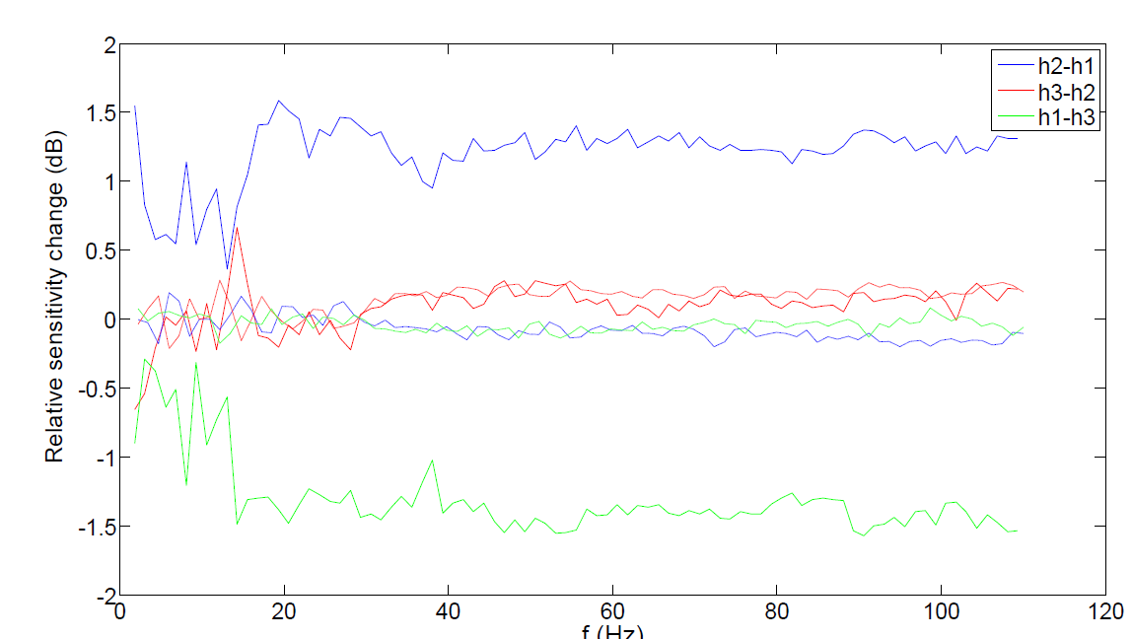
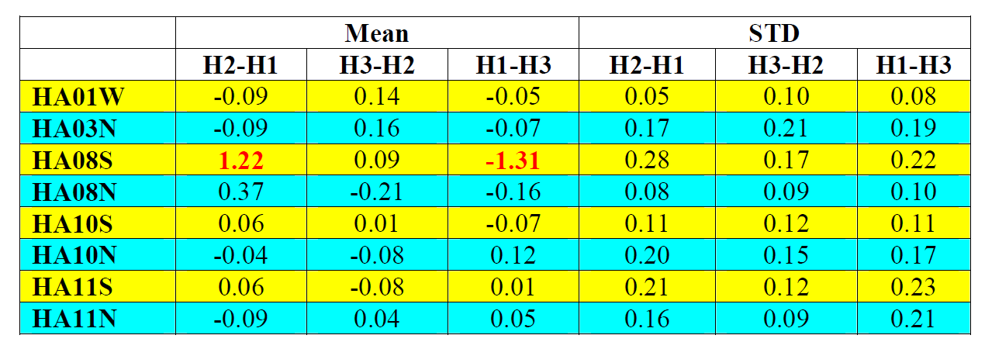
Check of relative hydrophone sensitivities
Underwater Acoustic - primary standards, traceability to the SI units, comparisons and validation Stephen Robinson
Side event
on metrology
SE01-O3
Study of relative sensitivities
Each station is a hydrophone triplet
Compare spectra between hydrophones
Test relative sensitivities
Look for drift over time
Data from 2011 compared to earliest data
Use background noise as source
  “low percentile” background
  assume that this is from distant sources
  noise statistics are the same for each hydrophone in a triplet

Slide 19
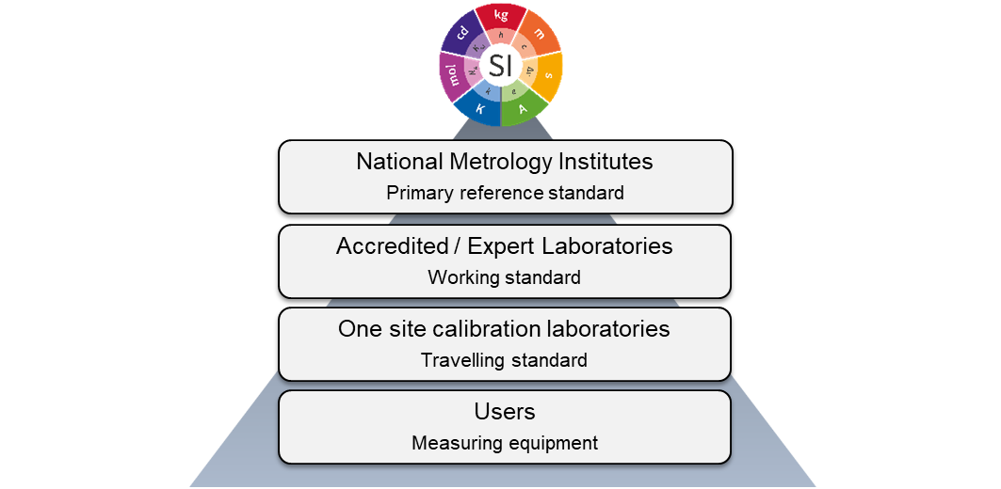
Underwater Acoustic - primary standards, traceability to the SI units, comparisons and validation Stephen Robinson
Side event
on metrology
SE01-O3
SUMMARY
Primary standards provide traceability to the fundamental S.I. units
More than one independent absolute calibration methods provides:
  Opportunity to cross-compare for consistency - greater confidence in measurement
  Need new CCAUV key comparison to cover range 0.5 Hz to 250 Hz
  Need calibrations to be undertaken as function of depth and temperature (ocean conditions)
metrological performances have been demonstrated for laser pistonphone (NPL) and coupler reciprocity (USRD)
primary link in the chain of traceability in the full frequency range of interest for infrasound measurements of the IMS
calibration methods now to be used in an intercomparison exercise
comparison of methods for ocean conditions still required
potential ideas for in-situ calibration checks under discussion

