Slide 1

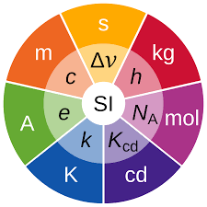


Side event
on metrology
SE01-O2
The Challenges of Measuring Ground Motion
Precision, Uncertainties and Calibration
Horst Rademacher
Berkeley Seismology Laboratory
University of California, Berkeley
(retired)
Vienna, 10 Sep 2025

Slide 2

Disclaimer:
In this contribution mentioning manufacturer’s names,
instrument models or showing photos or drawings
is purely for informational purposes and
does not imply any value judgement.

Slide 3
The Challenges of Measuring Ground Motion
Motivation for this session:
Calibration of instrumentation for the
three technologies used in the IMS
traceability to SI standards
Motivation for this contribution:
Explore complexities and difficulties in operation of seismic stations
I want to show that calibration is not enough,
its necessary but not nearly sufficient

Slide 4
We want to measure
ground motion with
- highest precision,
least uncertainties
lowest noise possible
- in real units (m/sec, m/sec² )
This is easier said than done
We need a complex measuring system

Slide 5
complete measuring system - commonly called a seismic station
Consists of many elements:
seismometer
digitizer
clock
data management and storage
telemetry
instrumental elements
thermal and other insulation
geologic conditions (i.e. tilt)
environmental elements
We need to understand all of them
and how they are working together.

Slide 6
What does this mean for
ground motion measurements?
each element of the measuring system
has its own precision and its specific uncertainties.
each element needs its own calibration
Just calibrating a seismometer gives us only limited information
about the overall health of a seismic station (SOH)
It is necessary
but it is not sufficient

Slide 7
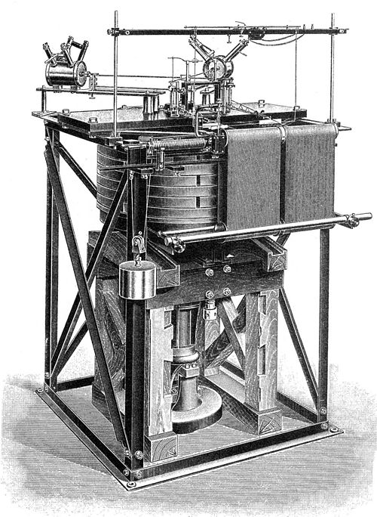
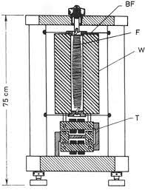
What does this mean for seismometer calibration?
In the old days we had
mechanical instruments
Put a penny of the inertial mass
Tuning fork (old Benioff sensors)
We measured the magnification of the ground motion:
seismometer plus system of mechanical levers with styluses to scratch on soot paper.

Slide 8
What does this mean for seismometer calibration?
In modern era: All seismometers are
- three components in one housing
different internal layout of the seismic components (classic orthogonal vs. Galperin)
controlled by feedback systems of different design
two methods of seismometer calibration in the lab
mechanical via precision shake table
electrical, by injecting a signal into the feedback system

Slide 9
What does this mean for seismometer calibration?
both methods are valid, but yield different insights
#1: mechanical:
we get a voltage proportional to the mechanical excitation
but we treat seismometer as a black box.
we don’t know at all what the internal components are doing
#2: electrical:
inject voltage into the feedback system, measure response of inertial mass
depending on component layout, we can test each component separately
gives somewhat more insight
get information about behavior of the inertial mass and the feedback system
more in Thomas Bruns’ talk (SE01-O5) later in this session

Slide 10
What about the other elements of the seismic system?
digitizer needs separate calibration
clock needs separate calibration
data management functionality test
telemetry functionality test
thermal and other insulation inspection necessary
geologic conditions (tilt) inspection necessary
Only when we know all these parameters can we judge the State of Health (SOH)
of a seismic station and can perform ground motion measurements with high precision

Slide 11
Is that complex enough?
What about field calibration - I
Simple: Huddle test
Many seismometers of same type operated simultaneously and collocated
yields comparison amongst the seismometer, easy to find outliers.
More complex:
take a lab calibrated seismometer (reference) into the field
set-up next to existing seismometer under test
compare their respective measurements

Slide 12
What about field calibration - II
sounds straight forward but several pitfalls:
What happens to the reference seismometer during transport?
mechanical vibrations, different environmental conditions
(temperature, pressure)
- Interruption of the continuous real time measurements by
opening the vault and insulation, generating mechanical vibrations
reference seismometer will be connected to separate periphery
(digitizer, data collection system) compared to seismometer under test.
Does that introduce any additional errors and uncertainties?
more in John Mechant’s talk later in this session

Slide 13
Conclusion
For precision measurements of ground motion
we need a stable State of Health
Calibration of seismometer is one element of
establishing SOH of a seismic station
necessary but not nearly sufficient
Seismometer calibration shall be viewed as
important element of troubleshooting process

Slide 14
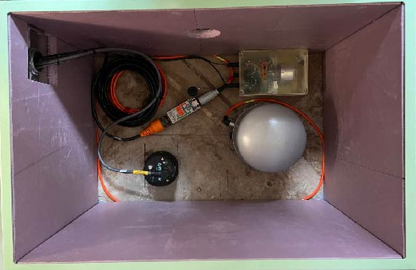
Possible Alternate Approach:
typical layout of a Berkeley vault station
Network: BK
Non-invasive health check
and alternative “calibration”
of a complete seismic station
Wait for EQ,
compare Accelerometer data
to BB Seismometer data
Integrate/Differentiate
Do they give the same results?
Accelerometer
Broadband
Seismometer
If yes, station in good health

Slide 15
Thank You

