Slide 1

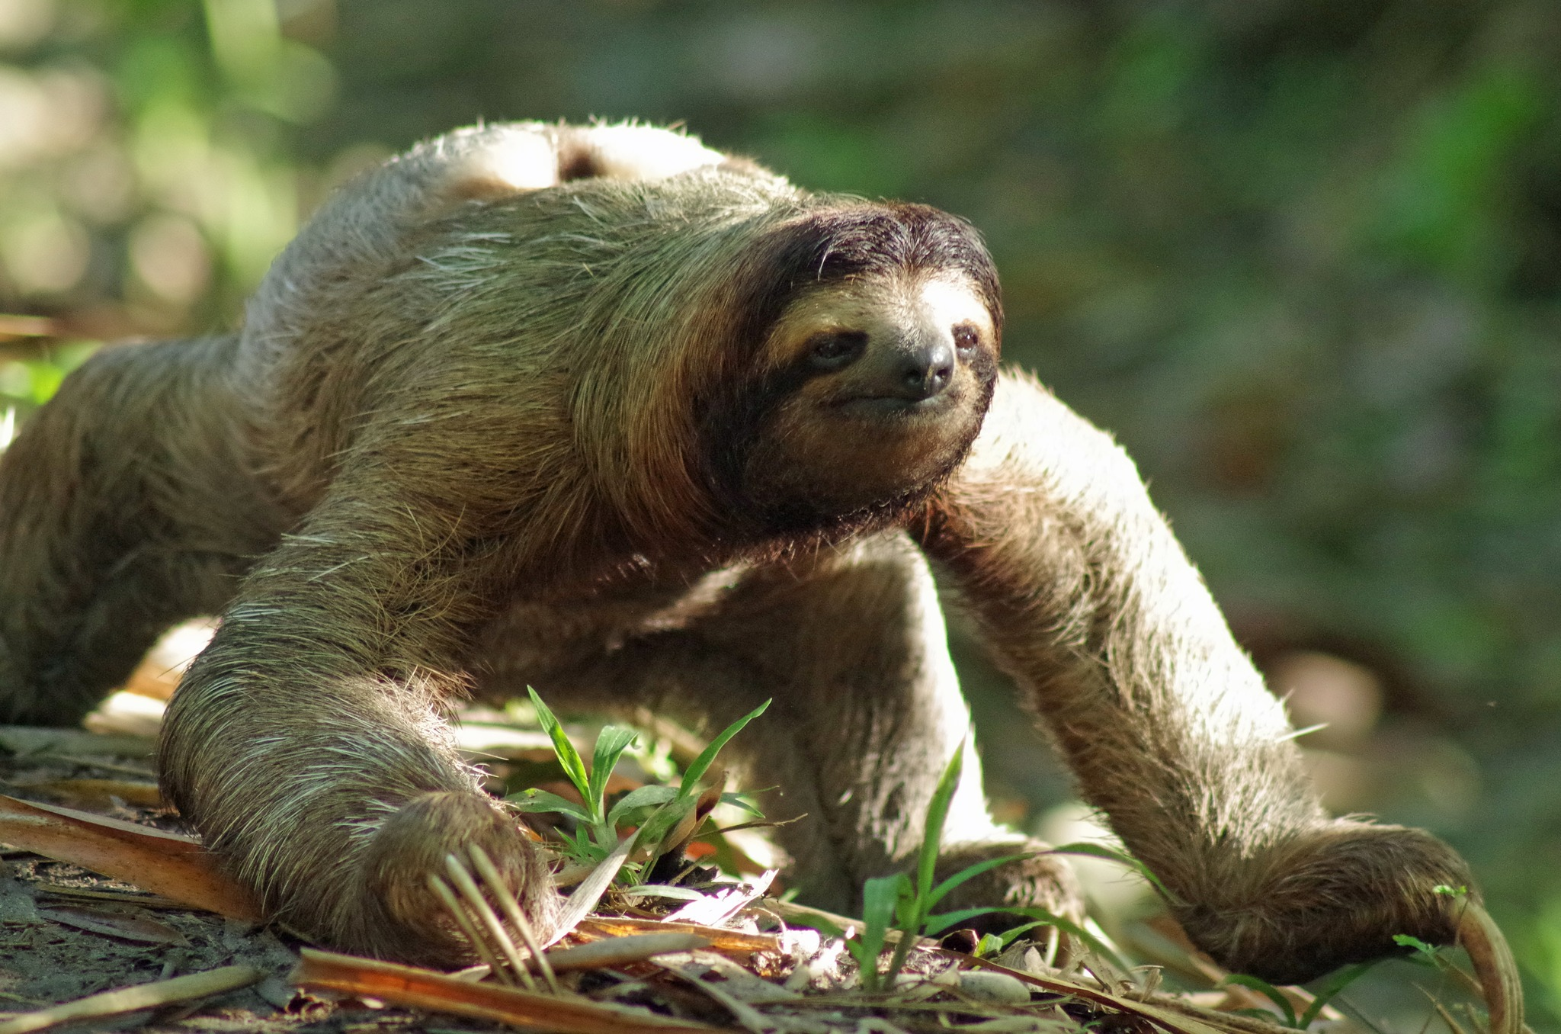
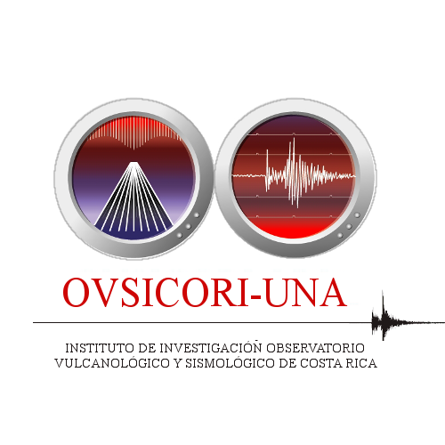
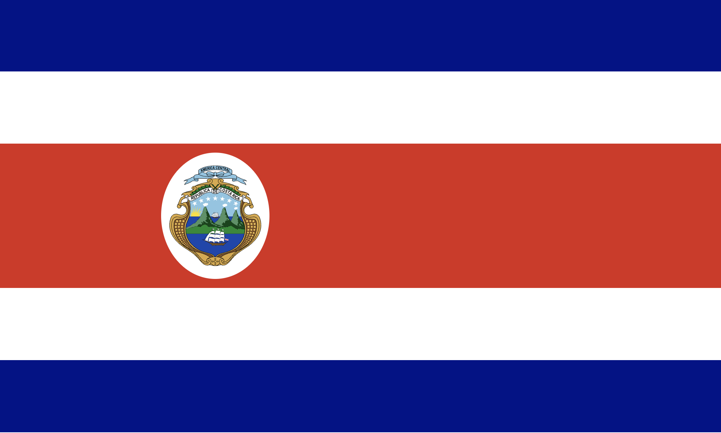
Geography, Gender, Generations:
How NDCs Shape the World Today and Tomorrow?
PANEL 06
Marino Protti
Costa Rica Volcanological and Seismological Observatory, National University of Costa Rica (OVSICORI-UNA)
The Costa Rica NDC is managed by OVSICORI-UNA, a university research institute, in charge of volcano and seismic monitoring. Although it only involves one monitoring technique of the CTBT-IMS, (an auxiliary seismic station) the Costa Rica NDC also operates its own broadband seismic and infrasound local networks. Four people are involved with NDC activities at OVSICORI-UNA: a system manager (Christian Garita), a telecommunications engineer (John Bolaños) and two seismologist (Evelyn Nuñez and Marino Protti).
The Costa Rica NDC hosted the first NDC training course for Spanish speaking NDCs in November 2023, providing an excellent opportunity to share experiences in our own language.
Peace and conservation are the main flags of Costa Rica foreign policy therefore, this panel and all our efforts related to the CTB Treaty, are focused not only to help preserve our own species though peace, but also all wildlife in this planet.

