Slide 1
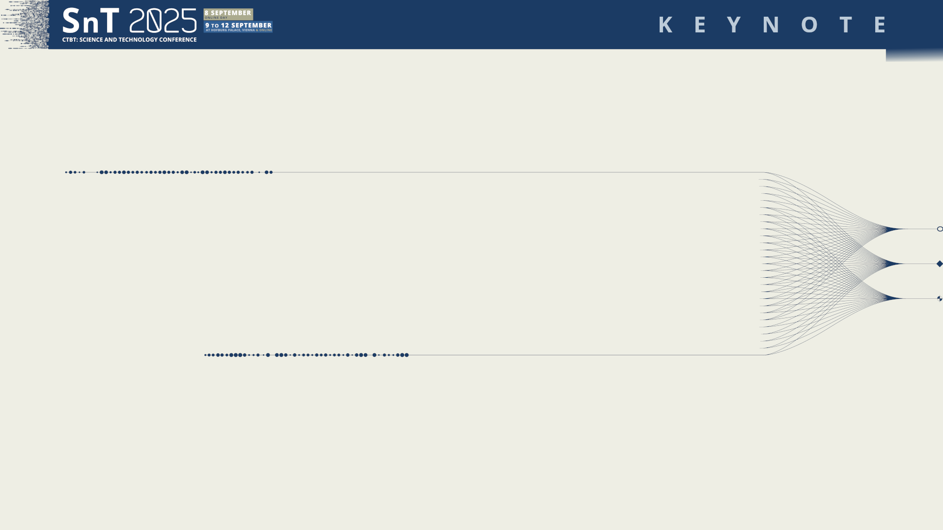

Place your programme code here
[Arial Bold; 10,5pt.]
Example
Ke01
Broadening the Impact of OSI Exercises and Field Tests
Mohamed ElGabry
Egyptian National Data Center
National Research Institute of Astronomy and Geophysics
11 September 2025
DISCLAIMER
The views, thoughts, and opinions expressed in this presentation are solely those of the author and do not necessarily reflect the official policy or position of the National Research Institute of Astronomy and Geophysics (NRIAG) or the Comprehensive Nuclear-Test-Ban Treaty Organization (CTBTO).

Slide 2
PLEASE DON‘T FORGET TO PUT THE KEYNOTE TITLE AND YOUR NAME IN THE SLIDE‘S HEADER.
THEN DUPLICATE THIS SLIDE FOR ALL OTHER PRESENTATION SLIDES.
Place your programme code here
[Arial Bold; 10,5pt.]
Example
Ke01
Broadening the Impact of OSI Exercises and Field Tests
Mohamed ElGabry
Final Verification Measure
OSI = Final Verification Measure
    Triggered by International Monitoring System (IMS) anomalies or other Treaty mechanisms
    Collect factual findings to confirm or refute a suspected nuclear test.
Inspection Facts (as defined by CTBT Protocol)
  Maximum Area: up to 1,000 km² (defined inspection area).
  Duration: 25 days, extendable up to 130 days with EC approval.
  Inspection Team: up to 40 inspectors.
  Techniques: 17 techniques permitted by Treaty
DISCLAIMER
he views, thoughts, and opinions expressed in this presentation are solely those of the author and do not necessarily reflect the official policy or position of the National Research Institute of Astronomy and Geophysics (NRIAG) or the Comprehensive Nuclear-Test-Ban Treaty Organization (CTBTO).

Slide 3
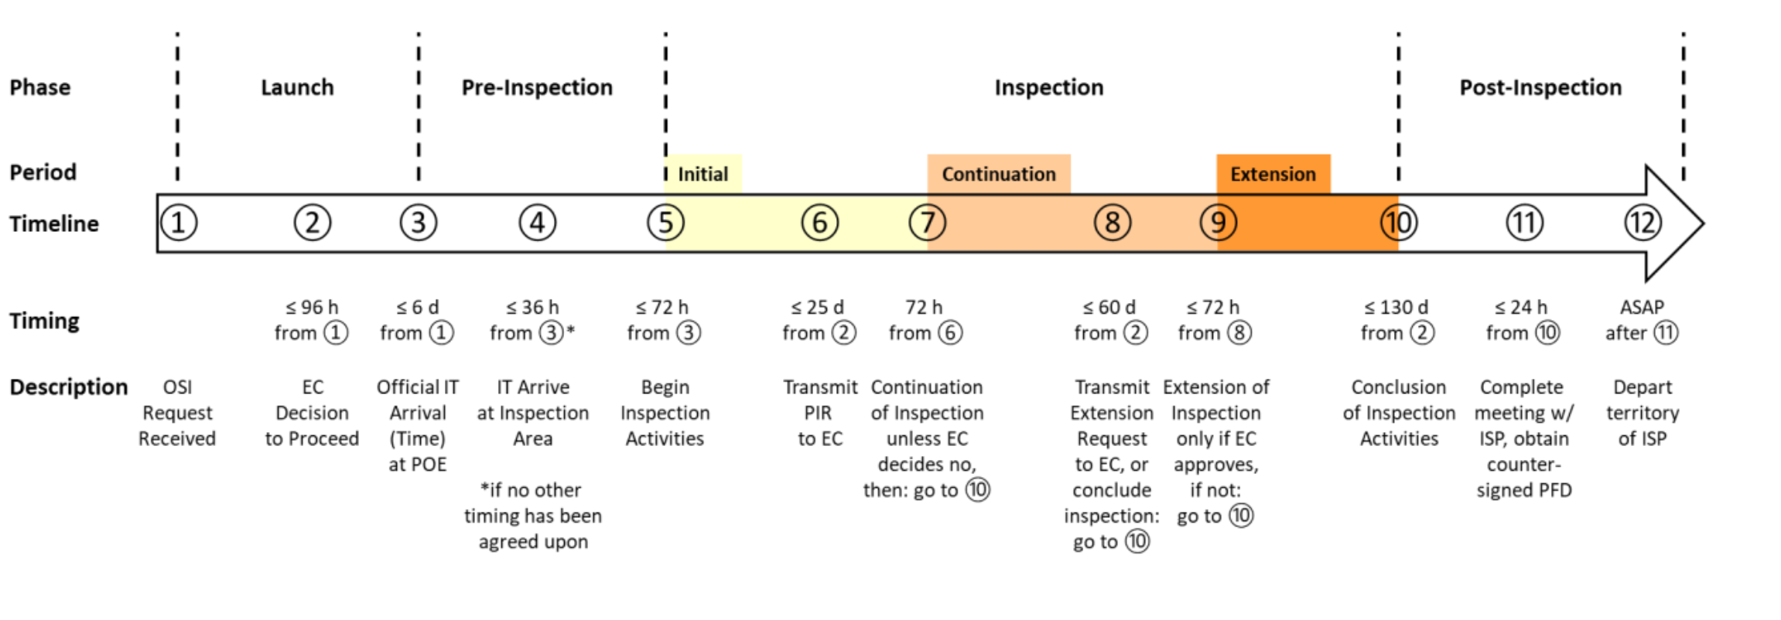
Field Operations — Operational Layers

Slide 4
PLEASE DON‘T FORGET TO PUT THE KEYNOTE TITLE AND YOUR NAME IN THE SLIDE‘S HEADER.
THEN DUPLICATE THIS SLIDE FOR ALL OTHER PRESENTATION SLIDES.
Place your programme code here
[Arial Bold; 10,5pt.]
Example
Ke01
Broadening the Impact of OSI Exercises and Field Tests
Mohamed ElGabry
Inspection activities and techniques, Treaty Protocol Para.69
Position finding from the air and at the surface to confirm the boundaries of the inspection area and establish coordinates of locations therein, in support of the inspection activities;
Visual observation, video and still photography and multi-spectral imaging, including infrared measurements, at and below the surface, and from the air, to search for anomalies or artifacts;
Measurement of levels of radioactivity above, at and below the surface, using gamma radiation monitoring and energy resolution analysis from the air, and at or under the surface, to search for and identify radiation anomalies;
Environmental sampling and analysis of solids, liquids and gases from above, at and below the surface todetect anomalies;
Passive seismological monitoring for aftershocks to localize the search area and facilitate determination of the nature of an event;
Resonance seismometry and active seismic surveys to search for and locate underground anomalies, including cavities and rubble zones;
Magnetic and gravitational field mapping, ground penetrating radar and electrical conductivity measurements at the surface and from the air, as appropriate, to detect anomalies or artifacts;
Drilling to obtain radioactive samples.
DISCLAIMER
he views, thoughts, and opinions expressed in this presentation are solely those of the author and do not necessarily reflect the official policy or position of the National Research Institute of Astronomy and Geophysics (NRIAG) or the Comprehensive Nuclear-Test-Ban Treaty Organization (CTBTO).
Notes:
OSI techniques are explicitly defined in the Treaty (Protocol Article II, para. 69)
Legal limits define what may be used — importance of staying treaty-compliant while innovating
Treaty & PrepCom guidance set the operational envelope for field activities

Slide 5
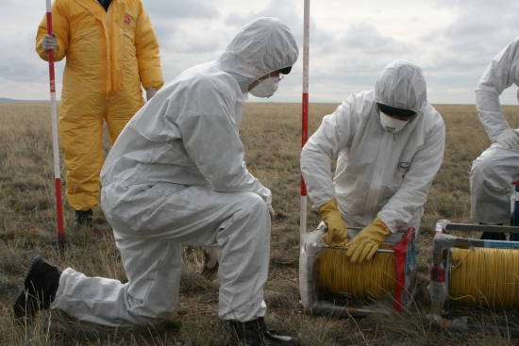
PLEASE DON‘T FORGET TO PUT THE KEYNOTE TITLE AND YOUR NAME IN THE SLIDE‘S HEADER.
THEN DUPLICATE THIS SLIDE FOR ALL OTHER PRESENTATION SLIDES.
Place your programme code here
[Arial Bold; 10,5pt.]
Example
Ke01
Broadening the Impact of OSI Exercises and Field Tests
Mohamed ElGabry
Field Operations — Operational Layers
Health, Safety & Security HSS: protocols and risk management
Logistics: mobility, transportation, field operations, equipment provisioning
Privileges and Rights: Inspector privileges and State rights (ISP context) — legal & diplomatic dimensions
Treaty and Protocol Text, Operational Manual, Standard Operating Procedures (SOPs)
DISCLAIMER
he views, thoughts, and opinions expressed in this presentation are solely those of the author and do not necessarily reflect the official policy or position of the National Research Institute of Astronomy and Geophysics (NRIAG) or the Comprehensive Nuclear-Test-Ban Treaty Organization (CTBTO).
Notes:
Underline the operational constraints often determine method choice and affect technical outcomes. Mention time/windows and area limitations as practical constraints.

Slide 6
PLEASE DON‘T FORGET TO PUT THE KEYNOTE TITLE AND YOUR NAME IN THE SLIDE‘S HEADER.
THEN DUPLICATE THIS SLIDE FOR ALL OTHER PRESENTATION SLIDES.
Place your programme code here
[Arial Bold; 10,5pt.]
Example
Ke01
Broadening the Impact of OSI Exercises and Field Tests
Mohamed ElGabry
The Mandate
The Resolution establishing the CTBT Preparatory Commission
The Commission shall make all necessary preparations in fulfilling the requirements of the treaty and its protocol, for the support of on-site inspections from the entry into force of the Treaty. It shall, inter alia:
Develop and prepare for the approval of the initial session of the Conference of the States Parties:
    An operational manual containing all appropriate legal, technical and administrative procedures;
    A list of equipment for use during on-site inspections
Develop a programme for the training of inspectors
Acquire or otherwise make provision for the availability of relevant inspection equipment, including communications equipment, and conduct technical tests of such equipment as necessary.
DISCLAIMER
he views, thoughts, and opinions expressed in this presentation are solely those of the author and do not necessarily reflect the official policy or position of the National Research Institute of Astronomy and Geophysics (NRIAG) or the Comprehensive Nuclear-Test-Ban Treaty Organization (CTBTO).

Slide 7
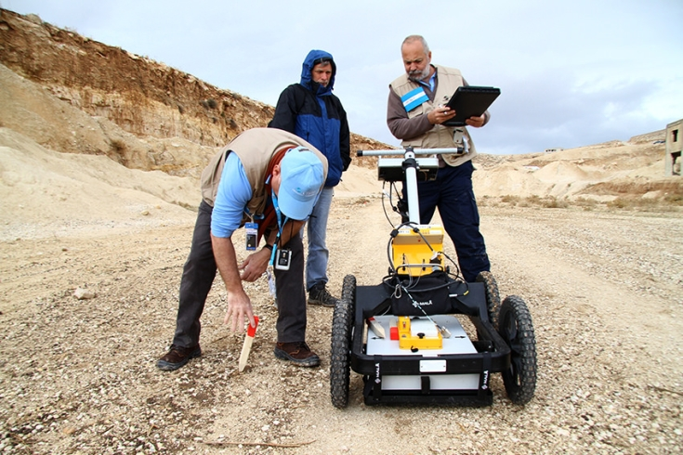
Exercises and Field Tests
Simulated 37-day OSI in Jordan (Nov–Dec 2014) over a ~1,000 km² area with ~40 inspectors.
IFE14 tested 15 of the OSI techniques prescribed by the Treaty
Introduced an improved in-field communications system and rapid-deployment capabilities for moving tons of equipment

Slide 8
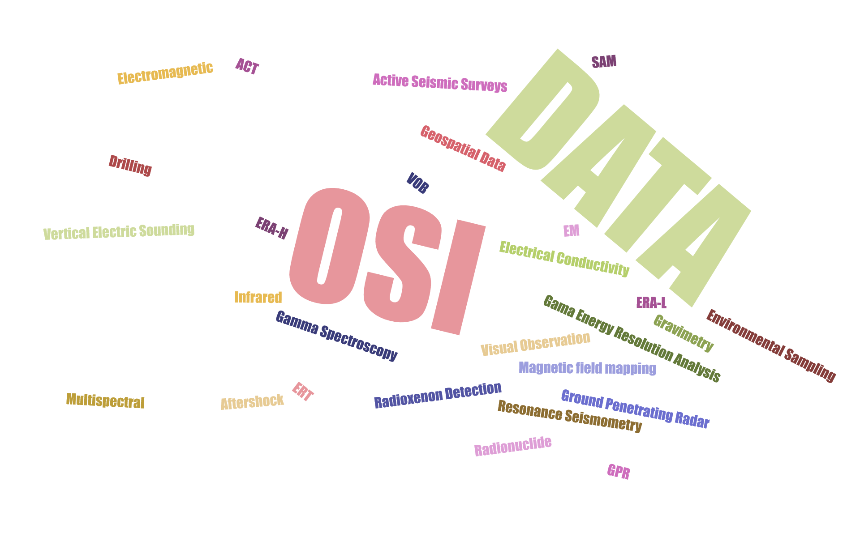

Slide 9
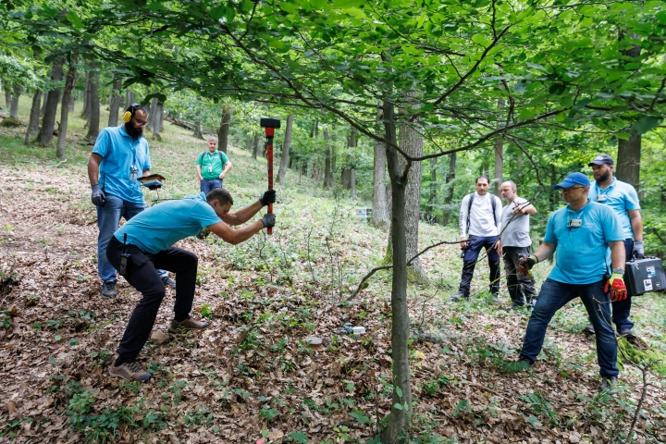
Exercises and Field Tests
BUE24 (June 2024) simulated the continuation phase of an OSI in mountainous terrain in Hungary
Nearly 200 participants from 40+ countries and ~100 tonnes of equipment were deployed across a 382 km² area
Tested updated inspection team functionality (ITF), search logic and data workflows, including use of the Geospatial Information Management (GIMO) platform

Slide 10
Outcomes / Impact
Operational Readiness
ensure that once the Treaty enters into force, OSI teams are fully prepared and equipment is functional
Procedure Validation
Running realistic scenarios validates and refines inspection procedures, workflows and reporting formats (leading to updated manuals).
Technical Improvement
Data collected allow calibration of sensors and testing new equipment in situ, improving detection resolution.
Efficiency Gains
Use of integrated tools (e.g. GIMO) and refined team protocols results in faster, more effective search missions (shorter mission planning cycles, better information sharing).
Strengthened Compliance
Demonstrating these capabilities builds confidence in the CTBT regime; the exercises show that inspectors can find evidence if needed, thus reinforcing deterrence.
Notes:
Emphasize that exercises “capture massive datasets and rich experiential information on OSI techniques” that enable improvement and recalibration of equipment, methods and dataflows.

Slide 11
Challenges
Data Integration
Combining diverse datasets (seismic waveforms, radiometric counts, GIS layers, lab results) in real time is complex. Large volumes of data from varied sources require robust fusion tools
Logistical
Transporting 150+ tones of heavy, delicate equipment into remote areas under tight time pressure with Calibration requirements and personnels limitation
Time Constraints
Certain signals decay quickly – e.g. the number of aftershocks and short-lived radionuclides dissipate; Inspectors must deploy within days to capture these signals; ITF cycle(steps 1-5);
Environmental
Technical Limits
OSI take place in environments ranging from arid deserts to the Arctic, impacting inspectors, equipment, search logic, logistics, and every component of the inspection.
Instruments have finite resolution and detection capabilities; some signals can be confused with background anomalies; Keeping all equipment calibrated under field conditions is also challenging
Notes:
(IFE14 specifically introduced rapid-deployment systems for tons of gear[4].) In BUE24, teams moved hundreds of cases of gear and set up a BoO on uneven ground[7][4]

Slide 12
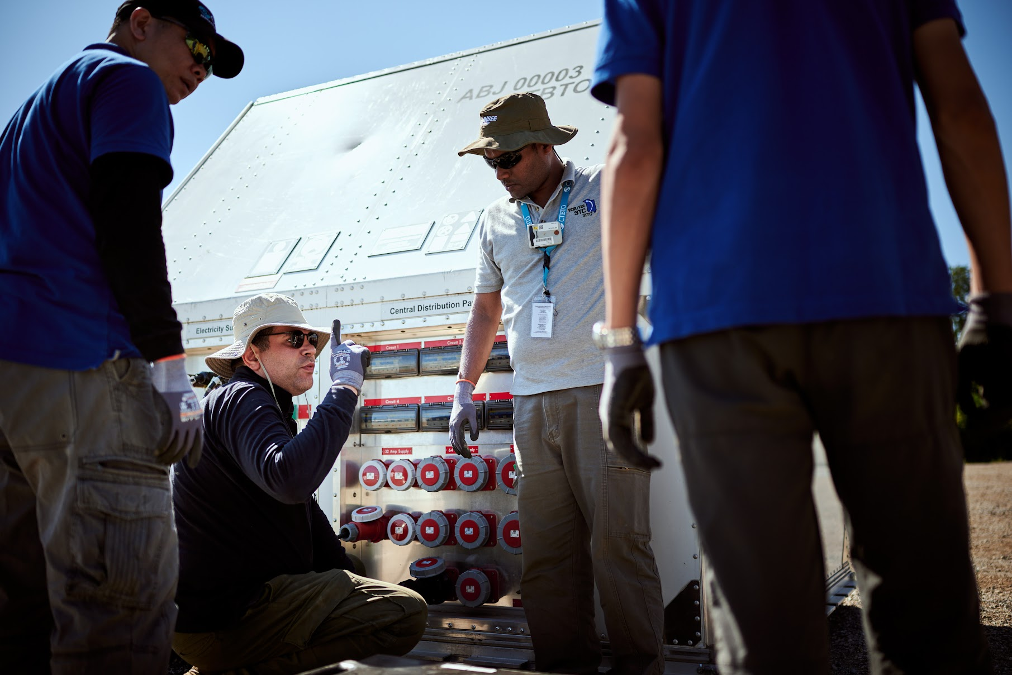
PLEASE DON‘T FORGET TO PUT THE KEYNOTE TITLE AND YOUR NAME IN THE SLIDE‘S HEADER.
THEN DUPLICATE THIS SLIDE FOR ALL OTHER PRESENTATION SLIDES.
Place your programme code here
[Arial Bold; 10,5pt.]
Example
Ke01
Broadening the Impact of OSI Exercises and Field Tests
Mohamed ElGabry
From Data to Improvement — Turning Field tests & Exercise Data into Value
High-volume, multi-modal datasets enable recalibration and QA/QC
Refine analytical algorithms and develop better acquisition SOPs
Procurement insights: inform future equipment acquisition, lifecycle planning, and upgrades.
Document lessons learned for operational manuals and training.
Knowledge transfer: lessons learned feed directly into operational manuals, training, and inspector preparation.
Innovation driver: exercise-derived data supports R&D, fostering continuous improvement of OSI capabilities
DISCLAIMER
he views, thoughts, and opinions expressed in this presentation are solely those of the author and do not necessarily reflect the official policy or position of the National Research Institute of Astronomy and Geophysics (NRIAG) or the Comprehensive Nuclear-Test-Ban Treaty Organization (CTBTO).

Slide 13
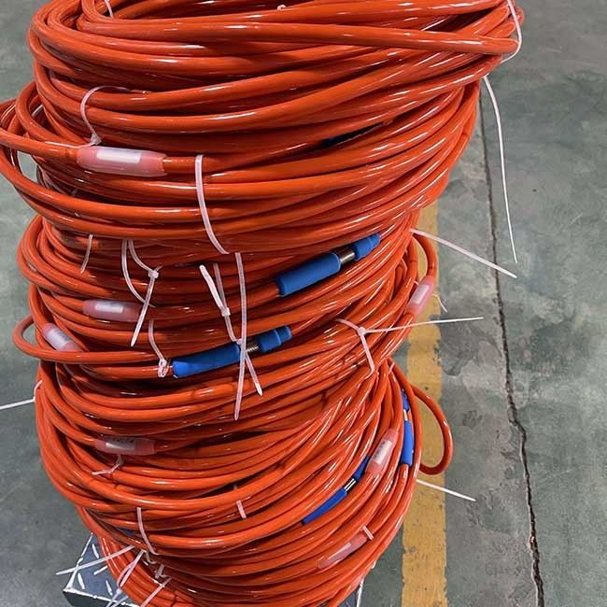
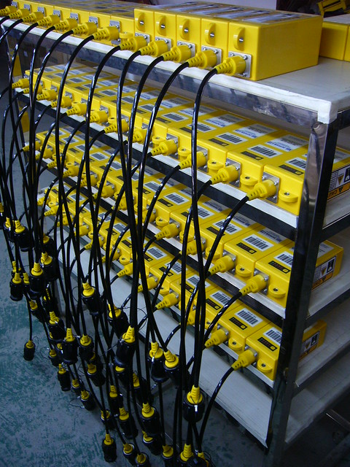
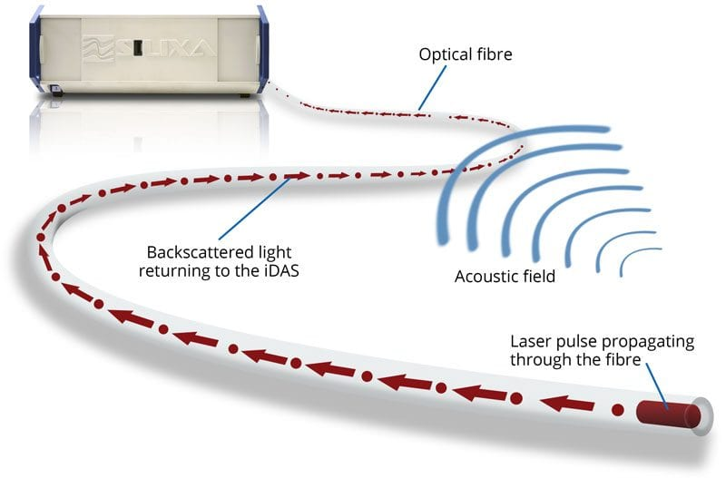

Slide 14

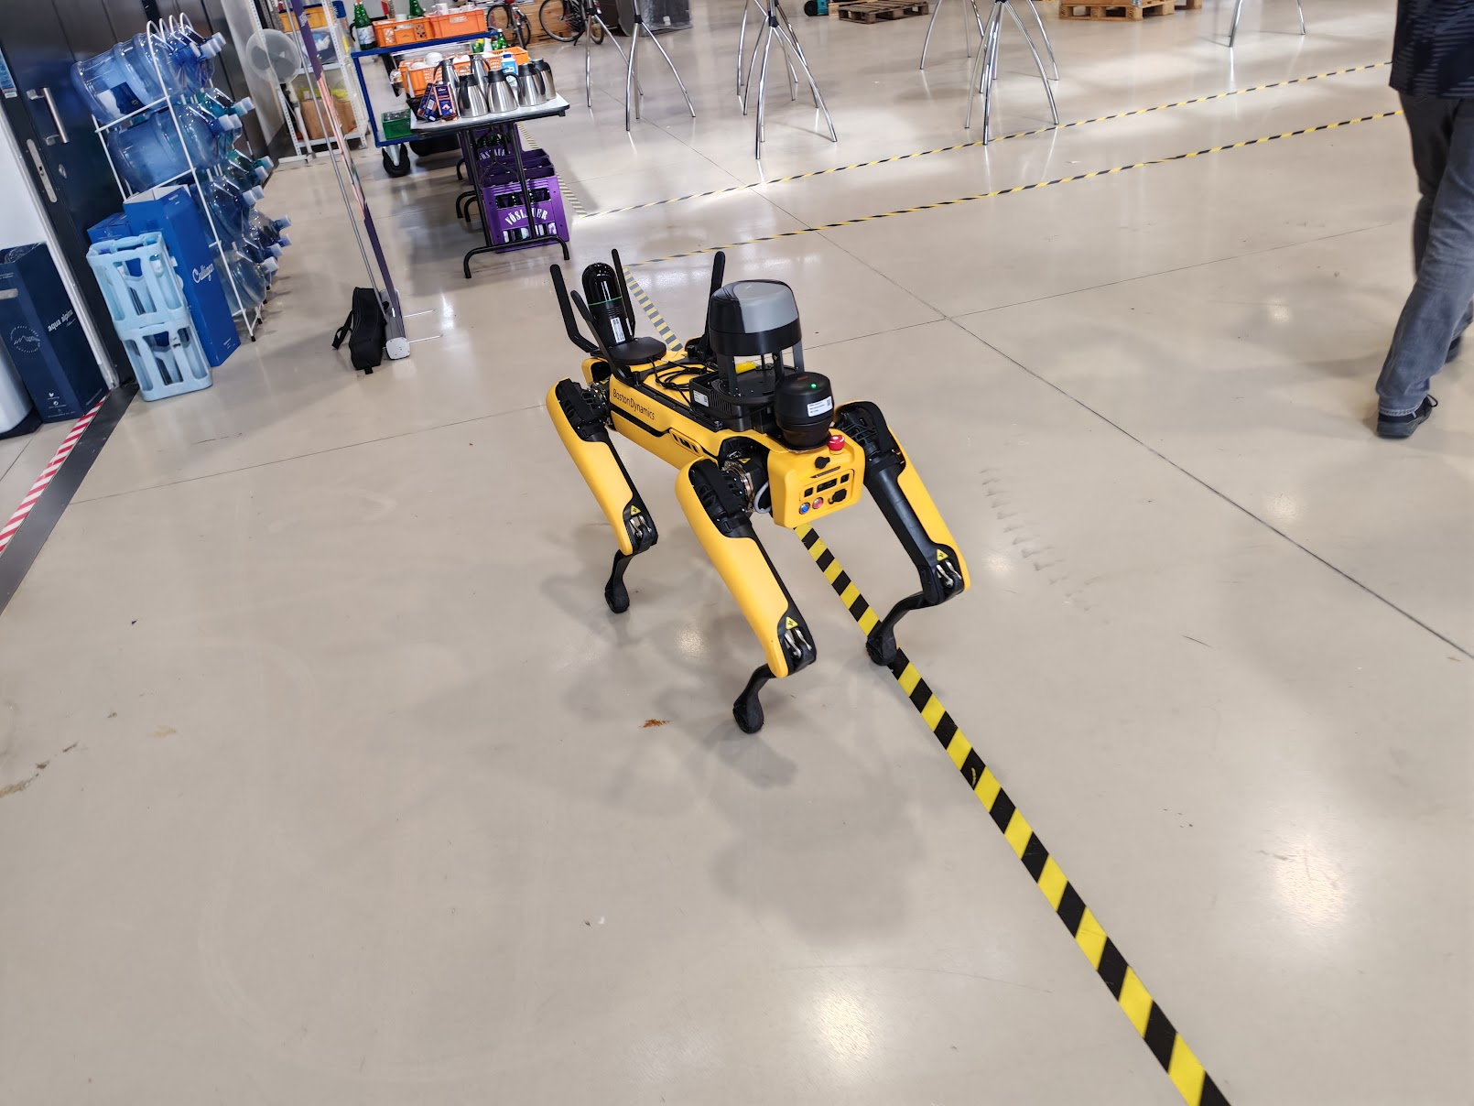
Data Fusion Tools
Autonomous Systems
Logistics Prep
Sensor Advances
Novel Processing methods

Slide 15
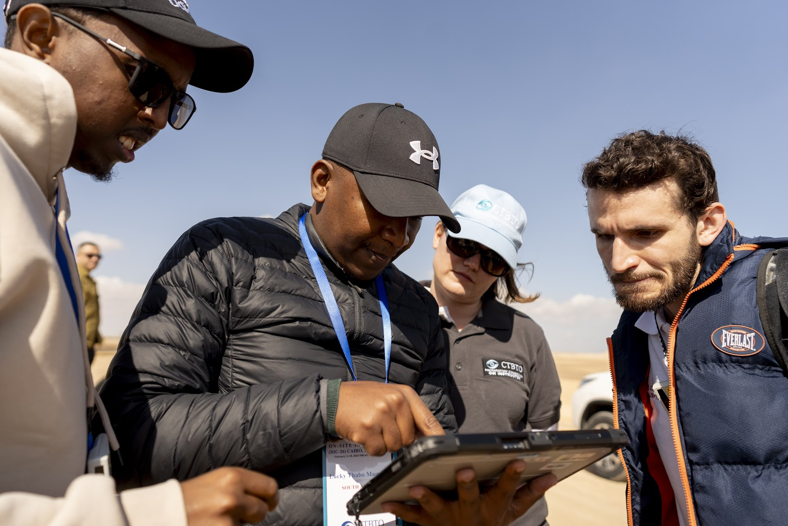
PLEASE DON‘T FORGET TO PUT THE KEYNOTE TITLE AND YOUR NAME IN THE SLIDE‘S HEADER.
THEN DUPLICATE THIS SLIDE FOR ALL OTHER PRESENTATION SLIDES.
Place your programme code here
[Arial Bold; 10,5pt.]
Example
Ke01
Broadening the Impact of OSI Exercises and Field Tests
Mohamed ElGabry
Broadening Engagement — Who to Involve
Academic researchers and university labs
Technical experts from member states
Industry partners
Students and early-career professionals
DISCLAIMER
he views, thoughts, and opinions expressed in this presentation are solely those of the author and do not necessarily reflect the official policy or position of the National Research Institute of Astronomy and Geophysics (NRIAG) or the Comprehensive Nuclear-Test-Ban Treaty Organization (CTBTO).

Slide 16
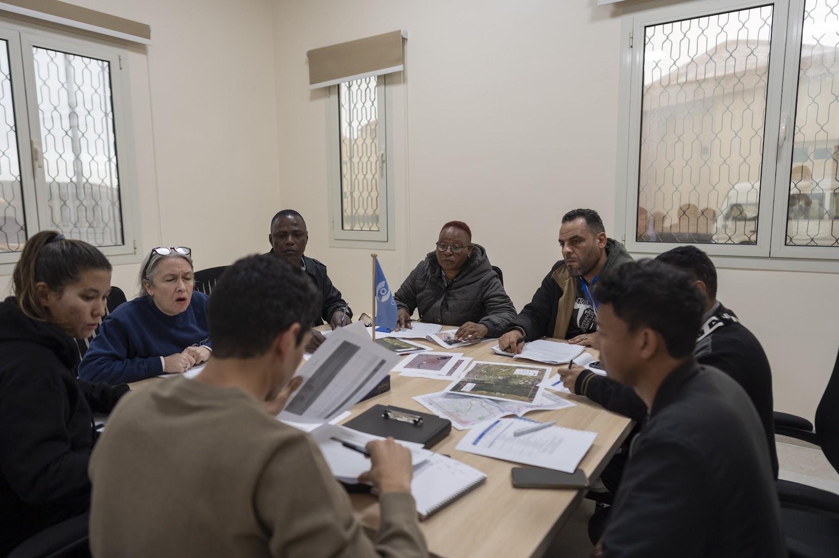
PLEASE DON‘T FORGET TO PUT THE KEYNOTE TITLE AND YOUR NAME IN THE SLIDE‘S HEADER.
THEN DUPLICATE THIS SLIDE FOR ALL OTHER PRESENTATION SLIDES.
Place your programme code here
[Arial Bold; 10,5pt.]
Example
Ke01
Broadening the Impact of OSI Exercises and Field Tests
Mohamed ElGabry
Broadening Engagement - Impact
Stronger feedback loops for procedures, software and equipment design
Innovation pipelines from academia and industry
Expanded capacity across member states — localized expertise
Greater transparency, trust-building and improved readiness
DISCLAIMER
he views, thoughts, and opinions expressed in this presentation are solely those of the author and do not necessarily reflect the official policy or position of the National Research Institute of Astronomy and Geophysics (NRIAG) or the Comprehensive Nuclear-Test-Ban Treaty Organization (CTBTO).

Slide 17
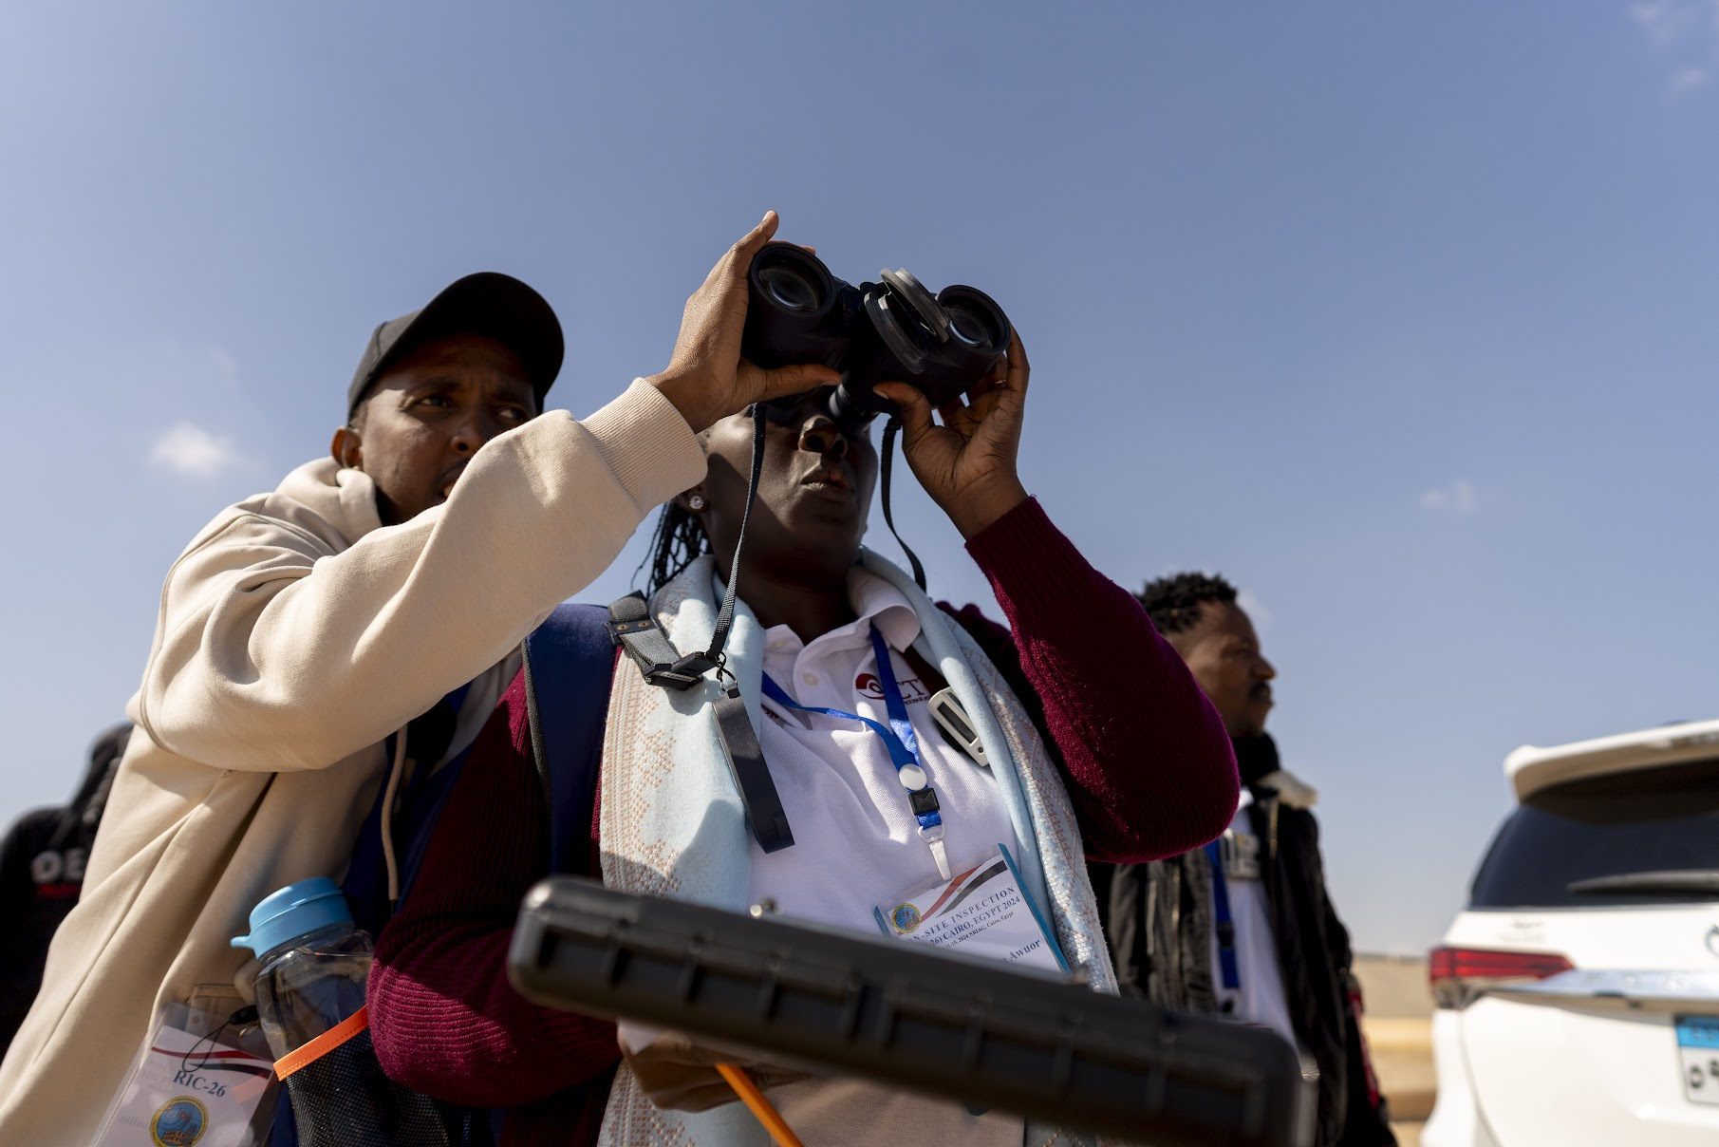
PLEASE DON‘T FORGET TO PUT THE KEYNOTE TITLE AND YOUR NAME IN THE SLIDE‘S HEADER.
THEN DUPLICATE THIS SLIDE FOR ALL OTHER PRESENTATION SLIDES.
Place your programme code here
[Arial Bold; 10,5pt.]
Example
Ke01
Broadening the Impact of OSI Exercises and Field Tests
Mohamed ElGabry
Vision Forward
Keep OSI techniques robust, treaty-compliant and future-ready
Institutionalize data-sharing mechanisms and collaborative Research and Development
Codify lessons into living manuals that evolve with technology
Leverage exercise-derived data to strengthen scientific foundations and preparedness
Broaden engagement to harness innovation, build capacity, and reinforce trust
DISCLAIMER
he views, thoughts, and opinions expressed in this presentation are solely those of the author and do not necessarily reflect the official policy or position of the National Research Institute of Astronomy and Geophysics (NRIAG) or the Comprehensive Nuclear-Test-Ban Treaty Organization (CTBTO).

Slide 18
Conclusions
OSI exercises prove that the CTBT’s verification system is robust, operational, and future-ready.
Exercise-derived data fuels improvements in equipment, methods, and data integration.
Community engagement broadens the impact — linking experts, policymakers, and students.
Shared goal: Strengthen trust, enhance readiness, and ensure effective treaty compliance.
👉 By operationalizing technological advances and broadening participation, OSI remains a cornerstone of global nuclear disarmament and security.

