Slide 1
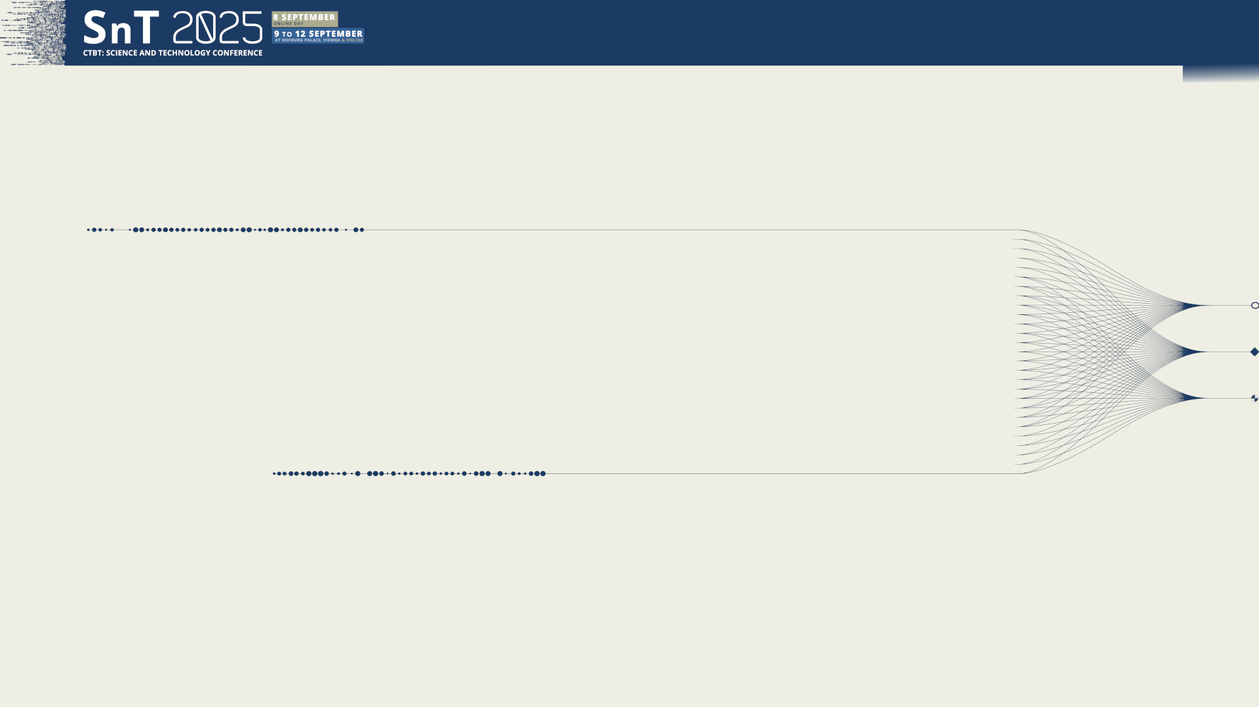

PTS-805
The development of a long term strategy for the sustainment of the International Monitoring System Sustainment
Xyoli Perez Campos, Michelle Grobbelaar
Comprehensive Nuclear-Test-Ban Treaty Organization (CTBTO)
Presentation Date: 11 September 2025
DISCLAIMER: The views expressed in this presentation are those of the authors and do not necessarily reflect the view of the CTBTO.

Slide 2

PTS-805
The development of a long term strategy for the sustainment of the International Monitoring System Sustainment
Xyoli Perez Campos, Michelle Grobbelaar
To ensure a high quality, authenticated and secure detection network and an assured flow of data, a comprehensive assessment of the long-term sustainment requirements of the IMS Network, looking prospectively from 2026 onwards for a twenty-year period was developed.
DISCLAIMER: The views expressed in this presentation are those of the authors and do not necessarily reflect the view of the CTBTO.

Slide 3
PTS-805
The development of a long term strategy for the sustainment of the International Monitoring System Sustainment
Xyoli Perez Campos, Michelle Grobbelaar
Diagnosis of current situation
  DOTS: equipment inventory & history
  IRS (IMS Reporting System)/PRTool/SOPET(PCA)/JIRA: station behavior, problem reports, failure analysis
  SAP: financial data, expenditure history
Sources within the PTS
  Station operators: IMS and other networks, infrastructure data, questionnaires
  Other network managers (e.g. Geoscope, USGS/SCSN)
  Equipment manufacturers: technology refreshment plans, expected lifetime
Sources outside the PTS
Data identification and information management
  Estimation of life cycle per technology
  Various statistics
  Predictability of problems/failure
DISCLAIMER: The views expressed in this presentation are those of the authors and do not necessarily reflect the view of the CTBTO.

Slide 4
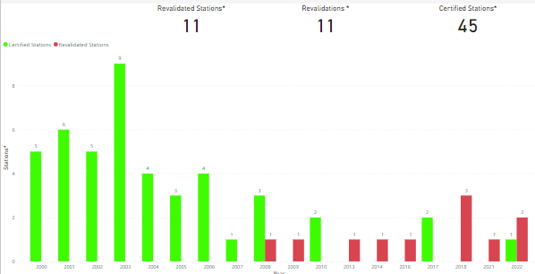
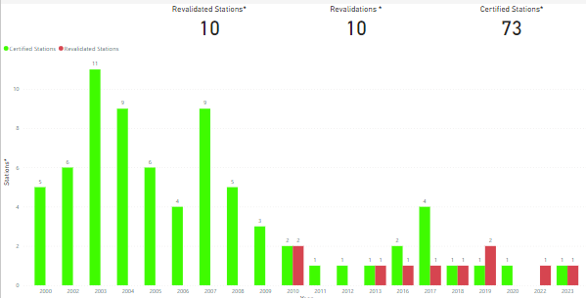
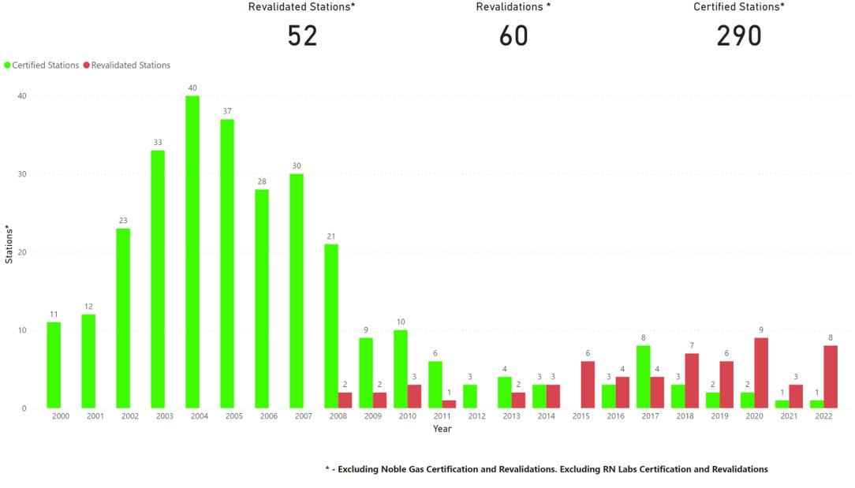
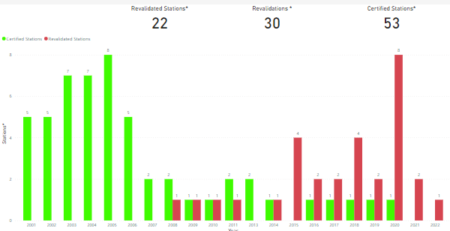
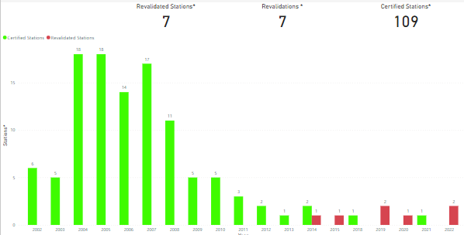
PTS-805
The development of a long term strategy for the sustainment of the International Monitoring System Sustainment
Xyoli Perez Campos, Michelle Grobbelaar
Diagnosis of current situation
Total number of:
certifications ( ) and revalidations ( ) per year
Primary seismic stations
Radionuclide (Part.) stations
2000
2022
2000
2022
Infrasound stations
Auxiliary seismic stations
2000
2022
Differences among technologies
2000
2022
2000
2022
DISCLAIMER: The views expressed in this presentation are those of the authors and do not necessarily reflect the view of the CTBTO.

Slide 5
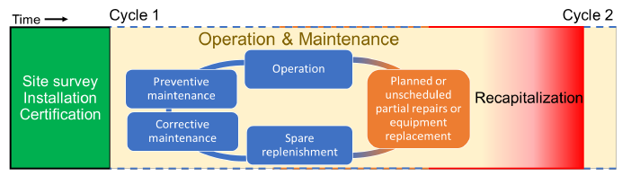
PTS-805
The development of a long term strategy for the sustainment of the International Monitoring System Sustainment
Xyoli Perez Campos, Michelle Grobbelaar
Life cycle
Phase 1: Site survey, installation and certification.
Phase 2: Operation & Maintenance
Phase 3: Recapitalization
DISCLAIMER: The views expressed in this presentation are those of the authors and do not necessarily reflect the view of the CTBTO.

Slide 6
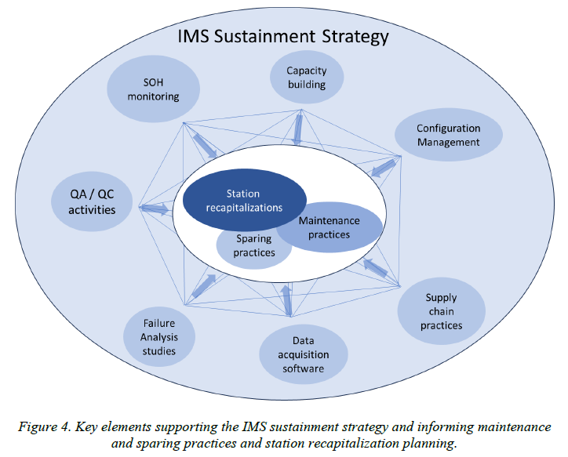
PTS-805
The development of a long term strategy for the sustainment of the International Monitoring System Sustainment
Xyoli Perez Campos, Michelle Grobbelaar
Approach to IMS Sustainment
Comprehensive and multifaceted approach.
Feedback from SO’s, informal consultations.
Key elements support the IMS Sustainment strategy and feed into the Station Recapitalization Planning.
Recapitalization characterized by significant mobilization of resources.
DISCLAIMER: The views expressed in this presentation are those of the authors and do not necessarily reflect the view of the CTBTO.

Slide 7
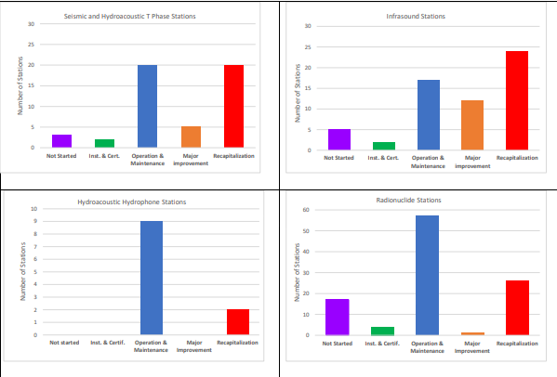
PTS-805
The development of a long term strategy for the sustainment of the International Monitoring System Sustainment
Xyoli Perez Campos, Michelle Grobbelaar
Stage of IMS stations lifecycle
DISCLAIMER: The views expressed in this presentation are those of the authors and do not necessarily reflect the view of the CTBTO.

Slide 8
PTS-805
The development of a long term strategy for the sustainment of the International Monitoring System Sustainment
Xyoli Perez Campos, Michelle Grobbelaar
Lifespan of subsystems
Technology specific identification of functional components.
Comprehensive estimates of the lifespans of technological station subsystems:
Equipment lifespans provided by manufacturers (when available)
Obsolescence and technological foresight
Failure analysis (gained from past 20 years of operating the IMS)
Feedback from station operators (SOs)
Capability of equipment repair and strategic decisions on type of equipment used across the network (standardization)
Careful balance is sought between maintenance cost and cost of the replacement of the technological station subsystems.
Estimated lifespans of equipment used to obtain average costs for subsystems.
Operating equipment until failure is not recommended (high risk of prolonged zero data availability).
DISCLAIMER: The views expressed in this presentation are those of the authors and do not necessarily reflect the view of the CTBTO.

Slide 9
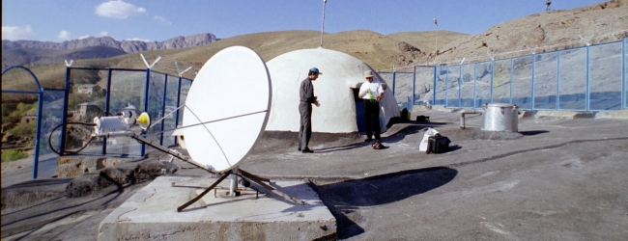
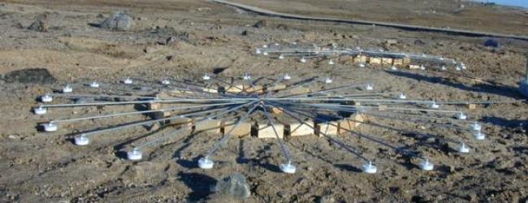

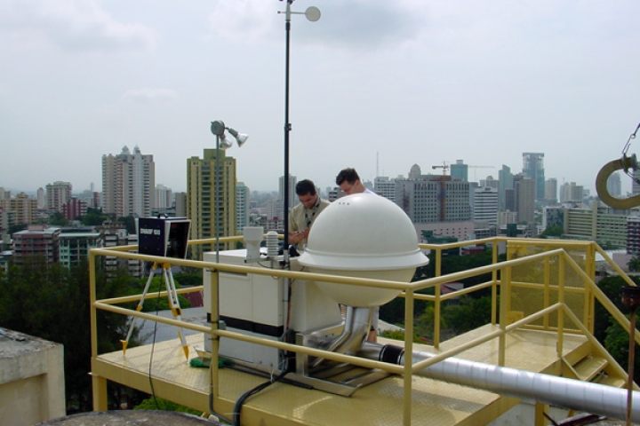
PTS-805
The development of a long term strategy for the sustainment of the International Monitoring System Sustainment
Risk of No Action
Delay in sustainment actions: Impact
Xyoli Perez Campos, Michelle Grobbelaar
Equipment at many IMS stations has reached (or will soon) the end of service life. Equipment is becoming obsolete.
Spare parts for ageing equipment are becoming increasingly scarce, with available stocks running low.
Infrastructure is also ageing and needs to be replaced more frequently.
A delay will have a knock-on effect across the network resulting in the reduction of the stations’ mission capability and the coverage of the IMS Network.
The IMS Network will no longer be capable to perform at the level that it was originally designed to achieve.
Authentication of data may become compromised, jeopardizing the value and confidence that the data provides for detection and eroding confidence in global peace and security.
DISCLAIMER: The views expressed in this presentation are those of the authors and do not necessarily reflect the view of the CTBTO.

Slide 10
PTS-805
The development of a long term strategy for the sustainment of the International Monitoring System Sustainment
Xyoli Perez Campos, Michelle Grobbelaar
Main Identified Risks
Inability to deliver a global verification regime to monitor compliance with the comprehensive ban on nuclear explosions (Organization reputation)
 | Quality of IDC products
1 | Decreased percentage of events in the reviewed event bulletin (REB) for which the area of the location error ellipse is less than 1,000 km²
2 | Missing events of importance due to decrease of data availability (reduced number of detections and associations)
DISCLAIMER: The views expressed in this presentation are those of the authors and do not necessarily reflect the view of the CTBTO.

Slide 11
PTS-805
The development of a long term strategy for the sustainment of the International Monitoring System Sustainment
Xyoli Perez Campos, Michelle Grobbelaar
Main Identified Risks
 | Mission capability/ Data availability/Network coverage
3 | Limited capability to implement any plans/strategies.
4 | Increased frequency of subsystem failure.
5 | Future lack of specialized suppliers.
6 | Lack of available spare parts for procuring.
7 | Lack of cybersecurity protection from disruptive new developments (e.g. quantum computing) that may compromise data surety.
8 | Increase cost of maintenance of obsolete equipment.
9 | Run away cost due to delay maintenance or recapitalization
10 | Simultaneous station failures due to similar ages and/or environments.
11 | Loss of expert knowledge in engineering and development
12 | Limited ability to address catastrophic failures.
13 | Increased number of stations going through long periods of non-mission capability.
14 | Decreased global detection coverage.
 | Environment/Climate
15 | Impact of Environmental and Climate Change on IMS Station
DISCLAIMER: The views expressed in this presentation are those of the authors and do not necessarily reflect the view of the CTBTO.

Slide 12
PTS-805
The development of a long term strategy for the sustainment of the International Monitoring System Sustainment
Xyoli Perez Campos, Michelle Grobbelaar
Conclusions
  Current state of the IMS network has been technically assessed with a comprehensive methodology.
  Cost estimation to address the technical needs suggests a critical funding gap.
  Updating the funding strategy is urgent.
DISCLAIMER: The views expressed in this presentation are those of the authors and do not necessarily reflect the view of the CTBTO.
Notes:
Offer the States Signatories additional sessions for those interested in knowing more about the paper and the next one

