Slide 1
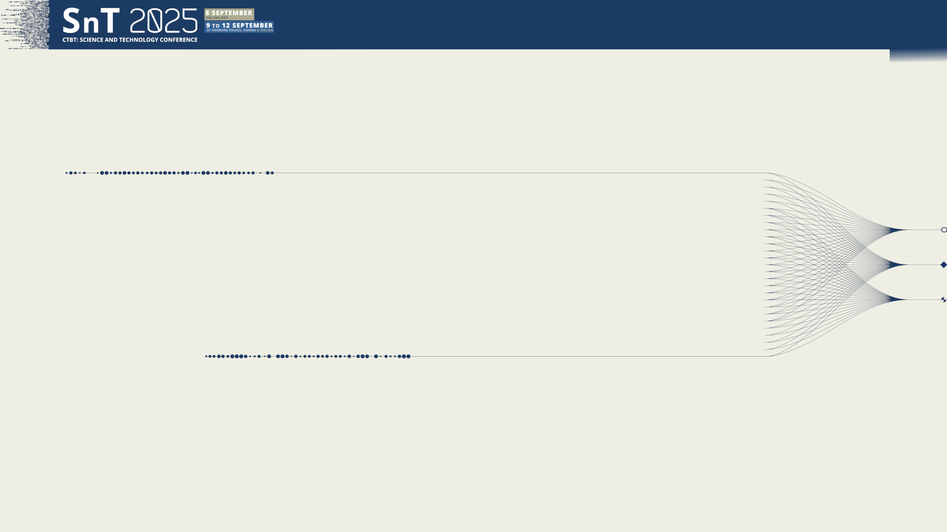

PTS talk
#881
IDC Software for NDCs, Status and Future
D. Keda, G. Graham and M. Villagrán
CTBTO IDC, Office of the Director
Presentation Date: 11 September 2025
DISCLAIMER:
The views expressed in this presentation are those of the authors and do not necessarily reflect the view of the CTBTO.

Slide 2
PLEASE DON‘T FORGET TO PUT THE E-POSTER TITLE AND YOUR NAME IN THE PRESENTATION HEADER.
THEN DUPLICATE THIS SLIDE FOR ALL OTHER PRESENTATION SLIDES.
IDC Software for NDCs, Status and Future
PTS talk
#881
D. Keda, G. Graham and M. Villagrán
Table of Contents
IDC services to States [mandate]
IDC Software-based services to States (NDCs)
NIAB & online Software Development History (1999-2025)
NIAB Scope
Inventory of IDC applications provided to NDCs (NIAB and online)
The future of Software-based services to States (2026→)
Conclusions

Slide 3
PLEASE DON‘T FORGET TO PUT THE E-POSTER TITLE AND YOUR NAME IN THE PRESENTATION HEADER.
THEN DUPLICATE THIS SLIDE FOR ALL OTHER PRESENTATION SLIDES.
IDC Software for NDCs, Status and Future
PTS talk
#881
D. Keda, G. Graham and M. Villagrán
IDC Services to States (1/2)
Technical assistance [CTBT Protocol Part 1 para 22]
The International Data Centre shall, where required, provide technical assistance to individual States Parties:
In formulating their requirements for selection and screening of data and products;
By installing at the International Data Centre, at no cost to a requesting State Party for reasonable efforts, computer algorithms or software provided by that State Party to compute new signal and event parameters that are not included in the Operational Manual for the International Data Centre, the output being considered products of the requesting State Party; and
By assisting States Parties to develop the capability to receive, process and analyse International Monitoring System data at a national data centre.
Technical support
Training
NIAB
Capacity Building and Training + Software Development

Slide 4
PLEASE DON‘T FORGET TO PUT THE E-POSTER TITLE AND YOUR NAME IN THE PRESENTATION HEADER.
THEN DUPLICATE THIS SLIDE FOR ALL OTHER PRESENTATION SLIDES.
IDC Software for NDCs, Status and Future
PTS talk
#881
D. Keda, G. Graham and M. Villagrán
Technical Training Programme
Training to Station Operators of the IMS
Training for NDC Staff
IDC Staff
Equipment Support
Provision and Installation of CBS equipment for NDCs
NDC4All initiative
Technical visits to follow-up (training on-site)
IDC Services to States (2/2)
Capacity Building and
Training Programme
Vectors of Work
Management and Coordination
Coordination of CB across PTS
Reporting
Information/Education/Research Resources
PTS Library Services
E-Learning Platform Services (multi-language)
PTS/CBT Meetings and Events
[Organization] 30-40/year
SnT Conferences
NDC Workshops (3-5/year)
Technical Meetings (3-4/year)
Technology Workshops (4-6/year)
Station Operator Training (12-15/year)
NDC Staff Training (7-9/year)
Workshops in cooperation with CTBTO/ERIC
Service to States Signatories
Management of information related to IDC Users and Station Operators
Provision of NDC-in-a-box Software (NIAB)
Provision of Web services/tools
Attending technical requests from NDC users (~1000 tickets/year)
Provision of information to Permanent Missions, National Authorities, NDCs
Others
Multi-Language
6 languages of the Commission
Software
Development
Training for NDC Staff
Access and (basic) Analysis of waveform IMS Data and IDC Products
NDC Waveform (advanced) Analyst training
Training on Additional components to the NDC in a box (extended)
Access and Analysis of RN IMS Data and IDC Products

Slide 5
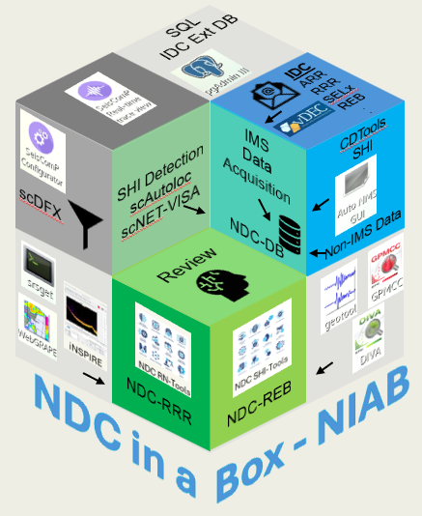
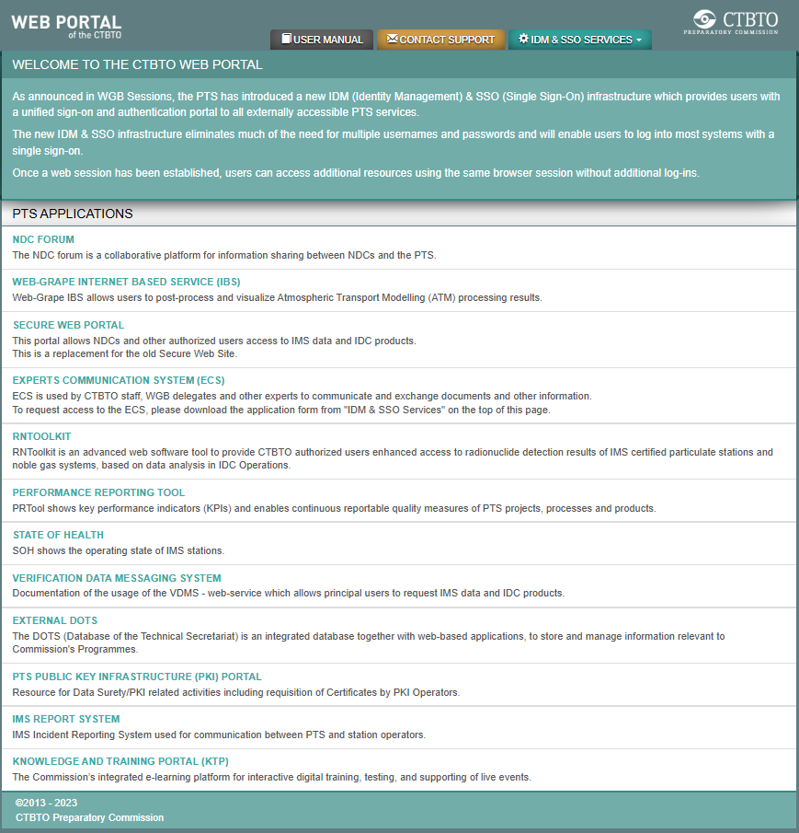
PLEASE DON‘T FORGET TO PUT THE E-POSTER TITLE AND YOUR NAME IN THE PRESENTATION HEADER.
THEN DUPLICATE THIS SLIDE FOR ALL OTHER PRESENTATION SLIDES.
IDC Software for NDCs, Status and Future
PTS talk
#881
D. Keda, G. Graham and M. Villagrán
IDC Software-based Services to States (NDCs)
The NIAB
The NDC in a Box (or NIAB) is a software suite that the IDC develops in cooperation and under the guidance of States Signatories. It assists the National Data Centres (NDCs) to support their National Authorities in their treaty verification role.
  The NIAB includes (in principle) the functionality of the IDC, this allows the NDCs to analyze, reproduce the IDC Operational Pipeline products obtained from IDC automatic and human analysis of IMS Data. NDCs can combine with non-IMS data for the use in civil and scientific applications, in accordance with national needs.
  The NIAB includes IDC operational software (developed in-house after 2000), guest customized applications and State’s contributions.
Online Services
Single-Sign-On SSO mechanism for access to online services.
The CTBTO Web Portal (through SSO). Provides links to:
  IDC Secure Web Portal: Access to IMS Data and IDC Products
  NDC Forum, Expert Communication System (ECS)
  Knowledge and Training Portal (KTP e-learning)
  Tools: Web-GRAPE IBS (ATM), RNToolkit, PRTool, SoH, VDMS, PKI-Portal
  IMS Information and ticketing: DOTS, IRS
  vDEC Virtual Data Exploitation Centre

Slide 6
PLEASE DON‘T FORGET TO PUT THE E-POSTER TITLE AND YOUR NAME IN THE PRESENTATION HEADER.
THEN DUPLICATE THIS SLIDE FOR ALL OTHER PRESENTATION SLIDES.
IDC Software for NDCs, Status and Future
PTS talk
#881
D. Keda, G. Graham and M. Villagrán
Evaluation Workshop
June 21-23 Hannover Germany
Contribution of States to the evaluation of the Verification Regime
Software will be required!
NIAB & online Software Development History (1999-2025)
IDC Software Release 3
Current version
Copyright Restriction
Geotool Testing
30 NDCs (states)
Groundwork
IDC Software Release 2
IDC Operations Begin
Secure Web Portal included
Copyright Restriction
Conditional Policy
Proof of Concept
NIAB Release
NDC in a Box
Release NIAB v.1
NDC in a Box
Start of periodical releases
Development
Forums
IDC Proposal to use Geotool
May 9-12 Edinburg UK
Workshop on PTS-NDCs cooperation and interaction
8 May, workshop on Geotool
Acceptance of proposal
Workshop on establishment of quality assurance system for the Verification Regime
November 22-23 Vienna
Discussions on distribution of IDC applications software to NDCs
The NDC Evaluation Workshop, NDC technical Workshops and WGB [WEG, RNEG, JEG] become the major forums for guiding the development of software-based services for NDCs.
The Geotool Seismic Analysis System was developed in the early 90’s for ARPA/NMRO under the Nuclear Monitoring Research and Development (NMRD) and later enhanced (1993-1995) at the Phillips Laboratory (US Air Force).

Slide 7
PLEASE DON‘T FORGET TO PUT THE E-POSTER TITLE AND YOUR NAME IN THE PRESENTATION HEADER.
THEN DUPLICATE THIS SLIDE FOR ALL OTHER PRESENTATION SLIDES.
IDC Software for NDCs, Status and Future
PTS talk
#881
D. Keda, G. Graham and M. Villagrán
SnT2017
Showcase the use of NIAB v.4x generation
NIAB & online Software Development History (1999-2025)
NDC in a Box
NIAB (extended) v.4.x
RN (qcecorr, bg_analyze, Autosaint, Norfy, Saint2, iNSPIRE)
SHI (adds SeisComP, DTK-(G)PMCC, DTK-DIVA, Qt version of Geotool)
ATM (WebGrape)
SeedLink Service
NDC in a Box
NIAB v.2
Updates across applications
NDC in a Box
NIAB v.7x generation
Linux 9
Online service
Testing
Single-Sign-On (SSO)
CTBTO Web Portal
NIAB Release
Alpha Testers
SHI, extended NIAB
11 NDCs
NDC in a Box
NIAB v.5x generation
FDSN Service
Development
Forums
VDMS 4.2.0
NDC in a Box
NIAB v.3
Adds WebGrape and srsget
Support 64bit
NDC Forum
May-June 2018: Survey on use of NIAB by NDCs
18 June 2018
https://ndc-forum.ctbto.org
NDC in a Box
NIAB v.7.2 & 7.3
iNSPIRE matches IDC Operational software
Beta Testers
WebGrape IBS
11 NDCs
(first) NDC Workshop
Becomes an important forum for guiding the development.
NDC Preparedness Exercised NPEs
RNToolkit Web

Slide 8
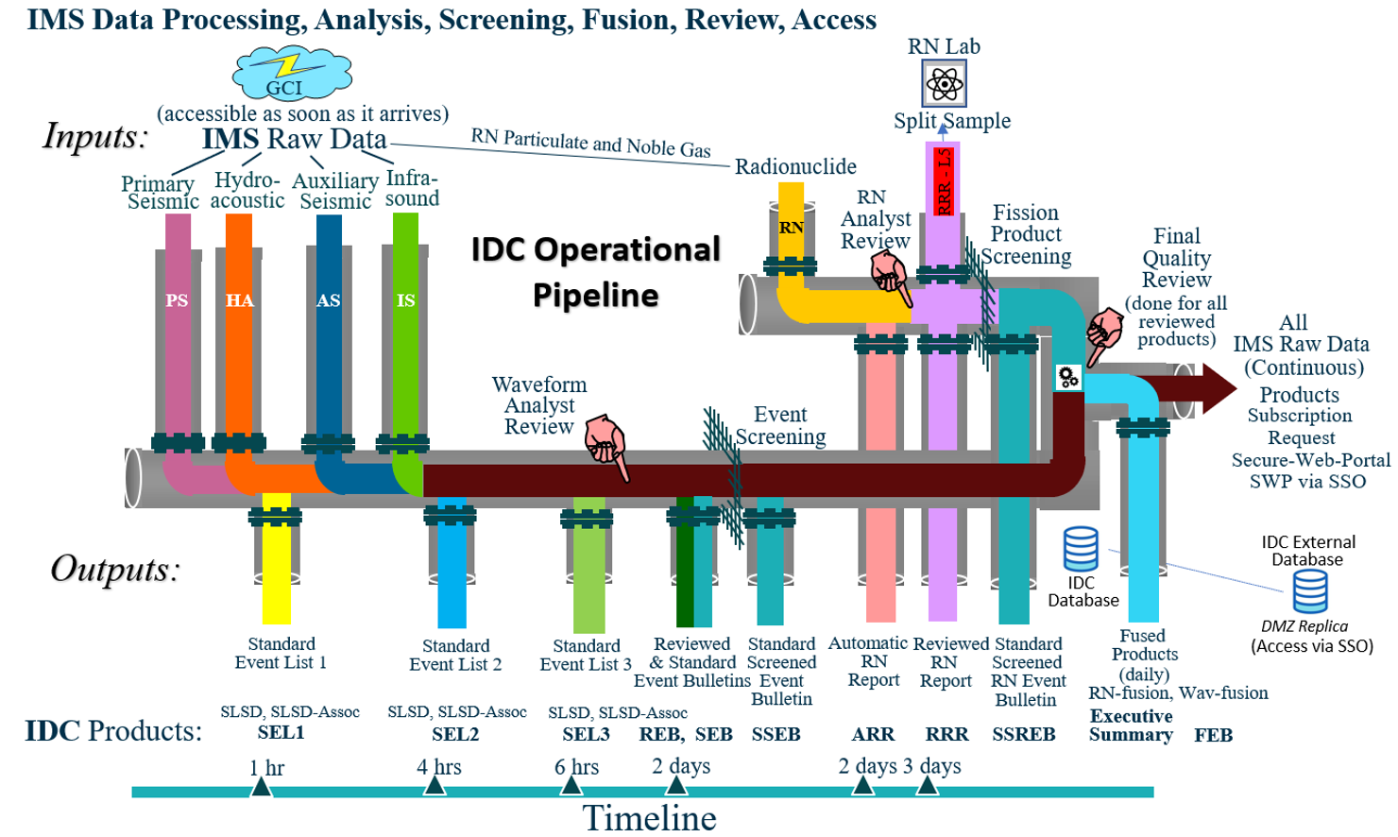

















PLEASE DON‘T FORGET TO PUT THE E-POSTER TITLE AND YOUR NAME IN THE PRESENTATION HEADER.
THEN DUPLICATE THIS SLIDE FOR ALL OTHER PRESENTATION SLIDES.
IDC Software for NDCs, Status and Future
PTS talk
#881
D. Keda, G. Graham and M. Villagrán
NIAB Software Scope
The NIAB includes SHI Detection (scDFX)
Automatic seismoacoustic event location (scAutoloc and scNET-VISA)
SQL
IDC Ext DB
IDC
ARR
RRR
SELx
REB
.
.
IMS
Data
Acquisition
NDC-DB
CDTools
SHI
Non-IMS Data
In analogy to the IDC operational pipeline, the NIAB has been designed for IMS data acquisition.
It has also been empowered with capability of acquisition of non-IMS Data and IDC Products.
The suite includes a relational NDC database
SHI Detection
scAutoloc
scNET-VISA
scDFX
Tools for
  Database Administration
  Data analysis and
  Reporting
Review
NDC-RRR
NDC-REB
NDC in a
Box - NIAB

Slide 9
PLEASE DON‘T FORGET TO PUT THE E-POSTER TITLE AND YOUR NAME IN THE PRESENTATION HEADER.
THEN DUPLICATE THIS SLIDE FOR ALL OTHER PRESENTATION SLIDES.
IDC Software for NDCs, Status and Future
PTS talk
#881
D. Keda, G. Graham and M. Villagrán
NDC in a Box - NIAB
Software | Operating System | Major Components | Release Date
SHI-NIAB Version 7.2 | Rocky Linux 9.5 | SeisComP v.6.6.3 Geotool v.3.2.4 Geotool Qt v 5.2_3.1.0 NET-VISA v.2.5.15 DTK-PMCC v.7.4.1 DIVA v.4.5.2 CDTools v.2.5.10rcl (LibCD 2.6.2) NMS_client v.1.0 | February 2025
RN-NIAB Version 7.2 | Rocky Linux 9.5 | iNSPIRE v.2.30.0 GRANDSim v.1.0.42 | February 2025
WebGRAPE (ATM) | Windows and Linux | Webgrape Desktop v.3.2.4 srsget v 0.26 | July 2025
SnT2025 Snapshot of NIAB (Inventory)
+ additional online services
NDC-in-a-Box software
SHI
CDTools
SeisComP
RN
Webgrape
ATM
iNSPIRE
Geotool
DTK
GRANDSim
Other tools and services provided to NDCs (online)
Technology | Service | Release Date
SHI | FDSN web service SeedLink service VDMS 4.2.0 / VDMS Client 1.4.8 | December 2023 January 2021 July 2025
RN | RNToolkit web https://rntoolkit.ctbto.org | March 2021
WebGRAPE (ATM) | Webgrape Internet Based Service (IBS) v.3.2.4 https://webgrape.ctbto.org | July 2025
Auto NMS
SRSGet
NMS Client
Data retrieval tools

Slide 10
PLEASE DON‘T FORGET TO PUT THE E-POSTER TITLE AND YOUR NAME IN THE PRESENTATION HEADER.
THEN DUPLICATE THIS SLIDE FOR ALL OTHER PRESENTATION SLIDES.
IDC Software for NDCs, Status and Future
PTS talk
#881
D. Keda, G. Graham and M. Villagrán
The Future of Software-based Services to States (2026→)
The methods of interaction between the IDC and NDCs on software development for NDCs include
  NDC Forum (https://ndc-forum.ctbto.org)
  NDC Support (email: support@ctbto.org)
  NDC Workshop hosted by states (every 2 years, 2026 is being planned)
  NDC Training courses, feedback from participants
  WGB NDC Issues and Capacity Building
  WGB [Waveform Expert Group (EG), Radionuclide Expert Group, Joint Expert Group (JEG)]
  Support to the NDC Preparedness Exercises (NPEs)
Several areas for improvement are identified
  The NIAB needs to (eventually) replicate the IDC Operational software results
    SHI-NIAB is pending on the IDC SHI Software re-engineering project (ongoing since 2011)
    RN-NIAB needs a mechanism acquire the same automatic processing results of IDC Operations
  The future role of AI in the NDC software is to be explored
  Additional online services
  Other features in accordance to needs
Proposal: An additional (highly focused) Technical Meeting on NDC Software to be established on ad hoc basis
  Sponsored by the PTS and States
  Bring together participants from NDCs (with recognized experience on the use of the NIAB)
  Define additional software-based services online
    i.e. Implementation of NIAB online for emerging NDCs [alternative to Capacity Building System (CBS)]
  Promote exchange of NDC-tools and feasibility to be part of the NIAB

Slide 11
PLEASE DON‘T FORGET TO PUT THE E-POSTER TITLE AND YOUR NAME IN THE PRESENTATION HEADER.
THEN DUPLICATE THIS SLIDE FOR ALL OTHER PRESENTATION SLIDES.
IDC Software for NDCs, Status and Future
PTS talk
#881
D. Keda, G. Graham and M. Villagrán
CONCLUSIONS
The provision of software-based services for NDCs is a fundamental part of the technical assistance, as it provides the States with the capability to use the IMS Data and IDC Products for treaty verification related issues, as well as for issues of national interest by combining IMS data and IDC information to local available resources.
  The NDC-in-a-Box (NIAB) is a software suite that has been tailored for (and under the guidance of) experts from States. The strategic approach for developing the NIAB has proven to be efficient, as a result, the NIAB has reached an advanced development status (matureness) but there is a path to follow and more milestones to achieve.
  The software-based online services provide the NDCs with a window into the IDC Operational Pipeline and additional educational and information resources.
The NDC Workshop and WGB technology groups serve as forums for guidance on the needs of NDCs, but they are not fully dedicated to this task.
The NDC forum is an excellent resource for discussion on the existing software-based services, but it is limited in terms of providing further guidance (it requires dedicated human resources and interaction).
The IDC plans to continue with the same development approach, but some areas have been identified to require special attention (a spinoff). To achieve this objective, the IDC is planning to create a new chapter of technical meetings, focusing on the intermediate and far future of the NIAB and online services.
To be announced in 2026 !

