Slide 1

O5.3- 773
Science-Based Truth During Mis/Dis-Information Crises: Expanding CTBTO’s Public Communication Role Post-EIF
Fer Avar
PhD Researcher
University of Antwerp, Department of Political Science
11 September 2025, Vienna

Slide 2
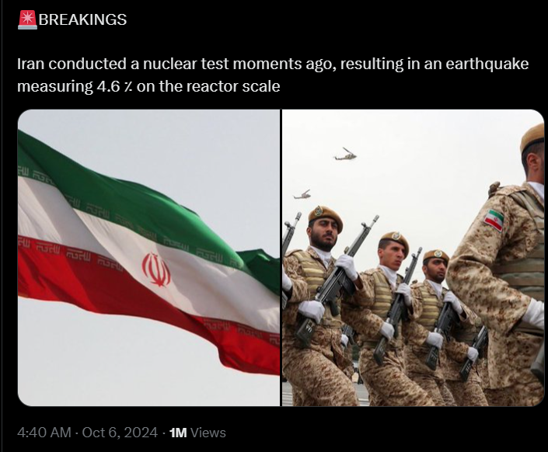
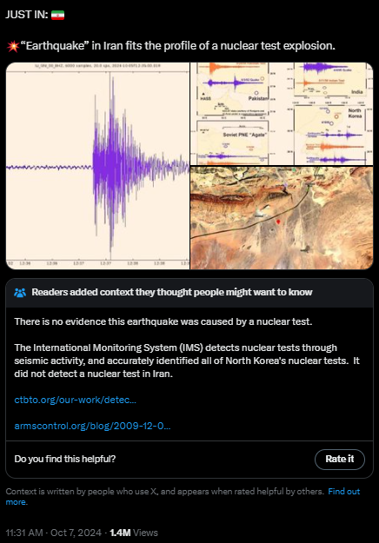
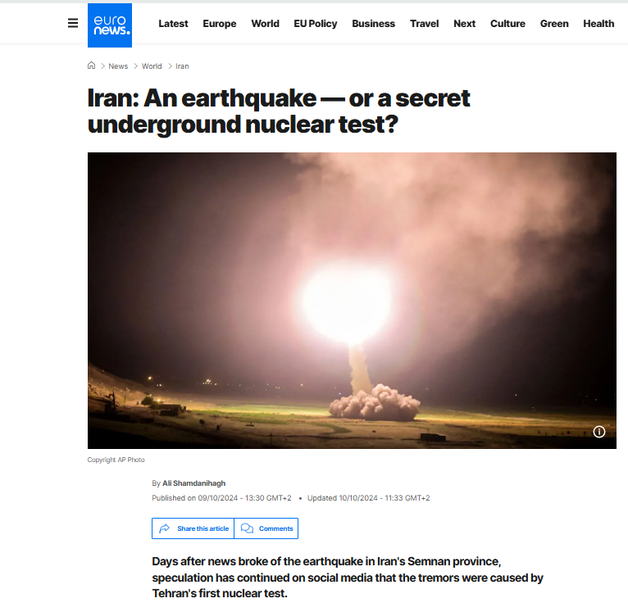
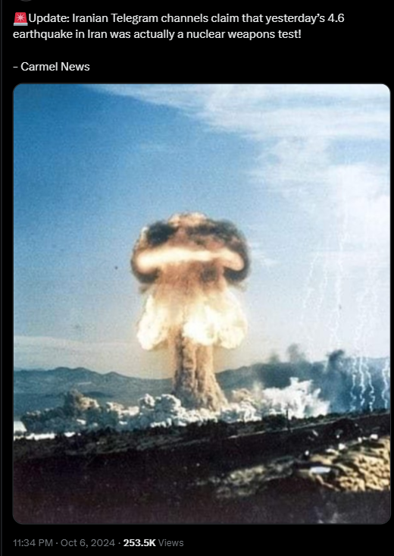
O5.3- 773
Science-Based Truth During Mis/Dis-Information Crises: Expanding CTBTO’s Public Communication Role Post-EIF
Fer Avar
Social Media Commotion Regarding Alleged Nuclear Testing in Iran – October 5, 2024

Slide 3
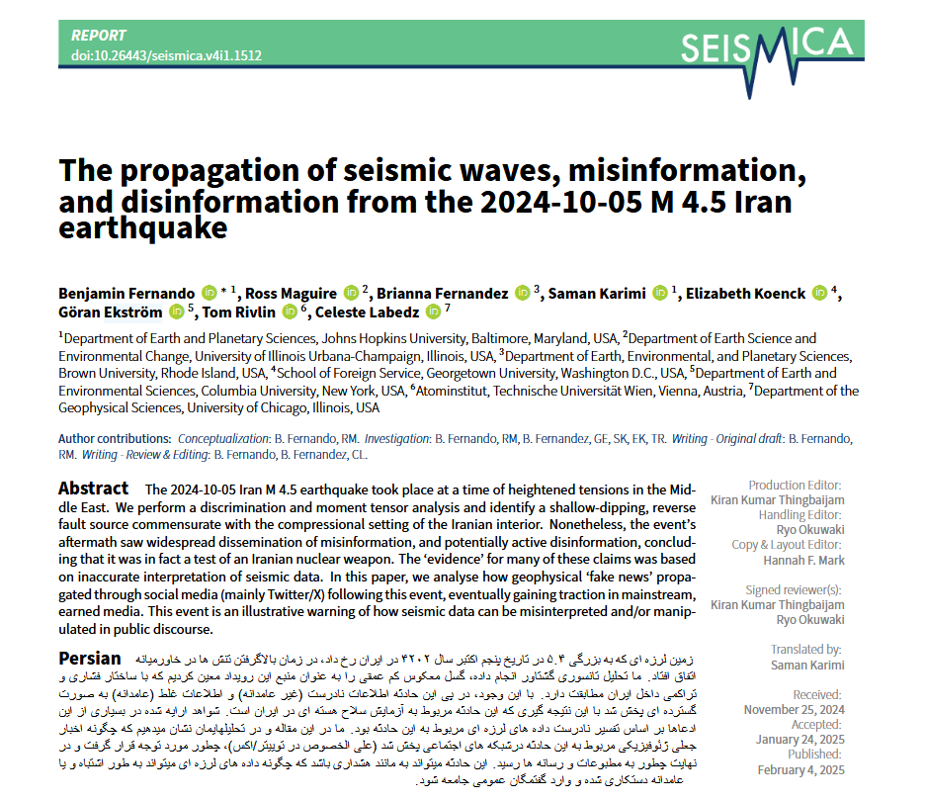
O5.3- 773
Science-Based Truth During Mis/Dis-Information Crises: Expanding CTBTO’s Public Communication Role Post-EIF
Fer Avar

Slide 4
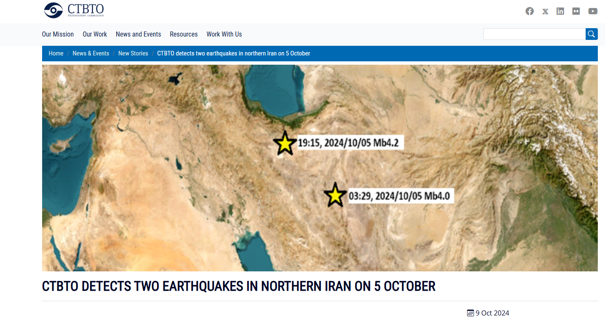
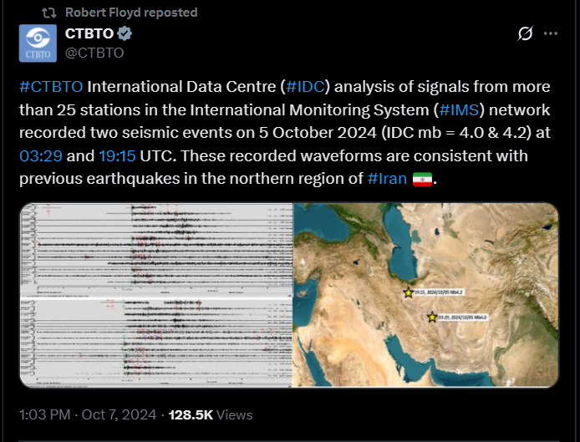
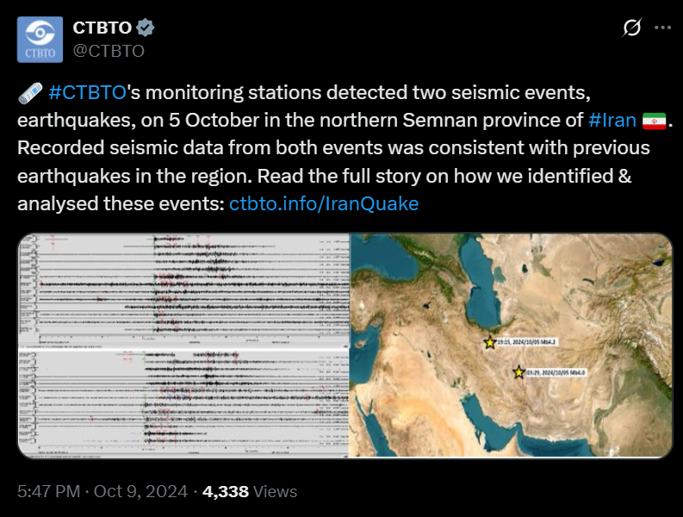
O5.3- 773
Science-Based Truth During Mis/Dis-Information Crises: Expanding CTBTO’s Public Communication Role Post-EIF
Fer Avar
CTBTO’s Response (Oct 7 & 9 – 2024 )

Slide 5
O5.3- 773
Science-Based Truth During Mis/Dis-Information Crises: Expanding CTBTO’s Public Communication Role Post-EIF
Fer Avar
Building on this success story, my research asks:
(How) could the CTBTO institutionalize a stronger public-facing role in managing mis/dis-information in high-escalation-risk contexts post-EIF?
(How) could it do so while continuing to further enable public access and literacy to technical data and interpretation?

Slide 6
O5.3- 773
Science-Based Truth During Mis/Dis-Information Crises: Expanding CTBTO’s Public Communication Role Post-EIF
Fer Avar
Political & Legal Hurdles in Institutionalizing Public Communication Role post-EIF
Political
Legal
Public commentary on specific states may be perceived as interference
Raw data outputs risk politicization in adversarial information environments
State Parties may resist disclosure of technical interpretations prior to domestic response
Mandate restrictions: Article IV (Clause 14 p. 22) restricts data-sharing for State Parties, not the public
Confidentiality obligations: restrictions on data release without State Party authorization
Governance delays: consensus decision-making can slow urgent communication
Risk of overreach: engagement on state-specific incidents could be framed as exceeding the technical remit

Slide 7





O5.3- 773
Science-Based Truth During Mis/Dis-Information Crises: Expanding CTBTO’s Public Communication Role Post-EIF
Fer Avar
(Starting) Strategies to Overcome Legal & Political Barriers
Formalize
science communication authority
via treaty amendment;
(Article VII, Clause 2, p. 42)
Negotiate
standing agreements with State Parties for pre-authorized release of verified data;
Establish
SOPs granting the ES fast-track authority for public emergency response;
Create
a dedicated Disinformation Unit spanning OES, IMS, & IDC for rapid public communication;
Conduct
regular scenario drills to stress-test readiness & directly involve State Party input.

Slide 8


O5.3- 773
Science-Based Truth During Mis/Dis-Information Crises: Expanding CTBTO’s Public Communication Role Post-EIF
Fer Avar
Strategies to Overcome Risk of Monopolization of Legitimate Data & Technical Interpretation
Implement Alternatives to
Reliance on public dissemination on commercial social media platforms;
Increase
Transparency by making visible how technical conclusions are reached in direct public crisis communication.
Notes:
& Risk of Gatekeeping
Avoid reliance on commercial social media platforms for dissemination;
Simplify and amend VDec procedures to increase access to verification data;
Increase transparency by making visible — in publicly available technical reporting, not only within the expert/diplomatic “in-group” — how certain conclusions are reached.

Slide 9

O5.3- 773
Science-Based Truth During Mis/Dis-Information Crises: Expanding CTBTO’s Public Communication Role Post-EIF
Fer Avar
Proposed Public Communication Flow
Immediate (minutes): Technical interpretation release based on standing agreements for crisis response via official website
Short term (hours): Live press briefings and webcasts by Disinformation Unit (publicly available) to increase literacy
Medium term (days): UN News and CTBTO Press Release

Slide 10
O5.3- 773
Science-Based Truth During Mis/Dis-Information Crises: Expanding CTBTO’s Public Communication Role Post-EIF
Fer Avar
Takeaway
Recommendation
Strategic Impact
Institutionalize (through amendment) a science-based public outreach role in fighting mis/dis-information post-EIF via concrete communication strategies and a dedicated Unit.
Protect verification integrity from distortion,
Enhance crisis stability through rapid public clarification,
Position CTBTO post-EIF as a publicly-responsive verification institution in addition to being a State-Party responsive international organization.

Slide 11
O5.3- 773
Thank you!
Fer Avar
PhD Researcher
University of Antwerp, Department of Political Science
Contact: fer.avar@uantwerpen.be

