Slide 1



T5.3 - 310
Amplifying the CTBTO’s Mission Through Art:
Democratizing Science and Technology, Empowering Youth, and Humanizing Nuclear Disarmament
Sanya Malik & Anna Manuel
CTBTO Youth Group, University of British Columbia
Drawing from experiences participating in the CYG’s 2024 Global Art Campaign and Art Exhibition at the UN, this presentation outlines the characteristics of art-based methodologies that can be used to amplify the CTBTO’s mission, analyzing historical examples of art in disarmament to inspire public engagement, empower youth, and employ a form of visual and sensory storytelling that humanizes technical information.

Slide 2
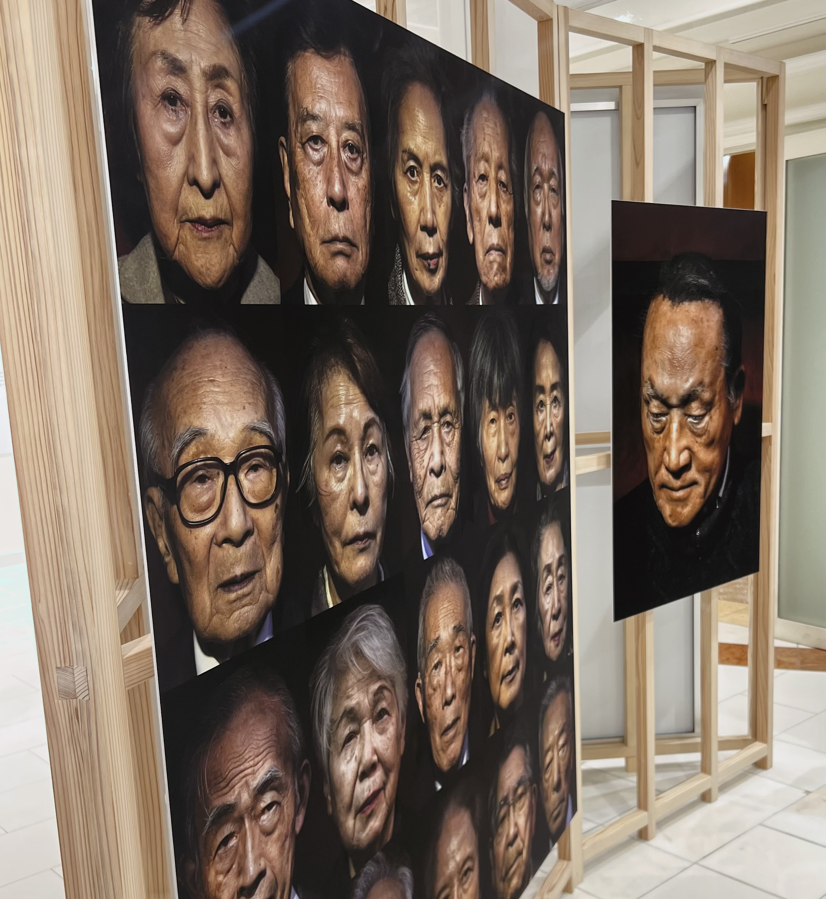
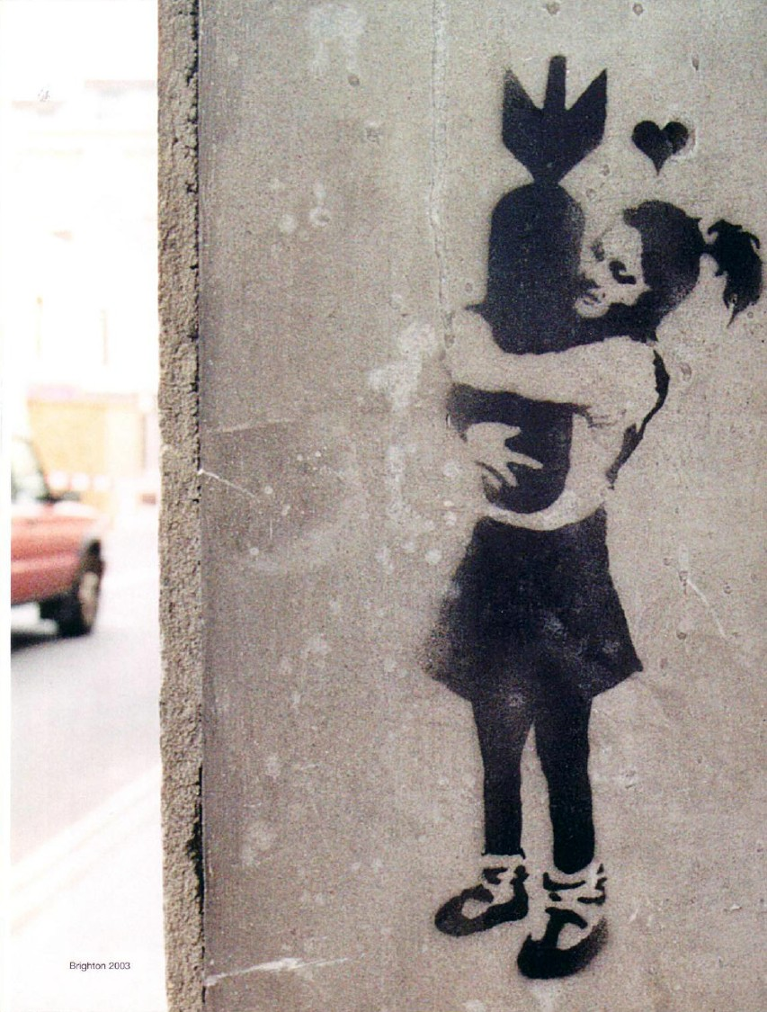
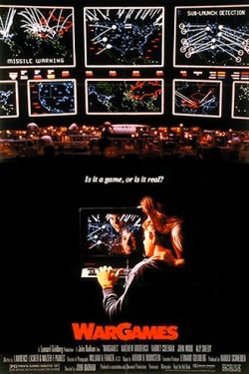
T5.3-310
Amplifying the CTBTO’s Mission Through Art
Sanya Malik & Anna Manuel
History and Context
Methodology and Conclusions
Historical Grounding​
Art in anti-nuclear advocacy has its historical roots in Hibakusha and Downwinders use of art, photography, and film to convey their lived experiences and influence policy.
Example: Peace Boat, a part of ICAN (Int'l Campaign to Abolish Nuclear Weapons) invites Hibakusha on a worldwide voyage to share their stories and campaign for peace and other human rights issues. Photo of the exhibit by Anna Manuel.
Methodology
Inspired by the CTBTO Youth Group's Art Competition and our participation as artists, we reviewed uses of artwork & media in nuclear-era & anti-war movements from literature and historical examples; and analyzed how art functions in self-advocacy, peacebuilding, and narrative-shaping.
Findings
Art-based methodologies and advocacy can:
Humanize and realize technical or scientific accounts of violence in conflict (i.e., casualty statistics, nuclear fallout);
Contest established narratives, reframing and democratizing the formation of collective memory following violence and conflict;
Support survivors in self-advocacy towards peacebuilding and future-making;
Foster intergenerational dialogue (including youth participation in peacebuilding and policy).
Cultural Role of Art
Art bridges science and society by translating technical data into emotional, accessible narratives, especially during periods of conflict or information fatigue. Storytelling is an essential part of art. Banksy, known worldwide for his political street art has produced several works critiquing war-generated destruction, invoking public attention and emotion using ironic elements.
Photo: Bomb Hugger 2002 by Banksy.
Popular media has also shifted public and political discourse.
WarGames, a sci-fi-nuclear war-based thriller called attention to the lack of nuclear cybersecurity during the Reagan administration.
Current Relevance
With rising nuclear tensions and public desensitization, art preserves and contests collective memory, amplifies marginalized voices, and creates inclusive spaces for youth in peacebuilding.

Slide 3




T5.3-310
Amplifying the CTBTO’s Mission Through Art
Moving Forward
Sanya Malik & Anna Manuel
Art is a powerful complement to technical discourse in disarmament.
Storytelling through art humanizes nuclear issues, making them relatable and emotionally resonant.
Youth participation ensures intergenerational relevance and new advocacy approaches by invoking emotions like rage and fear.
Action Steps
Harness Cultural Momentum
Pop culture and media (such as the recent film Oppenheimer or Bob Dylan's 1962 song A Hard Rain's Gonna Fall) act as catalysts in amplifying the salience of nuclear issues in the public consciousness.
The CTBTO can harness this momentum through art-driven outreach, collaborating with nuclear organizations like the Bulletin of Atomic Scientists, and even non-nuclear institutions like museums and film schools.
Utilize Murals, digital art, interactive exhibitions, and cross-cultural storytelling in disarmament.
Develop interactive digital exhibitions (VR/AR, online galleries) to reach audiences beyond Vienna or UN spaces.
Formalize a permanent CYG art fellowship, funding youth-led creative projects tied to CTBTO campaigns.
Alongside the CTBTO Research Fellowship, support art and media fellowship programs that respond to nuclear themes already in the spotlight, linking pop culture moments with CTBTO’s mission.
Create youth-art spaces at major CTBTO conferences (e.g., exhibition corners, live performances).
Integrate art showcases into conferences, including SnT.
Bolster social media campaigns, highlighting survivor art, youth voices, and CTBTO collaborations with contemporary artists.
Build cross-sector partnerships (e.g., museums, NGOs, youth organizations) to embed
CTBTO narratives in public culture and within CTBTO events.
Expand Multimedia Approaches
Centre Youth Voices
Leverage CTBTO Platforms

