Slide 1


P5.2-424
Enhancing Operational Excellence: A Comprehensive Training Strategy for IMS Station Operators
Abdelouaheb Agrebi, Jacques Pretorius, Lucie Paulet, Fernando Cascon Romero Contreras
CTBTO Vienna International Centre, P.O. Box 1200, 1400 Vienna, Austria
In this poster, we present a revised International Monitoring System (IMS) training strategy designed to support data production within the IMS network, strengthen the expertise of Station Operators (SOs), and enhance operational excellence. By combining tailored training programs that address varying levels of SO technical experience and roles, with blended learning and interactive e-learning, the strategy ensures compliance, develops both technical and managerial skills, and fosters a global network of proficient operators, ultimately improving data production across the IMS network.
DISCLAIMER: The views expressed on this e-poster are those of the author and do not necessarily reflect the view of the CTBTO

Slide 2
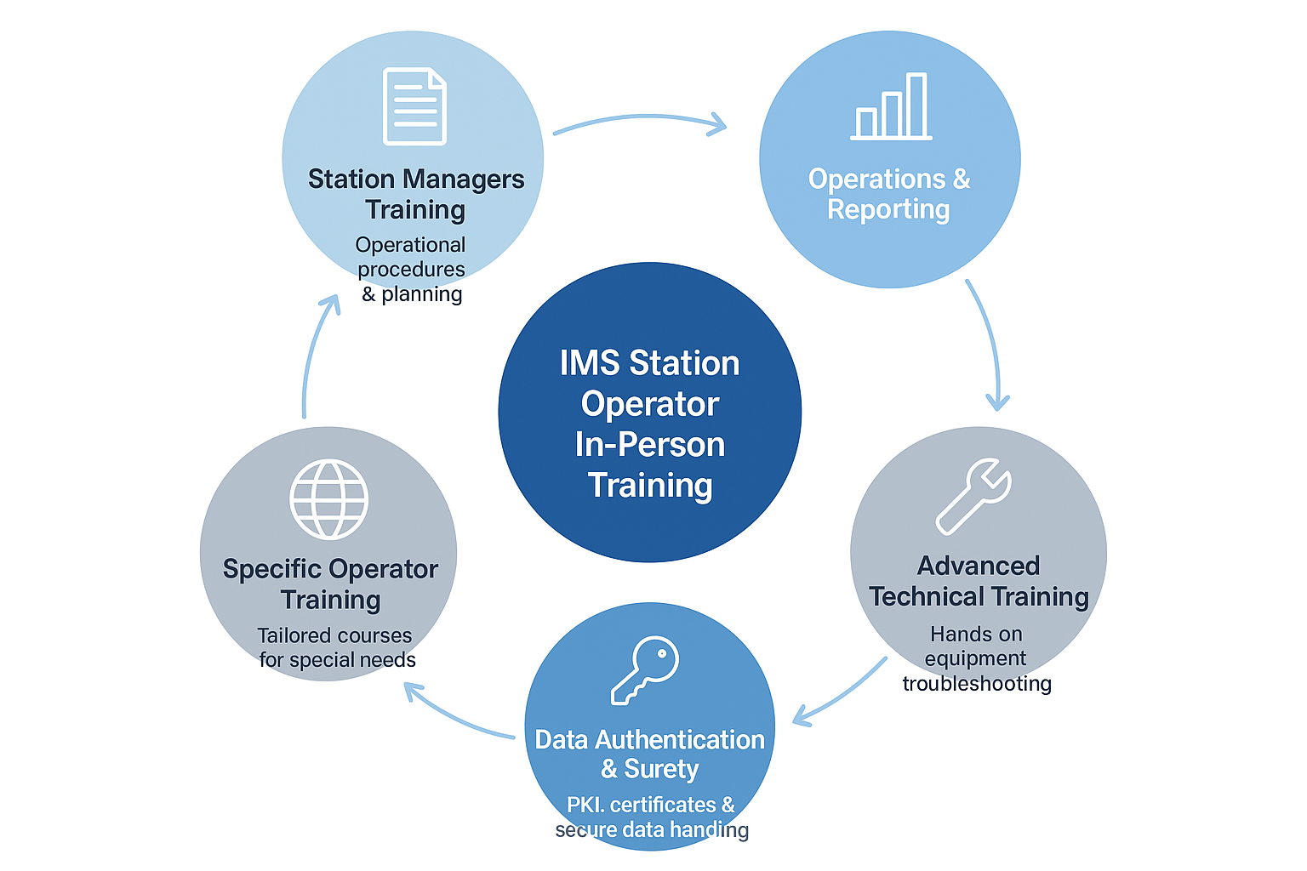

Enhancing Operational Excellence: A Comprehensive Training Strategy for IMS Station Operators
Abdelouaheb Agrebi, Jacques Pretorius, Lucie Paulet, Fernando Cascon Romero Contreras
P5.2-424
Station Operators Training Needs
Methods
Quality Control of trainings
Operational Proficiency: Ensure SOs are fully competent in station operations to maintain high data availability (98%, 95% for RN stations) and to fulfil contractual obligations for Station Operators under Post-Certification Activities (PCA).
Continuous and Refresher Training: Initial training for newly designated station operators, refresher courses for existing SOs to retain knowledge and reinforce standardized procedures, and additional training when stations undergo major upgrades or adopt new technologies.
Tailored Programs for Varying Expertise: Address different levels of technical experience among SOs and Local Operators (LOs), and provide specialized training modules for SOs managing multiple stations with diverse technologies.
Geographical Considerations: Recurrent training for SOs at isolated stations with high turnover to ensure operational continuity.
Modern Training Methods: Blended learning combining in-person trainings/workshops and online training modules, Simulation-based exercises, virtual reality, gamification, microlearning, and peer mentoring; flexible and dynamic approaches to accommodate different learning styles and reduce costs.
Ongoing Development: Continuous skill enhancement to adapt to evolving IMS technologies, with focus on maintaining operational standards across the IMS network.
E-Learning: The PTS offers 33 e-learning modules on CTBT, IMS operations, and verification technologies, requiring 80% completion via the Knowledge and Training Portal (KTP) before in-person training, with certificates awarded and content regularly updated.
In Person Training Courses:
Quality control ensures the effectiveness of training through systematic evaluation, feedback, and corrective actions. When objectives are not fully met, additional training is provided to address identified gaps. The impact of training is measured through site visits, assessments, and key performance indicators (KPIs), including response times and problem-resolution efficiency.
Conclusions:
The sustainment of IMS stations depends on multiple factors, with training for Station Operators (SOs) playing a key role. This revised training strategy enhances SO capabilities in operations and maintenance, enabling them to perform their responsibilities effectively and efficiently, while contributing to the overall operational excellence and reliable data production of the IMS network.
In-Situ Training: PTS technical visits to IMS stations include in-situ training on operations and troubleshooting.
Remote Software Training (RST): Provides SOs with interactive instruction on software use, configuration, and troubleshooting as needed.
Training cycle and Frequency: SO trainings are structured into Basic, Intermediate, and Advanced levels, with procedure-based, hands-on, and trainer courses tailored to specific needs and regularly updated.
DISCLAIMER: The views expressed on this e-poster are those of the author and do not necessarily reflect the view of the CTBTO

