Slide 1

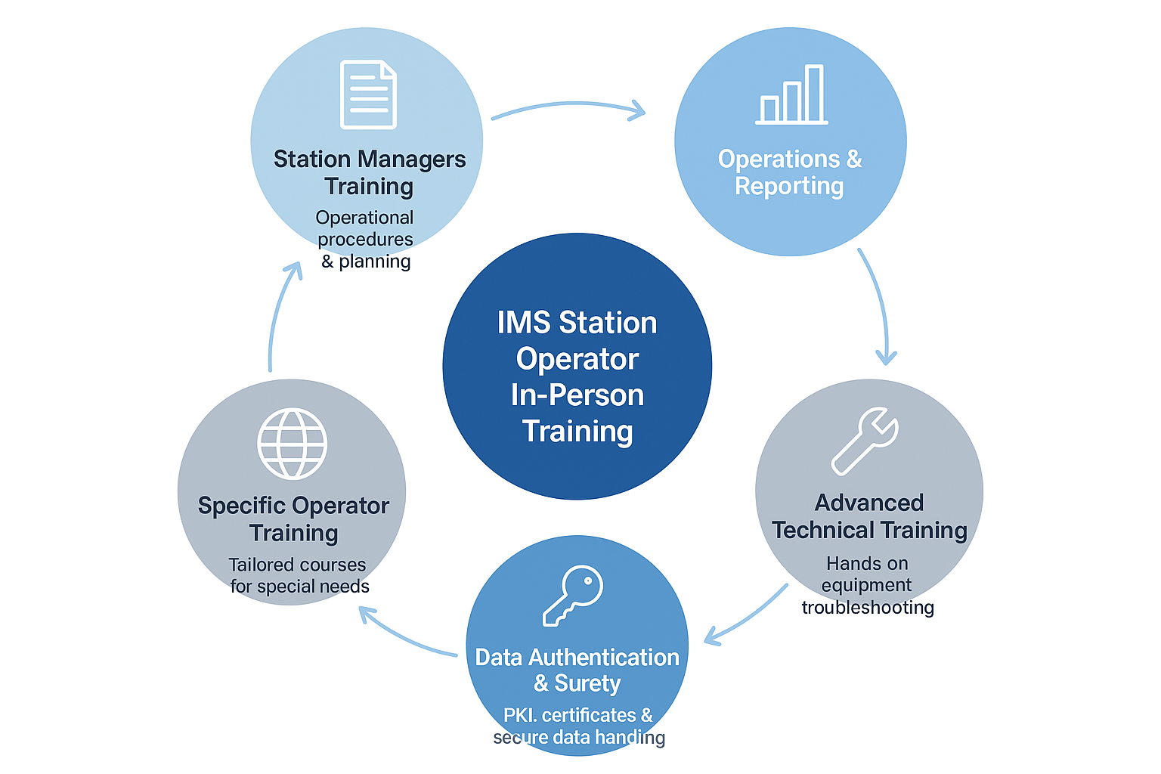

P5.2-424
Enhancing Operational Excellence: A Comprehensive Training Strategy for IMS Station Operators
Abdelouaheb Agrebi, Jacques Pretorius, Lucie Paulet, Fernando Cascon Romero Contreras
CTBTO Vienna International Centre, P.O. Box 1200, 1400 Vienna, Austria
IMS Station Operator (SO) trainings have been conducted annually since 1998 for both new and refresher participants.
Experience has highlighted the need to update and improve SO training strategies.
These trainings ensure that SO functions align with IMS Operational Manual standards.
The revised SO Training Strategy promotes compliance, builds skills, and fosters a global network of proficient operators, ultimately improving data production across the IMS network.
If you’d like to learn more, we’d be happy to chat with you at our poster.
DISCLAIMER: The views expressed on this e-poster are those of the author and do not necessarily reflect the view of the CTBTO

