Slide 1

Introduction Slide Title goes here [Font: Arial Bold/Size: 16]
Increasing the availability and safety by integrating CTBTO station and NDC Facilities as sensitive digital asset in the Framework of national cybersecurity programme
P5.2-778
Cheikh Amadou Bamba Dath
Laboratoire Atomes Laser, Faculte des Sciences et Techniques, UCAD, Senegal
This presentation gives provisions for Increasing the availability and safety the National Data Centres (NDC) and station Monitoring system facilities hold by Senegal on behalf of CTBTO
DISCLAIMER: This presentation has been generated for illustration purposes only.

Slide 2
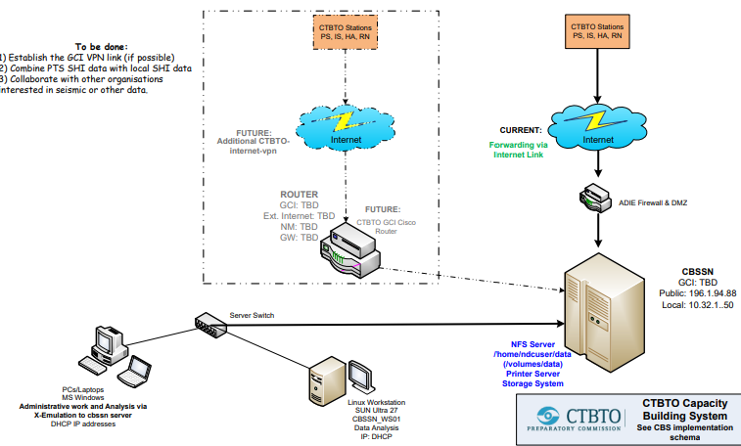
Increasing the availability and safety by integrating CTBTO station and NDC Facilities as sensitive digital asset in the Framework of national cybersecurity programme
TCheikh Amadou Bamba DATH
Px.x-yyy
Introduction
Approach for operation and facilities management
Advances and Challengess
Like several States Signatories, an auxiliary seismic station installation agreement was signed on 22 May 2001 between Senegal and Mr Wolfgang Hoffmann, Executive Secretary of the Comprehensive Nuclear-Test-Ban Treaty Organization (CTBTO). It entered into force on 24 March 2006. In the same vein, Senegal, like all States Signatories, has access to the data of the International Data Centre (IDC) and even holds a National Data Centre offered by the CTBTO. These elements of the International Monitoring System and IDC networks are managed under the responsibility of the CTBTO, in whole or in part from the point of view of operation and availability and IT security. Often with on-site support staff for maintenance and operation, from the structure serving as a focal point.
However, integrating this IT equipment and installations or operational technologies into the national register of sensitive digital assets to take them into account in a national IT security programme would allow for closer, more regular monitoring and consideration in the general budget of the structures in charge of digital technology and cybersecurity.
The auxialiary sismic station at Babate(MBOUR), coded AS0 97 with a second remote ICT VSAT sation
On september 2011, the country was provided with National Data Center Material which consit of the below specifications: SUN Ultra 40 M2 ; Disc Capacity : 1,5 TB ; Processors : 8 x Quad-Core AMD Opteron Processor 2356 · Power supply : APC Smart UPS
induction training of NDC groups on data uses,acces and analyses ( students, techer and professional)
Informations ans sensitiyation on the CTBTo treaty and data applications on various fields are weak
Still need continuous information and update tfor high decision making commitment and support
Necessary action where taken to place under the direct supervision of the Government the responsibility of the AS097, which was managed by another non governmental organisation partner
Appointment of a geophysisist as station operator and station responsible of AS097
Displaceùent of the NDC to the governement ICTs head quarter ( Senum, formely ADIE : Agence de Developpement de l'Informatique de l'Etat) ; in regard to ensure its full supervision and to let appear that the NDC is national property.
Challenges
-including the facilities of CTBTO in the national sensitive digital asset by the Government for consideration on:;
Operation support budget and resources
Safety qnd security including cybersecurity and ICT infrastructure availability
Financial supports in cooperation with CTBTO and other national institutions involved in the treaty obligations or scientific and civil applications of generated Data
Schematic overview of the processes for data acquisition and interface to the CTBTO NDC Dakar
DISCLAIMER: This presentation has been generated for illustration purposes only.

