Slide 1

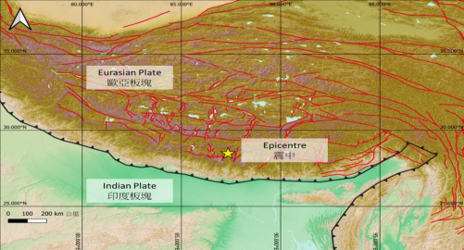
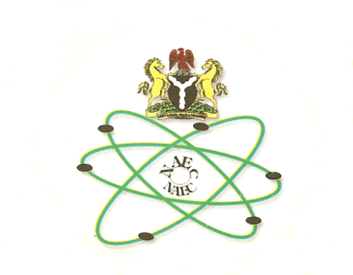
Study of Tectonic Plates Interactions Using IMS Stations: An Example of Inter-NDC Cooperation and Regional Empowerment
U.O. Madu¹; D.R. Seif² and J.K. Mulwa³
¹Nigeria Atomic Energy Commission, Abuja, Nigeria
²Tanzania Atomic Energy Commission, Dodoma, Tanzania
³University of Nairobi, Department of Earth and Climate Sciences, Nairobi, Kenya
P5.2-832
Come over to see our poster if you would like to find out more about:
Inter-NDC Cooperation
  their synergy
  and methodological feedback of scientific studies to monitoring and verification algorithms

