Slide 1

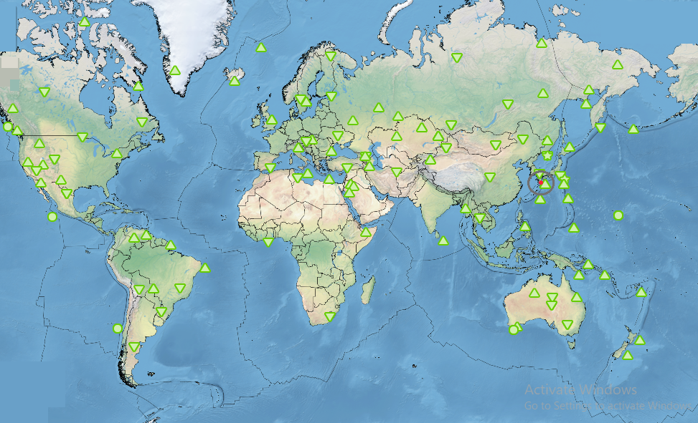
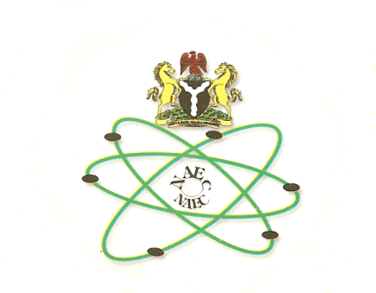
Seismoacoustic Analysis of 13 January 2025, Japan Earthquake
U.O. Madu; A. Bisallah; C.C. Anyaegbu; E. Oberafo
Nigeria Atomic Energy Commission, Abuja, Nigeria
P5.2-823
Come over to see our poster if you would like to find out more about:
IMS data
  their utility for scientific and civil applications
DISCLAIMER: This presentation has been generated for illustration purposes only

