Slide 1
Introduction Slide Title goes here [Font: Arial Bold/Size: 16]
Px.x-yyy
Difficulty to implement radiological monitoring in air in Mali
A. Coulibaly, A.A.M. Dicko, O. Camara
Environmental Monitoring Service, Département Contrôle et Surveillance du Territoire (DCST),
Agence Malienne de Radioprotection (AMARAP)
As sahelian country with several mines (artisanal and industrial) in exploration and exploitation which generally produce a lot of residues solid, liquid and dust (aerosols) in environment, this presentation in general gives the necessity to implement a regular and efficient environmental radiological program in order to avoid any over-exposition (determinist effects) and mitigate low dose exposition (stochastic effects) to the population.
It shows in Mali a current overview of radiological monitoring situation in air (achievements, difficulties, needs, challenges and perspectives).
DISCLAIMER: This presentation has been generated for illustration purposes only.

Slide 2
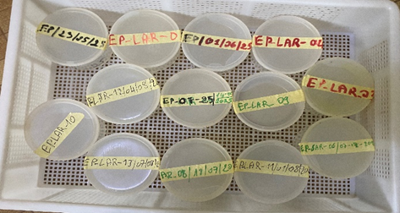
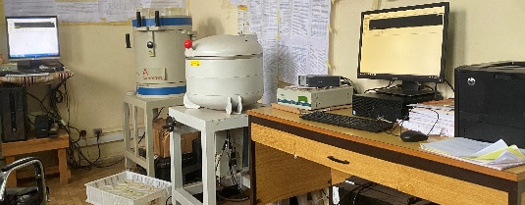
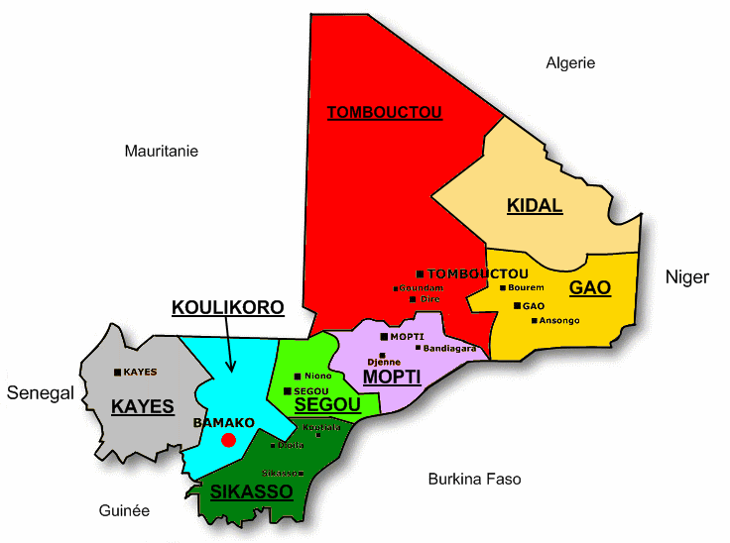
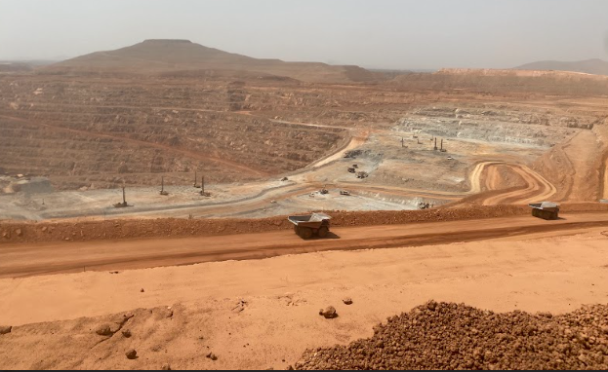
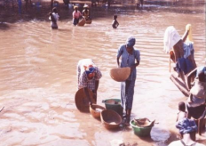
Difficulties to implement radiological monitoring in air in Mali
A. Coulibaly, A.A.M. Dicko, O. Camara
1. Introduction
2. Achievements in environmental monitoring
5. Needs, challenges and perspectives
P5.2-069
Mali is a developing country and located in West Africa. It is sharing common borders with seven (07) countries as showed in the picture. Mali has a superficy of 1.241.238 km² and its population is more than 20 millions.
Mining activity is the famous economic activity in Mali with several open pit industrial and artisanal mines in exploration and exploitation. Those mining activities are increasing the amount of NORM in environment (soil, water, air and foods) . The rapid development of nuclear industry has also raised new questions concerning the safety of nuclear installations and the consequences of radiological releases on human being and the biosphere.
Environmental monitoring program is crucial to be implemented by AMARAP in to protect people and environment against harmful effect of IR. Aerosols monitoring in air is part of this programme.
Some analysis have been done in soil, foodstuff and water samples around the country using HPGe.
In radionuclide monitoring in air (rain water with aerosol), two (02) activities have been carried out depending on existing capacities :
In 2022 winter, 33 samples have been analyzed and presented to the 2022 NDC workshop in Toledo ;
In 2025 winter, sampling is in process.
Needs
In order to start directly radionuclide monitoring in air some equipments are requested : more detectors (HPGe, αβ counters, etc.), specific pumps and associeted filters for direct air sampling, standards for calibrations, trainings of operators.
Main challenges
Terrorism across the country ;
Trainings and insufficient of qualified human resources ;
Etc.
Perspectives
Based on the motivation of AMARAP’s NDC, we plan :
To start as soon as possible direct air sampling ;
To ensure aerosol analysis to all mining area in Mali ;
To strengthen collaboration and data exchanges between stakeholders in charge of environment, etc.
Fig2: 2025 collected samples and picture of DCST’s HPGe.
3. NDCs in Mali
Mali is a member State of CTBTO since 1997. Mali has two (02) NDCs :
One in AMARAP created in February, 2023 for Radionuclide monitoring ;
One in DNGM created in July 2005 for seismic monitoring.
Conclusion
4. Difficulties in environmental monitoring
In order to achieve its main mission, AMARAP has to implement a complete and efficient radiological monitoring programme of environment to well assess radiological hazards risk on the health of workers and population.
AMARAP’s laboratories are facing with some difficulties such as :
Lack of financial support in terms of equipments, Building infrastructures and trainings ;
Lack of data to convaince decisions makers and stakeholders ;
Lack of collaboration between stakeholders, etc.
Continuous analysis is necessary to prevent any overexposure and mitigate exposition to low doses to the population.
Fig1: Map of Mali and some pictures from mining activities.

