Slide 1



P5.2-088
The National Authority for Arms Control and Disarmament of Angola (ANCAD) - Framework for the Implementation of the Treaty
Jesualdo Felino Jeremias Cambuta, Claudio Crispim
Ministry of National Defense, Former Combatants and Veterans of the Homeland / National Authority for Arms Control and Disarmament
Place your institution logo here after removing this text box!
[Text box indicates
max. height and/or width
of logo placement]
This presentation provides insights related to an overview of the current status of the CTBT implementation process in Angola and the future vision.
Angola has been a Signatory State to the CTBT since 2016, and institutionalized its National Authority for Arms Control and Disarmament (ANCAD) in 2017, the body responsible for implementing the CTBT and other international instruments on Non-Proliferation and Disarmament.
In October 2024, the National Data Center (NDC) was installed at ANCAD, an important contribution to the global process of expanding the nuclear weapons verification and non-proliferation regime.

Slide 2
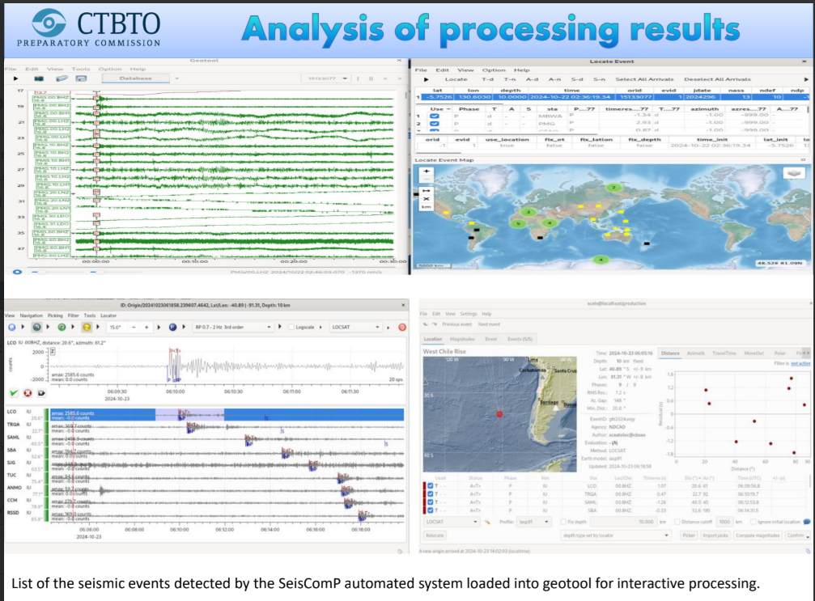
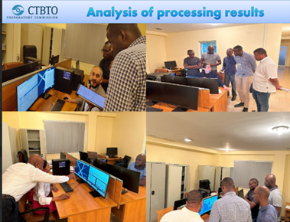
PLEASE DON‘T FORGET TO PUT THE E-POSTER TITLE AND YOUR NAME IN THE PRESENTATION HEADER.
DUPLICATE THIS SLIDE IF YOUR E-POSTER HAS MORE THAN 1 PAGE
P5.2-088
The National Authority for Arms Control and Disarmament of Angola (ANCAD) - Framework for the Implementation of the Treaty
Jesualdo Felino Jeremias Cambuta , Claudio Roberto H. Crispim
Introduction
ANCAD's Role in the Implementation of the CTBT
Results and Conclusions
Based on the technical assistance provided by the CTBTO to the Signatory States, Angola was awarded the donation of information technology resources for the operationalization of the National Data Center (NDC) at ANCAD, which formed a multidisciplinary and multisectoral team for the initial stage of formation and operationalization of the NDC in the national territory.
The NDC team was instructed on the use of data from the International Monitoring System (IMS) and the products of the International Data Center (IDC). Practical training was also provided on the use of NDC-in-a-Box components, including analysis of one of the local events (an earthquake detected on June 5, 2024, with a magnitude of 5.4 on the Richter scale, Moderate class, with its epicenter recorded approximately 142 km from the city of Namibe).
The establishment of the NDC enabled us to develop the capacity to read data from any nuclear experiment/test event, whether in our territory or in neighboring countries, as well as real-time detection of earthquakes and other climate data that could endanger human life.
For our daily activities, the NDC's raw data contributes significantly to:
Detection of unusual events (underground, atmospheric, or underwater explosions);
Training local technicians in the analysis of raw signals;
Validating alerts by comparing raw IMS data with IDC products and developing rapid responses, submitting national reports, and international cooperation.
Angola, as a Portuguese-speaking country, also plays a unique role in the inclusion of this language by regularly and actively participating in events and the internal translation of training materials and technical documentation related to the subject.
On this basis, the NDC is developing the Integrated National Plan for the Use of IMS Data and IDC Products, which will allow the inclusion of other national agencies in the CTBT implementation process, integrate rapid response protocols for unusual events, and allow for better regional cooperation in sharing information with neighboring countries and SADC members.
Thus, Angola's NDC is built on five essential pillars:
1-Training and Development;
2-Technical Assistance;
3-Regional Networks;
4-Multilingualism.

