Slide 1



Analyze data in the NDC of Congo by Geotool and GPMCC
Mr PINA-SILAS Franck Davy Rolland
PPOC of NDC Congo – Brazzaville / Ministry of Defense
Based on the explosion of an ammunition depot on 4 March 2012 in a military camp in our country Congo Brazzaville, we share the experience on the daily work of the NDC.
We show here the methods of data analysis by the analysts who analyze this explosion of ammunition depot with the GPMCC software for infrason data.

Slide 2
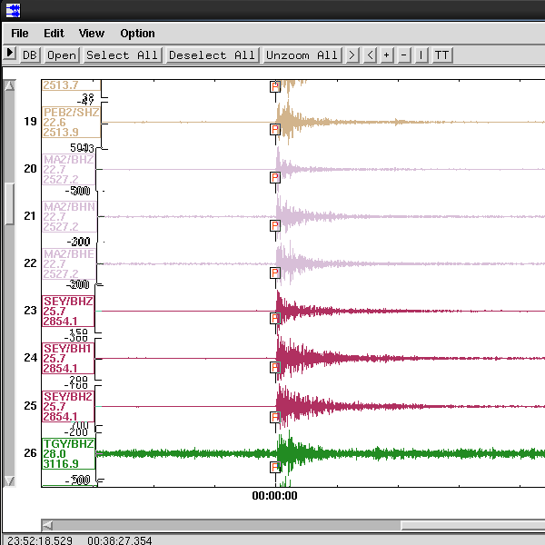
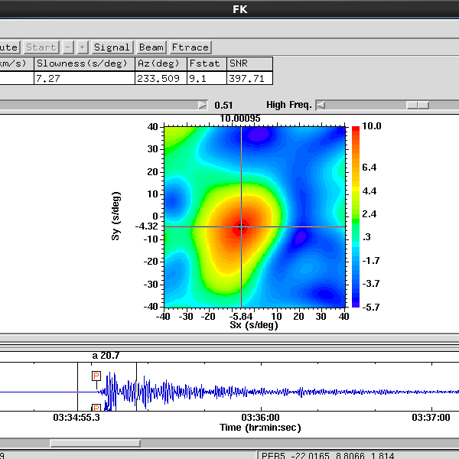
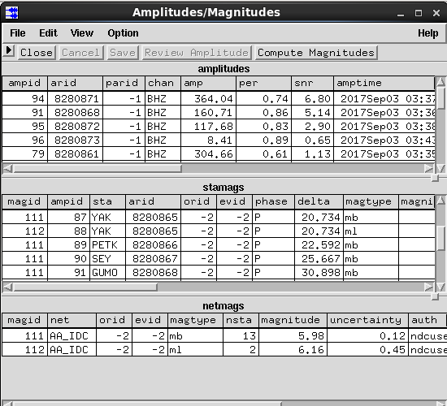
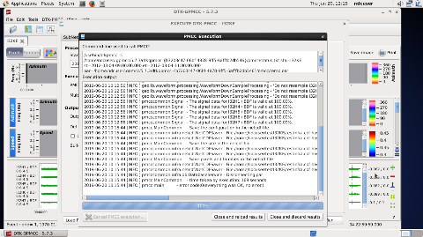
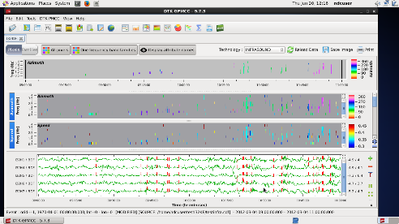
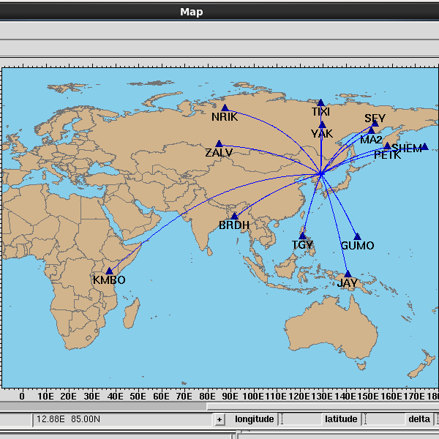
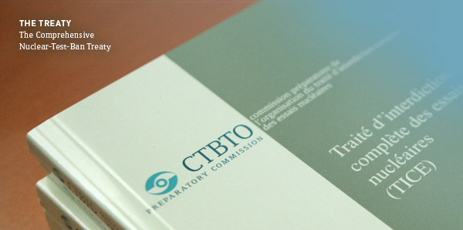
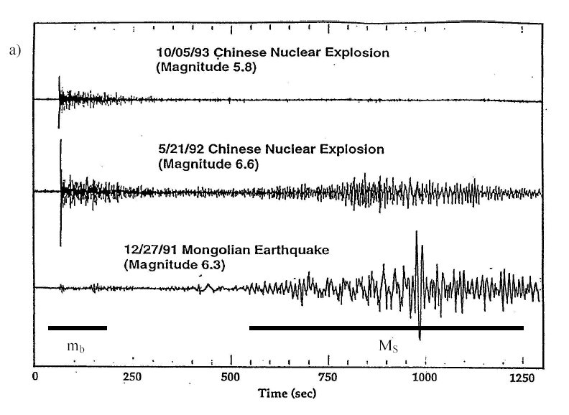
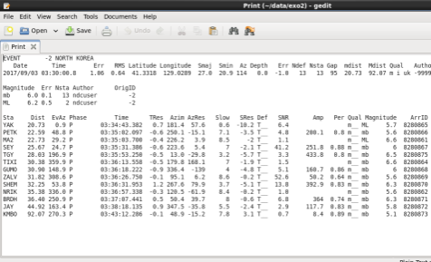
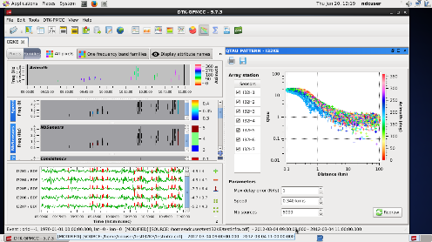
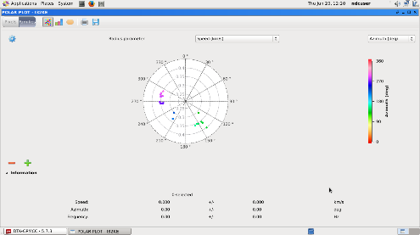
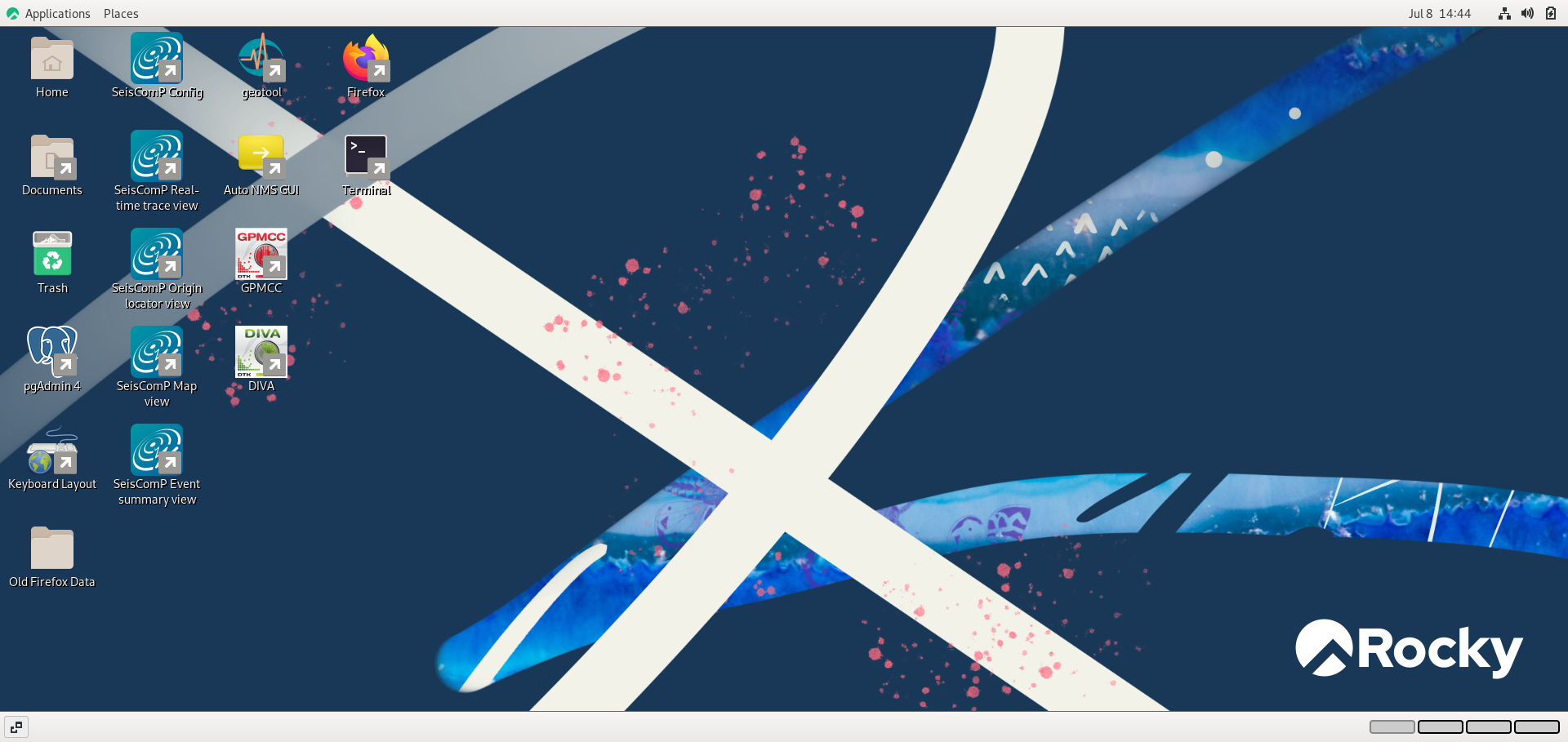
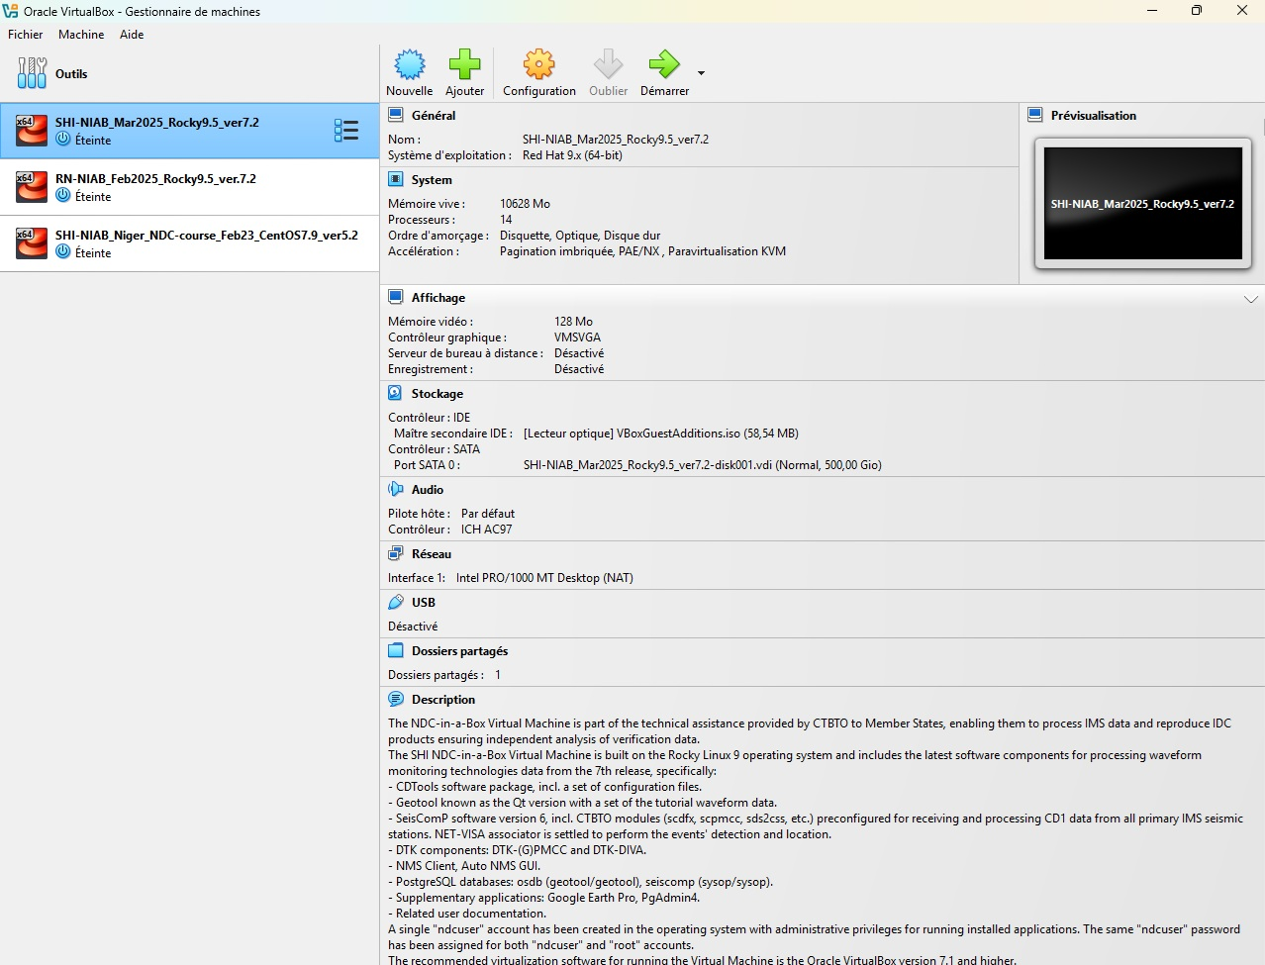
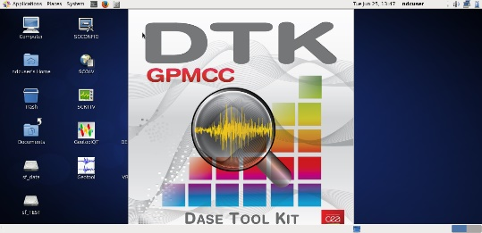
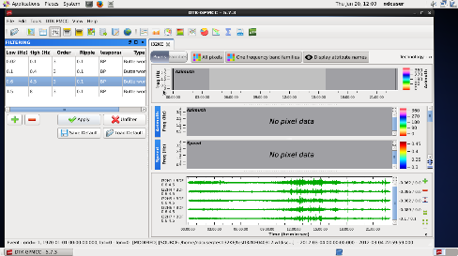
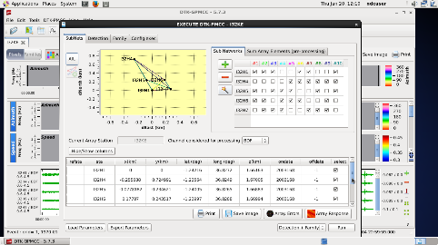
Analyze data in the NDC of Congo by GPMCC and Geotool
PINA-SILAS Franck Davy Rolland
I. Mission of NDC Congo
II. Technical analysis
How to use Geotool to analyze seismic data DPRK event
The NDC-CG is the interface of the international data center (IDC) at the national level it is placed under the supervision of the Minister of National Defense (MDN).
Its mission is to:
Verification of the treaty providing technical advice and support to the national authority;
Receive, exploit and analyze the data (seismic, infrasound, hydroacoustic and radionuclides) of the International Monitoring System via the NDC-in-a-box software (SHI-NIAB_Mar2025_Rocky9.5_ver7.2).
The beam for obtain the good signal for array station
The execution of the software
The locate event
The location on map
Bulletin of results our seismic analysis
Our results with the azimuth of the stations
How to use GPMCC to analyze infrasound data the explosion of an ammunition depot
III. Conclusion
Infrasound technology, which is mainly focused on detecting nuclear explosions in the atmosphere.
Helps us identify the location of these events, as in the case of the infrasound event in the Republic of Congo which had experienced an explosion of an ammunition depot in a military barracks, with the GPMCC software process, we analyzed this event
Open GPMCC
Download the data
Configure the executable by setting the rules.

