Slide 1

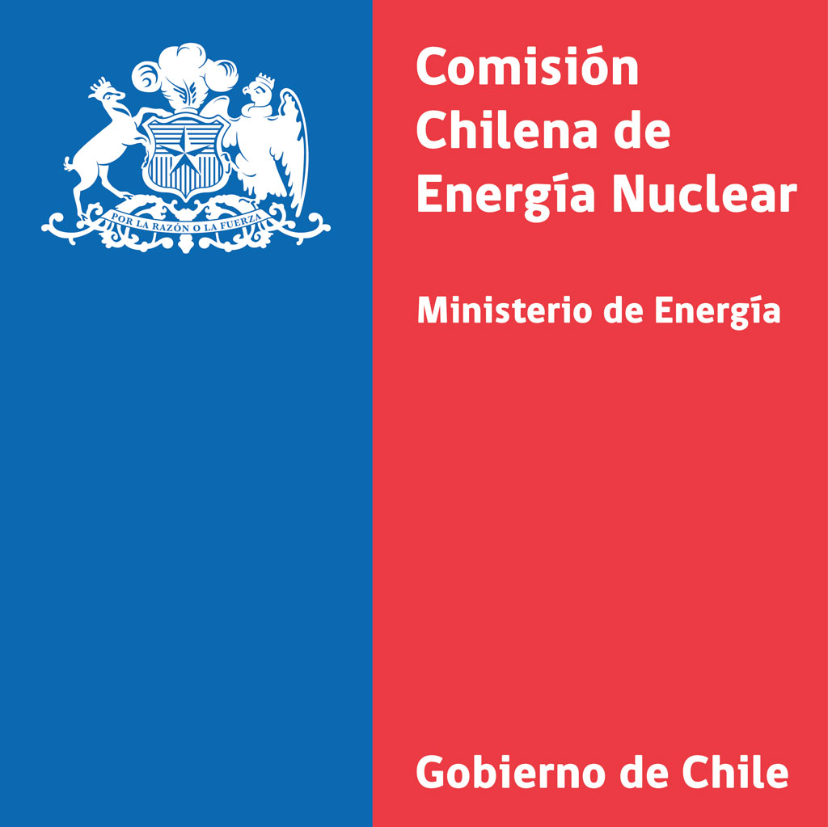
P5.2-026
Strengthening Latin American and Caribbean engagement in CTBTO technical, scientific and diplomatic arenas
Author: P. García and Co-Author: Y. Padilla
Comisión Chilena de Energía Nuclear (CCHEN)
Despite universal CTBT ratification, LAC shows low participation in technical activities due to small teams and barriers. Our initiative builds country profiles, connects authorities, NDCs & scientists, and launches a Chile-hosted hub.
Profiles reveal diverse realities, but sharing data and synergies can unify approaches, map engagement, and strengthen LAC’s CTBTO role. Women’s presence in O&M remains very limited.

Slide 2
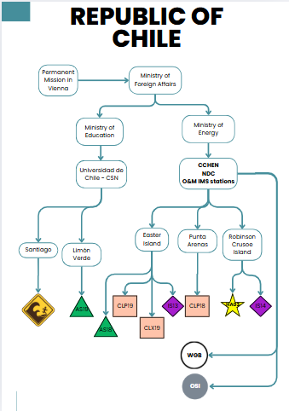
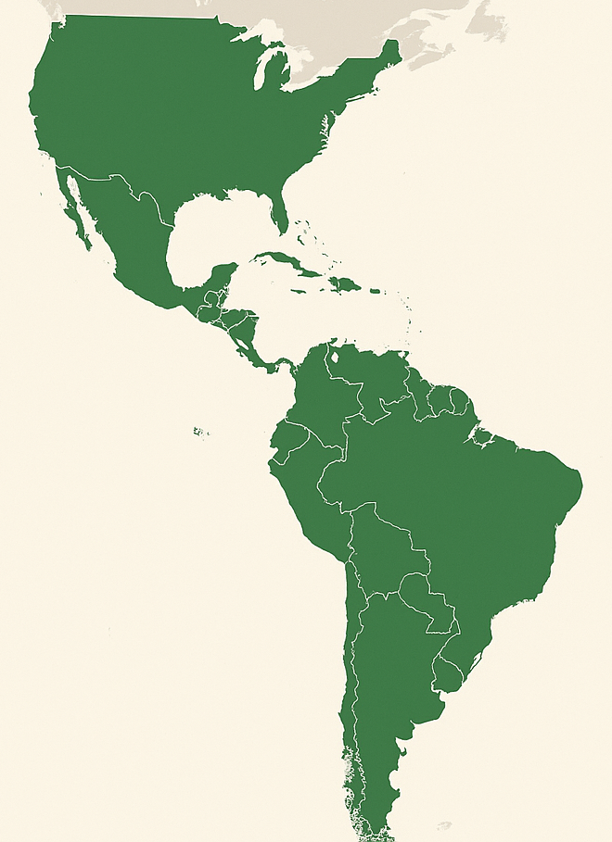

PLEASE DON‘T FORGET TO PUT THE E-POSTER TITLE AND YOUR NAME IN THE PRESENTATION HEADER.
DUPLICATE THIS SLIDE IF YOUR E-POSTER HAS MORE THAN 1 PAGE
Strengthening Latin American and Caribbean engagement in CTBTO technical, scientific and diplomatic arenas
Author: P. García and Co-Author: Y. Padilla
P5.2-026
1. Challenges for LAC Engagement in CTBT
2. Regional Initiatives and Synergies
3. Building a Stronger LAC Network
The Latin American and Caribbean (LAC) region has consistently demonstrated its political commitment to the Comprehensive Nuclear-Test-Ban Treaty (CTBT). However, the practical engagement of regional experts in the technical, scientific, and diplomatic arenas of the CTBTO remains limited. This situation arises from several interconnected challenges: national teams are often very small, communication across institutions is fragmented, and in many cases resources to support participation in international meetings are scarce.
Financial and logistical barriers frequently prevent LAC representatives from attending key sessions such as Working Group B, where scientific and technical decisions are discussed. As a result, the region’s technical knowledge and operational experience are underrepresented, reducing both visibility and influence. Beyond the institutional impact, this also limits opportunities for young professionals in LAC to gain exposure to the CTBTO community, preventing them from building careers in verification science and diplomacy.
Participation is even more limited for women, particularly in the field of station operation and maintenance, where female representation remains scarce across the region.
To overcome these barriers, LAC countries should work together to build regional synergies. Visual country profiles highlight each nation’s role within the CTBT system. To strengthen collaboration, Chile is developing a regional platform to address and support the community’s concerns, hosted at www.ndc-ctbt.cl as a Chilean contribution to exchange important solutions and information for all LAC countries.
This platform will also serve as an inclusive space, enabling sessions in Spanish and fostering linkages with other LAC organizations for technology exchange and cooperation.
A stronger LAC network will connect National Authorities, NDCs, scientists, regulators, diplomats, station operators, station managers, and providers, ensuring that both technical and political voices are represented. Access to CTBT materials in Spanish, mentoring for young professionals, internships, and joint research opportunities will enhance regional capacity.
By increasing LAC visibility and fostering collaboration, the region will act as a support hub for the CTBTO and make a stronger contribution to a nuclear test-free world. Strengthening regional cooperation will also allow LAC countries to share solutions to common challenges, from station operation and maintenance to international procurement and outreach. In this way, the network becomes not only a platform for collaboration but also a driver of innovation, inclusion, and resilience across the region.
Help us build our LAC CTBT Community!
DISCLAIMER: Country profiles are still under development. Information presented is preliminary and subject to updates.

Slide 3
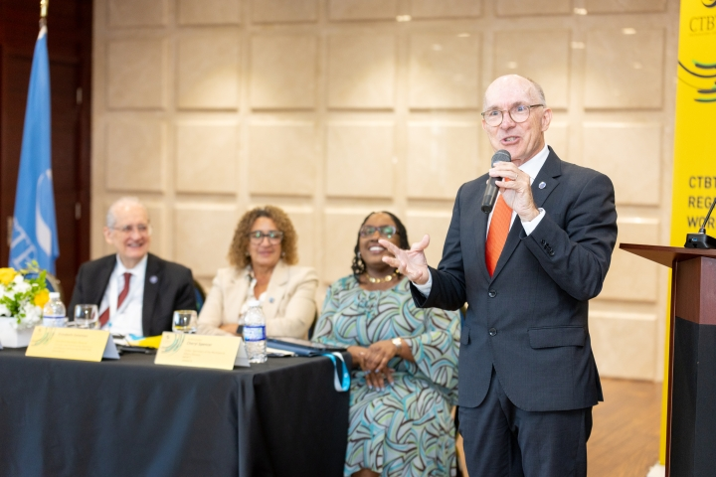
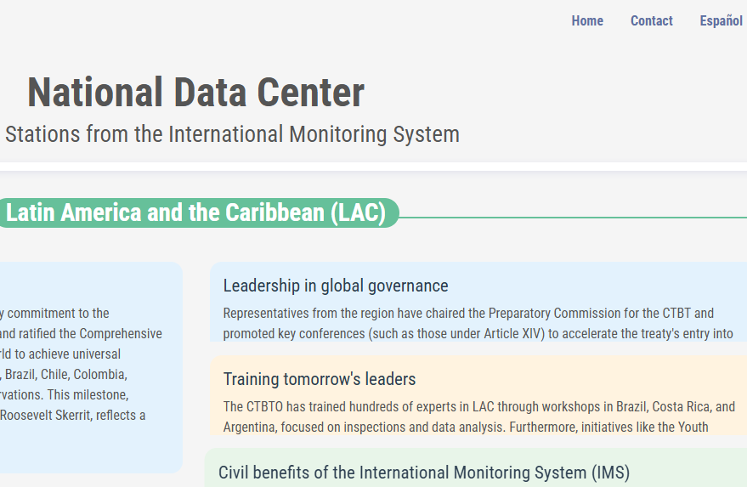
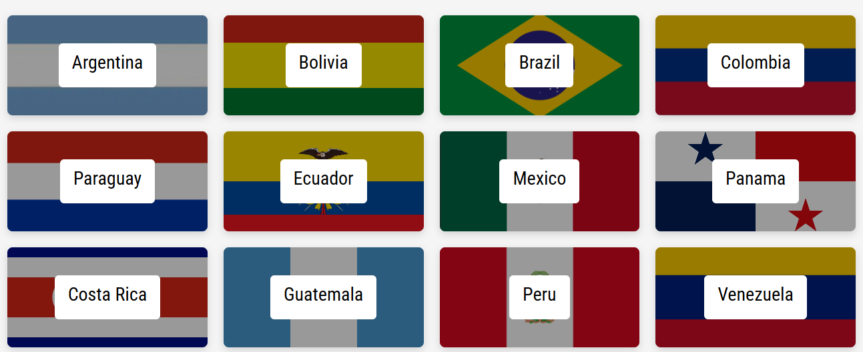
PLEASE DON‘T FORGET TO PUT THE E-POSTER TITLE AND YOUR NAME IN THE PRESENTATION HEADER.
DUPLICATE THIS SLIDE IF YOUR E-POSTER HAS MORE THAN 1 PAGE
Strengthening Latin American and Caribbean engagement in CTBTO technical, scientific and diplomatic arenas
Author: P. García and Co-Author: Y. Padilla
P5.2-026
Access to a platform for LAC CTBT
Support to CTBTO
Training, Tech, Treaty commitments: CTBTO LAC workshop strengthens regional capacity
One of the concrete objectives is to establish a dedicated digital space that brings together all Latin American and Caribbean (LAC) countries. This platform will serve as a hub for sharing knowledge, exchanging ideas, showcasing local solutions, and learning from replicable advances across the region. It will also provide diplomats with accessible technical information, helping to bridge the gap between scientific and political spheres.
In addition, the platform is envisioned as an entry point for addressing shared challenges—such as procurement and donation shipments, station operations and maintenance, and technical training opportunities. By connecting National Authorities, Ministries of Foreign Affairs, National Data Centres, scientists, and practitioners, it will foster stronger regional synergies and collective problem-solving.
The digital LAC Network will be a valuable support to the CTBTO by filtering and organizing relevant information from across the region. It will gather insights from people engaged in technical, scientific, diplomatic, and operational areas, capturing their concerns, daily challenges, and specific needs. By making these perspectives visible, the platform will help identify gaps in technical knowledge, highlight recurring issues, and point to opportunities for practical and locally driven scientific solutions.
This feedback will allow the CTBTO to better align training, capacity-building, and cooperation initiatives with the real priorities of LAC States. In addition, the LAC network will meet online at least every two months to exchange experiences, share progress, and remain constantly updated, ensuring stronger and more sustained regional collaboration.
The CTBTO held a regional workshop in Jamaica on 3–4 April, reaffirming LAC’s united commitment to banning nuclear testing.
Over 70 participants from 24 countries and regional bodies explored training, capacity building, and scientific applications of CTBT data.
All 33 LAC States have ratified the
Treaty, showing full consensus
against nuclear testing.
Help us build our LAC CTBT Community!

