Slide 1

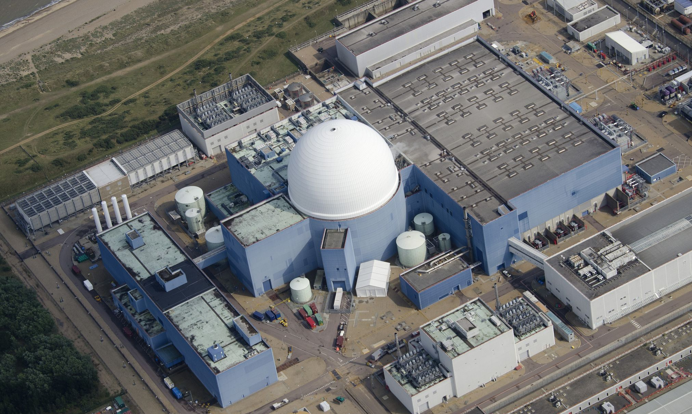
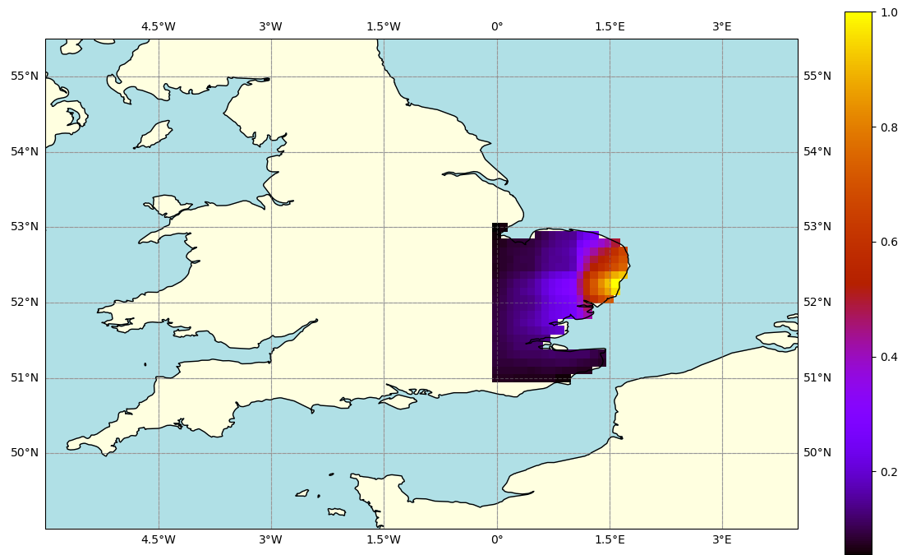
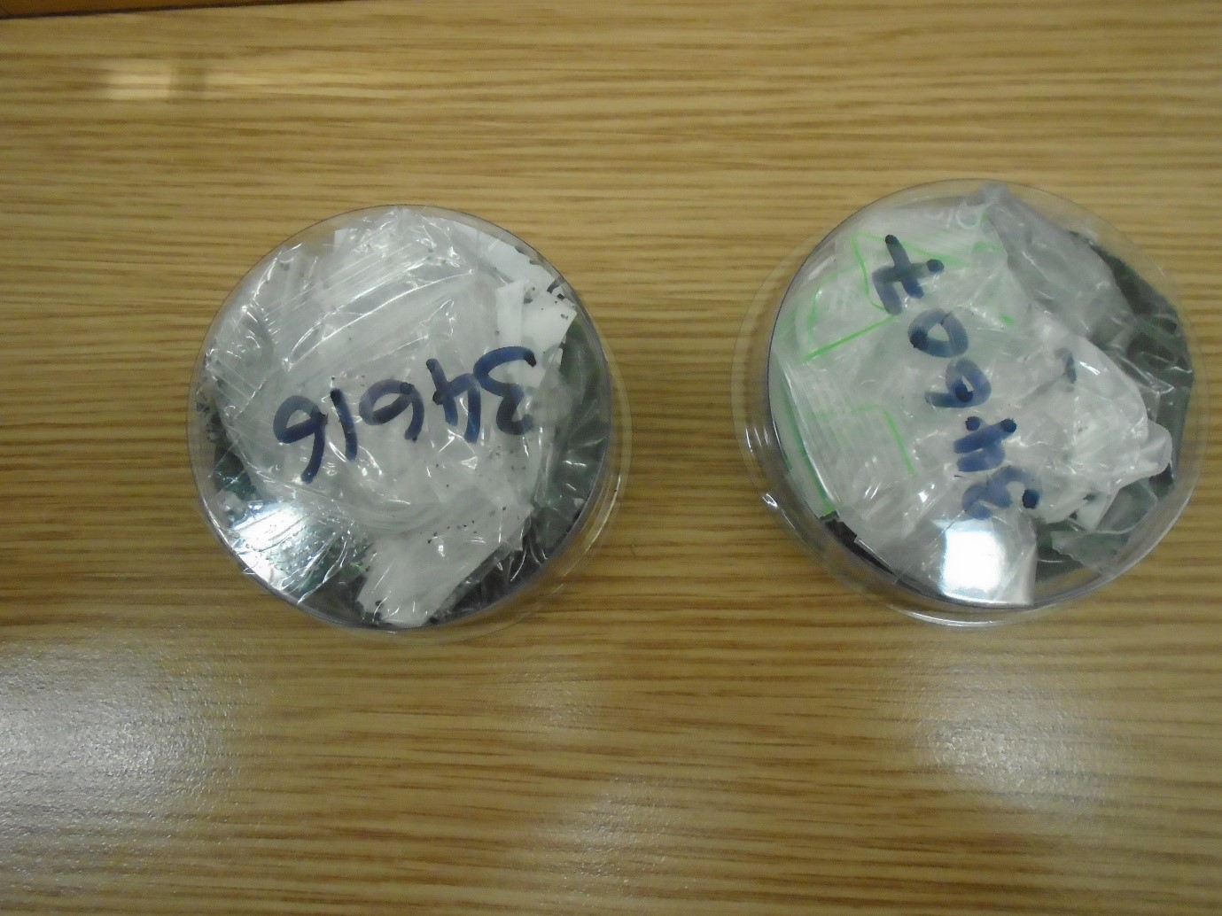

P5.1-371
XENAS: An Overview of Environmental Radionuclide Monitoring of Pressurised Water Reactor
C. Brown¹, M.A. Goodwin¹, D. Chester¹, A. Rae¹, A. Petts²
1. AWE Nuclear Security Technologies, Aldermaston, Reading, UK, RG7 4PR, 2. EDF Energy, UK
My poster is about an upcoming background measurement campaign for a pressurised water reactor in the UK
An atmospheric transport modelling survey has been performed to assess the efficacy of our proposed array
Direct measurement of samples from the facility have been analysed via gamma spectroscopy
Monitoring at Source
Deployment of a Q_{B} Array
Direct Sample Measurements
UK Ministry of Defence © Crown Owned Copyright 2025/AWE

