Slide 1


P5.1-371
XENAS: An Overview of Environmental Radionuclide Monitoring of Pressurised Water Reactor
C. Brown¹, M.A. Goodwin¹, D. Chester¹, A. Rae¹, A. Petts²
1 AWE Nuclear Security Technologies, Aldermaston, Reading, UK, RG7 4PR
2 EDF Energy, UK
GBL15 at AWE are conducting the XENAS (Xenon and Environmental Nuclide Analysis at Sizewell) project, a background measurement campaign assessing the impact of radionuclide emissions from pressurised water reactors (PWRs) on the atmospheric radionuclide background in the UK.
An ATM study has been carried out to predict proposed SAUNA Q_{b} deployment site suitability and preliminary filter measurements from the plant have been analysed using gamma spectroscopy.
UK Ministry of Defence © Crown Owned Copyright 2025/AWE

Slide 2
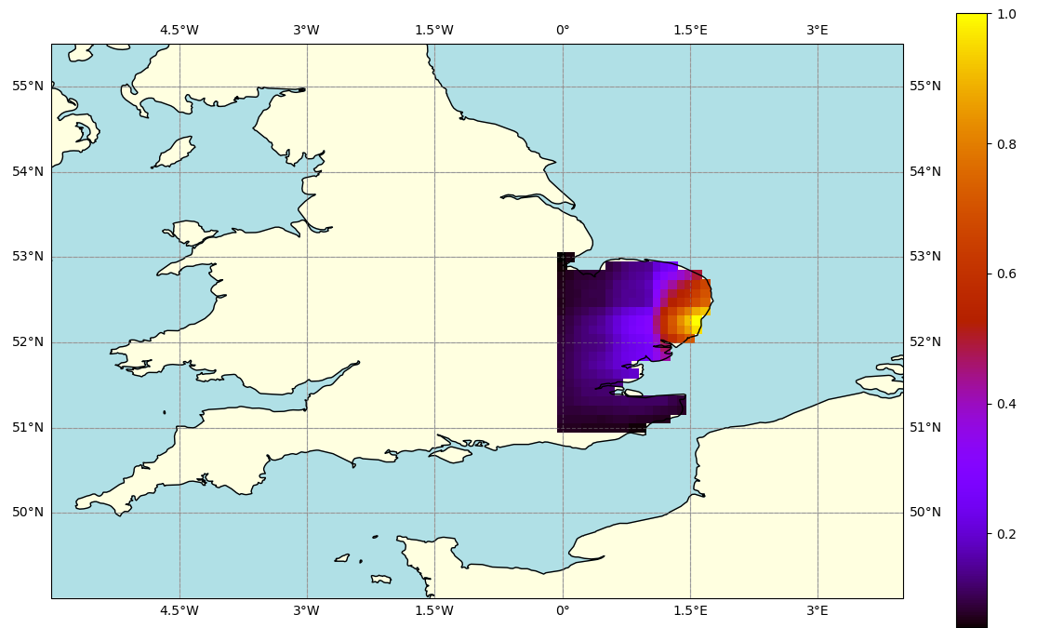
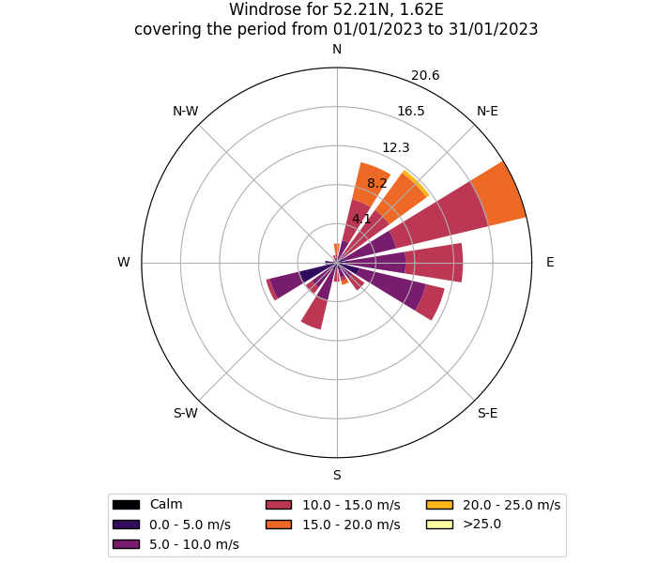
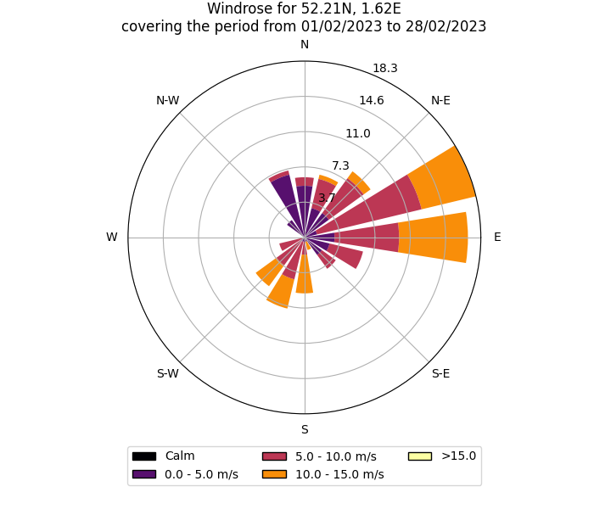
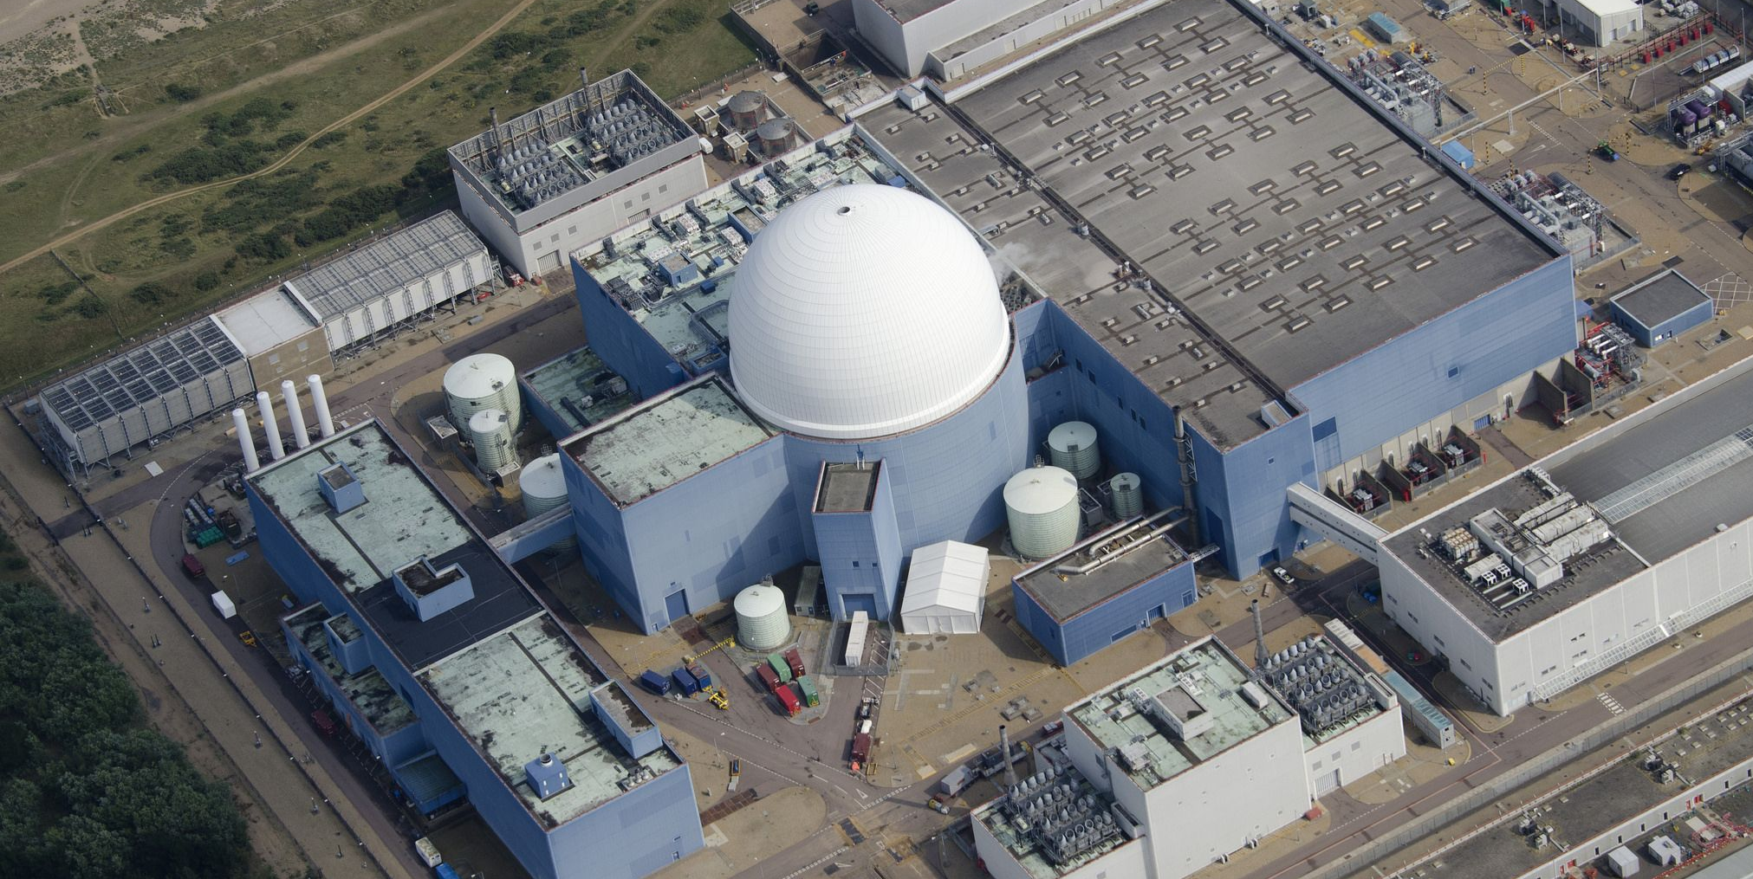
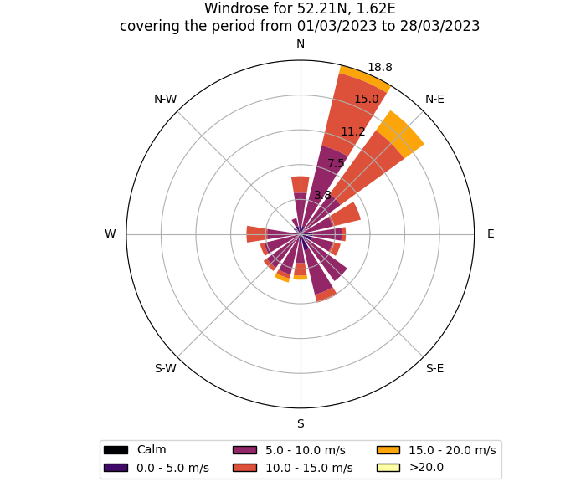
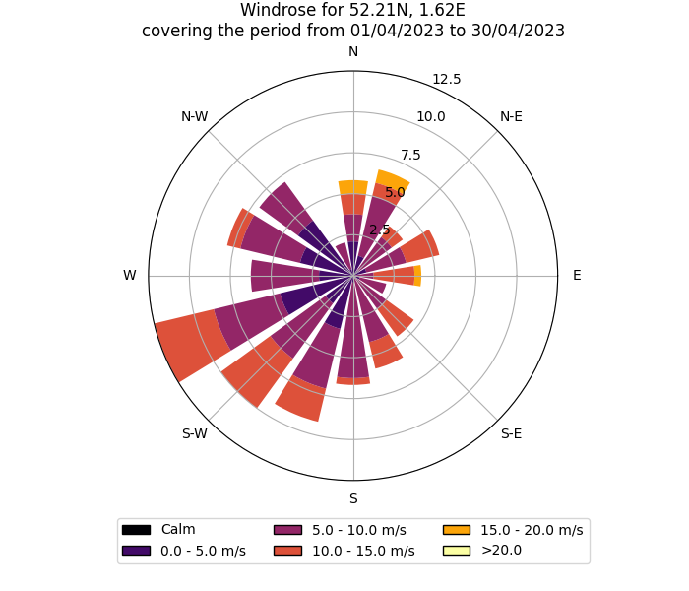
P5.1-371
XENAS: An Overview of Environmental Radionuclide Monitoring of Pressurised Water Reactor
Cameron Brown
XENAS
Deployment of a Qb Array
The XENAS project aims to assess the impact of radionuclide emissions from pressurised water reactors (PWRs). This is to be pursued via deployment of a Q_{b} array, direct sample measurements, and monitoring at source of the Sizewell B (SZB) PWR Nuclear Power Plant (Fig 1) in the UK.
Improved background measurements are invaluable in the context of nuclear monitoring. PWRs are the most common type of nuclear power reactor in the world, representing ~300 of current power reactors. The data obtained from this study will contribute toward understanding the impact of this type of radionuclide background source in the context of global monitoring networks like the IMS. [1]
The SAUNA Q_{b} (“Cube”) instrument is a sampling and measurement system for the detection of radioactive xenon gas in the atmosphere. Three such systems are planned to be deployed in the region around SZB. An ATM study has been performed to assess the most suitable locations for deployment of an array.
Initial assessment of wind patterns in the region were produced on a month-by-month basis (Fig 2). Modelling predicts predominantly offshore winds into the North sea. However, there are periods of westerly winds, where a land-based detector array placed around the location of Sizewell B may be able to detect measurable quantities of Xe emissions from the NNP.
ATM simulations were run with HYSPLIT v4.2. A heat map was produced indicating the area's most likely to be able to observe a given release. (Fig 3)
In addition to the SAUNA Q_{b} systems deployed in the UK a suitable deployment site in mainland Europe is being considered as this will offer opportunity to resolve IRE Fleurus emissions, an isotope production facility located in Belgium.
Figure 3. A heat map superimposed over East Anglia demonstrating a statistical spread for NPP potential release dilutions from Sizewell Power Plant
Figure 2. Windrose plots for the period 2023-01 → 2023-04
Figure 1. Sizewell B Nuclear Power Plant [2]
UK Ministry of Defence © Crown Owned Copyright 2025/AWE
Notes:
M. GOODWIN, A. PETTS et al, Characterising the Radionuclide Fingerprint of an Advanced Gas-Cooled Nuclear Power Reactor, pure and applied physics 2024
https://www.edfenergy.com/media-centre/sizewell-b-turns-thirty Date accessed 19/06/2025

Slide 3
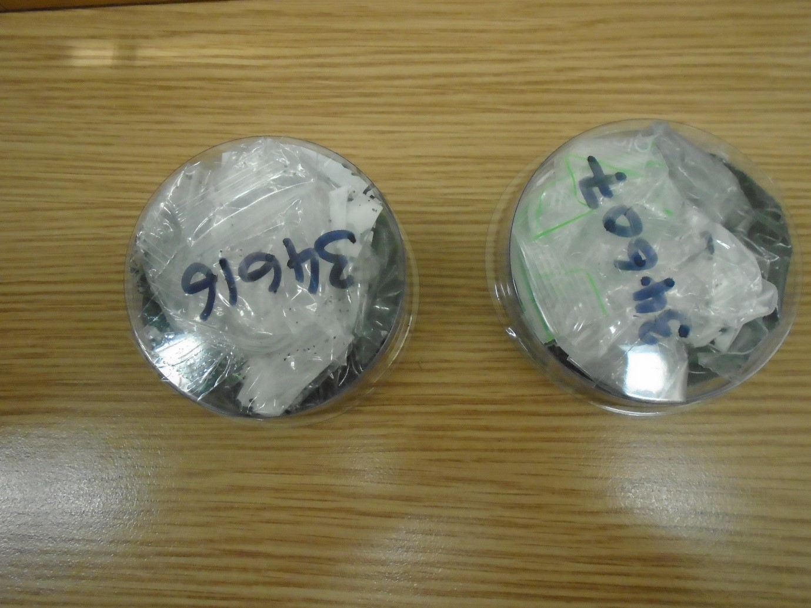
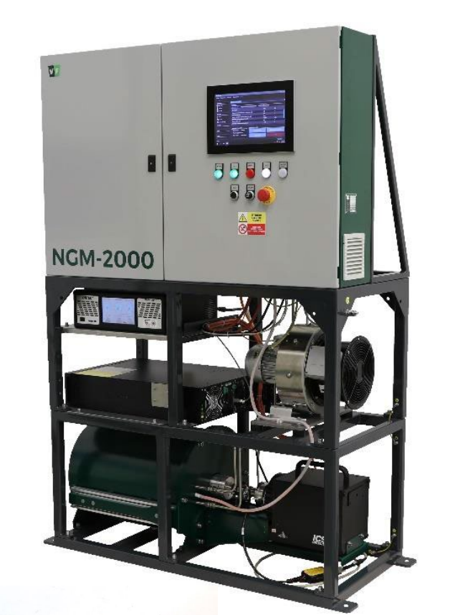
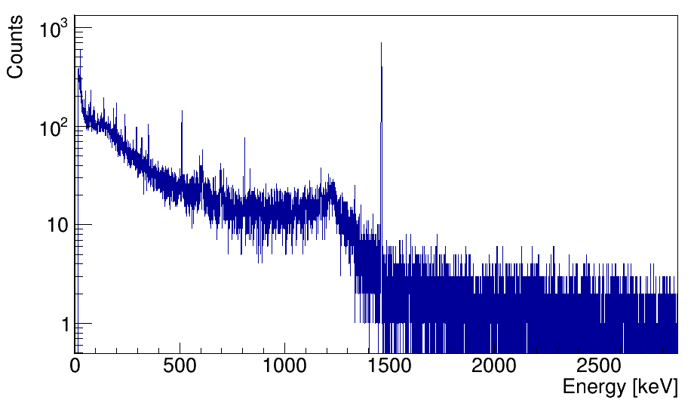
P5.1-371
XENAS: An Overview of Environmental Radionuclide Monitoring of Pressurised Water Reactor
Cameron Brown
Direct Sample Measurements
Monitoring at Source
Future Direction
Direct sample measurements will be measured and analysed using gamma spectrometry. Peaks in the resulting generated spectra can be attributed to characteristic energies of radionuclide fission products.
Samples generated and provided for analysis may arrive in a multitude of forms. Media agreed to be received may include:
Water samples
Gas samples
Charcoal filters
Charcoal filters (Fig 4), from Sizewell were counted on high purity germanium detectors and the resulting spectra analysed (Fig 5).
Cr-51 was detected in 2 samples
Co-58 was detected in 1 sample
Co-60 was detected in 4 samples
Bi-207 was detected in 1 sample
Plant operators have agreed to provide direct plant diagnostic data where requested and appropriate.
In addition, there are continued efforts - through contacts at EDF and Hartlepool - to install a STAX System (Fig 6) at SZB. STAX systems, one of which was installed at Hartlepool during the XENAH project (a precursor to XENAS, investigating Hartlepool power plant emissions) provide unique opportunities to obtain real, civil, high-quality emissions data to support interpretation of IMS noble gas monitoring data and facilitate calculation of a source term.[1,3]
Both logistically and analytically, work is ongoing as part of a wider concerted effort to ensure the array is receiving data by spring 2026. Broadly, the overarching objectives moving forward are as follows:
Alongside partner organisations, (FOI, PNNL) deploy a complete array of RX sensors in the region around Sizewell B (SZB)
Work with the EDF team at SZB to assess data and evaluate their source term
Work with EDF to determine whether a STAX (Source Term Analysis of Xenon) system could be installed at SZB
[1] M. GOODWIN, A. PETTS et al, Characterising the Radionuclide Fingerprint of an Advanced Gas-Cooled Nuclear Power Reactor, pure and applied physics 2024
[2] https://www.edfenergy.com/media-centre/sizewell-b-turns-thirty, Date accessed 19/06/2025
[3] A.PETTS, T. BOWYER et al, Measurements of radioxenon activities during periods of gaseous release from an advanced gas-cooled reactor
Figure 4. Charcoal filters received from SZB
References
Figure 5. Resulting gamma spectra of charcoal filters received from SZB
Figure 6. A STAX system
UK Ministry of Defence © Crown Owned Copyright 2025/AWE

