Slide 1


P5.1-707
Leveraging competencies and expertise across international organizations in support of global peace and security
Keegan McGrath
Organisation for the Prohibition of Chemical Weapons
This poster summarises the results of inter-agency workshops convened by the OPCW under the framework of the UN Global Counter-Terrorism Coordination Compact, which included CTBTO representatives.
While challenges remain, the project identified significant areas of potential cooperation between international organisations that can help promote global peace and security by leveraging the wide-ranging competencies and expertise built up by these organisations.

Slide 2

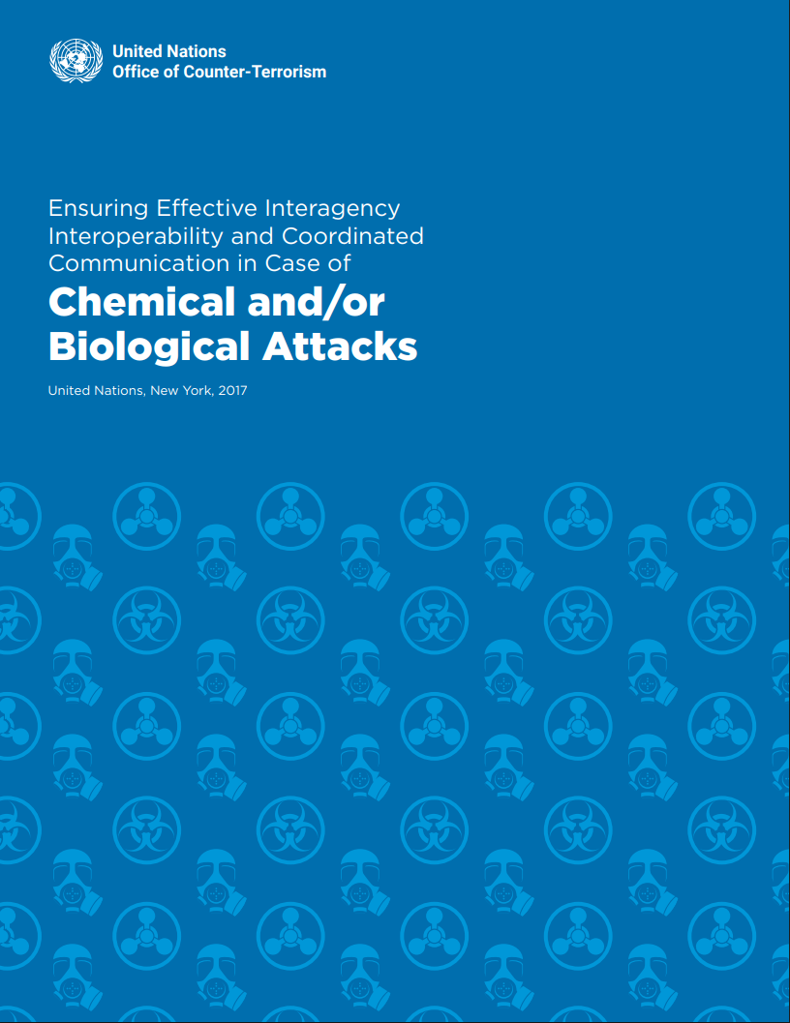


P5.1-707
Leveraging competencies and expertise across international organizations in support of global peace and security
Keegan McGrath
Project outcomes for Phases I and II were presented in a report published by the UN Office of Counter-Terrorism in 2017, which included the 18 recommendations produced by the table-top exercise.
Background
The Project on Ensuring Effective Inter-Agency Interoperability and Coordinated Communication in Case of Chem/Bio Attacks was initiated in 2015 by the UN Counter-Terrorism Implementation Task Force (CTITF) through its Working Group on Preventing and Responding to WMD Attacks, which was chaired by IAEA and co-chaired by OPCW. The Project’s specific objectives were two-fold and organised into two pillars:
(Pillar I) Ensure effective inter-agency interoperability in case of chem/bio weapons attacks; and
(Pillar II) Ensure coordinated and effective communication during emergencies caused by such attacks.
Project Phase I (Jan 2015 – Feb 2016)
Phase I was launched with a workshop at OPCW Headquarters in February 2015, bringing together 17 international organisations. It conducted a scenario-based gap analysis using three hypothetical terrorist attack scenarios (toxic chemical release, zoonotic disease, & infectious agent with a UN investigation request) to test agencies’ roles and interoperability.
The analysis mapped agency mandates and activities in the context of responding to a chem/bio weapons attack and proposed recommendations to improve interoperability. Additional outputs of Phase I included an interim report and a “Common Understanding of Terms”, which was a glossary of more than 60 operational definitions to harmonise understanding across agencies.
Project Phase II (Aug 2016 – May 2017)
Phase II built on Phase I conclusions, testing them through an inter-agency table-top exercise on chem/bio weapons terrorism, held at OPCW Headquarters in January 2017 with participants from 15 international organisations. The exercise simulated a coordinated international response to a fictional chem/bio weapons terrorist attack, testing both operational and crisis communication.
The table-top exercise produced several outputs, including detailed reports and an independent evaluation which validated Phase I conclusions, 18 recommendations, and refined cooperation tools to strengthen interoperability and public messaging strategies.

Slide 3



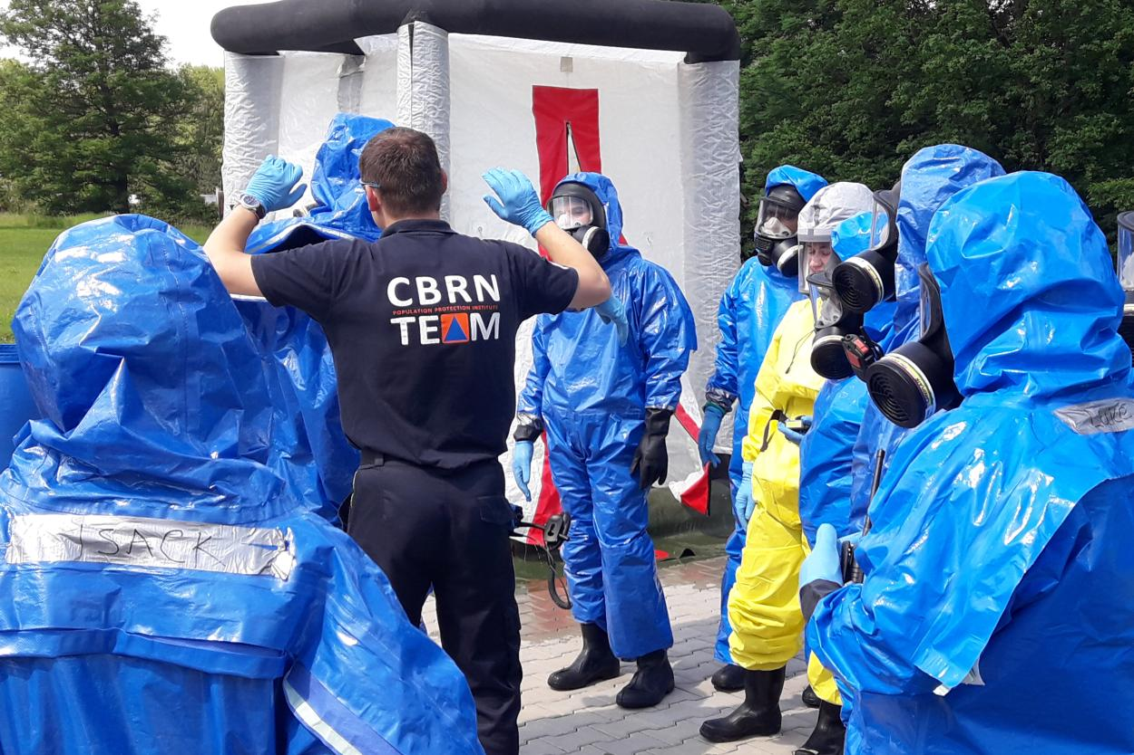
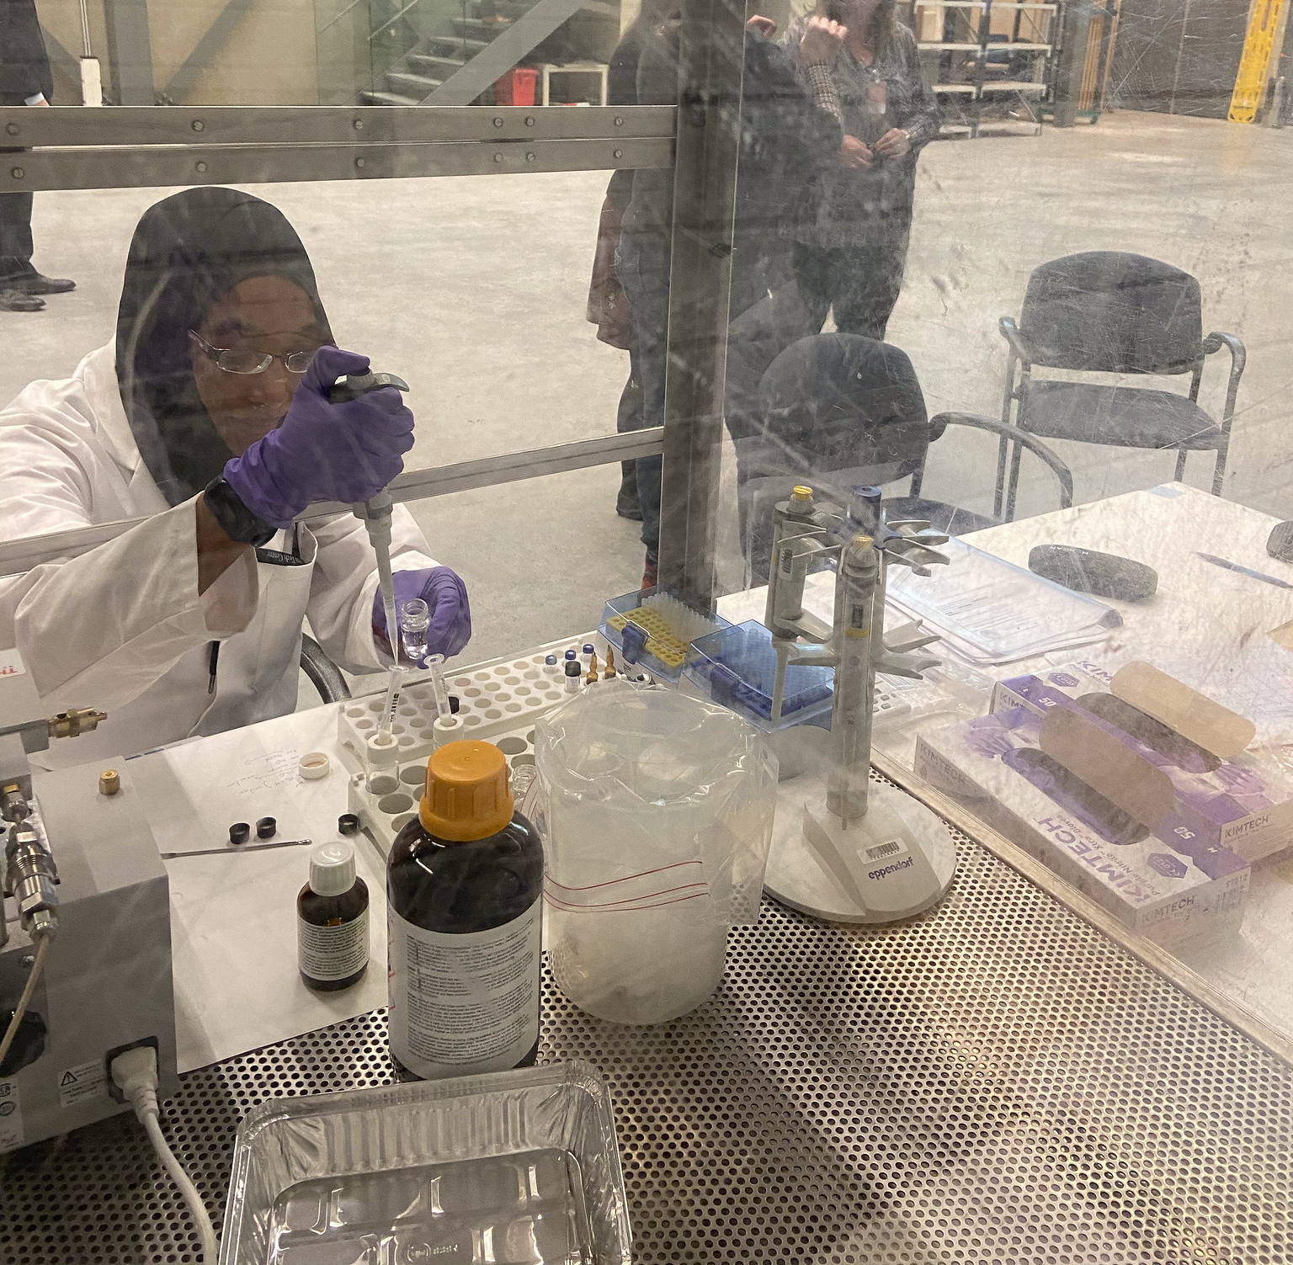
P5.1-707
Leveraging competencies and expertise across international organizations in support of global peace and security
Keegan McGrath
Project Phase III (2021-2023)
Phase III - Deliverables
Key Takeaways
Following Phases I and II, which were conducted under the former UNCTITF, Phase III of the Project commenced implementation in January 2022. Phase III elected to address a number of the 18 key recommendations identified in the previous phases in operational terms. The activities extended to June 2023, finally concluding in December 2023.
Phase III was carried forward under the newly established UN Global Counter-Terrorism Coordination Compact (formed in 2018), within its Working Group on Emerging Threats and Critical Infrastructure Protection.
The core outputs of Phase III were delivered through three inter-agency workshops:
Workshop on Information Exchange, OPCW Headquarters, March 2023;
Workshop on Emergency Response Centre/Operations Centre Cooperation, INTERPOL Headquarters, May 2023;
Workshop on Team Deployments, at OPCW Centre for Chemistry and Technology June 2023.
The major outputs produced by the workshops were a set of concrete resources:
The establishment of a Network of Functional Focal Points with agreed Terms of Reference;
A compendium of agencies’ response resources;
An inter-agency report on cooperation between Emergency Response Centres with a draft programme of work; and
A non-mandatory deployment checklist to guide joint operations.
The workshops also advanced discussions toward formal agreements between participating organisations. In addition, OPCW and WHO laid the groundwork for future inter-agency training on CBRN hazards.
The Project achieved progress in implementing the key recommendations on information exchange, needs assessment, and field coordination, notably by consolidating the Functional Focal Points Network and mapping operational resources.
Nevertheless, the Project confirmed the need for sustained engagement, regular dialogue between operational centres, and streamlining bilateral and multilateral agreements to improve interoperability.
It also highlighted that practical and easily sustainable measures and mechanisms are required to maintain effective long-term interagency interoperability and the coordination of crisis communication.

