Slide 1


P5.1-796
Tackling Trust in the Treaty: New Technologies and Diplomatic Strategies to Build Confidence in the CTBT(O)
Francesca Crema, Amber Gaskill
The University of British Columbia
In a rapidly developing geopolitical and technological world, how can we ensure that the CTBTO fulfills its objective of monitoring and deterring nuclear testing, while bolstering support and trust from existing and potential Member States?
We explore a political trust-building strategy based on inclusive diplomatic outreach and effective technological methods to maximise the CTBTO’s success.

Slide 2
P5.1-796
Tackling Trust in the Treaty: New Technologies and Diplomatic Strategies to Build Confidence in the CTBT(O)
Francesca Crema, Amber Gaskill
International
Trust Building
Regional
Technological
Innovation
Decentralization
National

Slide 3
P5.1-796
Tackling Trust in the Treaty: New Technologies and Diplomatic Strategies to Build Confidence in the CTBT(O)
Francesca Crema, Amber Gaskill
Decentralization
Decentralizing CTBTO activities to increase international awareness and networking of non-proliferation activities.
Scope | Significance | Proposed Actions
International | Emphasizing regional initiatives for non-proliferation and nuclear arms control. | Adopting a diplomatic approach that focuses primarily on confidence-building through addressing regional concerns. Prioritizing domestic/regional conditions over the political priorities of Nuclear Weapon States (NWS). Example: Bangkok Treaty.¹
Regional | Enhancing access and engagement with CTBTO initiatives, promoting non-proliferation at a regional scale. | CTBTO events and documentation translated into different languages (i.e. French, Arabic, Spanish). CTBTO diplomatic and technical workshops across different countries to mitigate scheduling difficulties.
National | Leveraging the CTBTO’s soft power influence to increase engagement and build networks. | Increasing engagement with the CTBTO Youth Group in universities. Example: UBC’s nuclear security course and CTBTO engagement. Establishing a CTBTO presence across civil society and public events.
Notes:
The CTBTO’s soft power influence should be leveraged to create non-proliferation networks at every level.
Signatories of the CTBT.
Civil society/grassroots initiatives (i.e. universities).

Slide 4
P5.1-796
Tackling Trust in the Treaty: New Technologies and Diplomatic Strategies to Build Confidence in the CTBT(O)
Francesca Crema, Amber Gaskill
Technological Innovation
Adapting the CTBTO’s monitoring and communications systems to a changing technological landscape.
Scope | Significance | Proposed Actions
International | Enforcing accountability and strengthening the CTBTO monitoring system with new technologies. | Enforcing accountability to all states, especially NWS whose activities might not be detected with current CTBTO monitoring capabilities.² Leveraging open source/commercial imagery and machine learning to strengthen CTBTO monitoring systems. Combatting mis-/dis-information through transparency. “Needlessly withholding fundamental details about one’s nuclear programme does not make the world safer; on the contrary, it opens the door to exaggeration, hype and miscalculation.”³
Regional | Enhancing access and engagement with CTBTO initiatives. | Translation of CTBTO documents and media. Creating robust AI models intended for nuclear researchers to navigate CTBTO data and policies, and to assist strategic decision-making. Enforcing regulations and guidelines for implementation of AI.⁴ Exploring AI integration in diplomatic outreach and initiating discussions on the establishment of ethical guidelines and application in CTBTO initiatives.
National | Leveraging technology to increase engagement and build networks. | Facilitating and expanding grassroots discussion through virtual Data Exploitation Centre (vDEC) access/information, and other open-source platforms for researchers, students, and the public to collaborate and learn from. Creating more simulations and workshops for training and education.
Notes:
Satellite imagery can detect activity at nuclear sites in the absence of chemical and seismic evidence.¹
Reliability and credibility
AI and OSINT (Open Source Intelligence) technology bring new opportunities and challenges.
Managing data overload
Cybersecurity

Slide 5
P5.1-796
Tackling Trust in the Treaty: New Technologies and Diplomatic Strategies to Build Confidence in the CTBT(O)
Francesca Crema, Amber Gaskill
Empowering non-nuclear weapon states through more access to information
Increase technical credibility to maintain the CTBTO’s non-proliferation and non-testing norms
Trust Building
Growing the CTBTO scientific and outreach network through OSINT
Technological
Innovation
Decentralization
Facilitating transparency and access to information about nuclear arsenals on multiple scales
AI for real-time translation and communication improvements
Platforming collaboration and cooperation despite volatile international environments

Slide 6
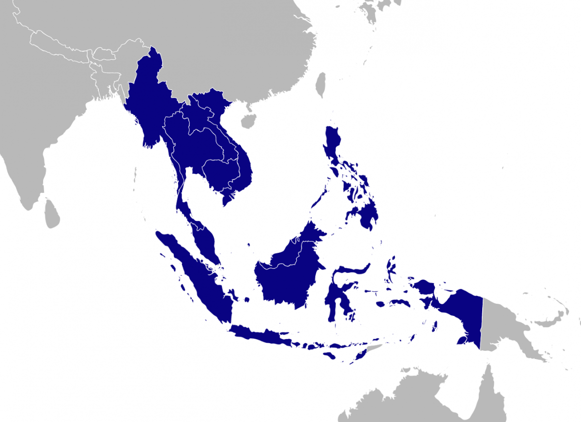
P5.1-796
Tackling Trust in the Treaty: New Technologies and Diplomatic Strategies to Build Confidence in the CTBT(O)
Francesca Crema, Amber Gaskill
Example of Decentralised Diplomacy: The Bangkok Treaty
Bangkok Treaty
The successful negotiation of the Bangkok Treaty (SEANWFZ) demonstrates that states with conflicting political interests can collaborate to develop enduring agreements on non-proliferation.
  “...the prior negotiation of the SPNFZ showed the feasibility of negotiating such zones in a diplomatic context where not all of the NWS were supportive.”⁵
  “...regional agreements, unlike global agreements; are less subject to veto pressures from the NWS, and that opportunities for dialogue and discussions on arms control issues are improving, if only incrementally, in some of the most conflict-prone regions.”
The Bangkok Treaty emphasized ASEAN’s principles of deterring external interference in the region, neutrality, and non-interference in internal affairs.⁶
  ASEAN Member States were able to overcome political barriers by ensuring the terms of the Bangkok Treaty aligned with domestic and regional conditions over the political priorities of NWS.
  Negotiations took place between ASEAN Member States, while NWS were consulted and invited to sign the Protocol to the SEANWFZ Treaty.
Notes:
https://www.cnn.com/2023/09/22/asia/nuclear-testing-china-russia-us-exclusive-intl-hnk-ml

Slide 7

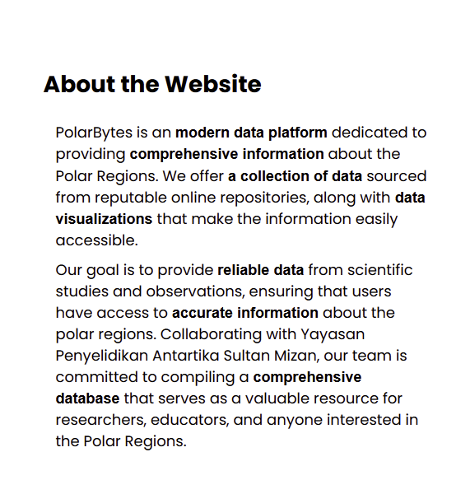
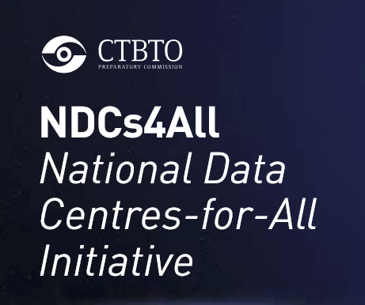
Tackling Trust in the Treaty: New Technologies and Diplomatic Strategies to Build Confidence in the CTBT(O)
Francesca Crema, Amber Gaskill
Examples of Technological Innovation in International Monitoring and Data Efforts
OSINT
IAEA: Regional Information Collection Centres (RICC) at King’s College London
  Aimed at focusing OSINT expertise.
  Has “extended the Agency’s ability to identify relevant information, without which the Agency’s confidence in safeguards conclusions would be reduced.”⁷
CTBTO: NDCs4All initiative.⁸
Publicly accessible centralized data sharing
  NASA’s citizen science platform.⁹
  PolarBytes research platform.¹⁰
AI
Satellite imagery for disaster monitoring
  ESA: Applying artificial intelligence to raw satellite imagery for time-critical applications.¹¹
Signal processing.
Student and Research Networking
University courses: APSC/POLI 377 at UBC
Continuing workshop efforts: East Asia Regional NDC Workshop 2025¹²
Notes:
https://www.ctbto.org/news-and-events/news/building-regional-expertise-ctbt-verification-across-east-asia

Slide 8
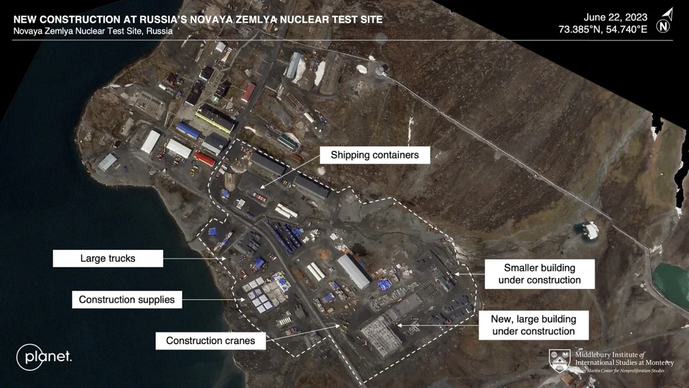
Tackling Trust in the Treaty: New Technologies and Diplomatic Strategies to Build Confidence in the CTBT(O)
Francesca Crema, Amber Gaskill
Source: “Satellite images show increased activity at nuclear test sites in Russia, China and US,” CNN, 2023.

Slide 9
P5.1-796
Tackling Trust in the Treaty: New Technologies and Diplomatic Strategies to Build Confidence in the CTBT(O)
Francesca Crema, Amber Gaskill
Challenges to Consider
Cybersecurity
Authentication and access
Misinformation and obfuscation
  Eg. Satellite imagery deep-fakes
Data management and ownership
Balancing AI with human judgment in decision-making
Bias in model training data
Balancing expanded CTBTO presence with governance of affiliated entities
Maintaining positive relations with NWS while pivoting to diplomatic outreach with regional emphasis

Slide 10
P5.1-796
Tackling Trust in the Treaty: New Technologies and Diplomatic Strategies to Build Confidence in the CTBT(O)
Francesca Crema, Amber Gaskill
References
¹ Hamel-Green, M. (2005) “Regional Initiatives on Nuclear and WMD-Free Zones: Cooperative Approaches to Arms Control and Non-Proliferation,” United Nations Institute for Disarmament Research. (Link)
² Cheung, E., Lendon, B& Watson. (2023) “Exclusive: Satellite images show increased activity at nuclear test sites in Russia, China and US,” CNN. (Link)
³ Kristensen, H. & Korda, M. (2024) “Monitoring Nuclear Weapons Developments with Open Source Intelligence,” Open Source Investigations in the Age of Google, pp. 66-86. (Link)
⁴ Ajaykumar, S. (2025) “Integrating AI in Nuclear Security: Challenges and Ethical Consideration,” Observer Research Foundation, 2025. (Link)
⁵ Hamel-Green. (2005) “Regional Initiatives on Nuclear and WMD-Free Zones.”
⁶ Nuclear Threat Initiative. “Bangkok Treaty,” Nuclear Threat Initiative. (Link)
⁷ “Development and Implementation Support Programme for Nuclear Verification 2024-2025,” IAEA Safeguards. (Link)
⁸ CTBTO. “National Data Centres-For-All Initiative,” CTBTO Preparatory Committee. (Link)
⁹ NASA. “Citizen Science,” NASA, 2025. (Link)
¹⁰ Hazman et al. (2025) “PolarBytes: Advancing Polar Research with a Centralized Open-Source Data Sharing Platform,” Environmental Modelling & Software Vol. 185(106325). (Link)
¹¹ Sentinel Online. (2024) “Applying Artificial Intelligence to Raw Satellite Imagery for Time-Critical Applications,” Sentinel Online. (Link)
¹² CTBTO. (2024) “Building Regional Expertise in CTBT Verification Across East Asia,” CTBTO Preparatory Commission. (Link)

