Slide 1

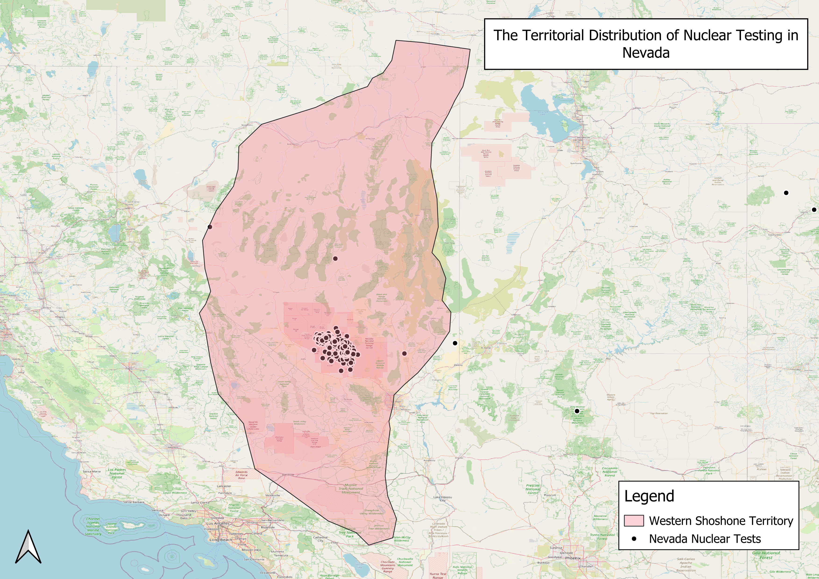

P5.1-822
Nuclear Explosions, GIS and Utilizing an Interdisciplinary Approach to Understanding Environmental Impacts
Carly Dargatz
The University of British Columbia
The effects of nuclear weapons testing can be visually represented with geospatial data, focusing on environmental or social variables
GIS offers an interdisciplinary approach to analyzing and understanding the multidimensional impacts of nuclear testing, and provides opportunities for:
  Public outreach
  Education campaigns
  Social media
  Increasing support of the CTBT
Come over if you’d like to chat more about the use of GIS and mapping in nuclear testing research, education and public outreach!

