Slide 1

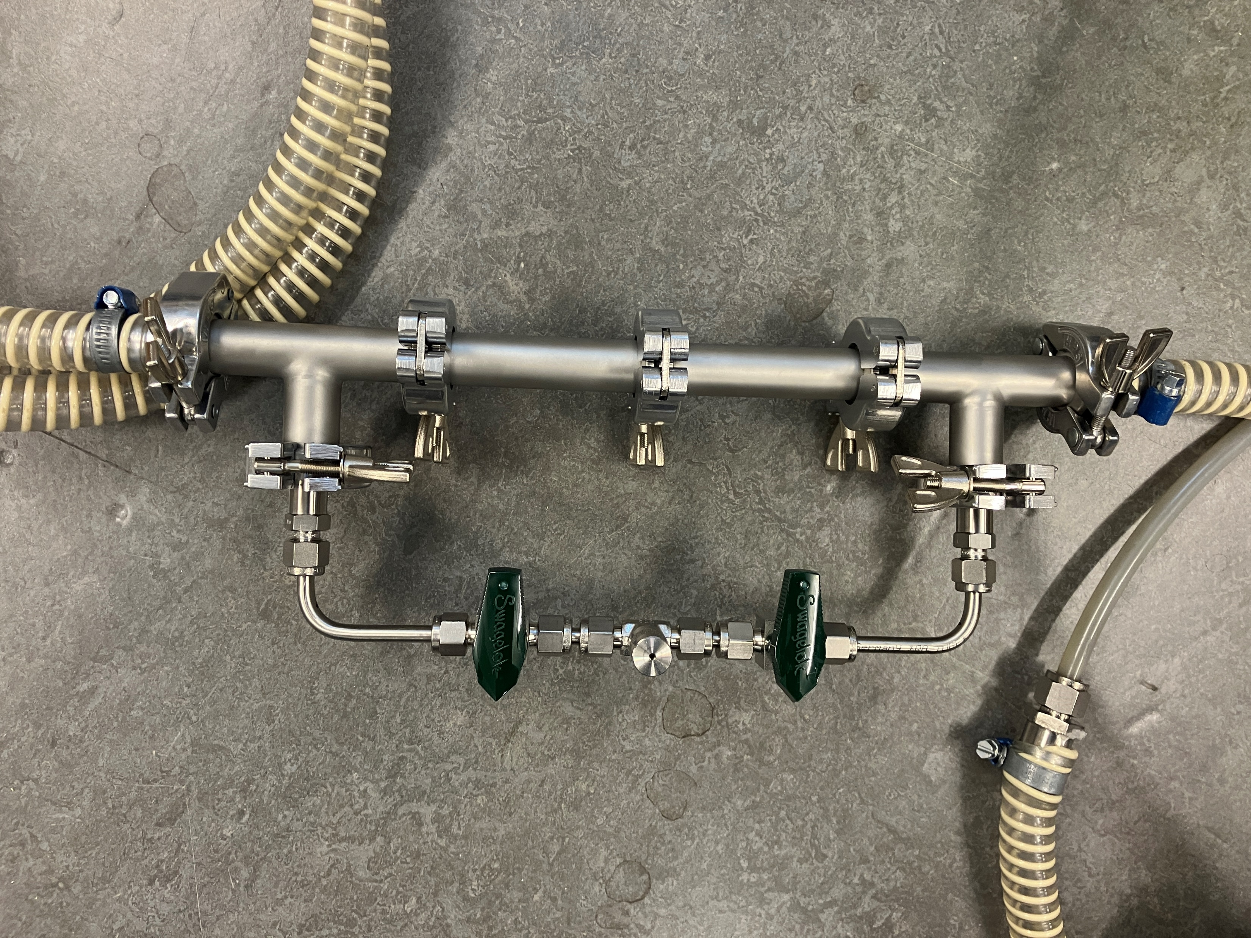
P4.5-189
The BUE24 Radionuclides Scenario and Updates Needed Before IFE
M. Aldener¹, M. Auer², K. Elmgren¹, and G. Haquin³
¹FOI, ²ISTI, ³IAEC
LEARN about the BUE24 radionuclide scenario
HEAR about the difficulty the Scenario Task Force encountered in doing radioxenon injects (and how they overcame it)
SEE how radioxenon injects will be handled at IFE in a new and different way
DISCLAIMER: Absolutely no information about the IFE scenario will be provided!
IFE gets a new “trumpet”

