Slide 1

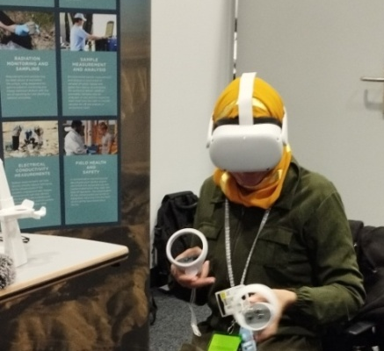

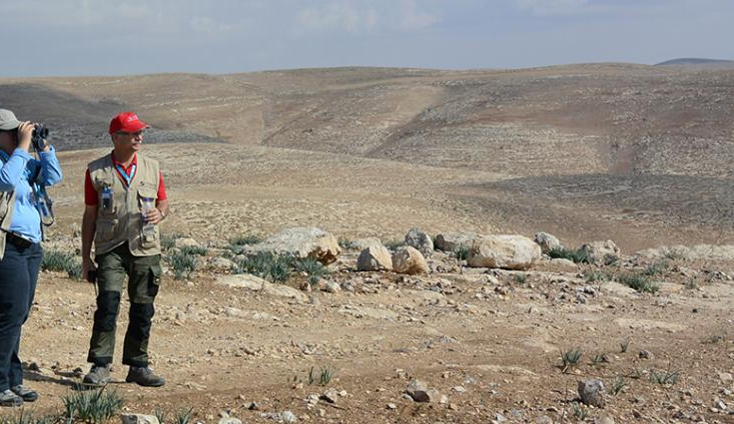
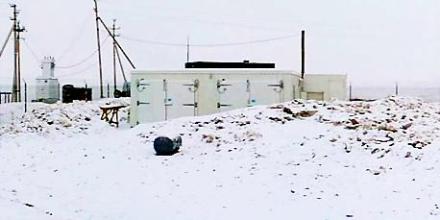
Necessity of a prototype test-site for optimization of OSI training
Nalin de Silva and W.A.G.K. Wickramasinghe
Geological Survey and Mines Bureau (GSMB) , Sri Lanka
P4.5-634
The necessity of developing a prototype training facility for OSI inspection is
emphasized herein…………
The OSI Intricacies
OSI could happen in any environment, whether the event is man-made or otherwise…potential variables that involved in OSI is multiple.
OSI training package, including IFE, is not adequate to address potential OSI variables and multiple scenarios. Further, testing of Inspector capabilities and adaptations to different environments are complex and costly affair.
Appropriate Measures
Developing an integrated prototype training facility for OSI would be an appropriate measure considered the multiple-scenarios associated with an Inspecttion. an inspection.
Geological Survey and Mines Bureau, Sri Lanka

