Slide 1
Introduction Slide Title goes here [Font: Arial Bold/Size: 16]
P4.5-634
Necessity of a prototype test-site for optimization of OSI training
Nalin de Silva and W.A.G.K. Wickramasinghe
Geological Survey and Mines Bureau Sri Lanka
Geological Survey and Mines Bureau, Sri Lanka
Prototype test-site enhances the Inspector Training and refines the Inspection Team Functionality as such facility could address OSI related variables effectively.
DISCLAIMER: This presentation has been generated for illustration purposes only.

Slide 2
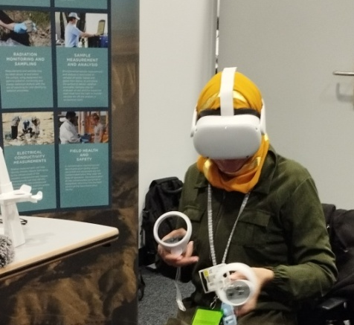
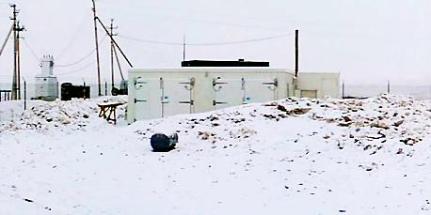
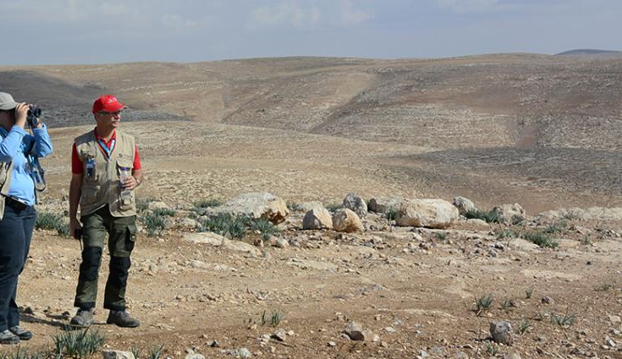


Necessity of a prototype test-site for optimization of OSI training
Nalin de Silva and W.A.G.K. Wickramasinghe
P4.5-634
Introduction
Once the Treaty entry into force (EIF), the On-Site Inspection (OSI) Inspectorate could be in a position to conduct an OSI almost in any environment. The main training process of the OSI Inspectorate, Integrated Field Exercise (IFE), could not practically be performed in demanding and different environments with all possible scenarios. Hence, building up plausible alternatives could be an added asset in making a versatile OSI inspectorate. Presently, advanced training on many complex objectives is partially conducted via computer-aided simulations and prototype settings that are cost-effective and provide room for a wide range of scenarios to be tested.
Recent Progress
Despite the limitations to develop OSI techniques, as of the CTBT Protocol, a commendable progress is made on introducing modern training facilities to OSI. The necessity to introduce virtual learning elements and simulations as training components are well recognized.
REMEDIAL MEASURES
Conclusion
The different elements that area developing in silos needed to be integrated according to a pre-designed plan towards optimizing the OSI training. In such backdrop prototype test-site with an aid of virtual elements computer-based simulations and models would be the right approach. Such facility will enables to address wide-range of scenarios in different environments in cost effective manner in the long-run. Such facility could function as an auxiliary to Integrated Field Exercise (IFE).
Geological Survey and Mines Bureau, Sri Lanka

