Slide 1


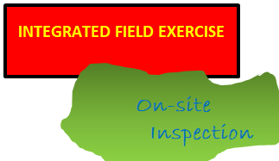
Bridging the gap between On-Site Inspection (OSI) and Integrated Field Exercise (IFE)
Nalin de Silva and W.A.G.K. Wickramasinghe
Geological Survey and Mines Bureau (GSMB) , Sri Lanka
P4.5-439
Here we are comparing and contrasting the IFE and OSI, with measures to
bridge the gap towards an effective OSI………….
The Main Issues
An OSI could conduct in any environment, yet with available resources and selective “comfort zones” IFE could conduct only at specific environments…………
The artificiality and injects largely governs the IFE, though such elements are not in an OSI………..
A friendly and well-trained OSI escorts could not be taken as granted, the real situation would be very complex………
Appropriate Measures
The key differences between an IFE and OSI needed to be analysed and identified enabling to transform IFE mind-set to OSI environment……
Geological Survey and Mines Bureau, Sri Lanka

