Slide 1


P4.4-728
Predictive Analytics for radionuclide systems of the International Monitoring System
R. Suarez, J. Dermigny, D. Keller, J. C. Hayes, L. Lidey, A. Usenko
Pacific Northwest National Laboratory (PNNL)
This presentation provides an update to research being conducted at PNNL to detect failures in radionuclide systems early. The idea is to use several techniques to identify critical failures early such that they can be mitigated before becoming catastrophic. This poster highlights recent advancements.
Acknowledgements:
The authors wish to acknowledge the funding support of the Nuclear Arms Control Technology Program of the U.S. Department of Defense, Defense Threat Reduction Agency
Cleared for Release
The views expressed here do not necessarily reflect the opinion of the United States Government,
the United States Department of Energy, or the Pacific Northwest National Laboratory
PNNL-SA-215414

Slide 2
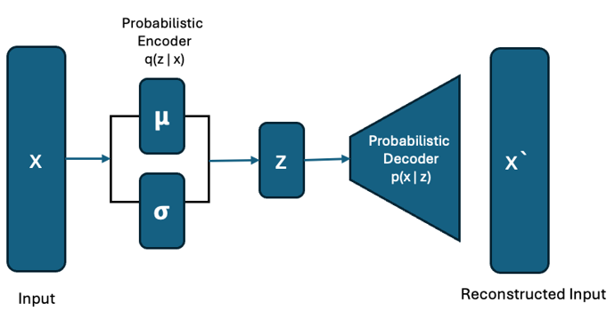
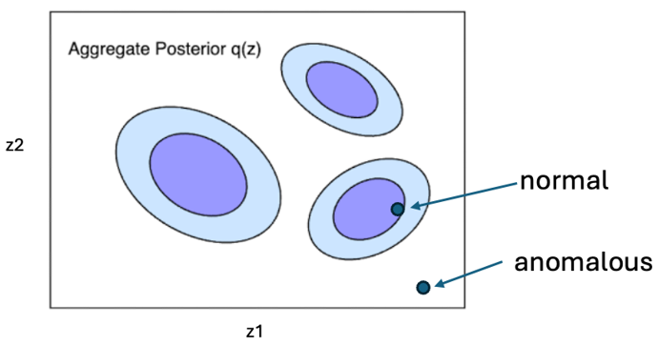
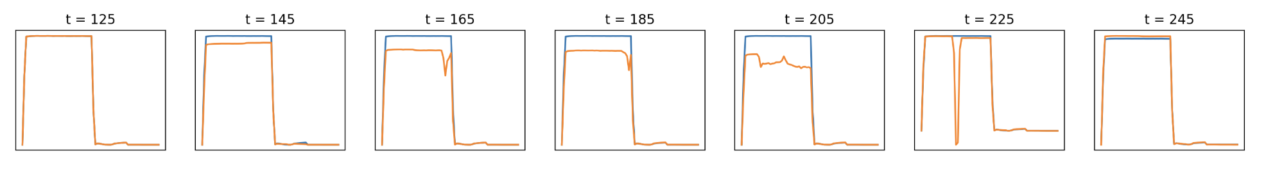
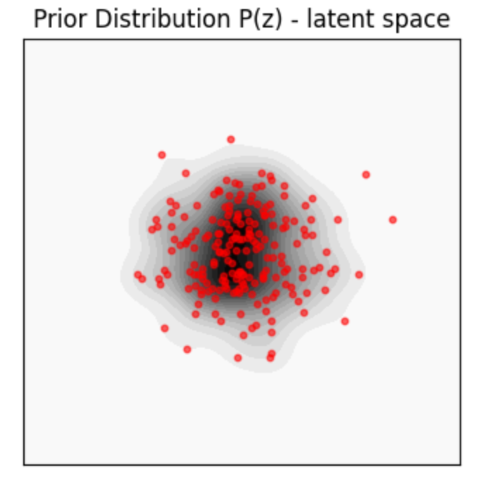
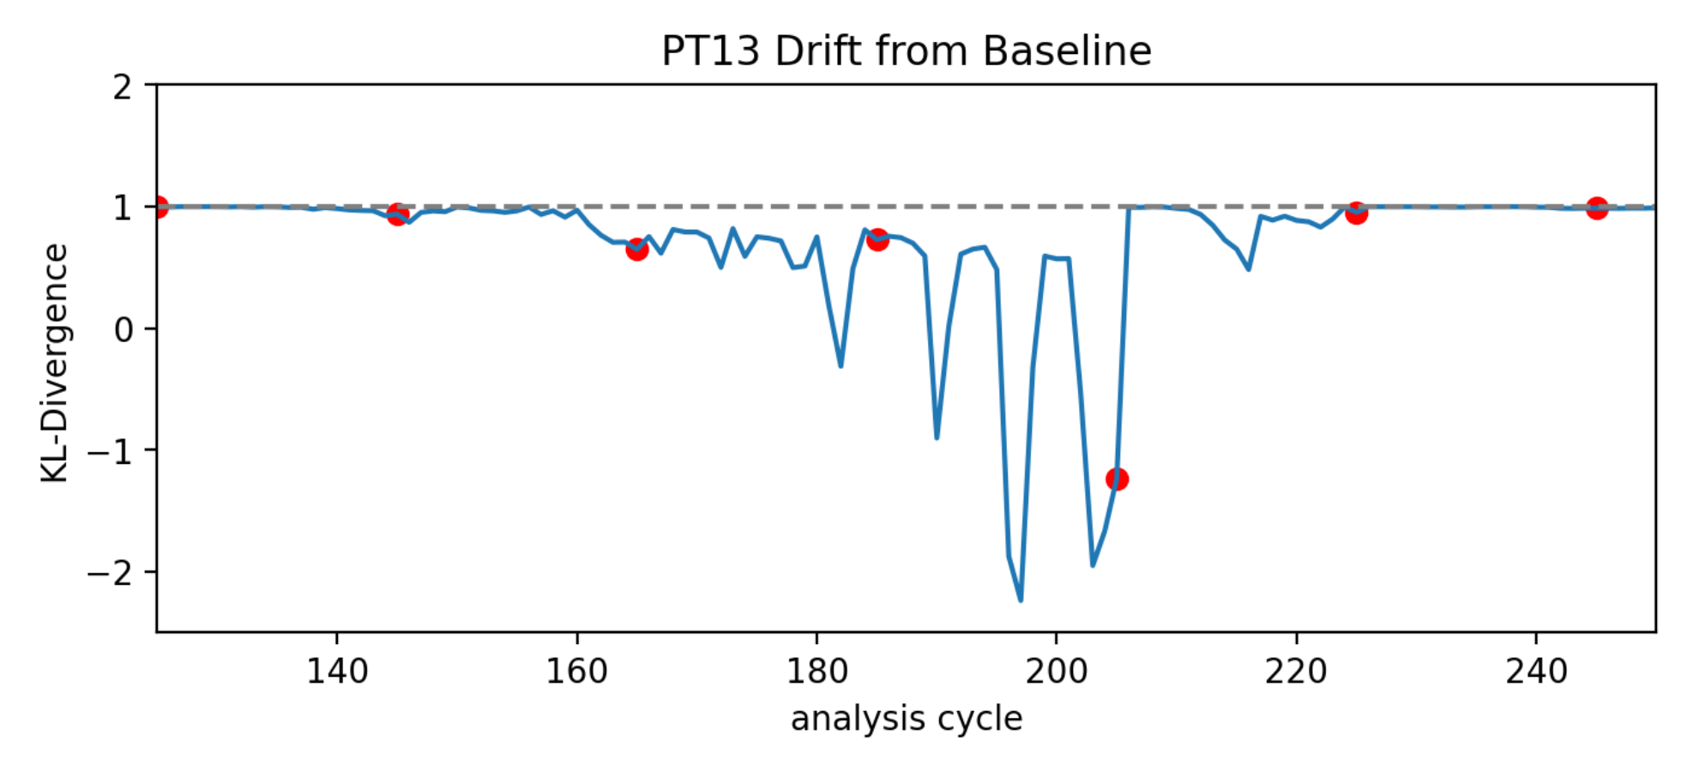
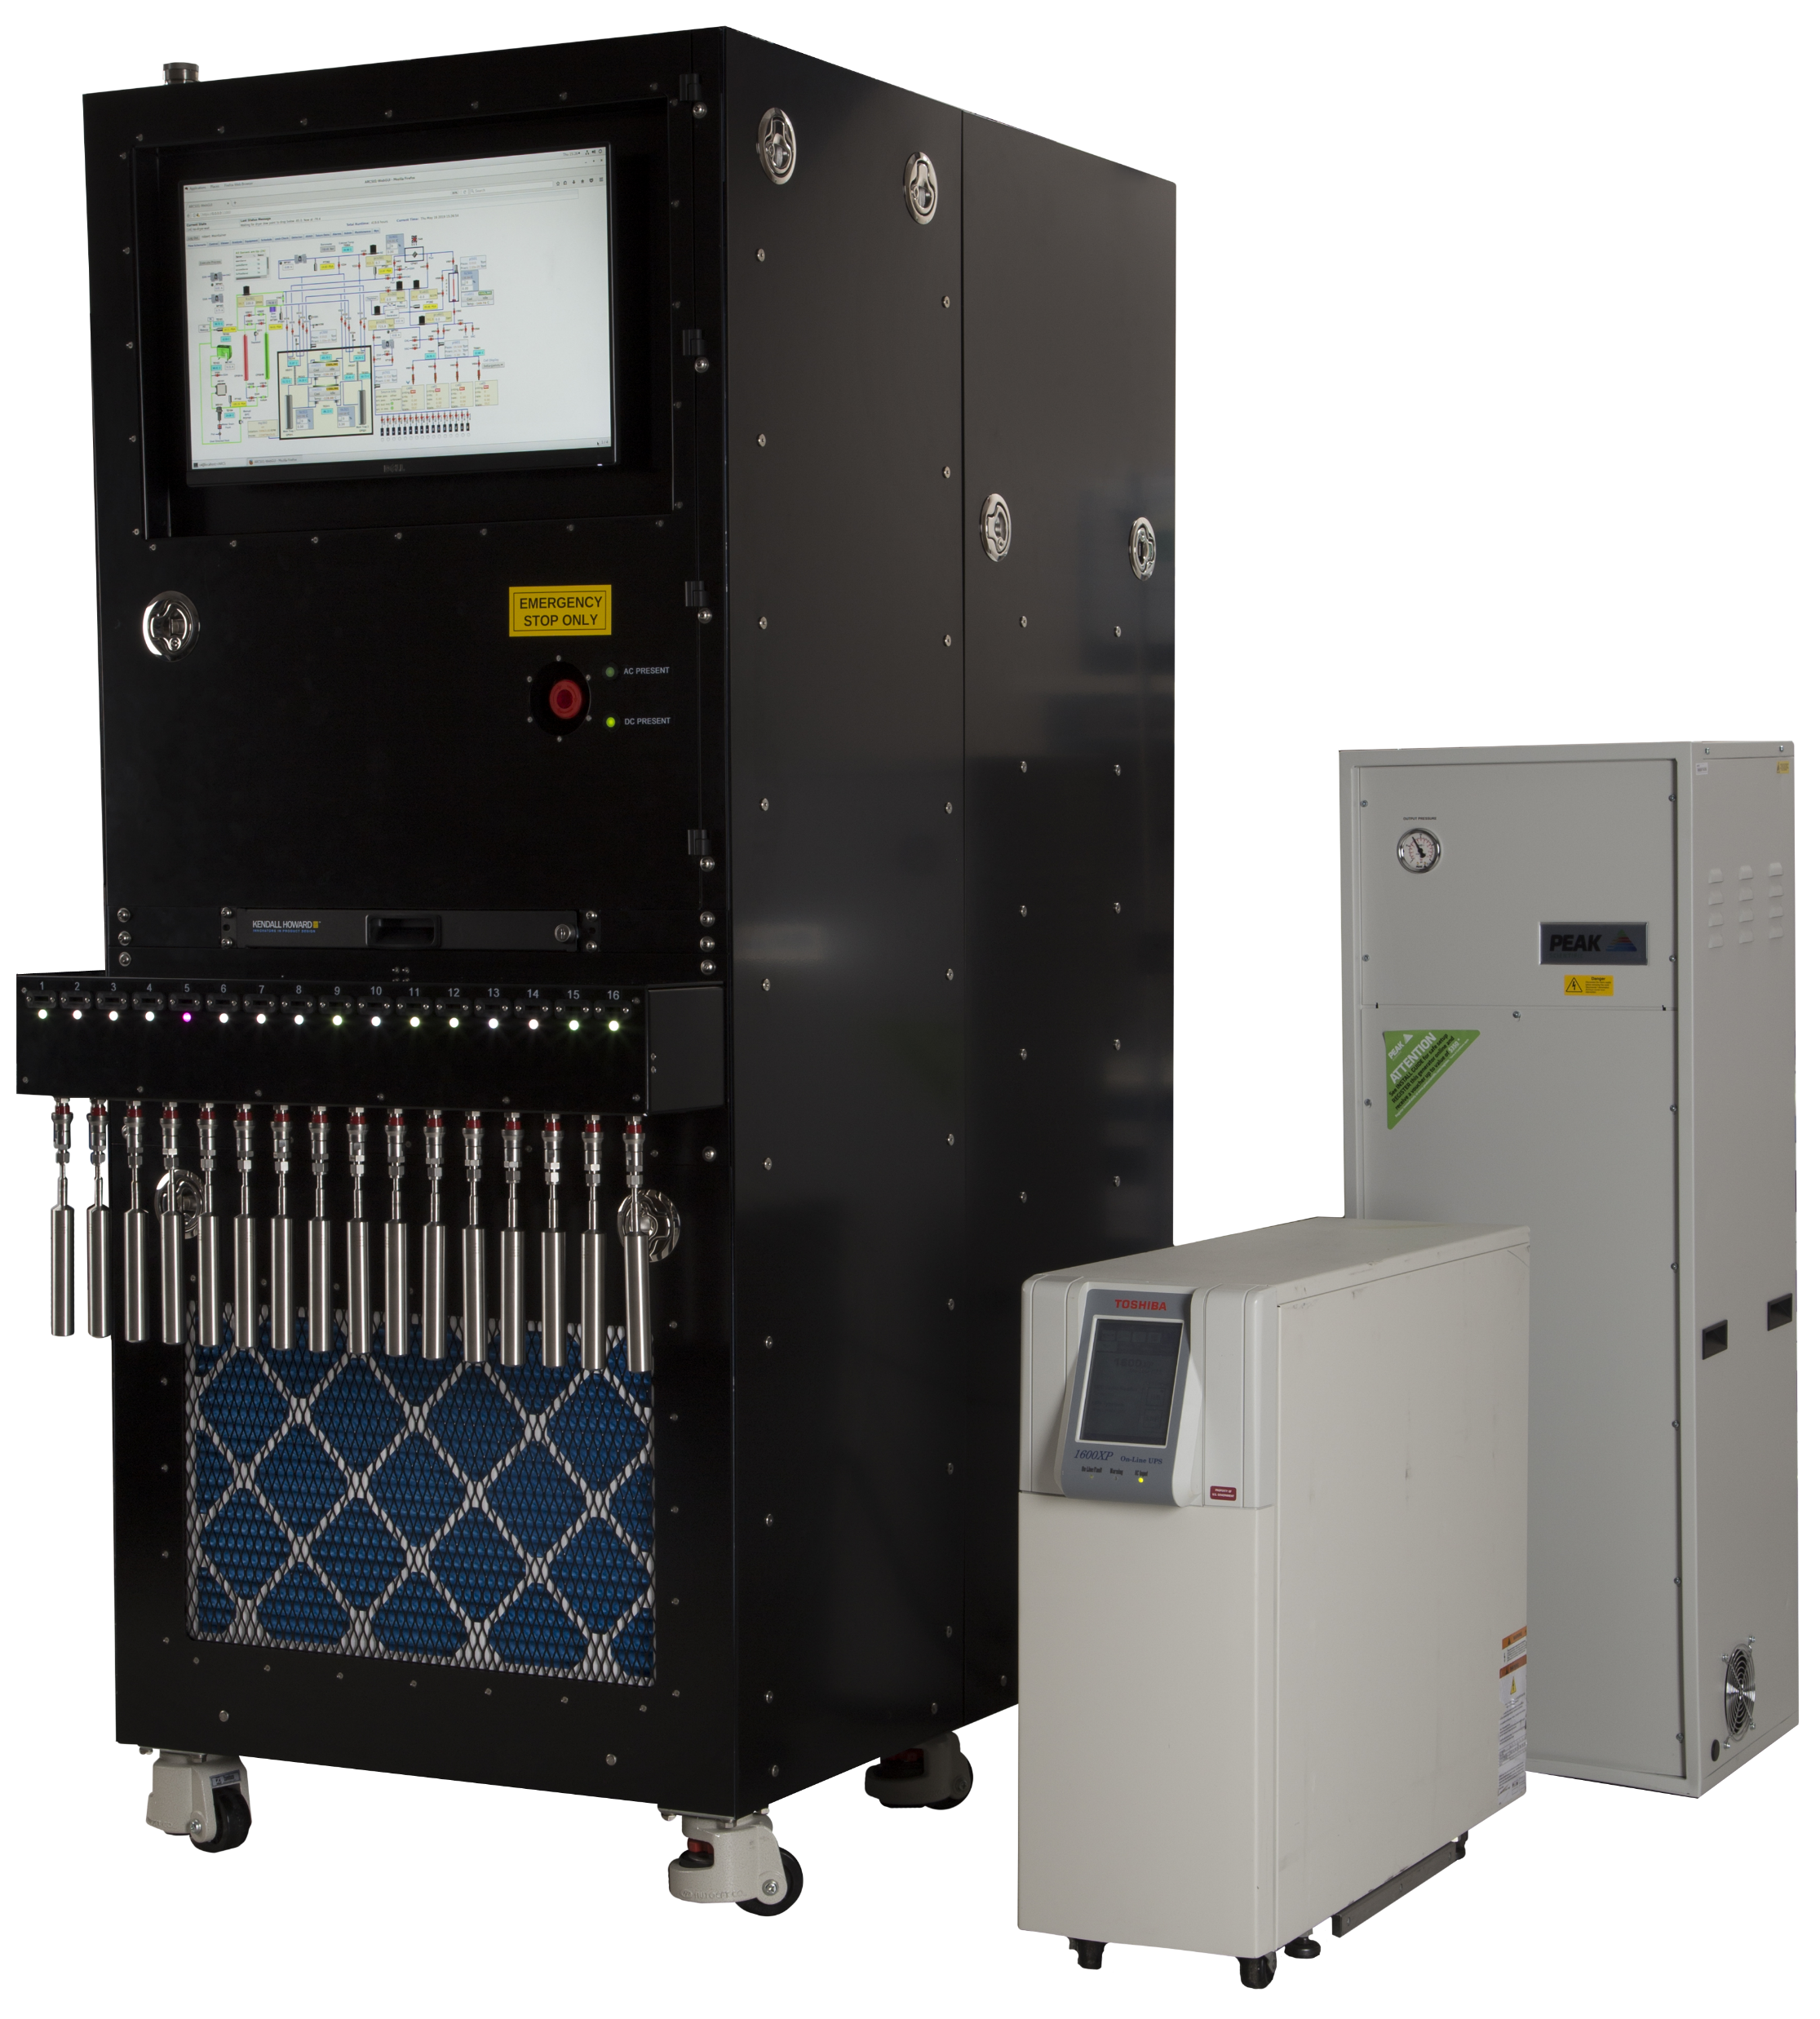
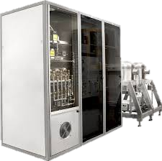
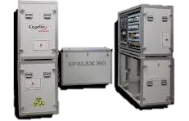
Predictive Analytics for radionuclide systems of the International Monitoring System
R. Suarez, J. Dermigny, D. Keller, J. C. Hayes, L. Lidey, A. Usenko
P4.4-728
Introduction
Methods
Results
Sensor data from radionuclide systems within the International Monitoring System (IMS) provide critical information about the operating status of a given station. Typically, station operators monitor sensors for significant deviations from normal operation to signify a potential problem and take some action. Detecting subtle changes over long periods of time always presents a challenge, but such a detection could provide valuable insight into an impending failure. To address this, Pacific Northwest National Laboratory (PNNL) is currently working towards the idea of predictive analytics through a comprehensive strategy. The idea is to use several techniques to identify critical failures early such that they can be mitigated before becoming catastrophic. This poster highlights recent advancements and discuss the overall strategy.
Algorithms
Anomaly detection algorithms typically compare data in a reduced-dimensional space called a latent space. Recent algorithm research has focused on methods using Variational Auto Encoders (VAE) to improve the structure of the latent space and make probabilistic assignments more meaningful.
Probabilistic Latent Space Modeling
VAE encoder learns a distribution (mean and variance) for latent space instead of fixed-point embeddings. This probabilistic approach enables the VAE to capture uncertainty in the latent representation. Anomalies can be detected as data points that do not conform to the aggregate posterior.
Regularized Latent Space Structure
VAEs incorporate a regularization term in their loss function, which ensures the latent space approximates a prior distribution. This leads to a smoother and more organized latent space, making anomalies more evident as points that deviate significantly from normal data patterns.
Tunable Prior Parameters:
VAEs generally assume a gaussian as a latent distribution – to support the variation of normal data in IMS sensor data, we use VAMPrior technique allowing multiple distributions to describe the aggregate posterior.
Modeling sensor behavior using VAEs has several promising use-cases for anomaly detection and failure prevention.
Change Detection:
Consider this deteriorating pressure scenario from US75
We can define a prior distribution or baseline using known “normal” sensor data like at t=125. As the sensor changes, we can compute similarity against the baseline using distribution tests such as KL-divergence. Here we see that KL-Divergence is sensitive to deterioration in the sensor readings.
T=125
Noble gas systems in the IMS. Xenon International (left), SAUNA-3 (center), Spalax NG (right)
Conclusion
VAE show potential in the ability to detect failures early and may be more sensitive to minute changes than a threshold-based system. The team is working on applying this method to known failures.
Acknowledgements:
The authors wish to acknowledge the funding support of the Nuclear Arms Control Technology Program of the U.S. Department of Defense, Defense Threat Reduction Agency
Cleared for Release
Rey Suarez
(509) 375-1992
Rey.Suarez@pnnl.gov

